Slide 1
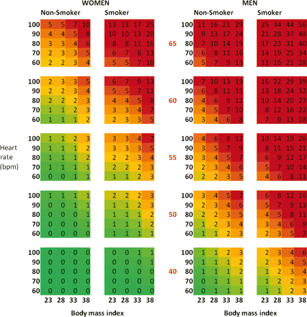
Figure 1 Chart for estimation of 10 year % risk of cardiovascular disease mortality (using only age, gender, smoking, ...
Notes:
Figure 1 Chart for estimation of 10 year % risk of cardiovascular disease mortality (using only age, gender, smoking, BMI and resting heart rate).
Unless provided in the caption above, the following copyright applies to the content of this slide: Published on behalf of the European Society of Cardiology. All rights reserved. © The Author 2010. For permissions please email: journals.permissions@oxfordjournals.org

