Slide 1
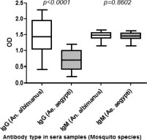
Fig. 1. Level of IgG and IgM antibodies in malaria patient serum against An. albimanus and Ae. aegypti in Haiti where ...
Notes:
Fig. 1. Level of IgG and IgM antibodies in malaria patient serum against An. albimanus and Ae. aegypti in Haiti where these two species are endemic (n = 21). P value denotes significance by the two-tailed Mann–Whitney U test.
Unless provided in the caption above, the following copyright applies to the content of this slide: © 2010 Entomological Society of AmericaThis is an Open Access article distributed under the terms of the Creative Commons Attribution Non-Commercial License (http://creativecommons.org/licenses/by-nc/3.0/), which permits non-commercial reuse, distribution, and reproduction in any medium, provided the original work is properly cited. For commercial re-use, please contact journals.permissions@oup.com

Slide 2
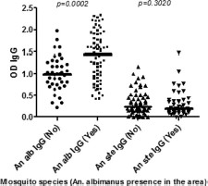
Fig. 2. Levels of anti-Anopheles (An. albimanus and An. stephensi) IgG antibodies associated with the presence of An. ...
Notes:
Fig. 2. Levels of anti-Anopheles (An. albimanus and An. stephensi) IgG antibodies associated with the presence of An. albimanus in the area: No, serum samples from Guinea and United States were An. albimanus is not endemic (n = 39); and Yes, serum samples from Colombia and Haiti (n = 51) where An. albimanus is endemic. P value denotes significance by the two-tailed Mann–Whitney U test.
Unless provided in the caption above, the following copyright applies to the content of this slide: © 2010 Entomological Society of AmericaThis is an Open Access article distributed under the terms of the Creative Commons Attribution Non-Commercial License (http://creativecommons.org/licenses/by-nc/3.0/), which permits non-commercial reuse, distribution, and reproduction in any medium, provided the original work is properly cited. For commercial re-use, please contact journals.permissions@oup.com

Slide 3
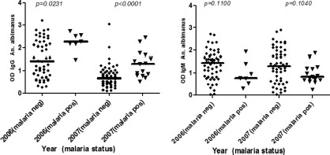
Fig. 3. Levels of anti-An. albimanus SGE antibodies by malaria status in blood collected in filter paper from Haitian ...
Notes:
Fig. 3. Levels of anti-An. albimanus SGE antibodies by malaria status in blood collected in filter paper from Haitian individuals in 2006 (malaria positive, n = 7; malaria negative, n = 54) and in 2007 (malaria positive, n = 15; malaria negative, n = 52). P value denotes significance by the two-tailed Mann–Whitney U test.
Unless provided in the caption above, the following copyright applies to the content of this slide: © 2010 Entomological Society of AmericaThis is an Open Access article distributed under the terms of the Creative Commons Attribution Non-Commercial License (http://creativecommons.org/licenses/by-nc/3.0/), which permits non-commercial reuse, distribution, and reproduction in any medium, provided the original work is properly cited. For commercial re-use, please contact journals.permissions@oup.com

Slide 4
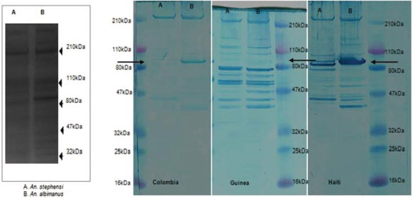
Fig. 4. SDS-PAGE and Western blot of pooled sera. An. stephensi (A) and An. albimanus (B) silver stain and immunoblot ...
Notes:
Fig. 4. SDS-PAGE and Western blot of pooled sera. An. stephensi (A) and An. albimanus (B) silver stain and immunoblot (IgG).
Unless provided in the caption above, the following copyright applies to the content of this slide: © 2010 Entomological Society of AmericaThis is an Open Access article distributed under the terms of the Creative Commons Attribution Non-Commercial License (http://creativecommons.org/licenses/by-nc/3.0/), which permits non-commercial reuse, distribution, and reproduction in any medium, provided the original work is properly cited. For commercial re-use, please contact journals.permissions@oup.com

