Slide 1
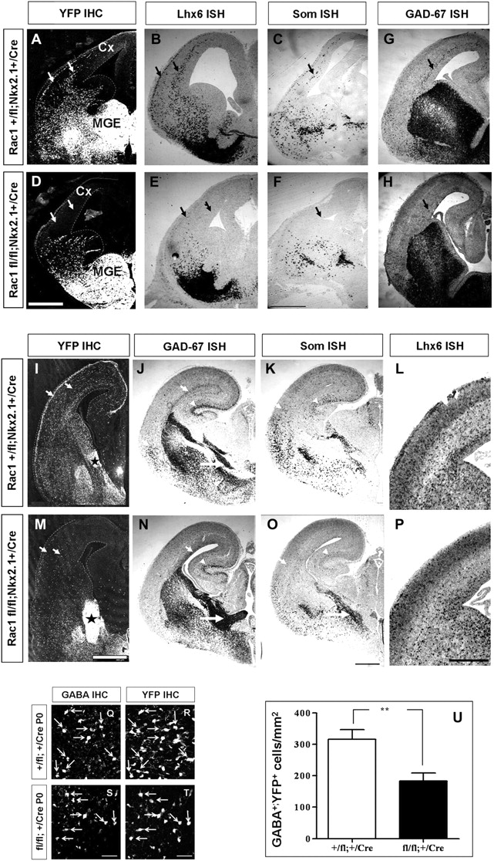
Figure 1. Ablation of Rac1 from GABAergic interneurons leads to a delayed migration toward the developing neocortex. ...
Notes:
Figure 1. Ablation of Rac1 from GABAergic interneurons leads to a delayed migration toward the developing neocortex. (A–P) Coronal sections from the forebrain of developing embryos. At E13.5 (A–F) and E14.5 (G–H), Rac1-deficient interneurons (D, E, F, H: Rac1fl/fl;Nkx2.1+/Cre) fail to migrate toward the developing neorcortex, compared with the control cells (arrows in A, B, C, G: Rac1+/fl;Nkx2.1+/Cre), as indicated by specific markers of GABAergic interneurons. Later on, at E16.5 (I–P), some of the Rac1-deficient cells manage to reach the cortex (arrows and arrowheads in M, N, O, P), although most of the cells remain aggregated at the ventral telencephalon (black asterisks in M and big white arrows in N, O), as revealed by staining for YFP and other interneuronal markers, in contrast to the control interneurons that have almost completed their tangential migration (black asterisk in I and big white arrows in J, K). As a result, significantly reduced GABA+–YFP+ interneurons are present in the P0 mutant brains (arrows in Q, R) compared with the control (arrows in S, T). (U) Statistical analysis was performed using Student’s t-test (**P value << 0.05) (for details on statistical analysis, see Materials and Methods). Arrows and arrowheads indicate the migratory streams of the marginal zone (MZ) and intermediate zone (IZ). Scale bars: A, D, I, M, 300 μm; B, C, G, E, F, H, J, K, L, N, O, P, 100 μm; Q, R, S, T, 75 μm.
Unless provided in the caption above, the following copyright applies to the content of this slide: © The Authors 2011. Published by Oxford University Press.This is an Open Access article distributed under the terms of the Creative Commons Attribution Non-Commercial License (http://creativecommons.org/licenses/by-nc/3.0), which permits unrestricted non-commercial use, distribution, and reproduction in any medium, provided the original work is properly cited.

Slide 2
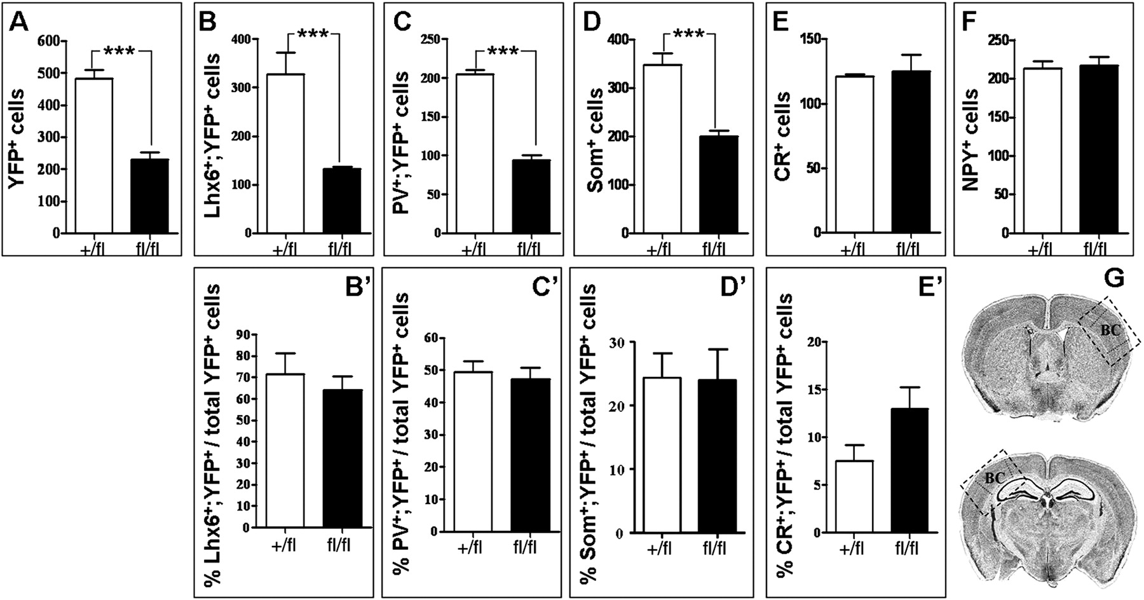
Figure 2. The number of MGE-derived interneurons subtypes is highly reduced in the adult Rac1 mutant brains. On coronal ...
Notes:
Figure 2. The number of MGE-derived interneurons subtypes is highly reduced in the adult Rac1 mutant brains. On coronal sections from P15 Rac1-deficient brains, the number of YFP+ interneurons is reduced to half compared with the control (A). In agreement with this, Lhx6+ cells are also severely reduced in the mutants (B) and so are most of the subpopulations that derive from Lhx6 precursors, like PV (C), and somatostatin (D). However, the percentage of Lhx6;YFP, PV;YFP and Som;YFP double-positive cells over the total number of YFP cells in the cortex remains unaffected, indicating a migration rather than a differentiation defect of these cells (B′, C′, D′). The number of calretinin+ (E, E′), and NPY+ (F) interneurons is not altered in the Rac1 conditional KO brains. These subpopulations are mainly derived from the CGE, where Nkx2.1 is not expressed. Even the small percentage of CR+ cells that derives from the MGE and expresses YFP is not significantly altered. (G) Representation of the brain sections that were used for counting. The dashed boxes indicate the area counted on each bregma, which includes the barrel cortex field (BC) between the lines. Statistical significance was assessed, using ANOVA for repeated measurements and Student's t-test (**P value << 0.05) (for details on statistical analysis, see Materials and Methods).
Unless provided in the caption above, the following copyright applies to the content of this slide: © The Authors 2011. Published by Oxford University Press.This is an Open Access article distributed under the terms of the Creative Commons Attribution Non-Commercial License (http://creativecommons.org/licenses/by-nc/3.0), which permits unrestricted non-commercial use, distribution, and reproduction in any medium, provided the original work is properly cited.

Slide 3
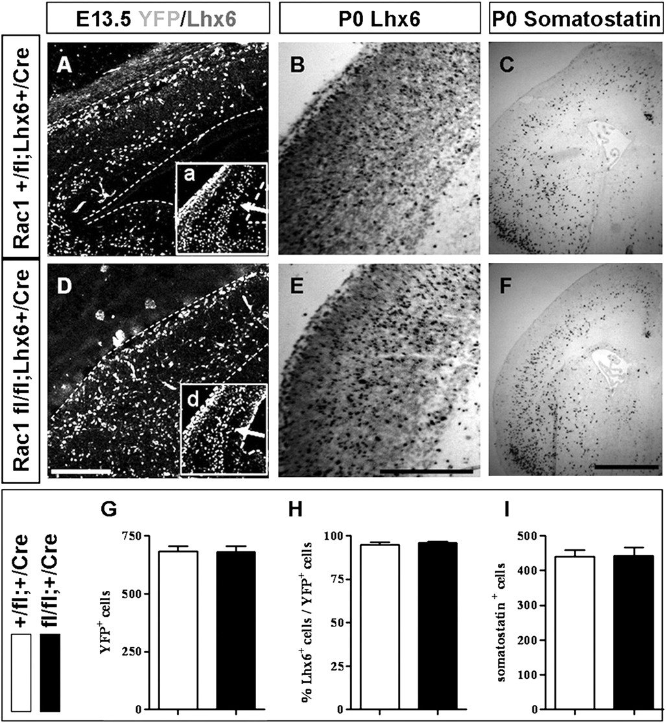
Figure 3. Ablation of Rac1 from postmitotic GABAergic interneurons, using the Lhx6-Cre line, does not affect the ...
Notes:
Figure 3. Ablation of Rac1 from postmitotic GABAergic interneurons, using the Lhx6-Cre line, does not affect the development of the neocortex. Migration of interneurons occurs normally in E13.5 Rac1fl/fl;Lhx6+/Cre embryos (D), compared with their control Rac1+/fl;Lhx6+/Cre littermates (A), as revealed by staining for YFP and Lhx6 (white arrows in a, d). Additionally, the postnatal brain of Rac1fl/fl;Lhx6+/Cre animals (E, F) has normal distribution and number of GABAergic interneurons, compared with Rac1+/fl;Lhx6+/Cre animals (B, C), as indicated by several markers. All Lhx6+ cells are YFP expressing (H) and there are no differences in the YFP+ (G) or som+ cells (I). White arrows in A and D indicate the migrating cells. Scale bars: A, D, 150 μm/B, E, C, F, 100 μm.
Unless provided in the caption above, the following copyright applies to the content of this slide: © The Authors 2011. Published by Oxford University Press.This is an Open Access article distributed under the terms of the Creative Commons Attribution Non-Commercial License (http://creativecommons.org/licenses/by-nc/3.0), which permits unrestricted non-commercial use, distribution, and reproduction in any medium, provided the original work is properly cited.

Slide 4
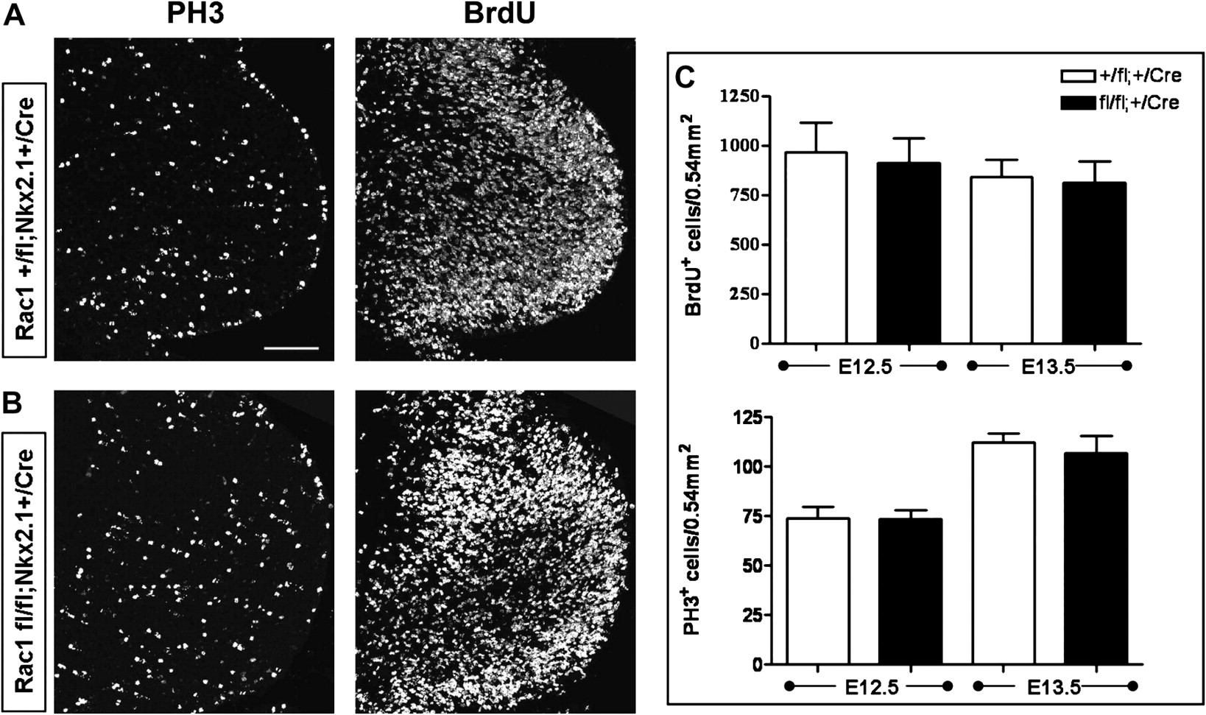
Figure 4. Ablation of Rac1 does not affect the proliferation of MGE-derived progenitors. The mitotic activity of ...
Notes:
Figure 4. Ablation of Rac1 does not affect the proliferation of MGE-derived progenitors. The mitotic activity of MGE-derived progenitors was assessed using immunohistohemistry for PH3 and BrdU on E13.5 brains were BrdU was incorporated for 30 min (A, B). The number of total BrdU+ cells is not altered between mutant and control embryos (C), and no differences were observed in the number or distribution of PH3+ mitotic cells in the mutant embryos compared with the controls (D). Four consecutive sections from each embryo were used for quantification, and statistical analysis was performed using ANOVA for repeated measurements and Student's t-test. Error bars represent the standard error of mean. Scale bars: 75 μm.
Unless provided in the caption above, the following copyright applies to the content of this slide: © The Authors 2011. Published by Oxford University Press.This is an Open Access article distributed under the terms of the Creative Commons Attribution Non-Commercial License (http://creativecommons.org/licenses/by-nc/3.0), which permits unrestricted non-commercial use, distribution, and reproduction in any medium, provided the original work is properly cited.

Slide 5
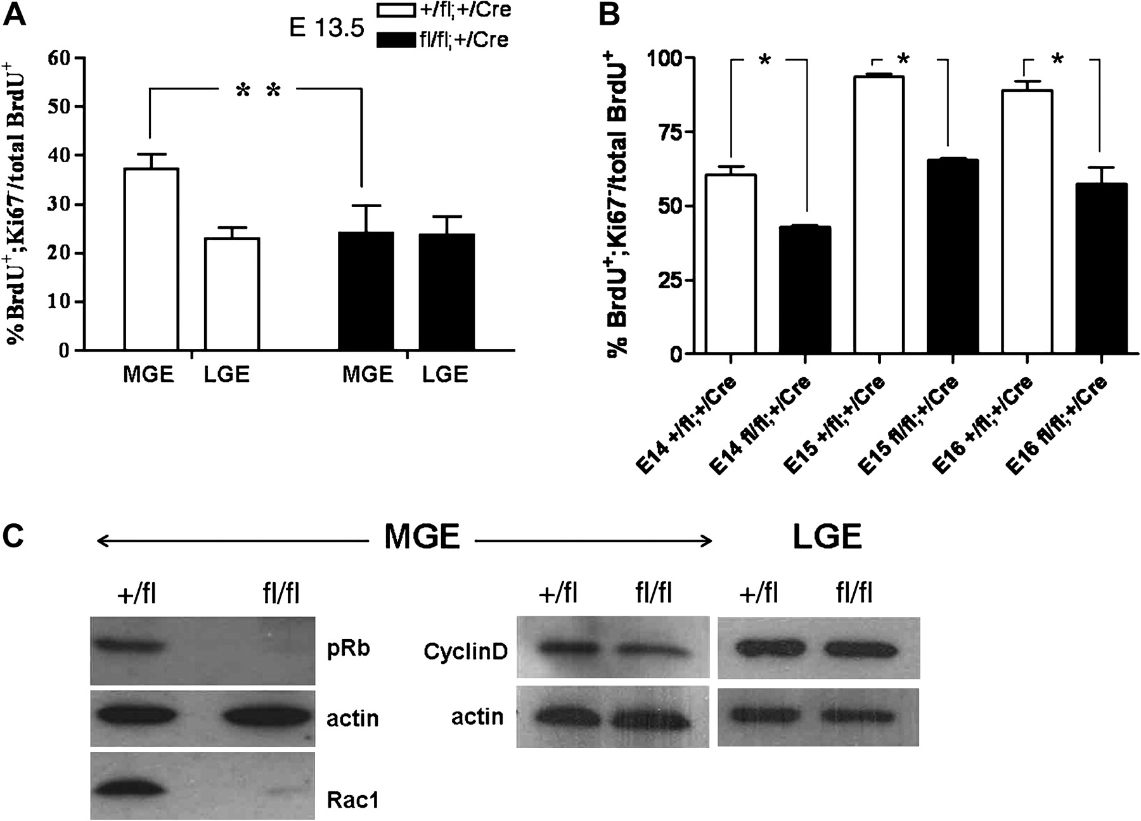
Figure 5. Rac1 absence leads to a reduced exit of GABAergic interneurons from the cell cycle and an imbalance in cyclin ...
Notes:
Figure 5. Rac1 absence leads to a reduced exit of GABAergic interneurons from the cell cycle and an imbalance in cyclin D expression. Cell cycle exit was assessed, by calculating the percentage of BrdU+; Ki67− cells to the total number of BrdU+ cells in the SVZ of the MGE and LGE in 4 sets of embryos (A). This percentage is significantly decreased in the MGE of Rac1-deficient embryos, compared with their control littermates. The respective percentage of the LGE is not altered in mutant embryos. (B) The same cell cycle exit index was calculated for embryos at E14, E15, and E16, showing that the Rac1-deficient cells are not able to exit the cell cycle even at later developmental stages. Four consecutive sections from each embryo were used for quantification and statistical analysis was performed using ANOVA for repeated measurements and Student's t-test. Error bars represent the standard error of mean. (C) Phosphorylated Rb is highly diminished from Rac1-deficient MGE-derived cells. Additionally, cyclin D levels are decreased, as indicated by western blot analysis of MGE-derived tissue, whereas in the LGE, similar levels of cyclin D expression are observed between Rac1-deficient and control cells.
Unless provided in the caption above, the following copyright applies to the content of this slide: © The Authors 2011. Published by Oxford University Press.This is an Open Access article distributed under the terms of the Creative Commons Attribution Non-Commercial License (http://creativecommons.org/licenses/by-nc/3.0), which permits unrestricted non-commercial use, distribution, and reproduction in any medium, provided the original work is properly cited.

Slide 6
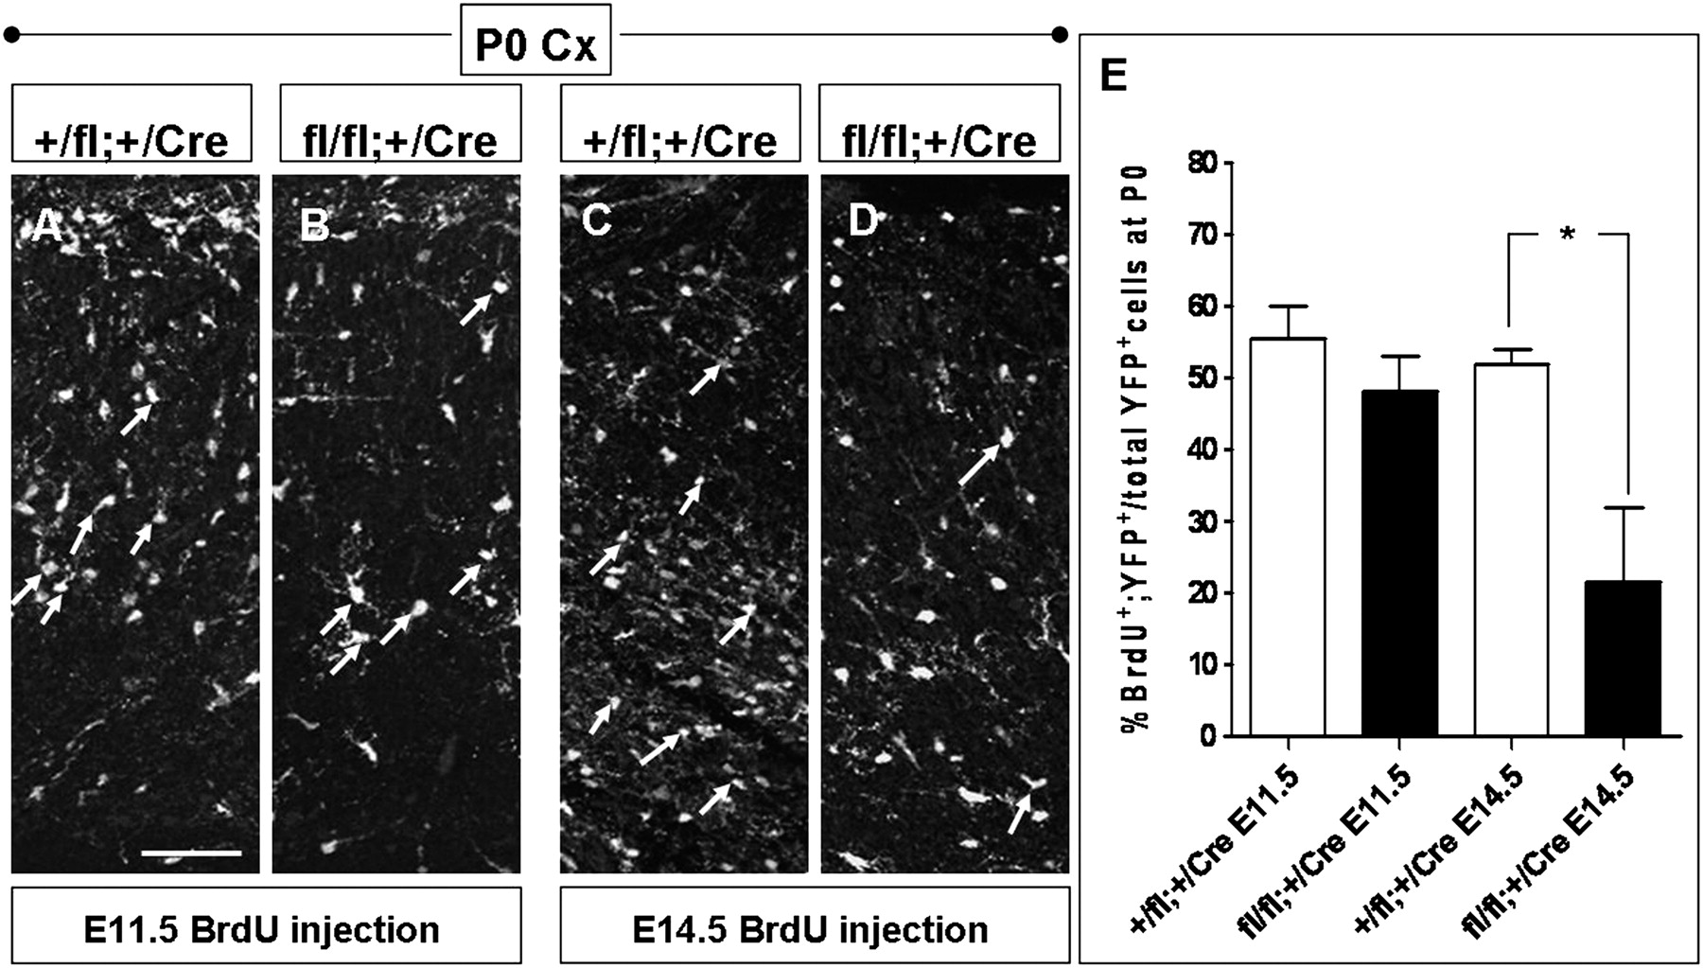
Figure 6. The majority of MGE-derived cells found in P0 mutant brains descend from early-born progenitors. ...
Notes:
Figure 6. The majority of MGE-derived cells found in P0 mutant brains descend from early-born progenitors. Immunohistochemistry at P0 sections for YFP and BrdU, after incorporation either at E11.5 (A, B) or E14.5 (C, D). (E) The percentage of early-born MGE-derived cells in the cortex of mutant mice (white arrows in B) is not significantly different from the controls (white arrows in A). The respective number of late-born cells, however, is reduced in mutant brains (white arrows in D) compared with controls (white arrows in C), highlighting that the majority of MGE-derived cells found in the mature cortex of mutant mice, descend from early-born progenitors, before Rac1 ablation. Scalebar: 75 μm.
Unless provided in the caption above, the following copyright applies to the content of this slide: © The Authors 2011. Published by Oxford University Press.This is an Open Access article distributed under the terms of the Creative Commons Attribution Non-Commercial License (http://creativecommons.org/licenses/by-nc/3.0), which permits unrestricted non-commercial use, distribution, and reproduction in any medium, provided the original work is properly cited.

Slide 7
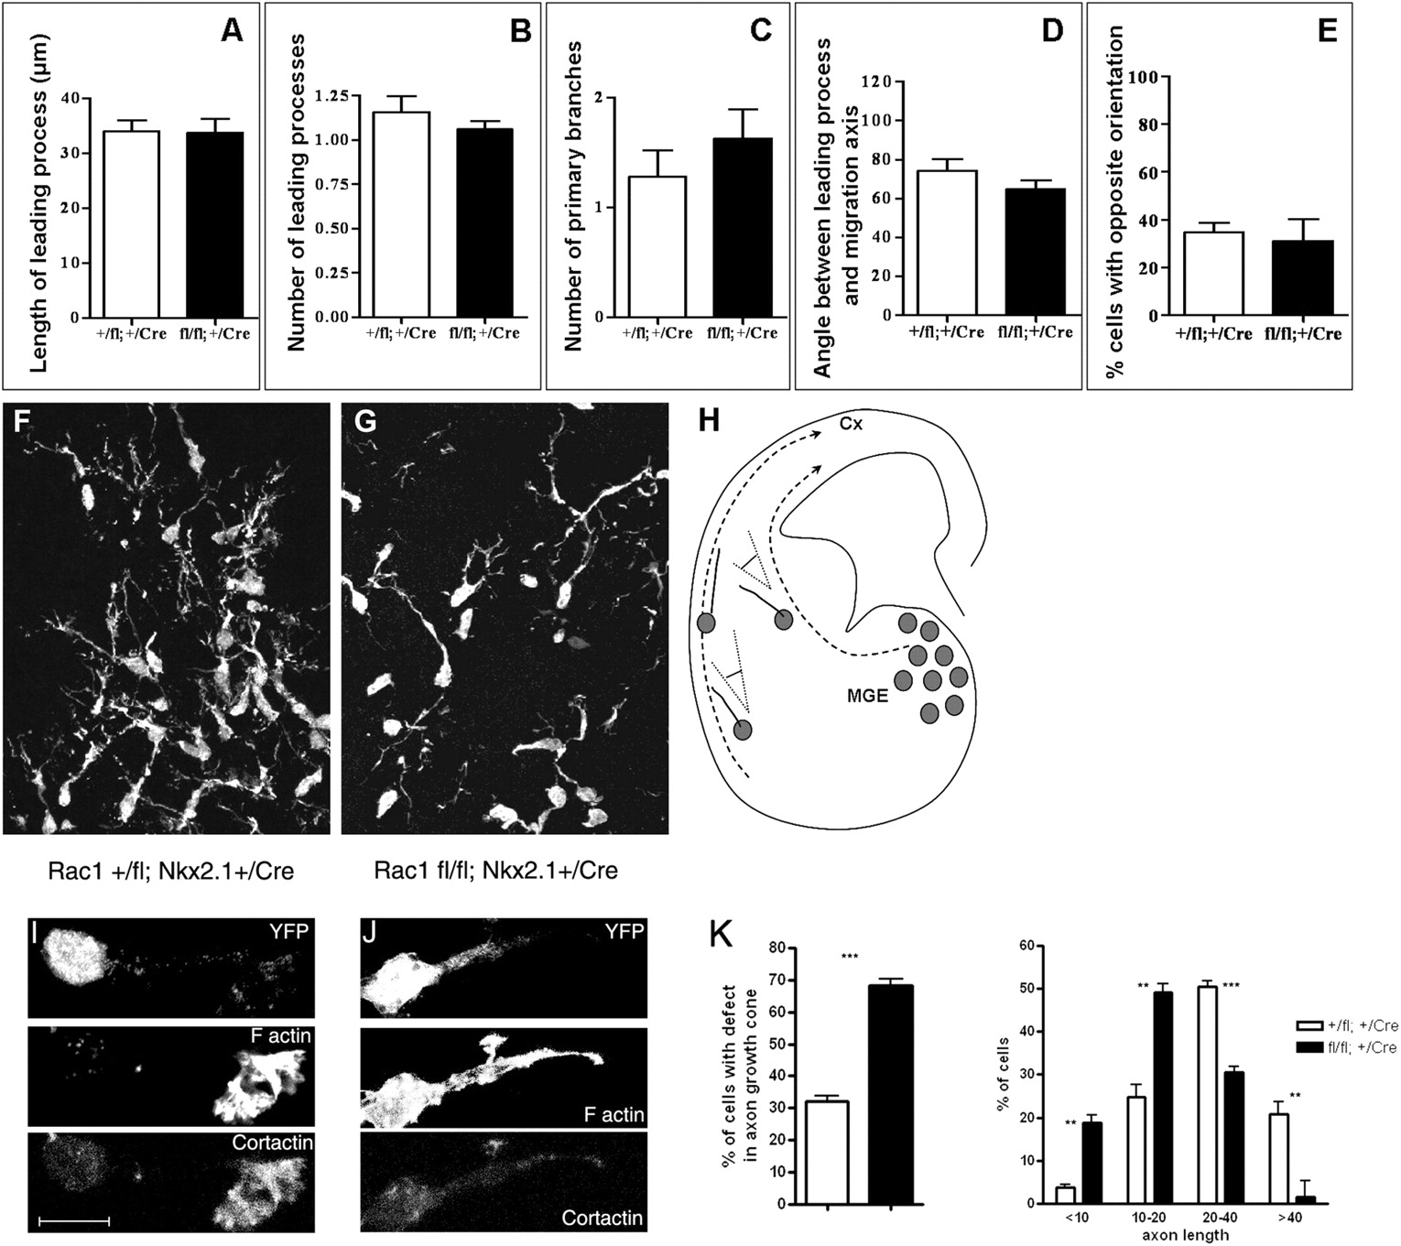
Figure 7. The morphology of Rac1-deficient interneurons. In vivo morphology of ...
Notes:
Figure 7. The morphology of Rac1-deficient interneurons. In vivo morphology of Rac1+/fl;Nkx2.1+/Cre (F) and Rac1fl/fl;Nkx2.1+/Cre (G) interneurons at E13.5 after they have left the MGE and are found close to the pallium/subpallium boundary, visualized by YFP expression. Rac1-deficient cells that manage to migrate have no differences compared with the control interneurons, in terms of length of their leading processes (A), number of processes (B), and number of primary branches (C). The angle formed between the leading process and the presumptive migratory axis, as well as the percentage of cells with orientation opposite to the expected, is not significantly altered in Rac1-deficient cells, compared with controls (D and E). (H) Cartoon depicting the migration axis (dashed lines) and the angle formed between the leading processes of migrating cells and the migratory route. (I–J) In vitro morphology of interneurons that have remained in the MGE at E13.5 after 2DIV on collagen is visualized by YFP, F-actin (phalloidin), and cortactin expression. Rac1-deficient cells (J) do not have normal growth cones compared with the control cells (I). The difference observed in the growth cones is statistically significant and a large percentage of Rac1-deficient cells fail to extend long leading processes compared with control cells. (K; ***P value <<< 0.05). Measurements were performed using ImageJ and analyzed by the Student's t-test. Error bars represent the standard error of mean. Cx: cortex. Scale bars F–G, 75 μm; I–J 7 μm.
Unless provided in the caption above, the following copyright applies to the content of this slide: © The Authors 2011. Published by Oxford University Press.This is an Open Access article distributed under the terms of the Creative Commons Attribution Non-Commercial License (http://creativecommons.org/licenses/by-nc/3.0), which permits unrestricted non-commercial use, distribution, and reproduction in any medium, provided the original work is properly cited.

