Slide 1
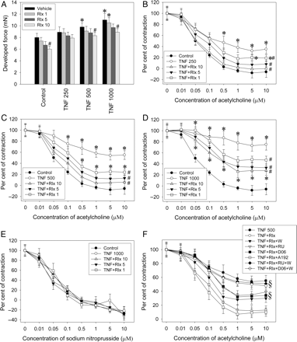
Figure 1 TNF-α over 48 h compromises endothelium-dependent vasodilation–restoration by 1, 5, or 10 nmol/L relaxin ...
Notes:
Figure 1 TNF-α over 48 h compromises endothelium-dependent vasodilation–restoration by 1, 5, or 10 nmol/L relaxin (Rlx). (A) Responses to 1 µmol/L phenylephrine (in mN), resting force 5 mN. (B) 250 pg/mL TNF-α; (C) 500 pg/mL TNF-α; (D) 1000 pg/mL TNF-α. (E) SNP acts independently of TNF-α or relaxin. (F) RU-486 (RU) (500 nmol/L), D06 (5 µmol/L), and wortmannin (W) (100 nmol/L) significantly mitigated relaxin's action. n = 8 each. P < 0.05; *, vs. control (vehicle); #, vs. TNF-α; §, vs. TNF plus relaxin.
Unless provided in the caption above, the following copyright applies to the content of this slide: Published on behalf of the European Society of Cardiology. All rights reserved. © The Author 2012. For permissions please email: journals.permissions@oup.com.

Slide 2
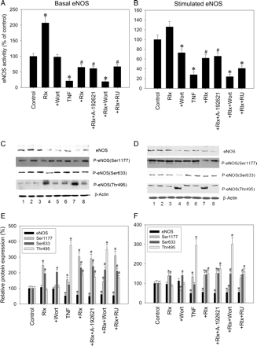
Figure 2 (A and B) Basal and stimulated eNOS activity after treatment with TNF-α (500 pg/mL), relaxin (Rlx) (5 ...
Notes:
Figure 2 (A and B) Basal and stimulated eNOS activity after treatment with TNF-α (500 pg/mL), relaxin (Rlx) (5 nmol/L), RU-486 (RU) (500 nmol/L), wortmannin (Wort) (100 nmol/L), A-192621 (500 nmol/L), and combinations. (C and D) Representative western blots. 1, control; 2, relaxin; 3, relaxin plus wortmannin; 4, TNF-α; 5, TNF-α plus relaxin; 6, TNF plus relaxin plus A-192621; 7, TNF plus relaxin plus wortmannin; 8, TNF plus relaxin plus RU-486. (E and F) Semi-quantitative analysis. n = 6. P < 0.05; *, vs. control (vehicle); #, vs. both control and TNF-α.
Unless provided in the caption above, the following copyright applies to the content of this slide: Published on behalf of the European Society of Cardiology. All rights reserved. © The Author 2012. For permissions please email: journals.permissions@oup.com.

Slide 3
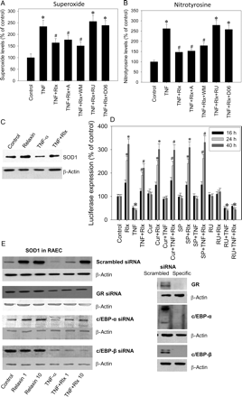
Figure 3 Superoxide generation (A) and nitrotyrosine levels (B) after treatment with TNF (500 pg/mL), relaxin (5 ...
Notes:
Figure 3 Superoxide generation (A) and nitrotyrosine levels (B) after treatment with TNF (500 pg/mL), relaxin (5 nmol/L), RU-486 (500 nmol/L), D06 (5 µmol/L), wortmannin (WM) (100 nmol/L), A-192621 (A) (500 nmol/L), and combinations. n = 6. P < 0.05; *, vs. control (vehicle); #, vs. both control and TNF-α. (C) Representative western blot of SOD1 in aortic rings (n = 4). (D) Luciferase assay of the full-length SOD1 promoter (p1499) in RAEC. n = 5. P < 0.05; *, vs. control (vehicle); #, vs. both control and TNF. Cells were treated with TNF, relaxin, RU-486, curcumin (Cur) (20 µmol/L), and the JNK inhibitor SP600125 (SP) (10 µmol/L). (D) Protein expression of SOD1 in RAEC after gene silencing of GR, C/EBP-α, or c/EBP-β (40 h treatment, n = 4).
Unless provided in the caption above, the following copyright applies to the content of this slide: Published on behalf of the European Society of Cardiology. All rights reserved. © The Author 2012. For permissions please email: journals.permissions@oup.com.

Slide 4
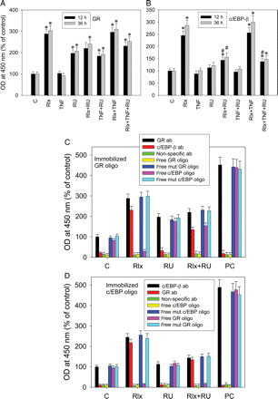
Figure 4 Nuclear translocation of and transcriptional activation by GR and c/EBP-β in RAEC. Following treatment with ...
Notes:
Figure 4 Nuclear translocation of and transcriptional activation by GR and c/EBP-β in RAEC. Following treatment with vehicle (C), relaxin (5 nmol/L), TNF-α (500 pg/mL), RU-486 (500 nmol/L), and combinations thereof, nuclear extracts were prepared and incubated with immobilized oligos specific for GR (A) or c/EBP (B), and the transcription factors were then detected by specific antibodies. n = 6; P < 0.05; *, vs. control (vehicle); #, vs. relaxin. (C and D) After the incubation of nuclear extracts (from 12 h treatments) with immobilized GR-specific (C) or c/EBP-α/β-specific oligos (D), either mixture was probed with GR, c/EBP-β, and non-specific antibodies as well as with free specific or mutated GR and c/EBP oligos. PC, positive control. n = 5. All reported changes were significant.
Unless provided in the caption above, the following copyright applies to the content of this slide: Published on behalf of the European Society of Cardiology. All rights reserved. © The Author 2012. For permissions please email: journals.permissions@oup.com.

Slide 5
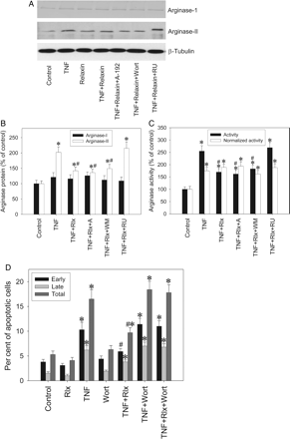
Figure 5 Arginase-I and arginase-II expression (A and B) and activity (C) and TNF-related apoptosis (D) in RAEC. ...
Notes:
Figure 5 Arginase-I and arginase-II expression (A and B) and activity (C) and TNF-related apoptosis (D) in RAEC. Treatment over 48 h with control (vehicle), TNF-α (500 pg/mL), relaxin (Rlx) (5 nmol/L), RU-486 (RU) (500 nmol/L) (not shown in D), wortmannin (WM) (100 nmol/L), A-192621 (A) (500 nmol/L) (not administered in D), and combinations. n = 6. P < 0.05; *, vs. control; #, vs. TNF-α.
Unless provided in the caption above, the following copyright applies to the content of this slide: Published on behalf of the European Society of Cardiology. All rights reserved. © The Author 2012. For permissions please email: journals.permissions@oup.com.

Slide 6
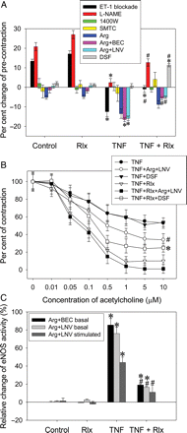
Figure 6 Effects of ET-1 blockade and inhibition of NOS, arginase, or SOD1. Aortic rings were treated over 48 h with ...
Notes:
Figure 6 Effects of ET-1 blockade and inhibition of NOS, arginase, or SOD1. Aortic rings were treated over 48 h with vehicle (control), relaxin (5 nmol/L), TNF (500 pg/mL), or relaxin plus TNF. On top of this treatment, rings were then perfused for another 2 h with the ETA antagonist A-127722 (100 nmol/L) plus the ETB antagonist A-192621 (500 nmol/L), the non-selective NOS inhibitor L-NAME (100 µmol/L), the iNOS-selective inhibitor 1400W (5 µmol/L), the nNOS inhibitor l-SMTC (10 µM), 1 mmol/L l-arginine (Arg) over 1 h followed by the arginase inhibitors BEC (200 µmol/L) or l-norvaline (LNV) (10 mmol/L), or the SOD1 inhibitor disulfiram (DSF) (0.5 µmol/L). In (A), contraction changes over these 2 h are given in per cent of identical pre-contraction. P < 0.05; *, vs. control; #, vs. TNF-α. (B) In groups with arginase (Arg plus LNV) or SOD1 inhibition (DSF), pre-contraction was once more re-adjusted after the 2 h period and Ach challenges were performed. P < 0.05; *, vs. TNF plus relaxin; #, vs. TNF. (C) eNOS activity following arginine (Arg) plus BEC/LNV treatment, either immediately after the 2 h period (basal) or after additional Ach stimulation (stimulated). Values are per cent changes of the data obtained without arginase inhibition (which are summarized in Figure 2A and B) (example: basal eNOS activity following TNF and Arg plus BEC/LNV has changed by ∼80%, i.e. from 21% under TNF alone in Figure 2A to 38% in this setting). P < 0.05; *, vs. control; #, vs. TNF-α.
Unless provided in the caption above, the following copyright applies to the content of this slide: Published on behalf of the European Society of Cardiology. All rights reserved. © The Author 2012. For permissions please email: journals.permissions@oup.com.

