Slide 1
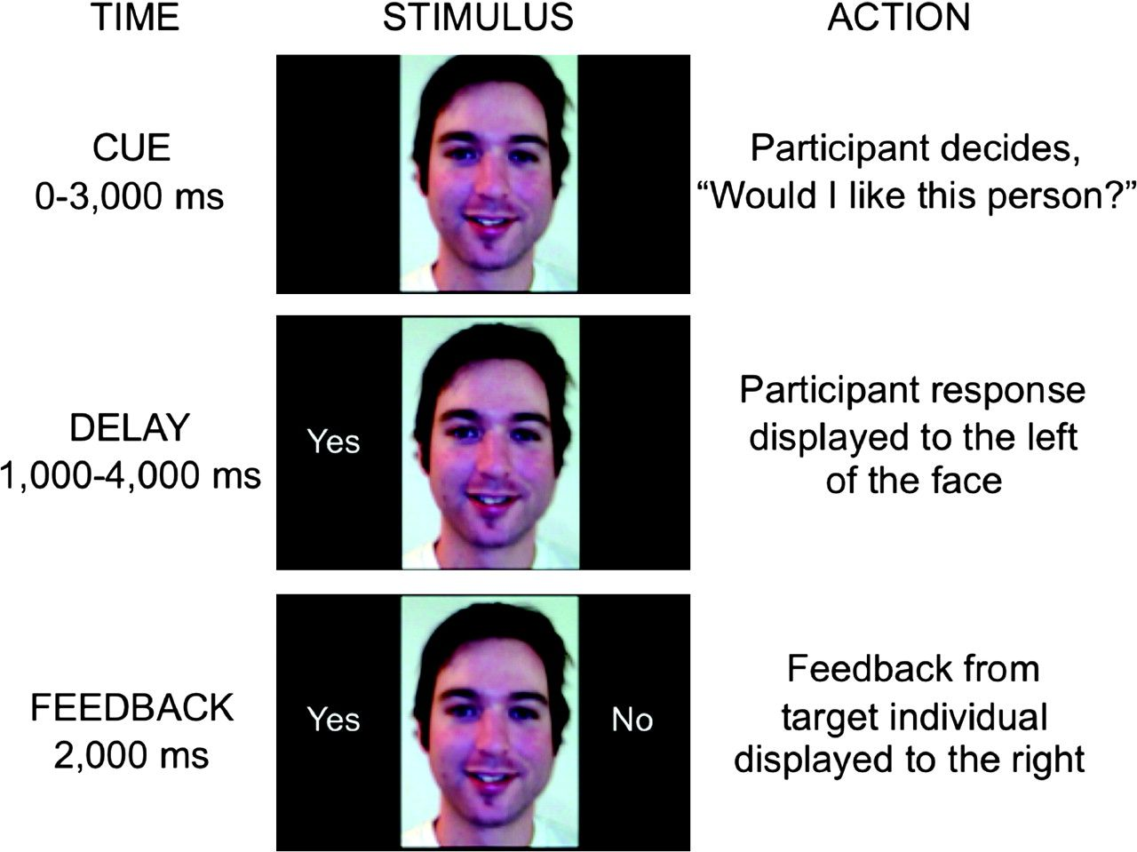
Figure 1. Time course of a single experimental trial. The current findings focus on responses to the feedback phase.
Notes:
Figure 1. Time course of a single experimental trial. The current findings focus on responses to the feedback phase.
Unless provided in the caption above, the following copyright applies to the content of this slide: © The Author 2010. Published by Oxford University Press. All rights reserved. For permissions, please e-mail: journals.permissions@oxfordjournals.org

Slide 2
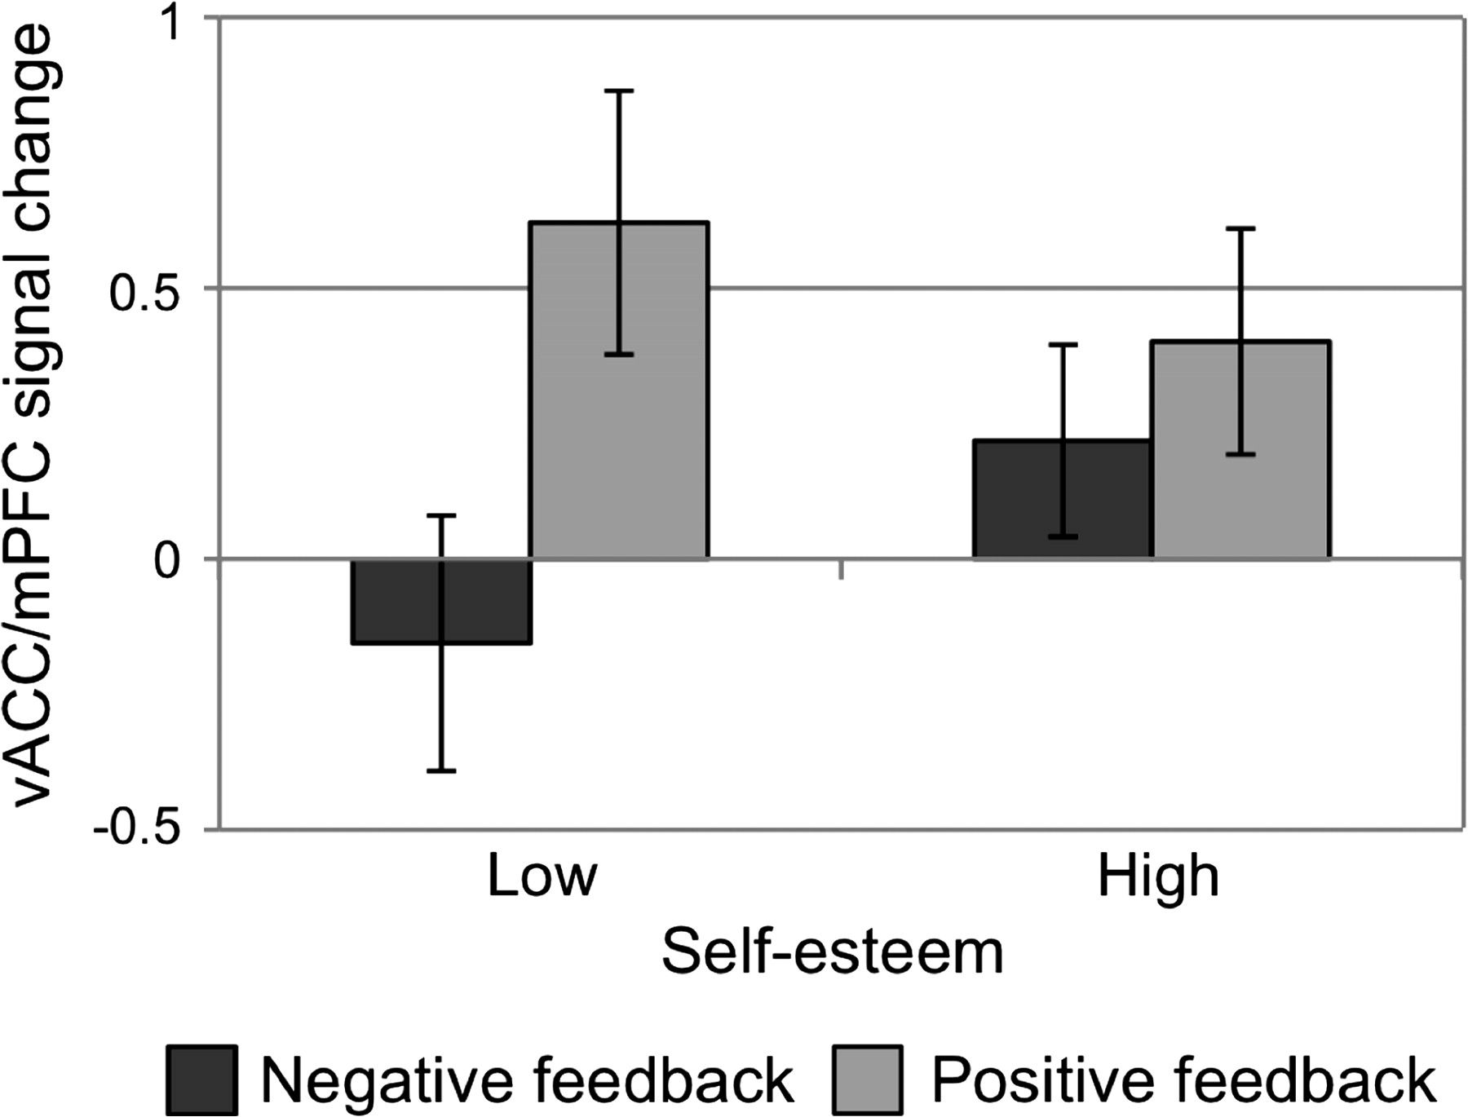
Figure 2. The ventral anterior cingulate/medial prefrontal region defined from Somerville et al. (2006) (x = −6, y = ...
Notes:
Figure 2. The ventral anterior cingulate/medial prefrontal region defined from Somerville et al. (2006) (x = −6, y = 49, z = −13) showed a significant self-esteem by feedback type interaction (P = 0.004) such that low self-esteem individuals show an exaggerated neural sensitivity to feedback valence. See Figure 3 for image of ROI (in green). Error bars denote standard error of the mean.
Unless provided in the caption above, the following copyright applies to the content of this slide: © The Author 2010. Published by Oxford University Press. All rights reserved. For permissions, please e-mail: journals.permissions@oxfordjournals.org

Slide 3
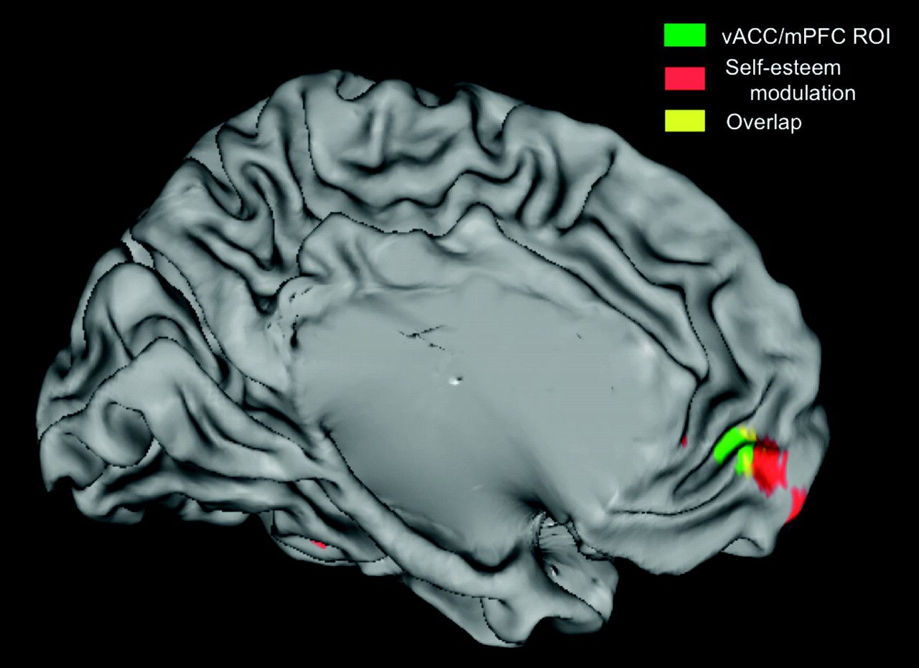
Figure 3. An overlapping area of the mPFC shows an increase in recruitment as a function of lower self-esteem while ...
Notes:
Figure 3. An overlapping area of the mPFC shows an increase in recruitment as a function of lower self-esteem while participants view positive versus negative social feedback. Green region: vACC/mPFC region from Somerville et al. (2006), activity depicted in Figure 3. Red region: results of whole-brain regression identifying brain regions showing a linear increase in differential response to positive versus negative social feedback as a function of (lower) self-esteem. Image threshold P < 0.05, corrected for multiple comparisons (see Materials and Methods). Yellow: Overlap between green and red maps. Image depicted on the left hemisphere of standard inflated brain in Talairach and Tournoux atlas space, rendered with Caret 5.6 software.
Unless provided in the caption above, the following copyright applies to the content of this slide: © The Author 2010. Published by Oxford University Press. All rights reserved. For permissions, please e-mail: journals.permissions@oxfordjournals.org

