Slide 1
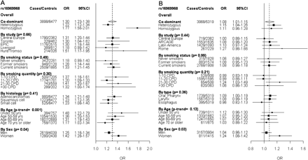
Figure 1 Forest plots representing LC (A) and UADT cancer (B) risk and rs16969968 genotype. Unless specified, the ORs ...
Notes:
Figure 1 Forest plots representing LC (A) and UADT cancer (B) risk and rs16969968 genotype. Unless specified, the ORs and 95% CIs are derived from the per allele model including age, sex and country. The overall OR is shown by the broken vertical line. P-values are from heterogeneity tests, unless the P-trend for the age effect
Unless provided in the caption above, the following copyright applies to the content of this slide: Published by Oxford University Press on behalf of the International Epidemiological Association © The Author 2009; all rights reserved.

Slide 2
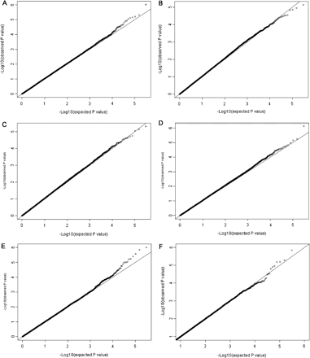
Figure 2 Quantile–quantile plot from the GWA study. The observed P-values (Y-axis) are plotted against the expected ...
Notes:
Figure 2 Quantile–quantile plot from the GWA study. The observed P-values (Y-axis) are plotted against the expected P-values (X-axis) for the various smoking phenotypes: smoking quantity (CPD) (A), smoking initiation (ever vs never smokers) (B), smoking cessation (current vs former smokers) (C), heavy smoking (D), age of smoking initiation (E), heaviness of smoking index (F)
Unless provided in the caption above, the following copyright applies to the content of this slide: Published by Oxford University Press on behalf of the International Epidemiological Association © The Author 2009; all rights reserved.

