Slide 1
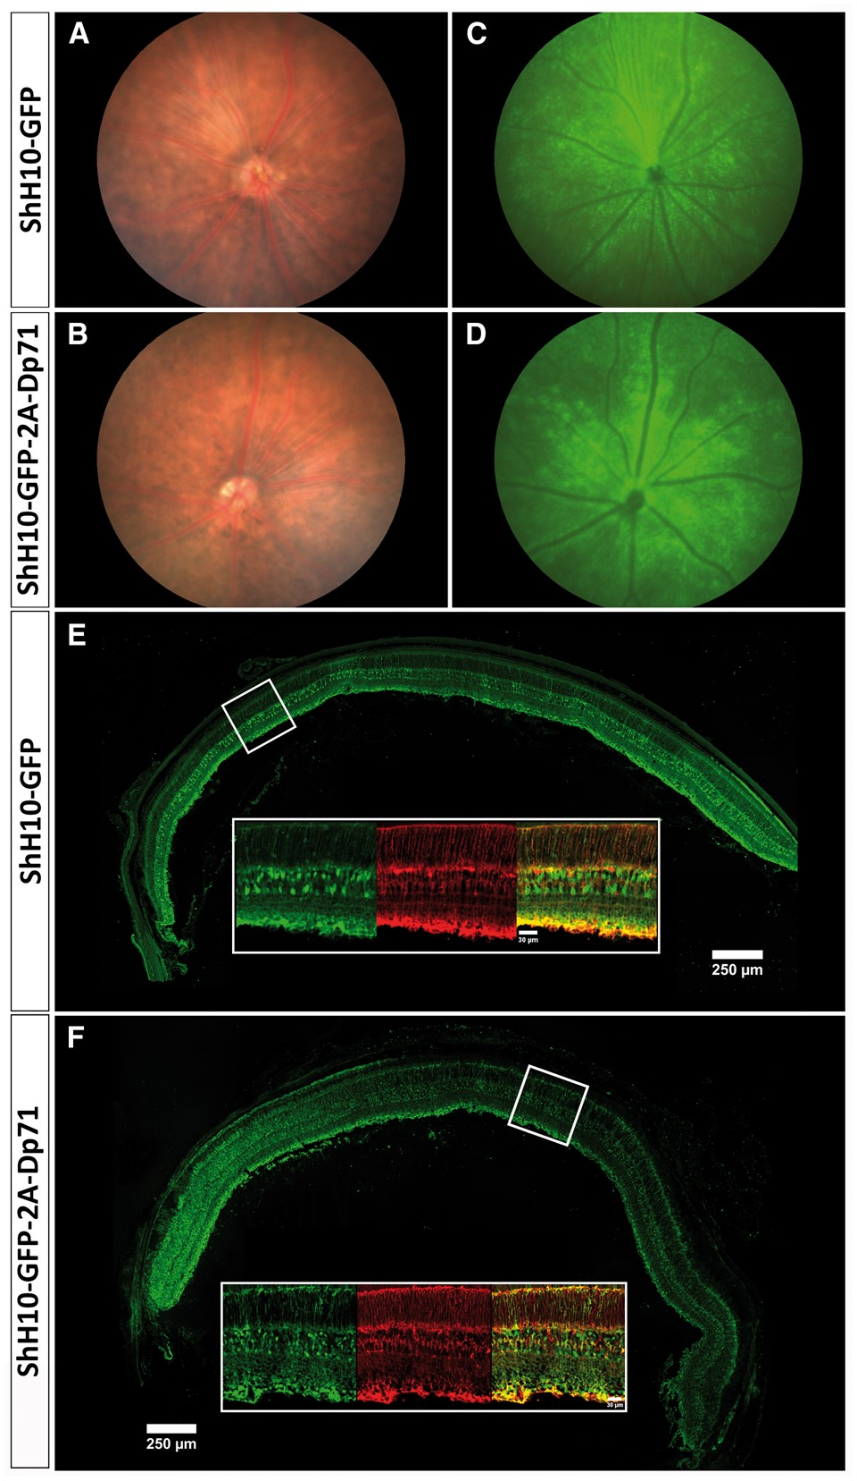
Figure 1. Retinal integrity and transduction efficiency. Fundus images of the Dp71-null retina 2 months after ...
Notes:
Figure 1. Retinal integrity and transduction efficiency. Fundus images of the Dp71-null retina 2 months after intravitreal injection of ShH10-GFP (A, C) or ShH10-GFP-2A-Dp71 (B, D) showed that both AAVs strongly transduced the whole retina (C, D). Confocal imaging (E, F) of an entire cryoslice (scale bar = 250 µm) showing the GFP expression (green) with both ShH10-GFP (E) and ShH10-GFP-2A-Dp71 (F) vectors and immunostaining of close-up images (white rectangle) with glutamine synthetase (red) to visualize the colocalization meaning that transduced cells are Müller cells with both vectors (scale bar = 30 µm).
Unless provided in the caption above, the following copyright applies to the content of this slide: © The Author 2016. Published by Oxford University Press. All rights reserved. For permissions, please e-mail: journals.permissions@oup.com

Slide 2
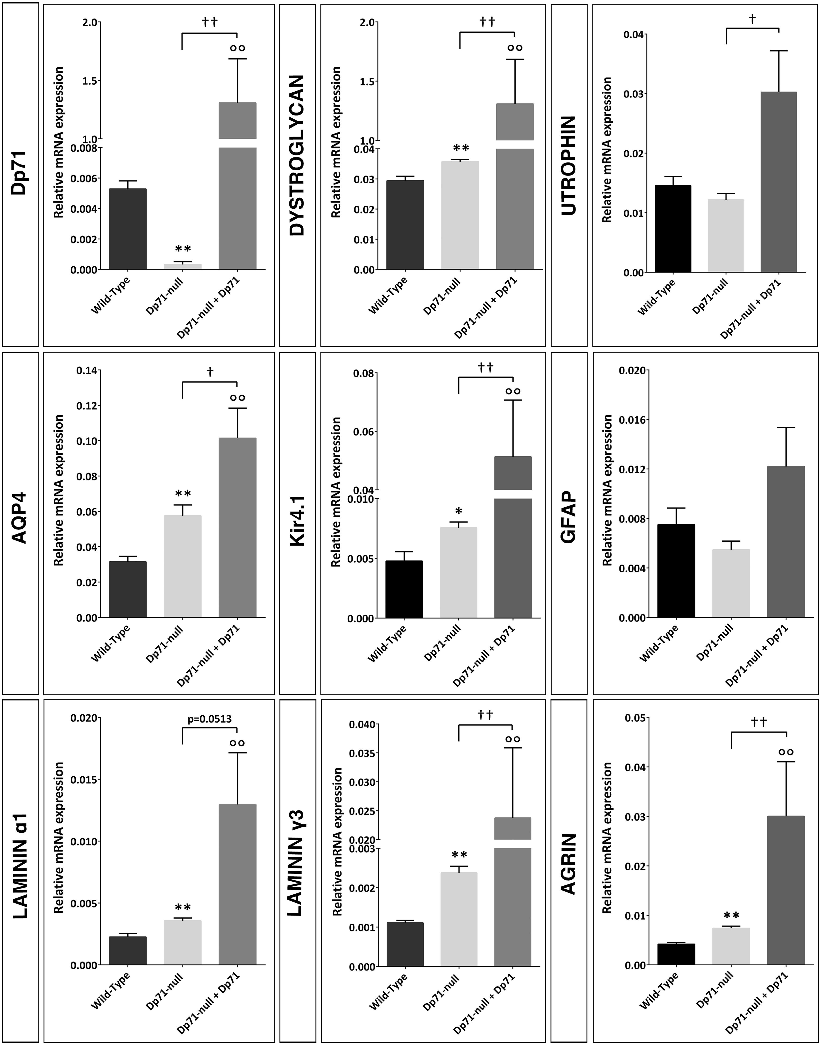
Figure 2. Dp71 mRNA over-expression leads to over-expression of mRNAs associated with Dp71. Quantitative RT-PCR showed ...
Notes:
Figure 2. Dp71 mRNA over-expression leads to over-expression of mRNAs associated with Dp71. Quantitative RT-PCR showed an over-expression of Dp71, dystroglycans, AQP4, Kir4.1, agrin and laminins mRNAs in the treated Dp71-null mouse in comparison with the wild-type. Quantitative RT-PCR showed that the utrophin mRNA is slightly up-regulated while GFAP didn’t show any variation. Bars represent means ± SEM for triplicate data points; n = 7. *P < 0.05, **P < 0.01 significant differences versus wild-type; °°P < 0.01 significant differences versus wild-type; †P < 0.05, ††P < 0.01 significant differences versus Dp71-null (Mann-Whitney test).
Unless provided in the caption above, the following copyright applies to the content of this slide: © The Author 2016. Published by Oxford University Press. All rights reserved. For permissions, please e-mail: journals.permissions@oup.com

Slide 3
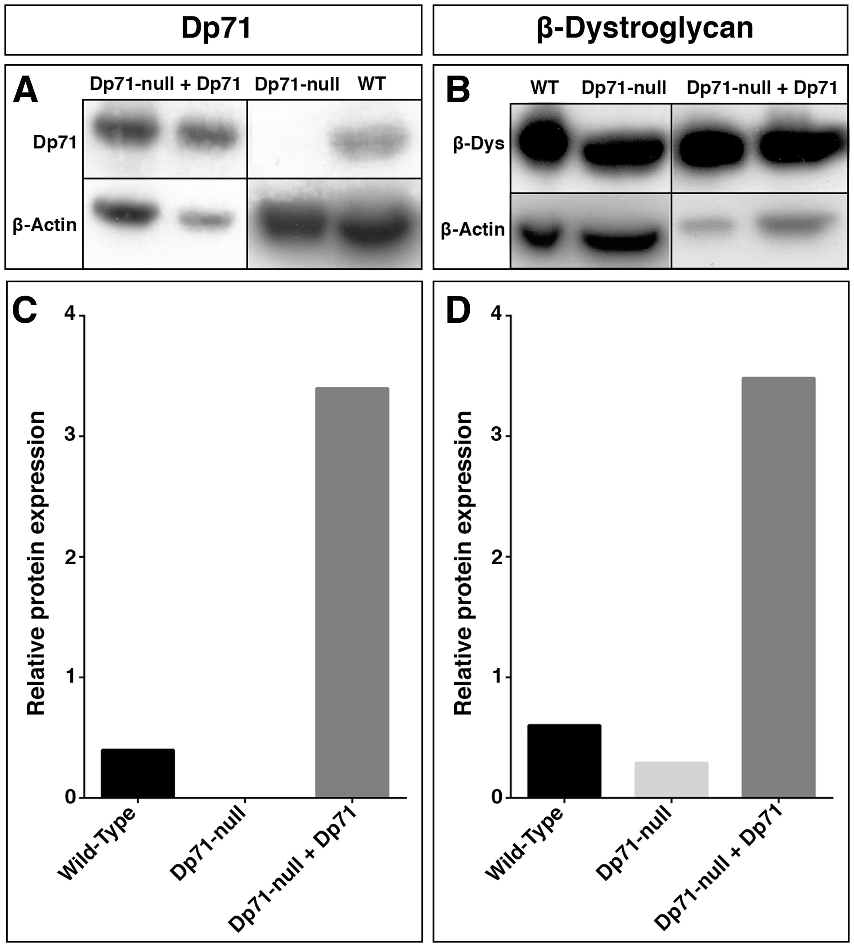
Figure 3. Dp71 and β-dystroglycan over-expression two months after intravitreal injection of ShH10-GFP-Dp71 in the ...
Notes:
Figure 3. Dp71 and β-dystroglycan over-expression two months after intravitreal injection of ShH10-GFP-Dp71 in the Dp71-null mouse retina. Western blot and subsequent band density semi-quantification relative to β-actin of Dp71 (A, C) using H4 antibody and of β-dystroglycan (B, D).
Unless provided in the caption above, the following copyright applies to the content of this slide: © The Author 2016. Published by Oxford University Press. All rights reserved. For permissions, please e-mail: journals.permissions@oup.com

Slide 4
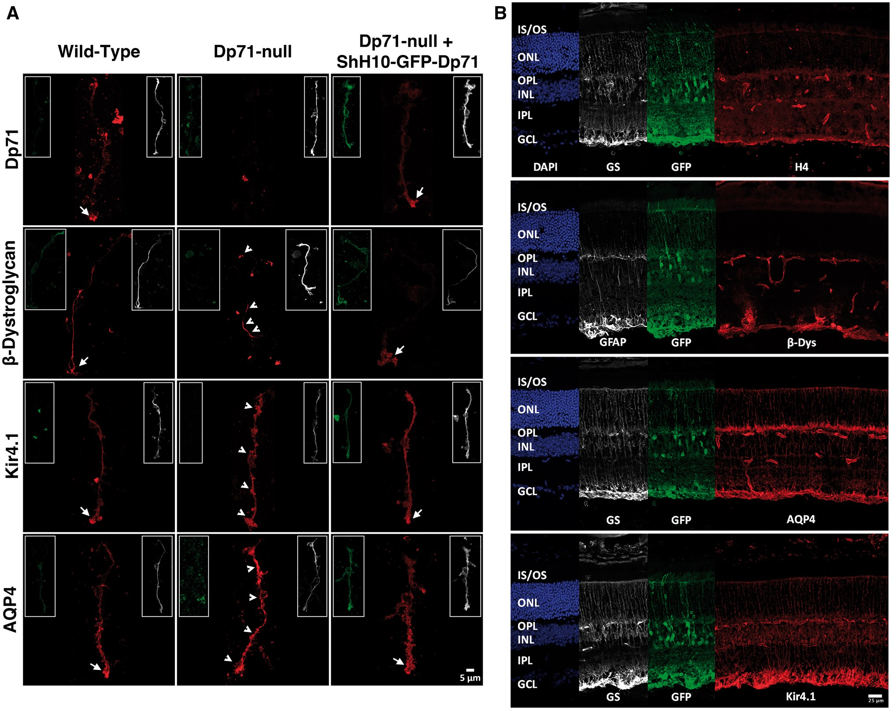
Figure 4. A. Relocalization of Dp71 and Dp71 related proteins in the Müller glial cells. Isolated Müller glial cells ...
Notes:
Figure 4. A. Relocalization of Dp71 and Dp71 related proteins in the Müller glial cells. Isolated Müller glial cells stained with GS antibody (grey), expressing GFP (green) and stained with H4 (red) showing Dp71 expression mainly located in the Müller glial cell endfeet (white arrows). Same observations were made for β-dystroglycan, potassium channel Kir4.1 and for water channel AQP4 (n = 4) (scale bar = 5 µm). B. Retinal cryosections of Dp71-null mice retinas after Dp71 restoration. Sections were labelled with DAPI (blue), glutamine synthetase (grey) or GFAP (grey) to visualize Müller cells, GFP (green) to identify transduced cells, H4 to localize Dp71, β-dystroglycan, AQP4 and Kir4.1 (red) (scale bar = 25 µm).
Unless provided in the caption above, the following copyright applies to the content of this slide: © The Author 2016. Published by Oxford University Press. All rights reserved. For permissions, please e-mail: journals.permissions@oup.com

Slide 5
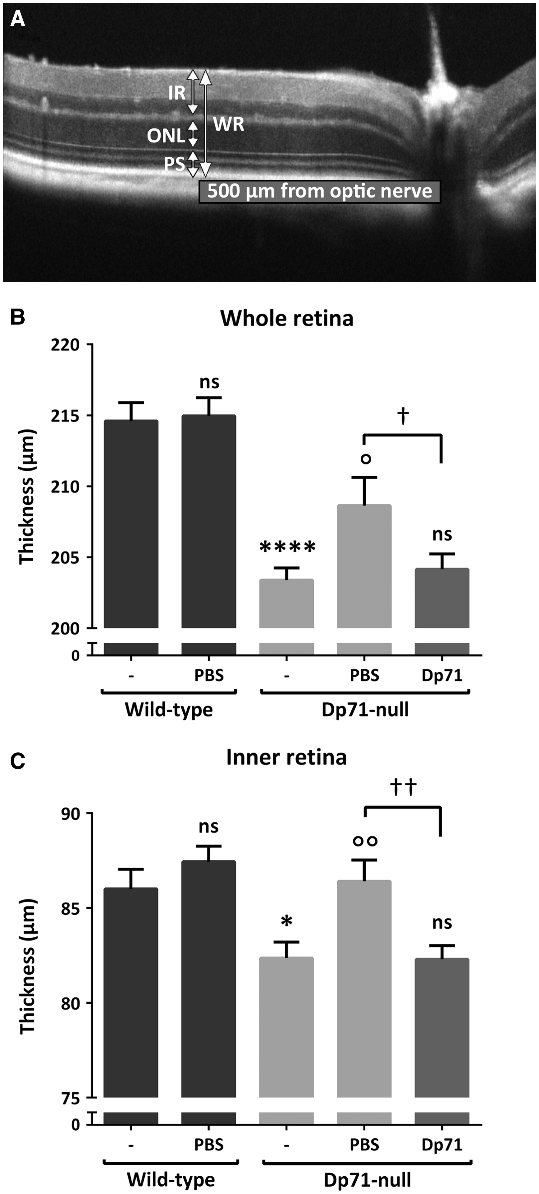
Figure 5. Reabsorption of induced retinal oedema in Dp71-null mice. Image A shows measurements performed on OCT images ...
Notes:
Figure 5. Reabsorption of induced retinal oedema in Dp71-null mice. Image A shows measurements performed on OCT images to evaluate the thickness of different retinal layers. Graphs B and C show the thickness of the whole retina (B) and of the inner retina (C) in wild-type and Dp71-null mice intravitreally injected with PBS or ShH10-GFP-2A-Dp71. Two months after PBS intravitreal injection, we observed a significant increase in the retinal thickness of Dp71-null mice but no modification in the wild-type retina. Dp71 restoration completely resorbed the retinal oedema caused by the needle intrusion. Bars represent means ± SEM for triplicate data points; n = 9. *P < 0.05, ****P < 0.0001 significant differences versus wild-type; °P < 0.05, °°P < 0.01 significant differences versus wild-type; †P < 0.05, ††P < 0.01 significant differences versus Dp71-null (Mann Whitney test).
Unless provided in the caption above, the following copyright applies to the content of this slide: © The Author 2016. Published by Oxford University Press. All rights reserved. For permissions, please e-mail: journals.permissions@oup.com

Slide 6
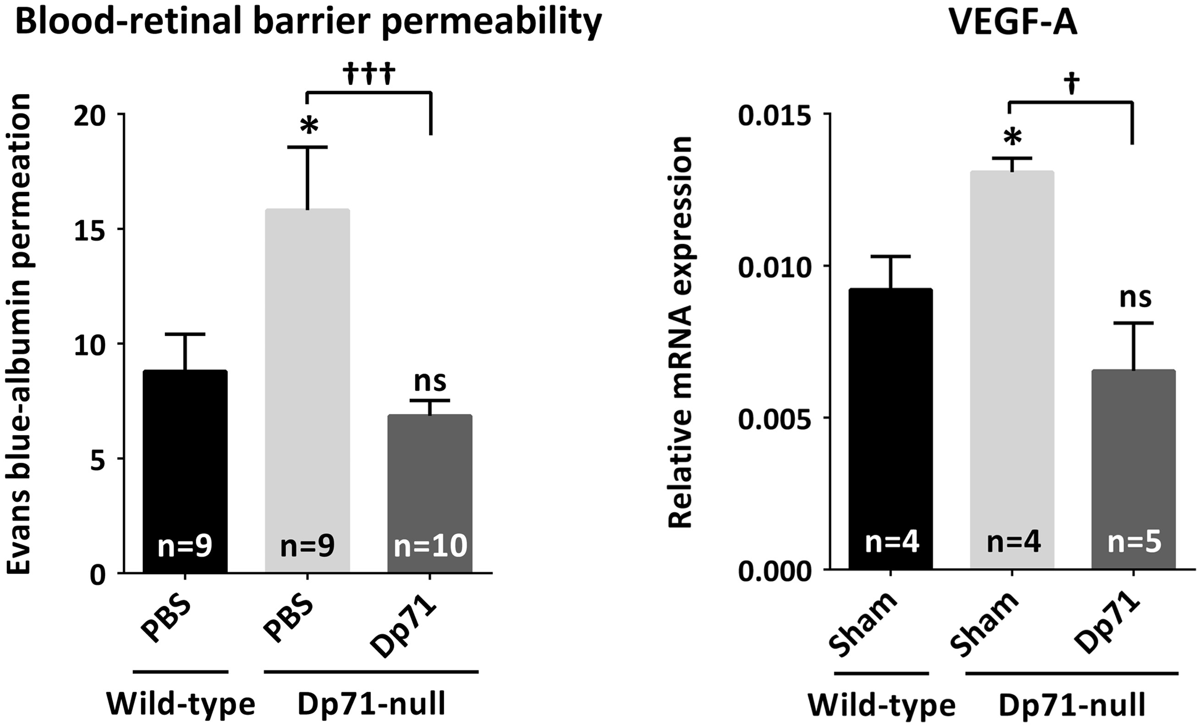
Figure 6. Restoration of the BRB permeability and of VEGF physiological expression in the Dp71-null mouse. BRB ...
Notes:
Figure 6. Restoration of the BRB permeability and of VEGF physiological expression in the Dp71-null mouse. BRB permeability was measured using Evans blue dye vascular permeability assay on WT and Dp71-null adult mice intravitreally injected with PBS or ShH10-GFP-2A-Dp71. Vascular permeability was strongly increased in Dp71-null mice compared to WT. However, Dp71-null mice with ShH10-GFP-2A-Dp71 present a normal BRB permeability compared to WT. Quantitative RT-PCR showed that VEGF-A mRNA expression was up-regulated in Dp71-null mice and that 2 months after ShH10-GFP-2A-Dp71 injection, VEGF wild-type expression level was restored. Bars represent means ± SEM for triplicate data points; n = 10 for BRB permeability and n = 5 for VEGF qPCR. *P < 0.05 significant differences versus wild-type; †††P < 0.001 significant differences versus Dp71-null (Man-Whitney test).
Unless provided in the caption above, the following copyright applies to the content of this slide: © The Author 2016. Published by Oxford University Press. All rights reserved. For permissions, please e-mail: journals.permissions@oup.com

