Slide 1
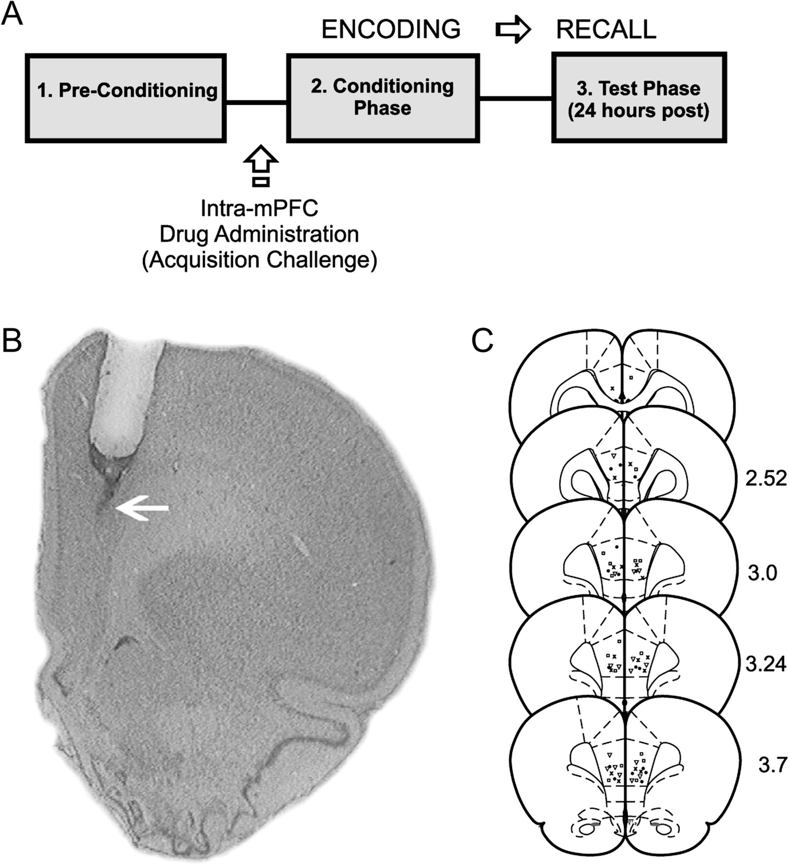
Figure 1. Histological analysis of intra-mPFC microinjection sites and experimental protocol summary. (A) ...
Notes:
Figure 1. Histological analysis of intra-mPFC microinjection sites and experimental protocol summary. (A) Microphotograph of a representative injector placement within the mPFC (white arrow represents injector tip location). (s) Schematic representation showing experimental associative fear conditioning assay and timeline for examining the acquisition (encoding) of associative olfactory fear memory. (C) Schematic illustration showing representative bilateral placements of microinjectors. For illustrative clarity, only a subset of experimental groups is presented. Symbols represent separate experimental groups; ▿, D4 agonist PD 168077; 50 ng/0.5 μL versus acquisition of subthreshold emotional stimuli; ×, D4 agonist PD 168077 50 ng/0.5 μL versus acquisition of supra-threshold emotional stimuli; , Saline versus acquisition of subthreshold emotional stimuli; •, Saline versus acquisition of suprathreshold emotional stimuli.
Unless provided in the caption above, the following copyright applies to the content of this slide: © The Author 2011. Published by Oxford University Press. All rights reserved. For permissions, please e-mail: journals.permissions@oup.com

Slide 2
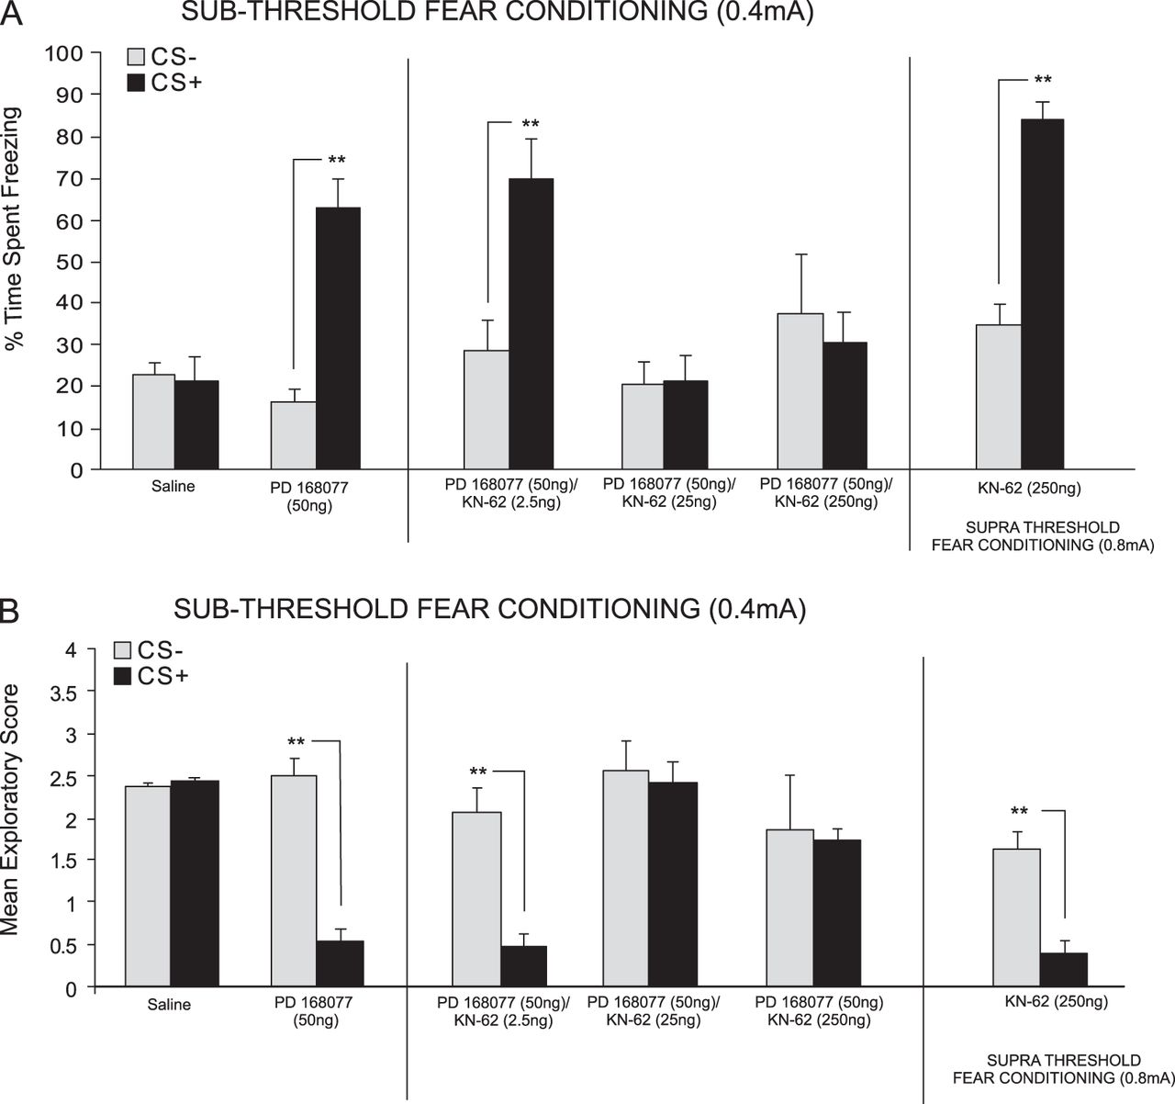
Figure 2. Effects of intra-mPFC DA D4 receptor and CaMKII inhibition during fear-conditioning. (A) Saline controls ...
Notes:
Figure 2. Effects of intra-mPFC DA D4 receptor and CaMKII inhibition during fear-conditioning. (A) Saline controls displayed no significant difference in time spent freezing in response to CS+ vs. CS− presentations following subthreshold (0.4 mA; see Materials and Methods) fear conditioning. In contrast, intra-PLC PD 168077 (50 ng/0.5 μL) significantly potentiated the acquisition of subthreshold fear memory. Coadministration with the CaMKII inhibitor KN-62 (2.5–250 ng/0.5 μL dose dependently attenuates the effects of D4 receptor activation. In contrast, intra-PLC KN-62 (250 ng/0.5 μL) alone did not have a significant effect on the acquisition of suprathreshold (0.8 mA) fear memory. (B) Analysis of exploratory scores revealed that saline controls showed no CS+-related exploratory behavior suppression. In contrast, PD 168077 (50 ng/0.5 μL) significantly potentiated CS+-related suppression of exploratory behavior, which was dose dependently blocked by coadministration of KN-62 (2.5–250 ng/0.5 μL). Bars represent mean ± standard error of the mean for this and all subsequent figures.
Unless provided in the caption above, the following copyright applies to the content of this slide: © The Author 2011. Published by Oxford University Press. All rights reserved. For permissions, please e-mail: journals.permissions@oup.com

Slide 3
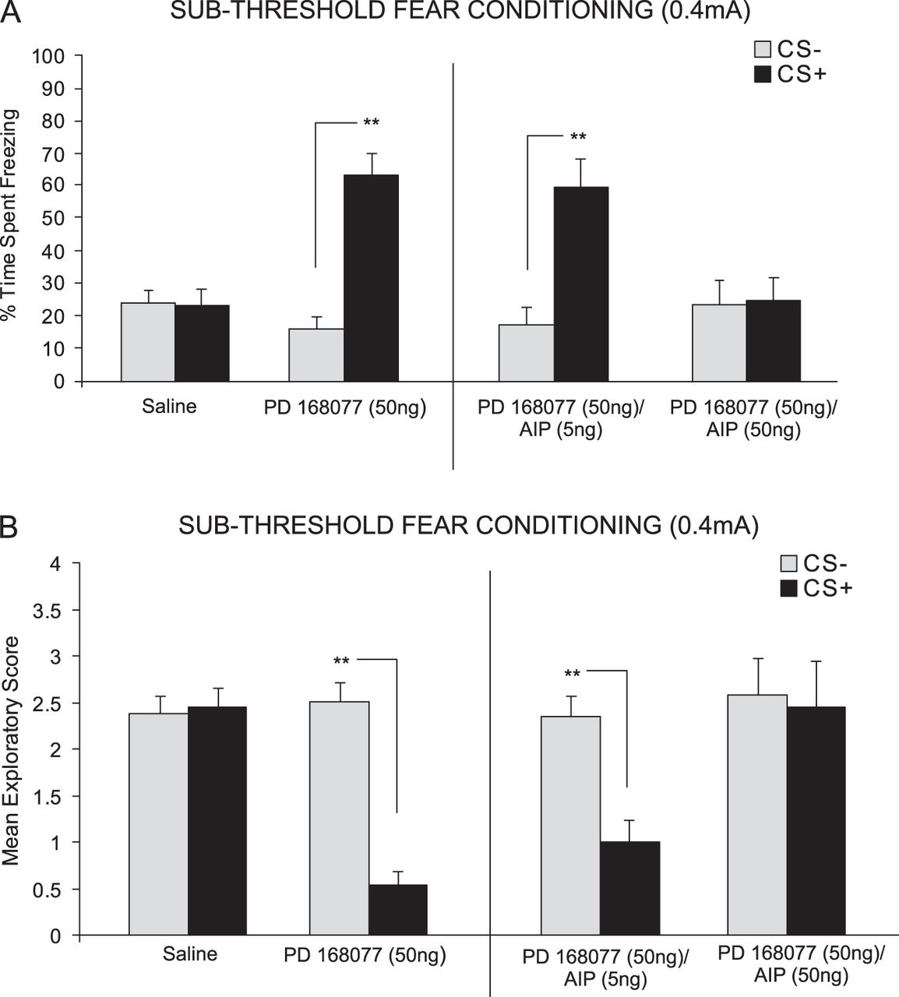
Figure 3. Effects of intra-PLC D4 receptor activation and blockade of CaMKII autophosphorylation on fear-conditioning. ...
Notes:
Figure 3. Effects of intra-PLC D4 receptor activation and blockade of CaMKII autophosphorylation on fear-conditioning. (A) Saline controls showed no significant CS+-related freezing behavior. In contrast, PD 168077 (50 ng/0.5 μL) significantly potentiated the acquisition of subthreshold olfactory fear memory, demonstrated by significantly greater CS+ freezing behavior. This effect was dose dependently blocked by coadministration of the CaMKII autophosphorylation inhibitor AIP (5–50 ng/0.5 μL). (B) Analysis of fear memory-related exploratory scores revealed that saline control rats showed no associative suppression of spontaneous exploratory behavior. In contrast, PD 168077 (50 ng/0.5 μL) significantly potentiated the acquisition of subthreshold (0.4 mA footshock) fear memory, demonstrated by significant suppression of CS+-related exploratory scores. This effect was dose dependently blocked by coadministration of AIP (5–50 ng/0.5 μL).
Unless provided in the caption above, the following copyright applies to the content of this slide: © The Author 2011. Published by Oxford University Press. All rights reserved. For permissions, please e-mail: journals.permissions@oup.com

Slide 4
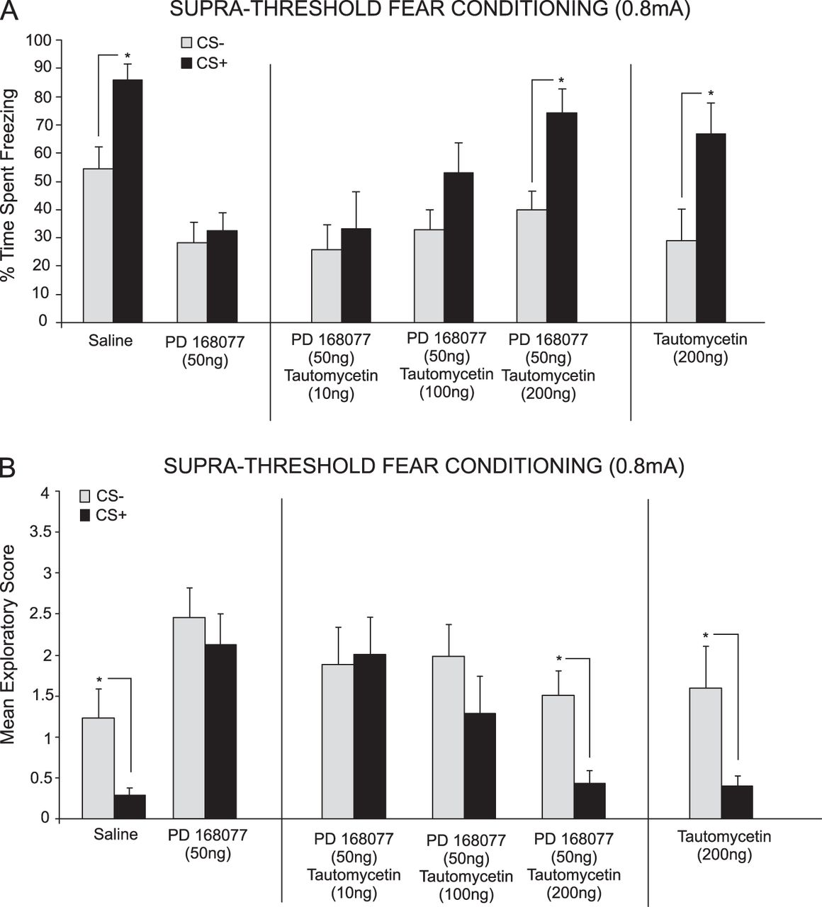
Figure 4. Inhibition of PP1 rescues DA D4 receptor–mediated blockade of suprathreshold fear memory acquisition. (A) ...
Notes:
Figure 4. Inhibition of PP1 rescues DA D4 receptor–mediated blockade of suprathreshold fear memory acquisition. (A) Saline controls showed significant freezing to CS+ presentations after conditioning with a suprathreshold footshock (0.8 mA). In contrast, intra-PLC PD 168077 (50 ng/0.5 μL) blocked the acquisition of suprathreshold fear memory. This effect was dose dependently reversed by coadministration of tautomycetin (10–200 ng/0.5 μL). In a separate control experiment, intra-PLC tautomycetin (200 ng/0.5 μL) alone did not influence the acquisition of suprathreshold fear memory. (B) Saline controls showed significant suppression of exploratory behavior in response to CS+ presentations. In contrast, intra-PLC PD 168077 (50 ng/0.5 μL) blocked this effect. D4-mediated blockade of suprathreshold fear memory acquisition was dose dependently reversed by tautomycetin (10–200 ng/0.5 μL). In a separate control experiment, intra-PLC tautomycetin (200 ng/0.5 μL) alone did not affect the acquisition of suprathreshold fear memory.
Unless provided in the caption above, the following copyright applies to the content of this slide: © The Author 2011. Published by Oxford University Press. All rights reserved. For permissions, please e-mail: journals.permissions@oup.com

Slide 5
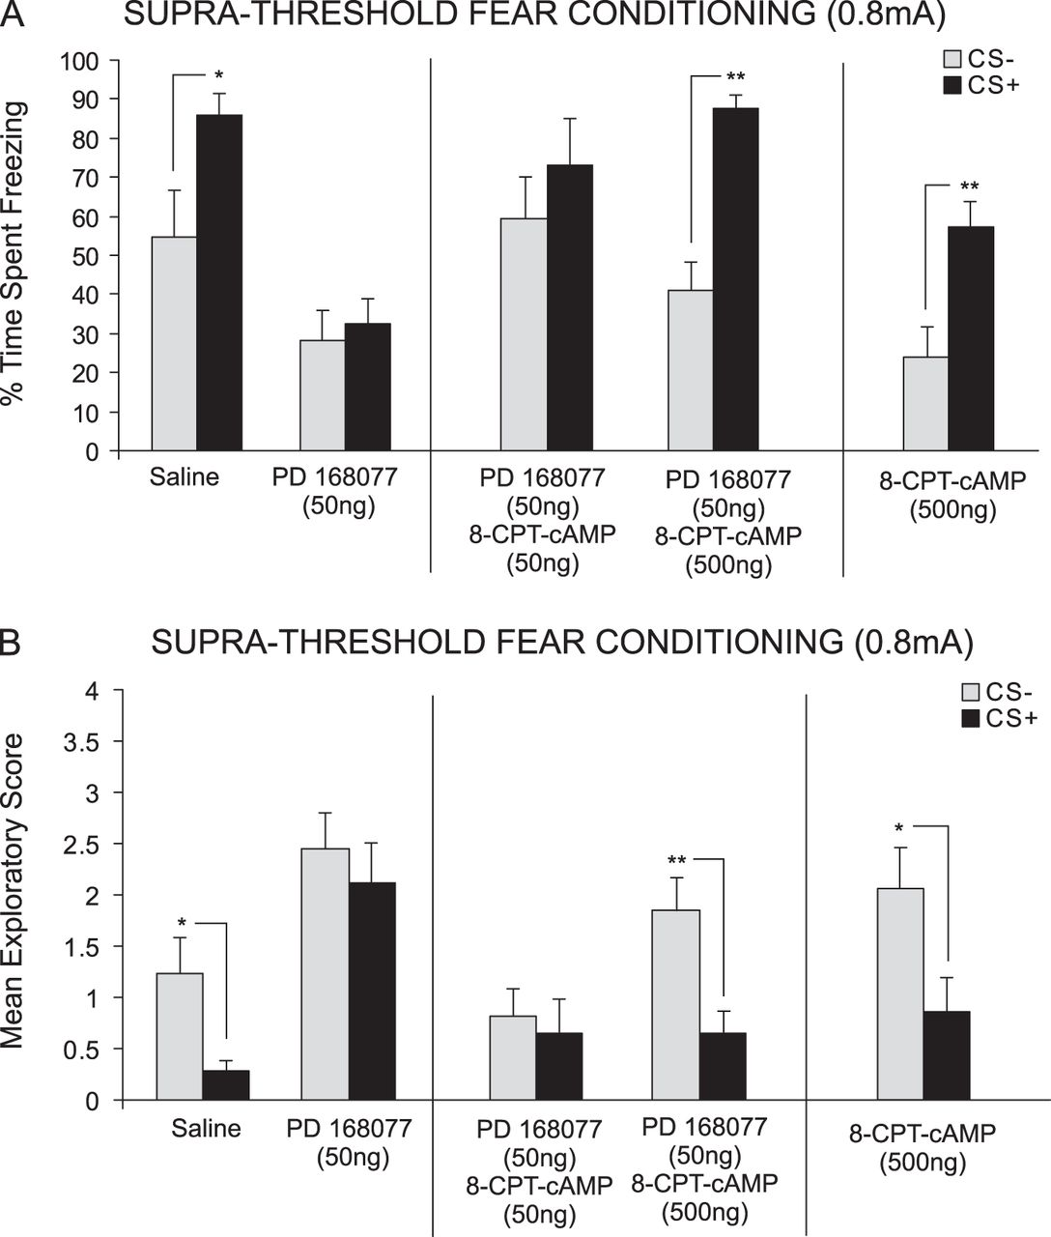
Figure 5. Activation of cAMP/PKA signaling rescues D4 receptor–mediated blockade of suprathreshold fear memory. (A) ...
Notes:
Figure 5. Activation of cAMP/PKA signaling rescues D4 receptor–mediated blockade of suprathreshold fear memory. (A) Saline controls showed significant CS+-related freezing after conditioning with suprathreshold footshock (0.8 mA). However, intra-PLC PD 168077 (50 ng/0.5 μL) blocked acquisition of suprathreshold fear memory. This effect was dose dependently reversed by coadministration of the cAMP/PKA activator 8-CPT-cAMP (50–500 ng/0.5 μL). In a separate control experiment, intra-PLC 8-CPT-cAMP (500 ng/0.5 μL) alone did not influence the acquisition of suprathreshold fear memory. (B) Similarly, exploratory behavior analyses demonstrated significant CS+-related attenuation in exploratory behavior in saline controls. In contrast, intra-PLC PD 168077 (50 ng/0.5 μL) administration blocked this effect. D4 receptor–mediated blockade of suprathreshold fear memory acquisition was dose dependently reversed by coadministration of 8-CPT-cAMP (50–500 ng/0.5 μL). Intra-PLC 8-CPT-cAMP (500 ng/0.5 μL) alone did not have any significant effect on fear-related exploratory scores.
Unless provided in the caption above, the following copyright applies to the content of this slide: © The Author 2011. Published by Oxford University Press. All rights reserved. For permissions, please e-mail: journals.permissions@oup.com

