Slide 1
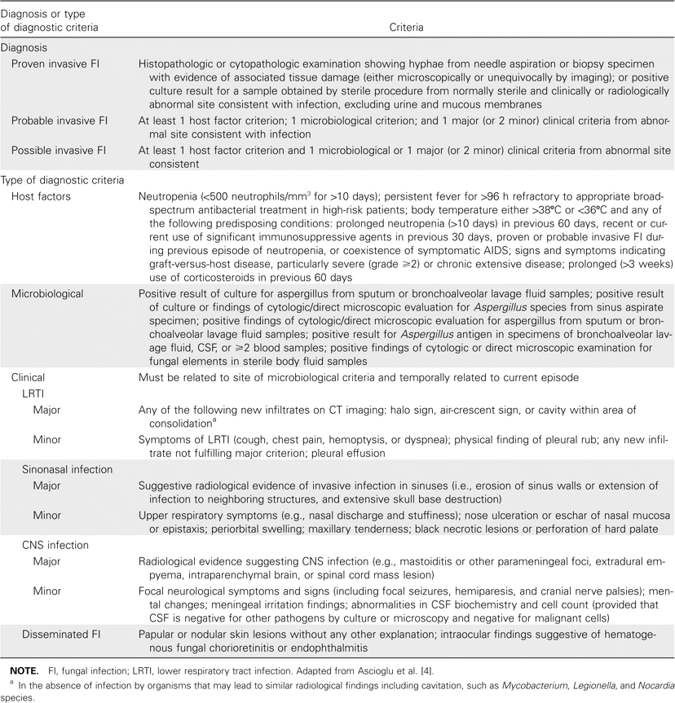
Table 1 European Organization of the Research and Treatment of Cancer/Mycoses Study Group criteria for diagnosis of ...
Notes:
Table 1 European Organization of the Research and Treatment of Cancer/Mycoses Study Group criteria for diagnosis of invasive aspergillosis.
Unless provided in the caption above, the following copyright applies to the content of this slide: © 2006 by the Infectious Diseases Society of America

Slide 2
Table 6 Predictive values of the galactomannan assay for diagnosis of invasive aspergillus (IA), by prevalence.
Notes:
Table 6 Predictive values of the galactomannan assay for diagnosis of invasive aspergillus (IA), by prevalence.
Unless provided in the caption above, the following copyright applies to the content of this slide: © 2006 by the Infectious Diseases Society of America

Slide 3
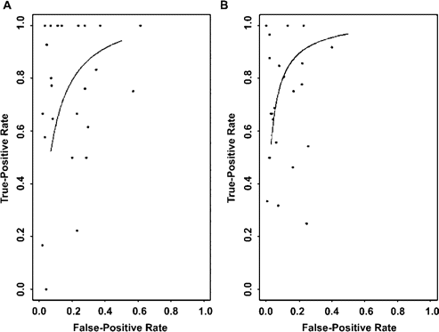
Figure 2 Summary receiver-operating characteristic curve for the galactomannan assay (Platelia; Bio-Rad), compared ...
Notes:
Figure 2 Summary receiver-operating characteristic curve for the galactomannan assay (Platelia; Bio-Rad), compared with reference standard, for proven cases of invasive aspergillosis (A) and both proven or probable cases of invasive aspergillosis (B). Each dot represents a study.
Unless provided in the caption above, the following copyright applies to the content of this slide: © 2006 by the Infectious Diseases Society of America

Slide 4
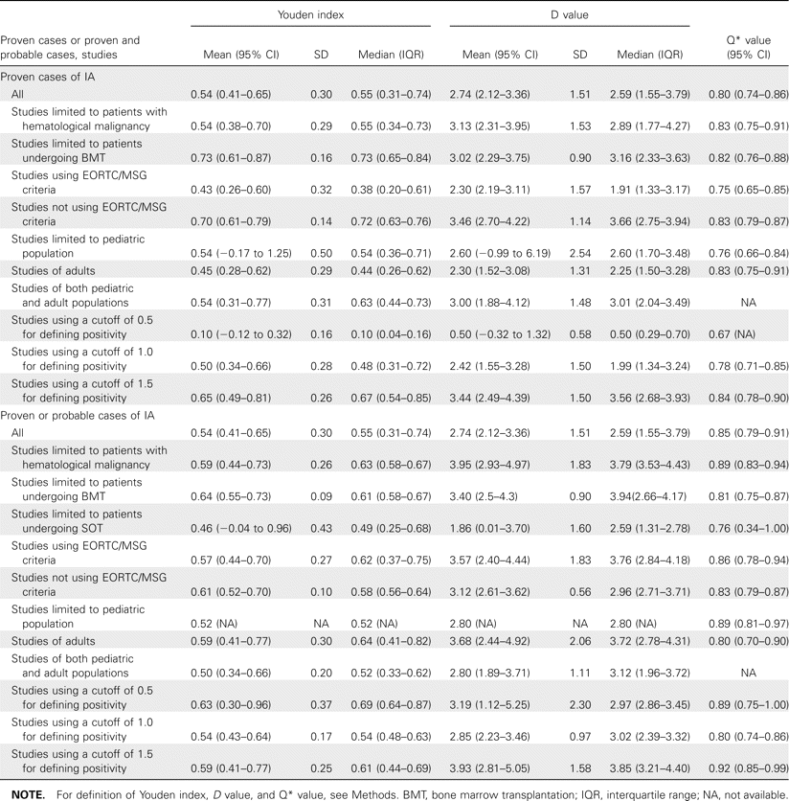
Table 5 Summary measures of accuracy and and subgroup analyses for the galactomannan assay for diagnosis of invasive ...
Notes:
Table 5 Summary measures of accuracy and and subgroup analyses for the galactomannan assay for diagnosis of invasive aspergillosis, compared with reference standard.
Unless provided in the caption above, the following copyright applies to the content of this slide: © 2006 by the Infectious Diseases Society of America

Slide 5
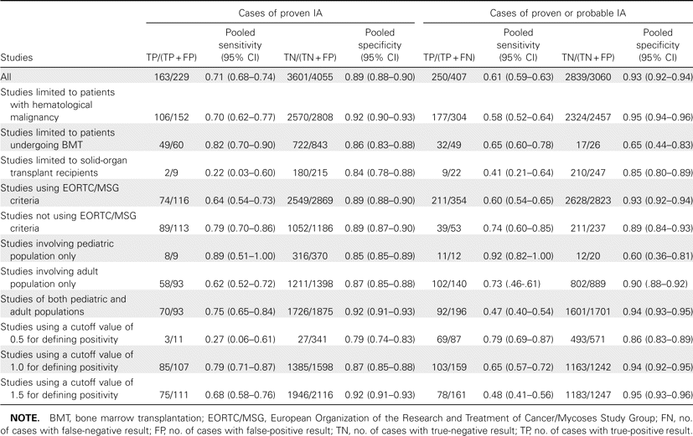
Table 4 Pooled sensitivity and specificity of the galactomannan assay for diagnosis of invasive aspergillosis (IA).
Notes:
Table 4 Pooled sensitivity and specificity of the galactomannan assay for diagnosis of invasive aspergillosis (IA).
Unless provided in the caption above, the following copyright applies to the content of this slide: © 2006 by the Infectious Diseases Society of America

Slide 6
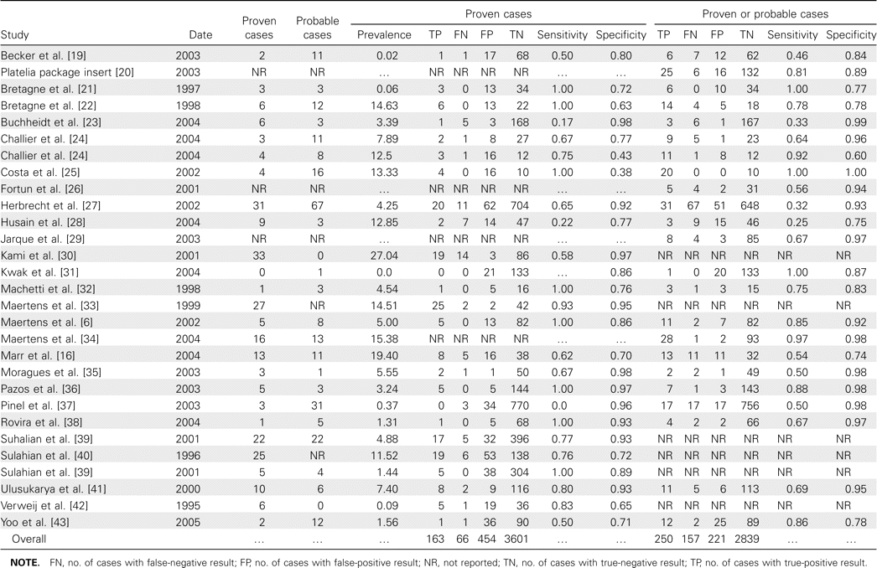
Table 3 Characteristics and results of studies included in the meta-analysis of diagnosis of invasive aspergillosis ...
Notes:
Table 3 Characteristics and results of studies included in the meta-analysis of diagnosis of invasive aspergillosis using a galactomannan assay.
Unless provided in the caption above, the following copyright applies to the content of this slide: © 2006 by the Infectious Diseases Society of America

Slide 7
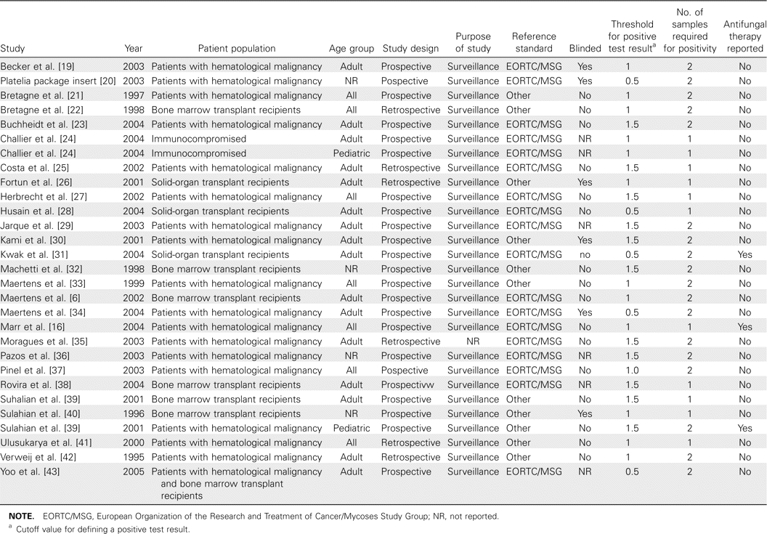
Table 2 Characteristics of studies included in the meta-analysis of diagnosis of invasive aspergillosis using a ...
Notes:
Table 2 Characteristics of studies included in the meta-analysis of diagnosis of invasive aspergillosis using a galactomannan assay.
Unless provided in the caption above, the following copyright applies to the content of this slide: © 2006 by the Infectious Diseases Society of America

Slide 8
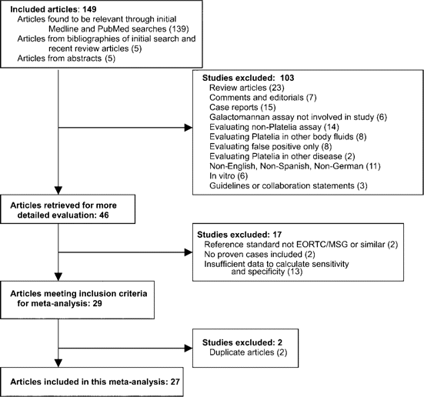
Figure 1 Summary of study assessment and inclusion in a meta-analysis of studies involving diagnosis of invasive ...
Notes:
Figure 1 Summary of study assessment and inclusion in a meta-analysis of studies involving diagnosis of invasive aspergillosis using a galactomannan assay. EORTC, European Organization of the Research and Treatment of Cancer; MSG, Mycoses Study Group.
Unless provided in the caption above, the following copyright applies to the content of this slide: © 2006 by the Infectious Diseases Society of America

