Slide 1
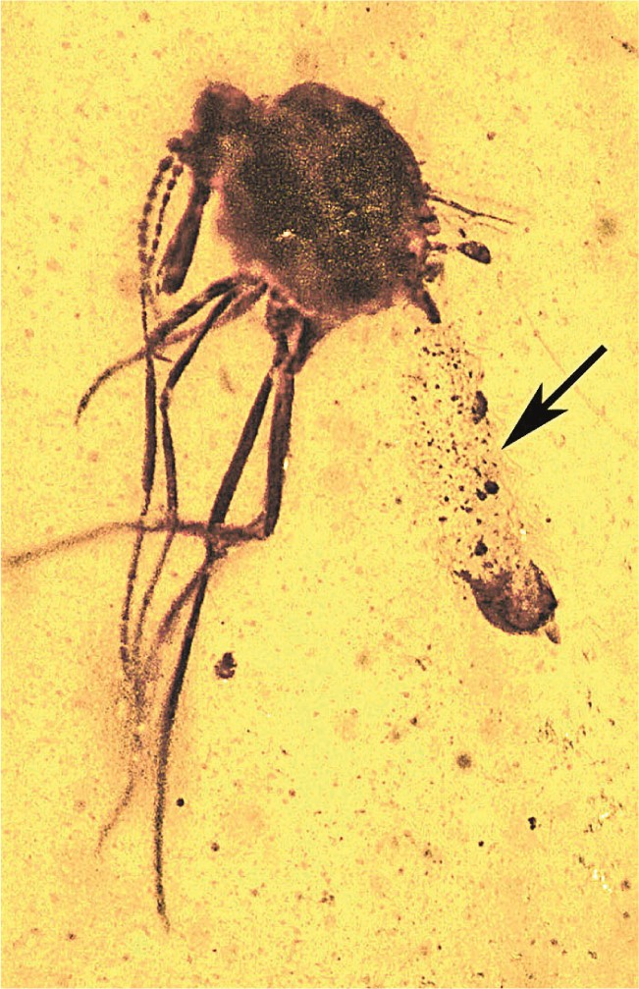
Fig. 1. One hundred million-year-old Protoculicoides biting midge containing numerous oocysts (arrow) of the ...
Notes:
Fig. 1. One hundred million-year-old Protoculicoides biting midge containing numerous oocysts (arrow) of the malarial parasite Paleohaemoproteus burmacis in Myanmar amber.
Unless provided in the caption above, the following copyright applies to the content of this slide: © The Authors 2016. Published by Oxford University Press on behalf of Entomological Society of America. All rights reserved. For Permissions, please email: journals.permissions@oup.com

Slide 2
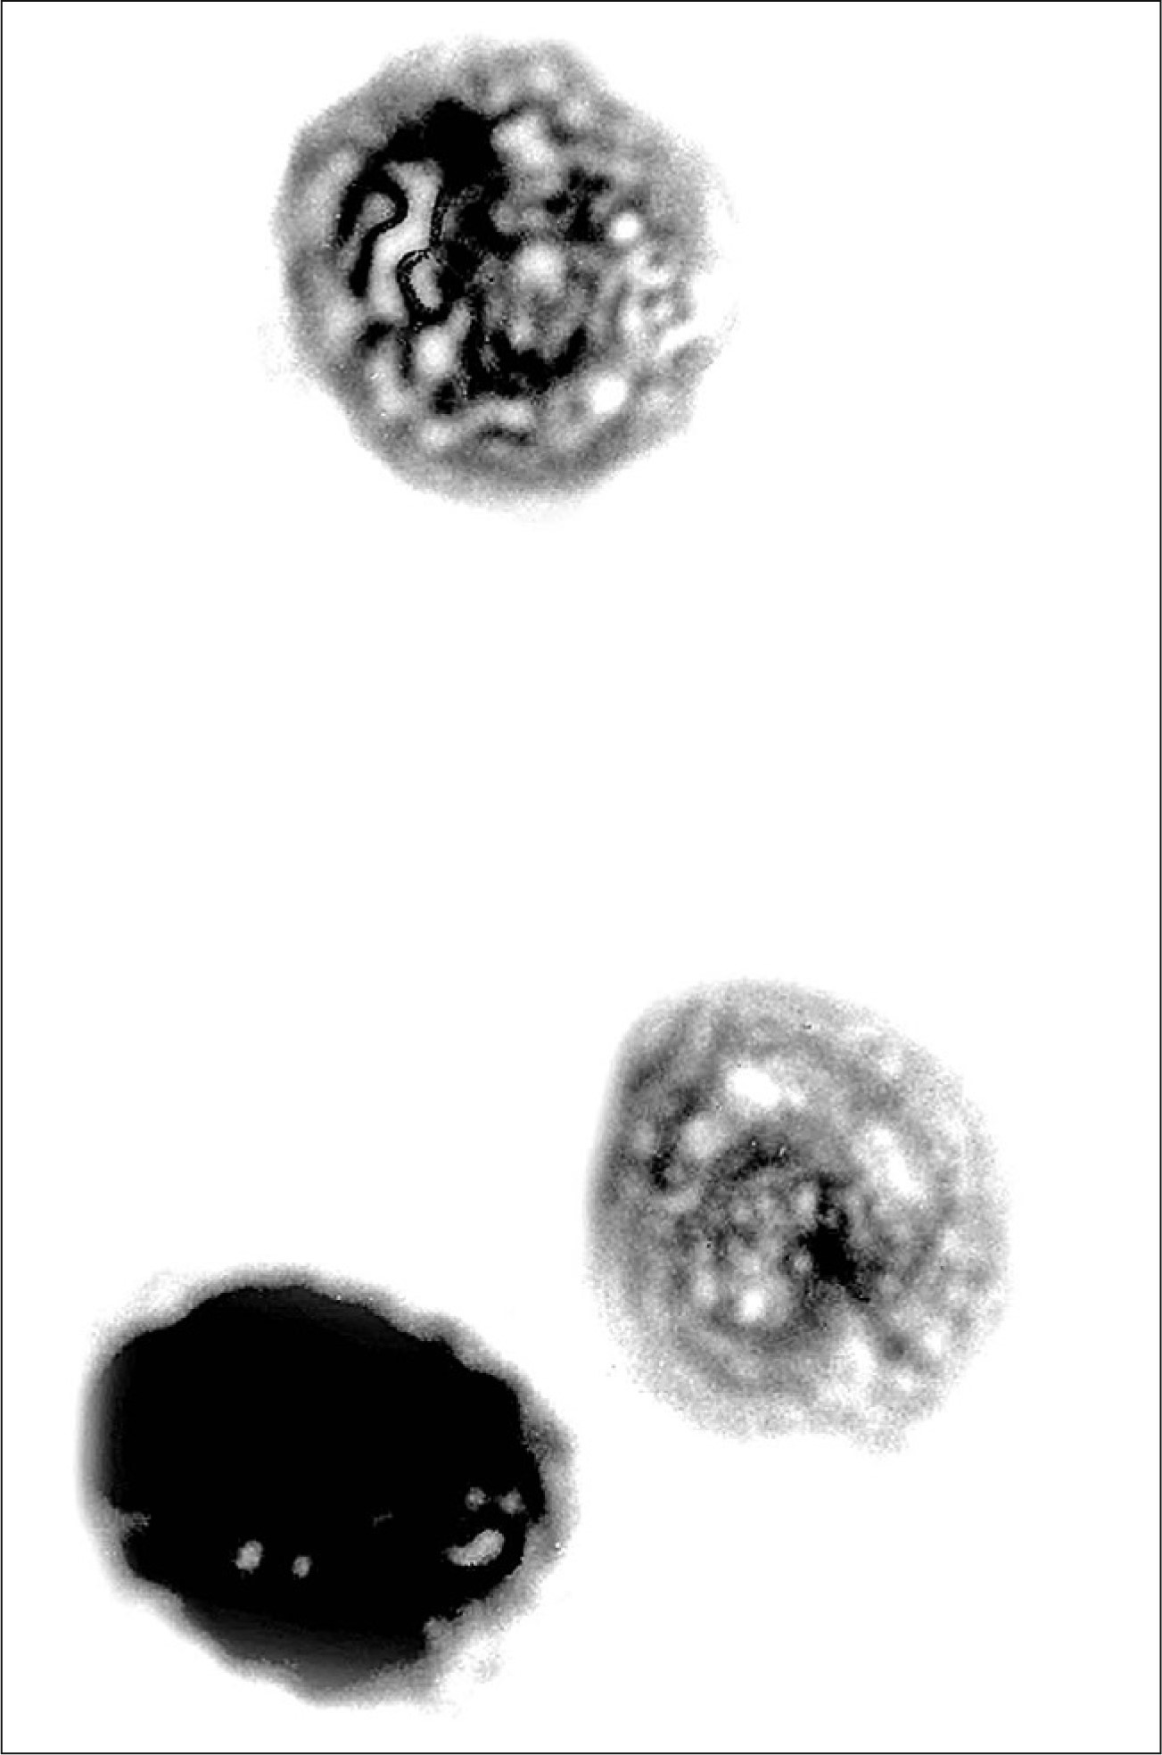
Fig. 2. Detail of oocysts of Paleohaemoproteus burmacis in various stages of development in the abdomen of the ...
Notes:
Fig. 2. Detail of oocysts of Paleohaemoproteus burmacis in various stages of development in the abdomen of the Protoculicoides biting midge shown in Fig. 1 .
Unless provided in the caption above, the following copyright applies to the content of this slide: © The Authors 2016. Published by Oxford University Press on behalf of Entomological Society of America. All rights reserved. For Permissions, please email: journals.permissions@oup.com

Slide 3
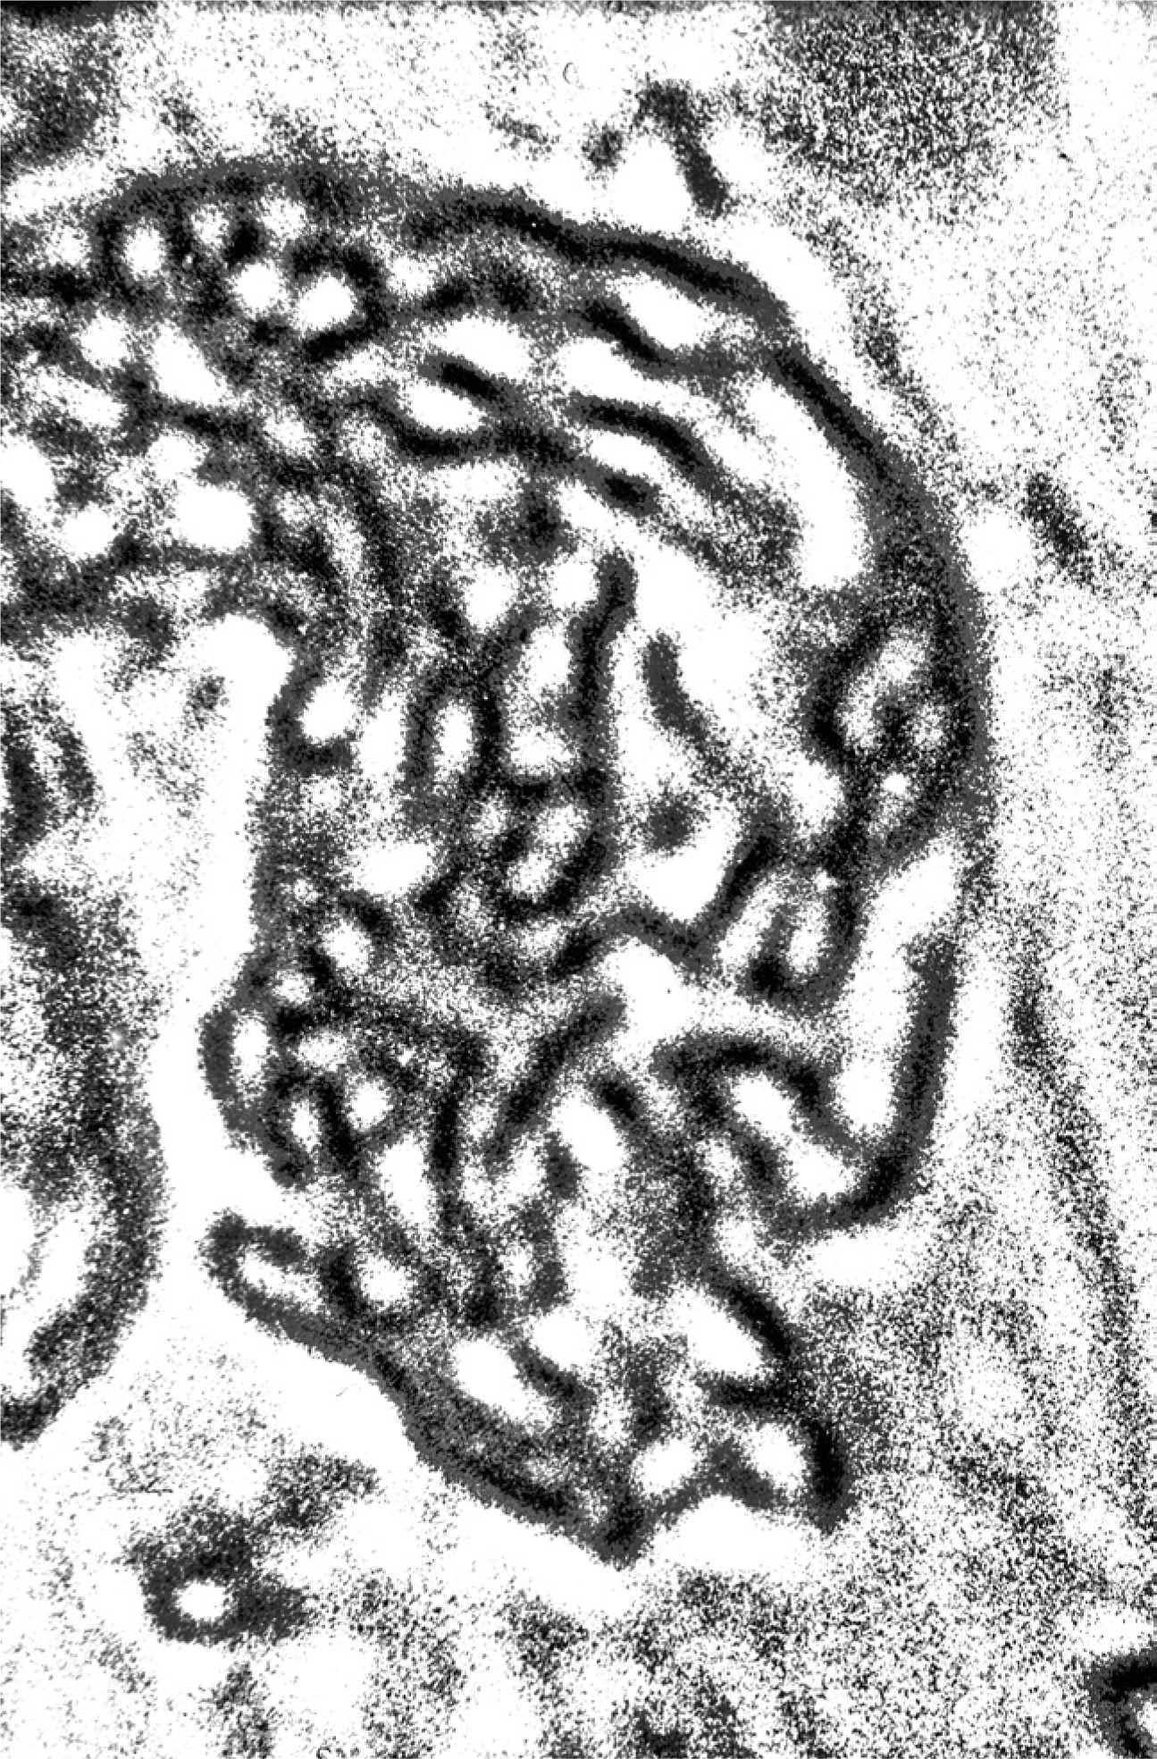
Fig. 3. Detail of sporozoites of Paleohaemoproteus burmacis in the abdomen of the Protoculicoides biting midge shown ...
Notes:
Fig. 3. Detail of sporozoites of Paleohaemoproteus burmacis in the abdomen of the Protoculicoides biting midge shown in Fig. 1 .
Unless provided in the caption above, the following copyright applies to the content of this slide: © The Authors 2016. Published by Oxford University Press on behalf of Entomological Society of America. All rights reserved. For Permissions, please email: journals.permissions@oup.com

Slide 4
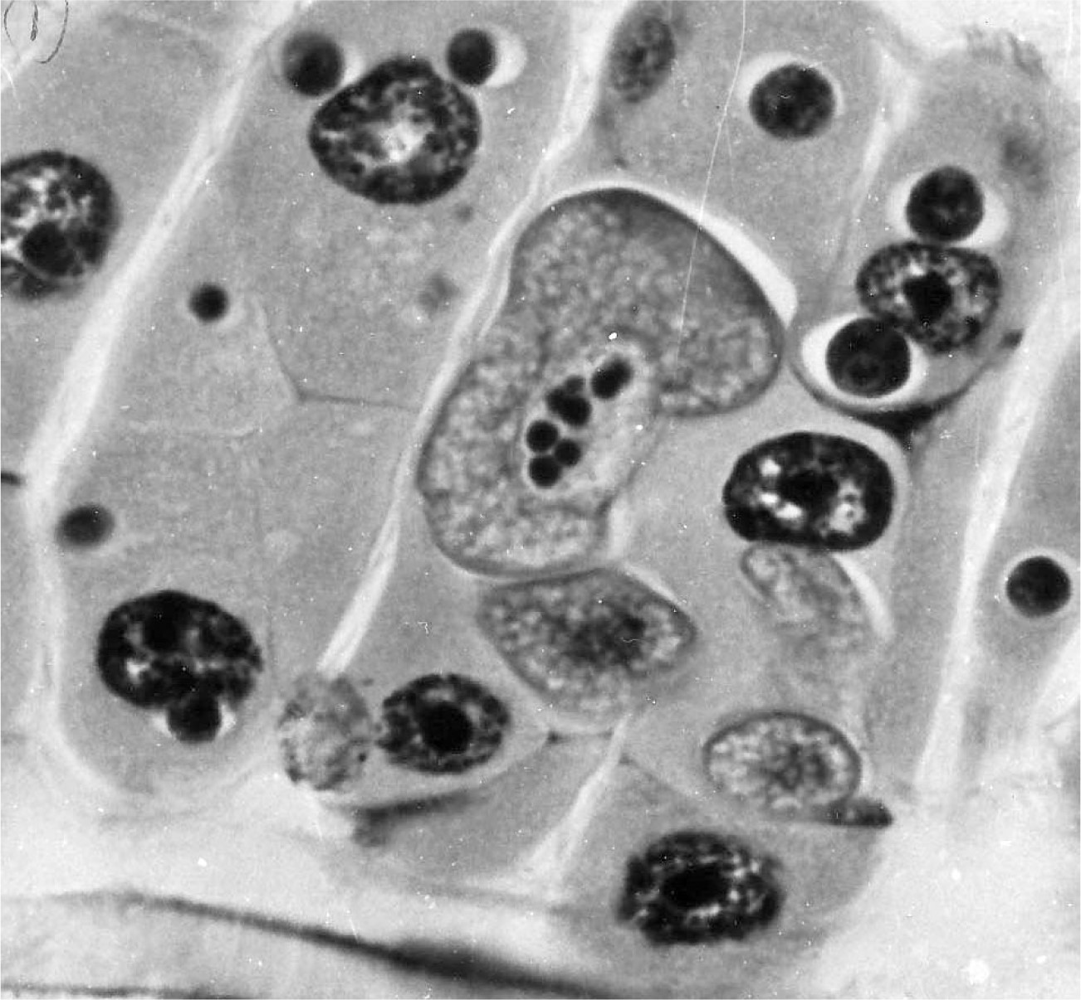
Fig. 4. Trophozoites of the mosquito gregarine parasite Ascogregarina culicis developing in the gut wall of a larva ...
Notes:
Fig. 4. Trophozoites of the mosquito gregarine parasite Ascogregarina culicis developing in the gut wall of a larva of Aedes sierrensis .
Unless provided in the caption above, the following copyright applies to the content of this slide: © The Authors 2016. Published by Oxford University Press on behalf of Entomological Society of America. All rights reserved. For Permissions, please email: journals.permissions@oup.com

Slide 5
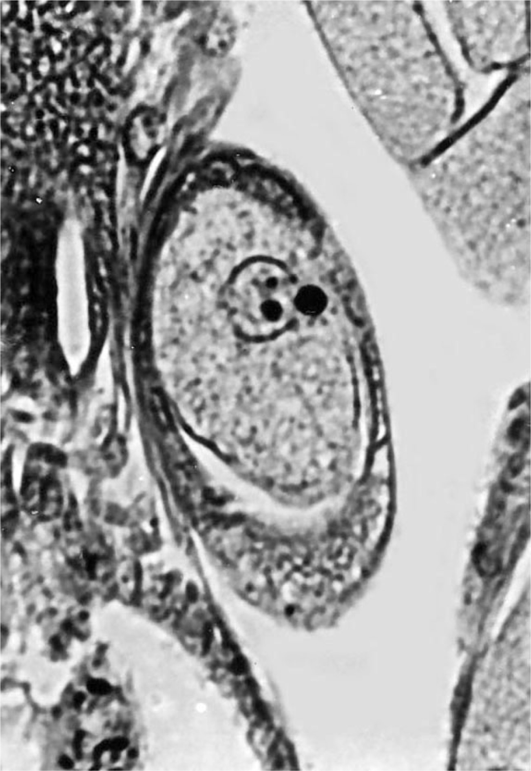
Fig. 5. Gamont of the mosquito gregarine parasite Ascogregarina culicis developing in the Malpighian tubules of a ...
Notes:
Fig. 5. Gamont of the mosquito gregarine parasite Ascogregarina culicis developing in the Malpighian tubules of a pupa of Aedes sierrensis .
Unless provided in the caption above, the following copyright applies to the content of this slide: © The Authors 2016. Published by Oxford University Press on behalf of Entomological Society of America. All rights reserved. For Permissions, please email: journals.permissions@oup.com

Slide 6
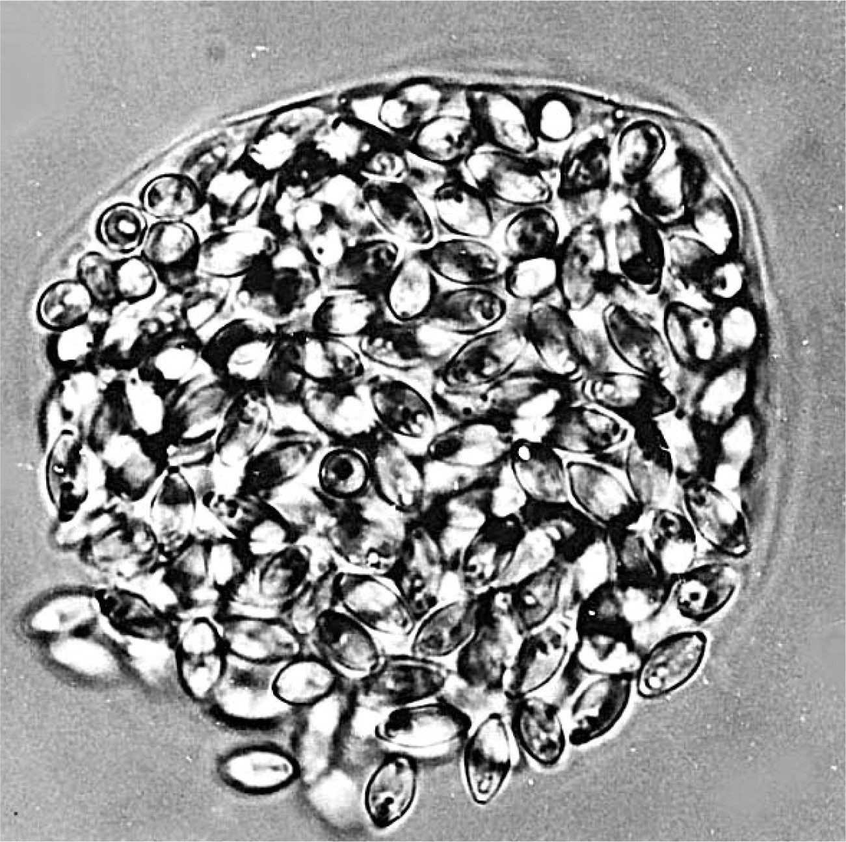
Fig. 6. Mature zygote of the mosquito gregarine parasite Ascogregarina culicis liberating spores containing ...
Notes:
Fig. 6. Mature zygote of the mosquito gregarine parasite Ascogregarina culicis liberating spores containing sporozoites in the lumen of the Malpighian tubules of an adult Aedes sierrensis .
Unless provided in the caption above, the following copyright applies to the content of this slide: © The Authors 2016. Published by Oxford University Press on behalf of Entomological Society of America. All rights reserved. For Permissions, please email: journals.permissions@oup.com

Slide 7
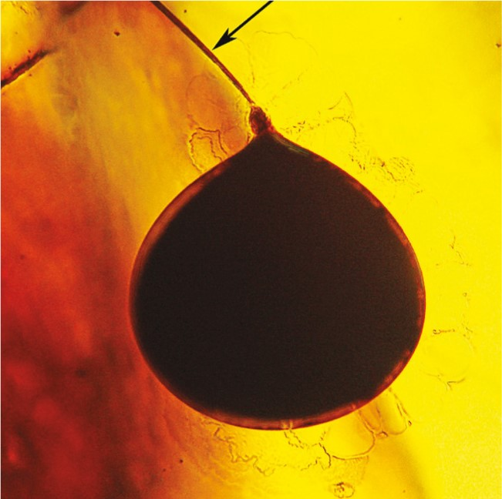
Fig. 7. Gametocyst of the gregarine Primigregarina burmanica in early mid-Cretaceous Myanmar amber. Arrow shows ...
Notes:
Fig. 7. Gametocyst of the gregarine Primigregarina burmanica in early mid-Cretaceous Myanmar amber. Arrow shows extruded spore duct filled with spores containing sporozoites.
Unless provided in the caption above, the following copyright applies to the content of this slide: © The Authors 2016. Published by Oxford University Press on behalf of Entomological Society of America. All rights reserved. For Permissions, please email: journals.permissions@oup.com

Slide 8
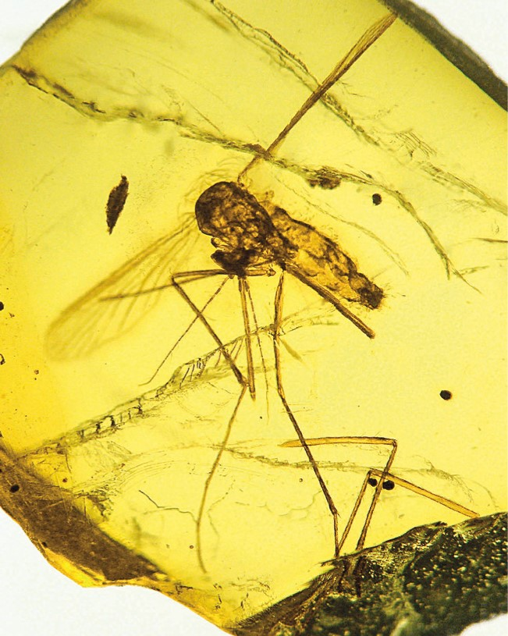
Fig. 8. The Tertiary mosquito Culex malariager infected with the malarial parasite Plasmodium dominicana in ...
Notes:
Fig. 8. The Tertiary mosquito Culex malariager infected with the malarial parasite Plasmodium dominicana in Dominican amber.
Unless provided in the caption above, the following copyright applies to the content of this slide: © The Authors 2016. Published by Oxford University Press on behalf of Entomological Society of America. All rights reserved. For Permissions, please email: journals.permissions@oup.com

Slide 9
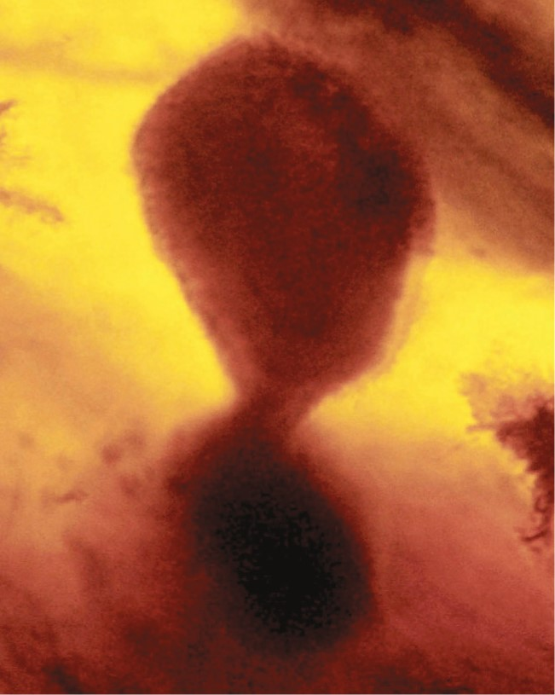
Fig. 9. Developing oocyst of the Tertiary Plasmodium dominicana in the abdomen of Culex malariager in Dominican ...
Notes:
Fig. 9. Developing oocyst of the Tertiary Plasmodium dominicana in the abdomen of Culex malariager in Dominican amber.
Unless provided in the caption above, the following copyright applies to the content of this slide: © The Authors 2016. Published by Oxford University Press on behalf of Entomological Society of America. All rights reserved. For Permissions, please email: journals.permissions@oup.com

Slide 10
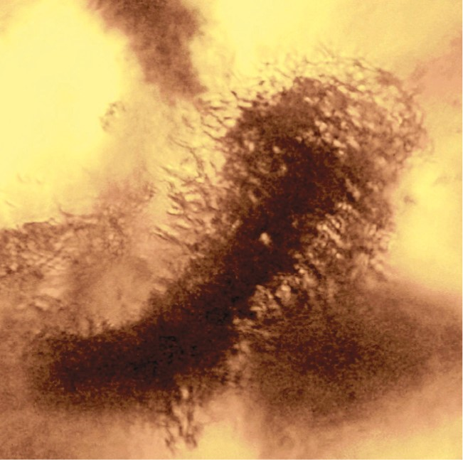
Fig. 10. Sporozoites emerging from a mature oocyst of the Tertiary Plasmodium doininicana in the body cavity of Culex ...
Notes:
Fig. 10. Sporozoites emerging from a mature oocyst of the Tertiary Plasmodium doininicana in the body cavity of Culex malariager in Dominican amber.
Unless provided in the caption above, the following copyright applies to the content of this slide: © The Authors 2016. Published by Oxford University Press on behalf of Entomological Society of America. All rights reserved. For Permissions, please email: journals.permissions@oup.com

Slide 11
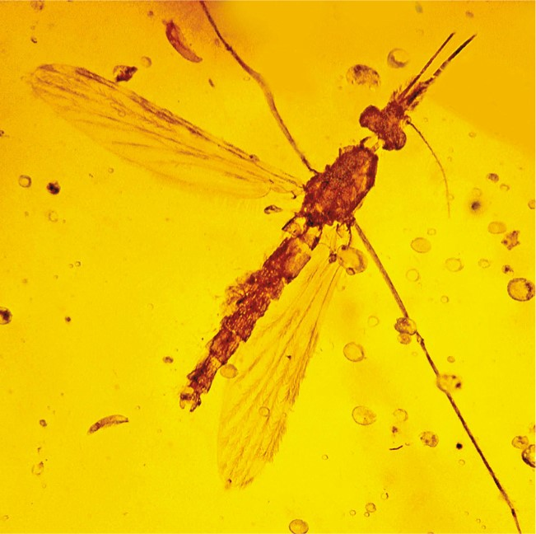
Fig. 11. Anopheles dominicanus in Tertiary Dominican amber.
Notes:
Fig. 11. Anopheles dominicanus in Tertiary Dominican amber.
Unless provided in the caption above, the following copyright applies to the content of this slide: © The Authors 2016. Published by Oxford University Press on behalf of Entomological Society of America. All rights reserved. For Permissions, please email: journals.permissions@oup.com

