Slide 1
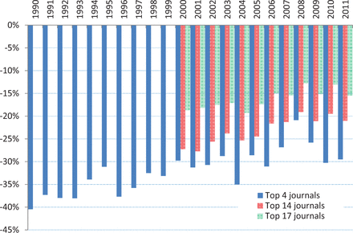
Figure 1. US home bias in publishing papers in top Finance journals, 1990–2011. This figure presents the annual excess ...
Notes:
Figure 1. US home bias in publishing papers in top Finance journals, 1990–2011. This figure presents the annual excess fraction of published papers in top Finance journals on international (non-US) topics in which it is defined in excess of the fraction of the world’s total capitalization that is represented by non-US markets (including equity, private and public bond market capitalization, and total bank credit). The fraction of empirical papers published in Finance journals is determined by a search of abstracts, titles, keywords of the “international” papers (papers that include multiple non-US countries), and “country-specific” papers (papers that specifically study certain non-US countries) in the top four Finance journals (“top four,” Journal of Finance, Review of Financial Studies, Journal of Financial Economics, and Journal of Financial & Quantitative Analysis) from 1990 to 2011, papers in the top fourteen finance journals (“top fourteen,” which also include Journal of Corporate Finance, Financial Analysts Journal, Financial Management, Journal of Financial Intermediation, Journal of Empirical Finance, Financial Review, Journal of Banking & Finance, Review of Finance, and Journal of Portfolio Management) from 2000 to 2011, and papers in the top seventeen finance journals (“top seventeen,” which also include Journal of International Money and Finance, Pacific Basin Finance Journal, and Emerging Markets Review) from 2000 to 2011. Data on publications are from EBSCO Publishing, an aggregator of full-text search library databases based in Ipswich, MA. See Online Appendix Table F for details on keyword search algorithms. We include forty-five different countries in the country-specific set. Annual data on public and private bond market capitalization and private credit by deposit money banks and other financial institutions are obtained from the World Bank’s Financial Structure and Development database (November 2013 update).
Unless provided in the caption above, the following copyright applies to the content of this slide: © The Authors 2016. Published by Oxford University Press on behalf of the European Finance Association. All rights reserved. For Permissions, please email: journals.permissions@oup.com

Slide 2
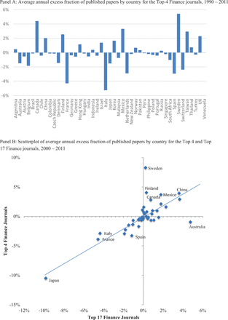
Figure 2. Foreign bias in publishing papers in top Finance journals, 1990–2011. This figure presents the annual excess ...
Notes:
Figure 2. Foreign bias in publishing papers in top Finance journals, 1990–2011. This figure presents the annual excess fraction of published papers in top Finance journals on non-US country-specific topics in which it is defined in excess of the fraction of the world’s total capitalization (excluding the USA) that is represented by that country’s market (including equity, private and public bond market capitalization, and total bank credit). The fraction of empirical papers published in Finance journals is determined by a search of abstracts, titles, keywords of “country-specific” papers (papers that specifically study certain non-US countries) in the top four Finance journals from 1990 to 2011, and papers in the top fourteen and top seventeen finance journals from 2000 to 2011. See Figure 1 for the list of journals in each category. Data on publications are from EBSCO Publishing, an aggregator of full-text search library databases based in Ipswich, MA. See Online Appendix Table F and text for details on keyword search algorithms. We include forty-five different countries in the country-specific set. Panel A presents the average annual excess fraction of published papers by country for the “top four” Finance journals using publications from 1990 to 2011. Panel B presents a scatterplot of those excess fractions by country for the “top four” and “top seventeen” Finance journals from 2000 to 2011. The equation in the figure reports the intercept and slope coefficients of a best-fitted line with the associated coefficient of determination (R2). We include forty-five different countries in the country-specific set. Annual data on public and private bond market capitalization and private credit by deposit money banks and other financial institutions are obtained from the World Bank’s Financial Structure and Development database (November 2013 update).
Unless provided in the caption above, the following copyright applies to the content of this slide: © The Authors 2016. Published by Oxford University Press on behalf of the European Finance Association. All rights reserved. For Permissions, please email: journals.permissions@oup.com

