Slide 1
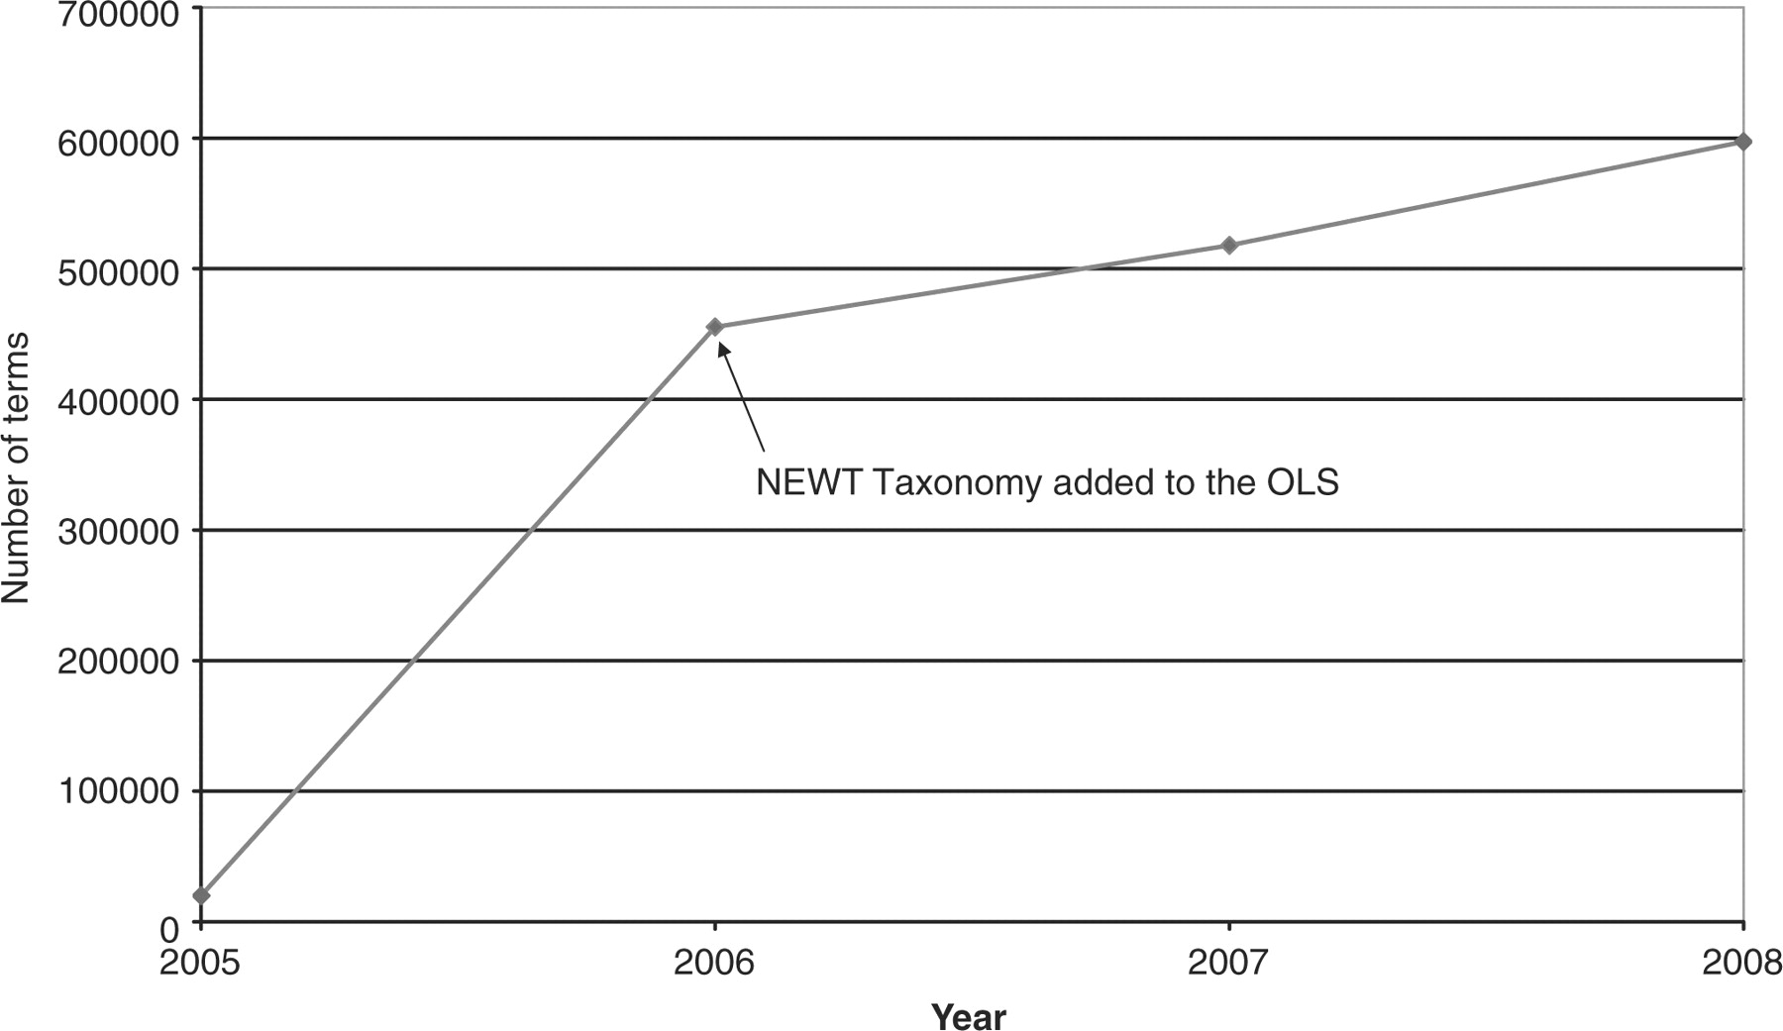
Figure 1. Growth chart of the OLS data content. The amount of data loaded into the OLS, based on unique terms, has more ...
Notes:
Figure 1. Growth chart of the OLS data content. The amount of data loaded into the OLS, based on unique terms, has more than quadrupled since the service went online. Note that the large increase in 2006 is largely due to the incorporation of the NEWT taxonomy.
Unless provided in the caption above, the following copyright applies to the content of this slide: © 2008 The Author(s)This is an Open Access article distributed under the terms of the Creative Commons Attribution Non-Commercial License (http://creativecommons.org/licenses/by-nc/2.0/uk/) which permits unrestricted non-commercial use, distribution, and reproduction in any medium, provided the original work is properly cited.

Slide 2
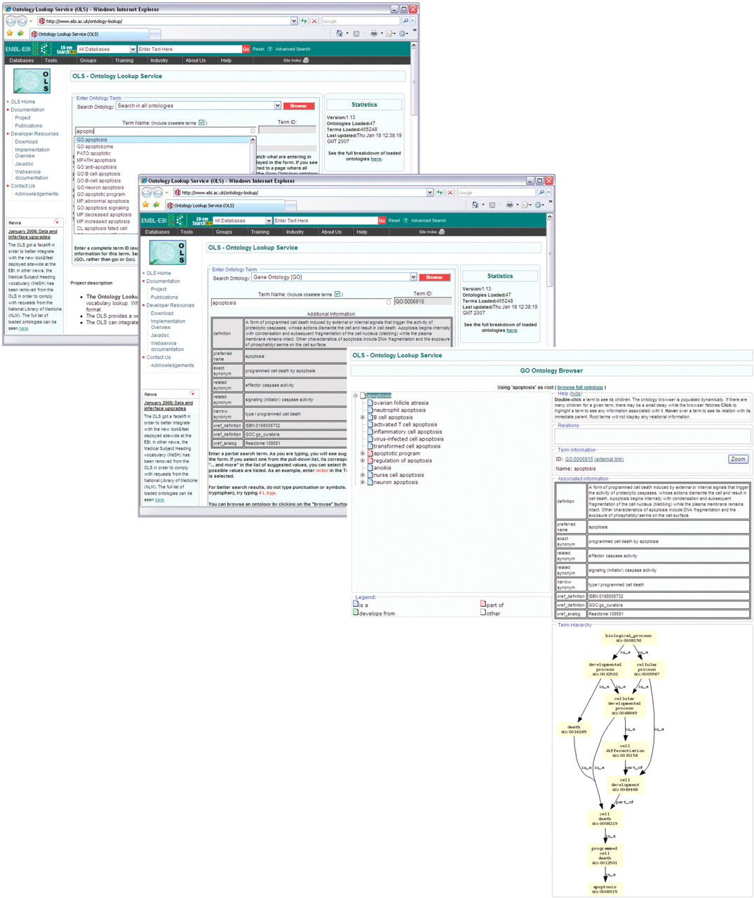
Figure 2. The interactive OLS user interface. A suggest-as-you-type search mechanism provides users with interactive ...
Notes:
Figure 2. The interactive OLS user interface. A suggest-as-you-type search mechanism provides users with interactive term lists based on their input. Once a term is selected, known metadata are obtained and displayed. Users can browse an ontology using the selected term as a starting point. Using the ontology browser, term relations can be navigated. Highlighting a term will load metadata and provide a graphical display of all paths from that term to the ontology root(s).
Unless provided in the caption above, the following copyright applies to the content of this slide: © 2008 The Author(s)This is an Open Access article distributed under the terms of the Creative Commons Attribution Non-Commercial License (http://creativecommons.org/licenses/by-nc/2.0/uk/) which permits unrestricted non-commercial use, distribution, and reproduction in any medium, provided the original work is properly cited.

Slide 3
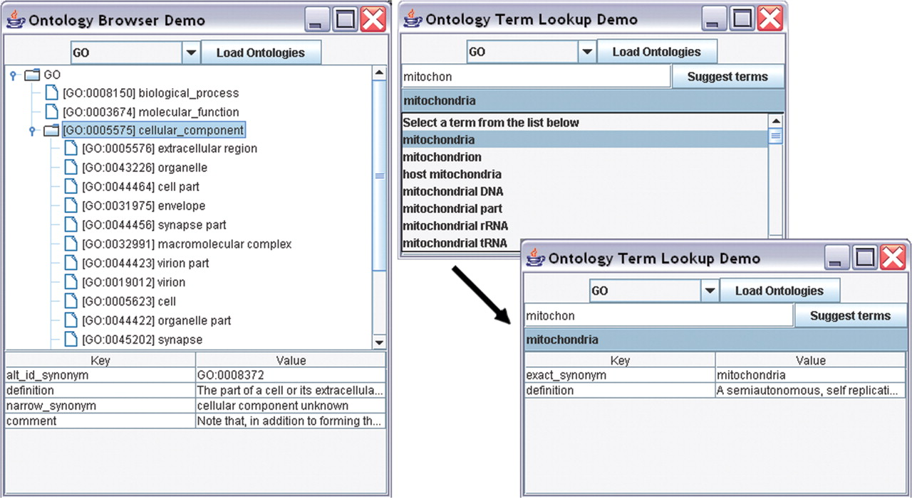
Figure 3. Two Java applications using the SOAP interface. An ontology browser demo application and a term search demo ...
Notes:
Figure 3. Two Java applications using the SOAP interface. An ontology browser demo application and a term search demo application can be downloaded from the OLS website to illustrate the ease with which OLS functionality can be integrated within existing applications.
Unless provided in the caption above, the following copyright applies to the content of this slide: © 2008 The Author(s)This is an Open Access article distributed under the terms of the Creative Commons Attribution Non-Commercial License (http://creativecommons.org/licenses/by-nc/2.0/uk/) which permits unrestricted non-commercial use, distribution, and reproduction in any medium, provided the original work is properly cited.

