Slide 1
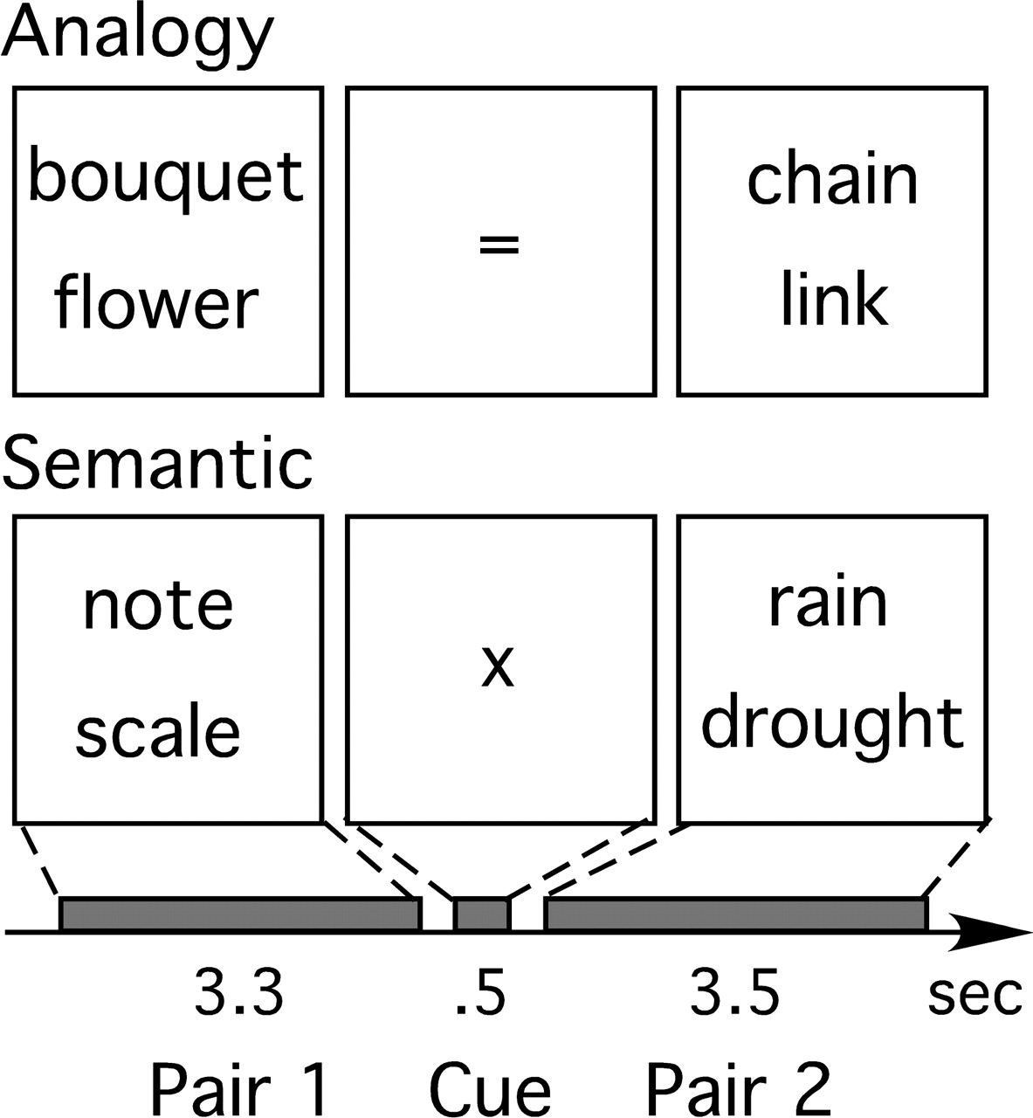
Figure 1. Shown here is the trial structure for the analogy and semantic tasks. For both tasks, subjects were ...
Notes:
Figure 1. Shown here is the trial structure for the analogy and semantic tasks. For both tasks, subjects were instructed to determine how the words in pair 1 are related to one another. On analogy trials, cued by a ‘=’, they were then instructed to evaluate whether the words in pair 2 are related to one another along the same dimension as the words in pair 1. On semantic trials, cued by a ‘x’, subjects were then instructed to determine whether the words in pair 2 are related to one another along any dimension.
Unless provided in the caption above, the following copyright applies to the content of this slide: Cerebral Cortex V 15 N 3 © Oxford University Press 2004; all rights reserved

Slide 2
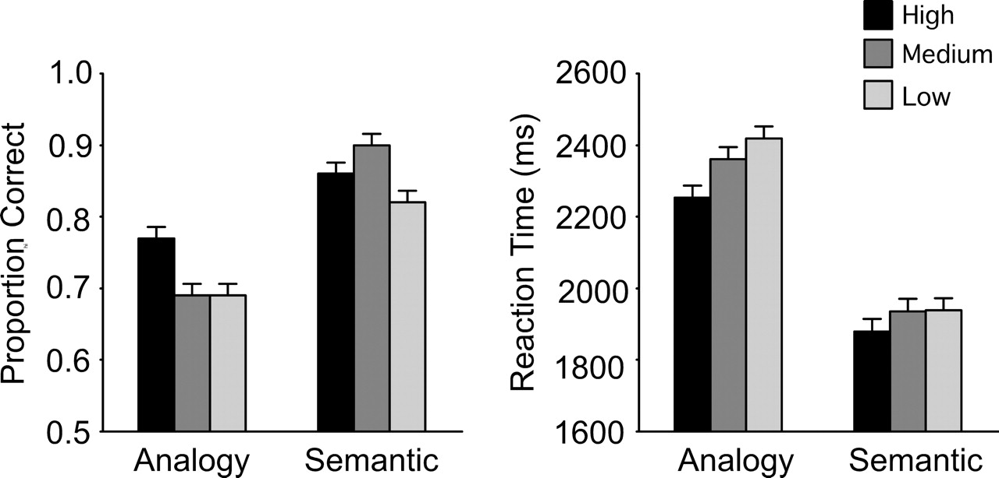
Figure 2. Group-averaged behavioral performance is plotted separately for Task and Associative Strength manipulations. ...
Notes:
Figure 2. Group-averaged behavioral performance is plotted separately for Task and Associative Strength manipulations. Error bars depict within-subject SE.
Unless provided in the caption above, the following copyright applies to the content of this slide: Cerebral Cortex V 15 N 3 © Oxford University Press 2004; all rights reserved

Slide 3
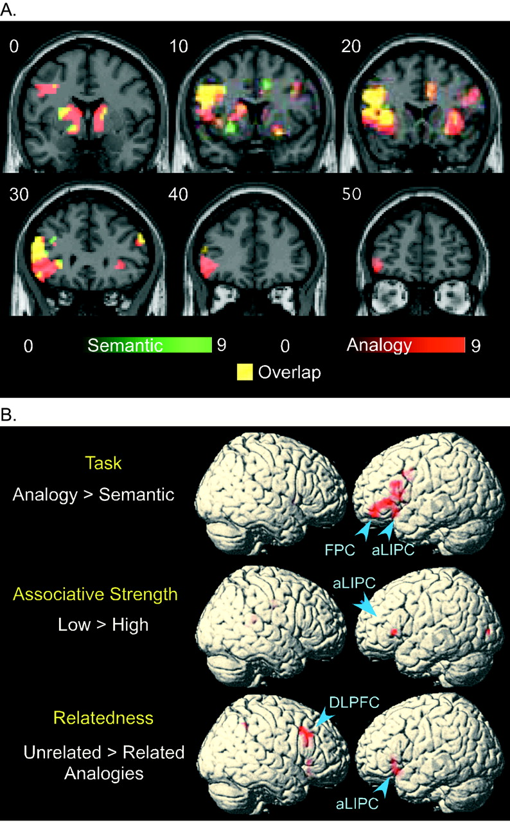
Figure 3. Group-averaged activations for contrasts of interest are displayed. (A) Coronal slices through a canonical ...
Notes:
Figure 3. Group-averaged activations for contrasts of interest are displayed. (A) Coronal slices through a canonical brain display regions activated by analogy and semantic trials relative to fixation. Areas of overlap between the two contrast maps appear yellow. (B) Shown here on a rendered canonical brain are regions activated to a greater extent by analogy relative to semantic trials, by low relative to high Associative Strength trials, and by unrelated- relative to related-analogy trials.
Unless provided in the caption above, the following copyright applies to the content of this slide: Cerebral Cortex V 15 N 3 © Oxford University Press 2004; all rights reserved

Slide 4
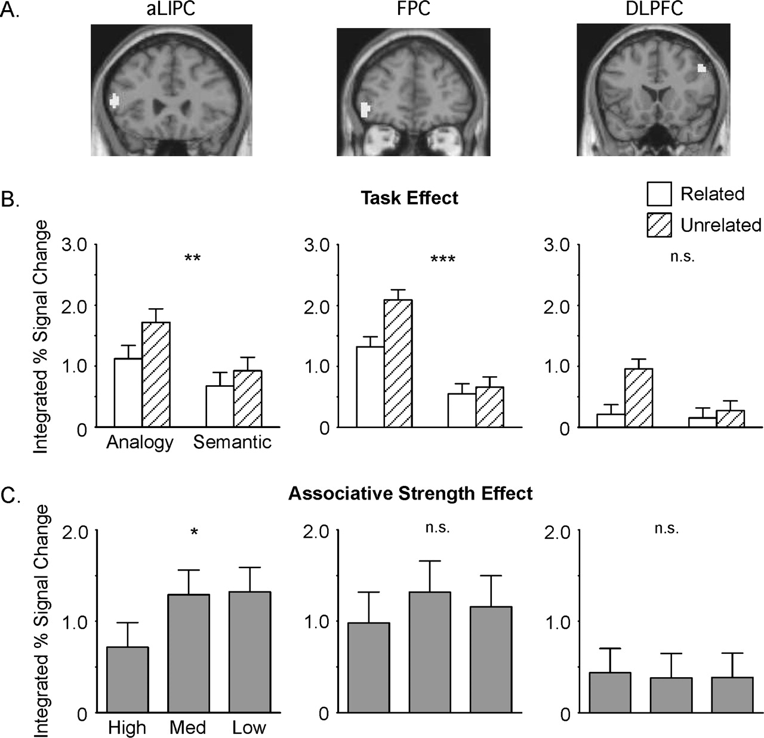
Figure 4. Shown here is the activation profile of three ROIs in PFC. (A) The ROIs in aLIPC (centered on coordinates of ...
Notes:
Figure 4. Shown here is the activation profile of three ROIs in PFC. (A) The ROIs in aLIPC (centered on coordinates of −57, 27, 12), left FPC (−45, 45, −6) and right DLPFC (51, 18, 39) are plotted here on a canonical brain. (B) These bar graphs display the Task effects for the three ROIs. The effect of task was greater in FPC than in aLIPC, and was not significant in DLPFC. (C) These bar graphs depict the Associative Strength effects for the three ROIs. Only aLIPC was significantly modulated by Associative Strength. *P < 0.05, **P < 0.001, ***P < 0.0001.
Unless provided in the caption above, the following copyright applies to the content of this slide: Cerebral Cortex V 15 N 3 © Oxford University Press 2004; all rights reserved

