Slide 1
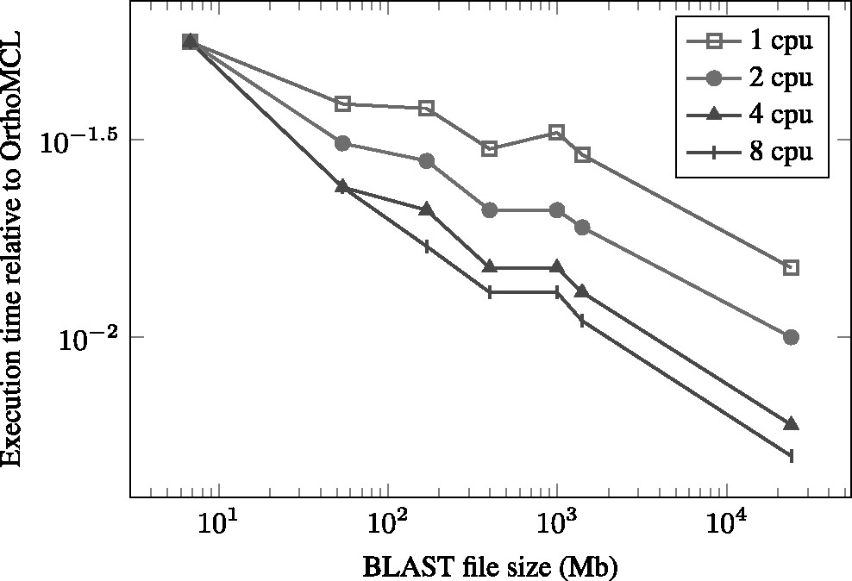
Fig. 1. Benchmarking of OrthAgogue and OrthoMCL using the imput BLAST files ranging from 6.8 MB to 24 GB. The ...
Notes:
Fig. 1. Benchmarking of OrthAgogue and OrthoMCL using the imput BLAST files ranging from 6.8 MB to 24 GB. The performance of OrthAgogue is expressed as a fraction of the processing time of OrthoMCL. The number of Central Processing Units (CPU) used is indicated in the top right corner
Unless provided in the caption above, the following copyright applies to the content of this slide: © The Author 2013. Published by Oxford University Press. All rights reserved. For Permissions, please e-mail: journals.permissions@oup.com

