Slide 1
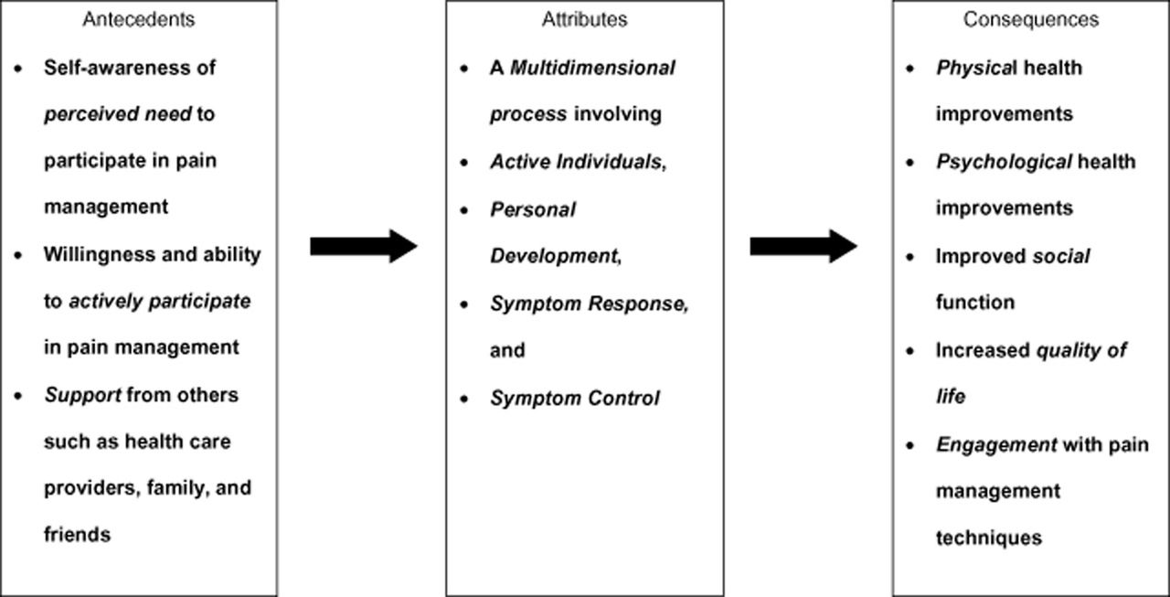
Figure 1 Diagram illustrating the antecedents, attributes, and consequences of older adults' self-management of ...
Notes:
Figure 1 Diagram illustrating the antecedents, attributes, and consequences of older adults' self-management of persistent pain.
Unless provided in the caption above, the following copyright applies to the content of this slide: © 2014 American Academy of Pain Medicine

