Slide 1
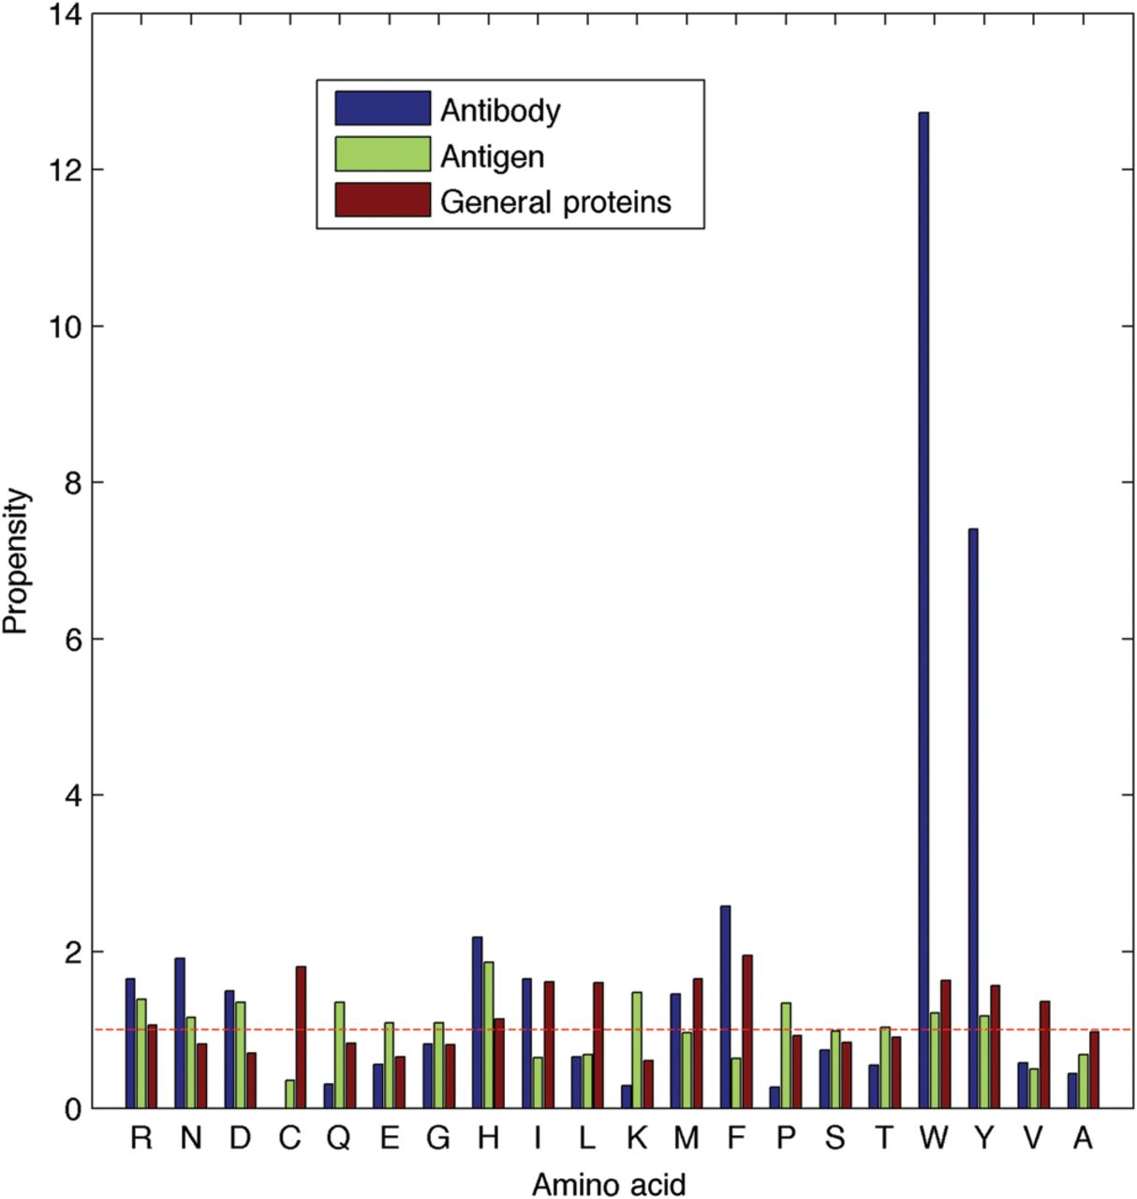
Fig. 1. Binding propensity differences between antibody, antigen and general proteins. Binding propensities of each ...
Notes:
Fig. 1. Binding propensity differences between antibody, antigen and general proteins. Binding propensities of each residue type were calculated for antibodies and antigens. Values above ‘1’ indicate a preference to be in contact while those below ‘1’ correspond to a preference not to be in contact (red line in the figure above; for full details of how propensity was calculated please see the Supplementary Information). These propensities are contrasted to those of other proteins reported by the authors of i-Patch (Hamer et al., 2010). Antibodies appear to have radically different binding preferences from antigens and general proteins.
Unless provided in the caption above, the following copyright applies to the content of this slide: © The Author 2013. Published by Oxford University Press. All rights reserved. For Permissions, please e-mail: journals.permissions@oup.com

Slide 2
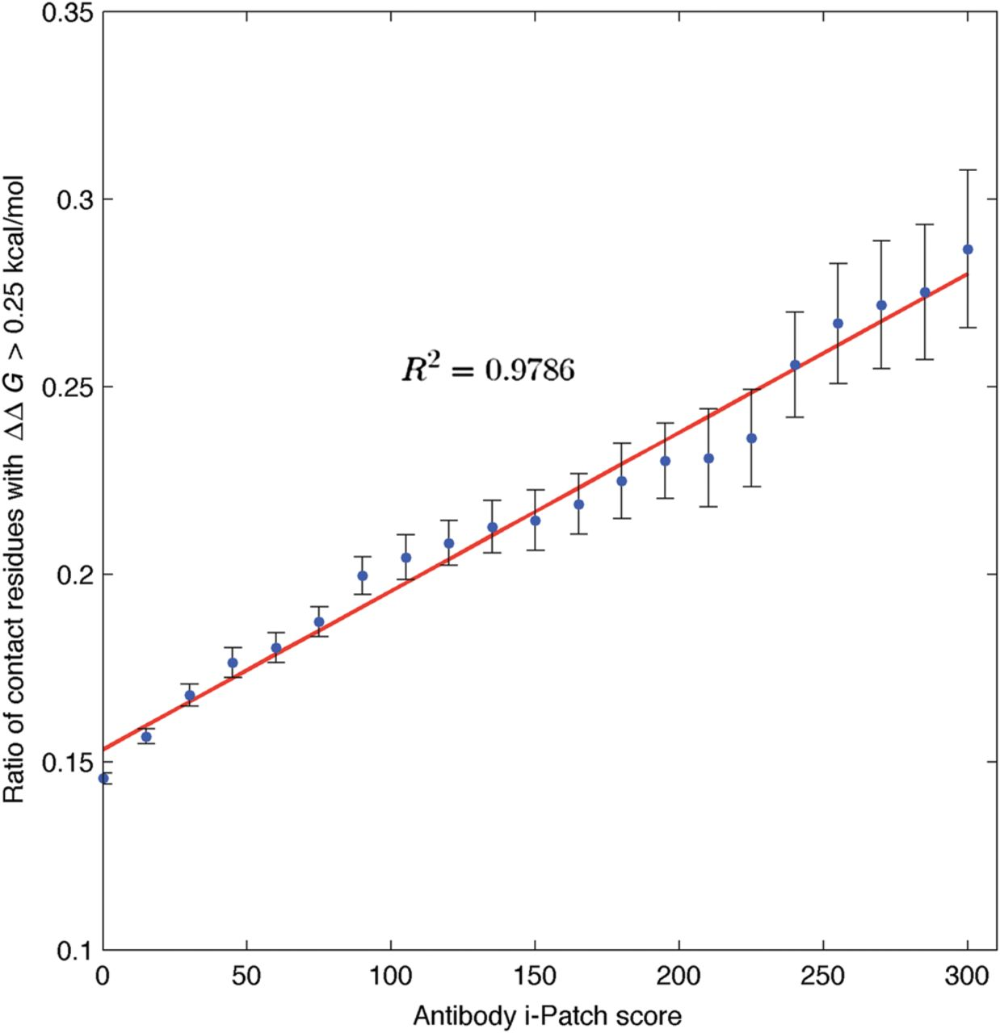
Fig. 3. The energetic importance of antibody–antigen contact residues is correlated with the Antibody i-Patch score. ...
Notes:
Fig. 3. The energetic importance of antibody–antigen contact residues is correlated with the Antibody i-Patch score. The number of contact residues with an Antibody i-Patch score greater than a cut-off which lead to a ΔΔG > 0.25 kcal/mol when mutated to alanine compared with the number of contact residues in general that lead to a ΔΔG > 0.25 kcal/mol when mutated to alanine. As the Antibody i-Patch score cut-off is increased, the ratio of residues which cause an energetic change upon alanine mutation increases. In other words, residues with a high Antibody i-Patch score tend to be energetically more important.
Unless provided in the caption above, the following copyright applies to the content of this slide: © The Author 2013. Published by Oxford University Press. All rights reserved. For Permissions, please e-mail: journals.permissions@oup.com

Slide 3
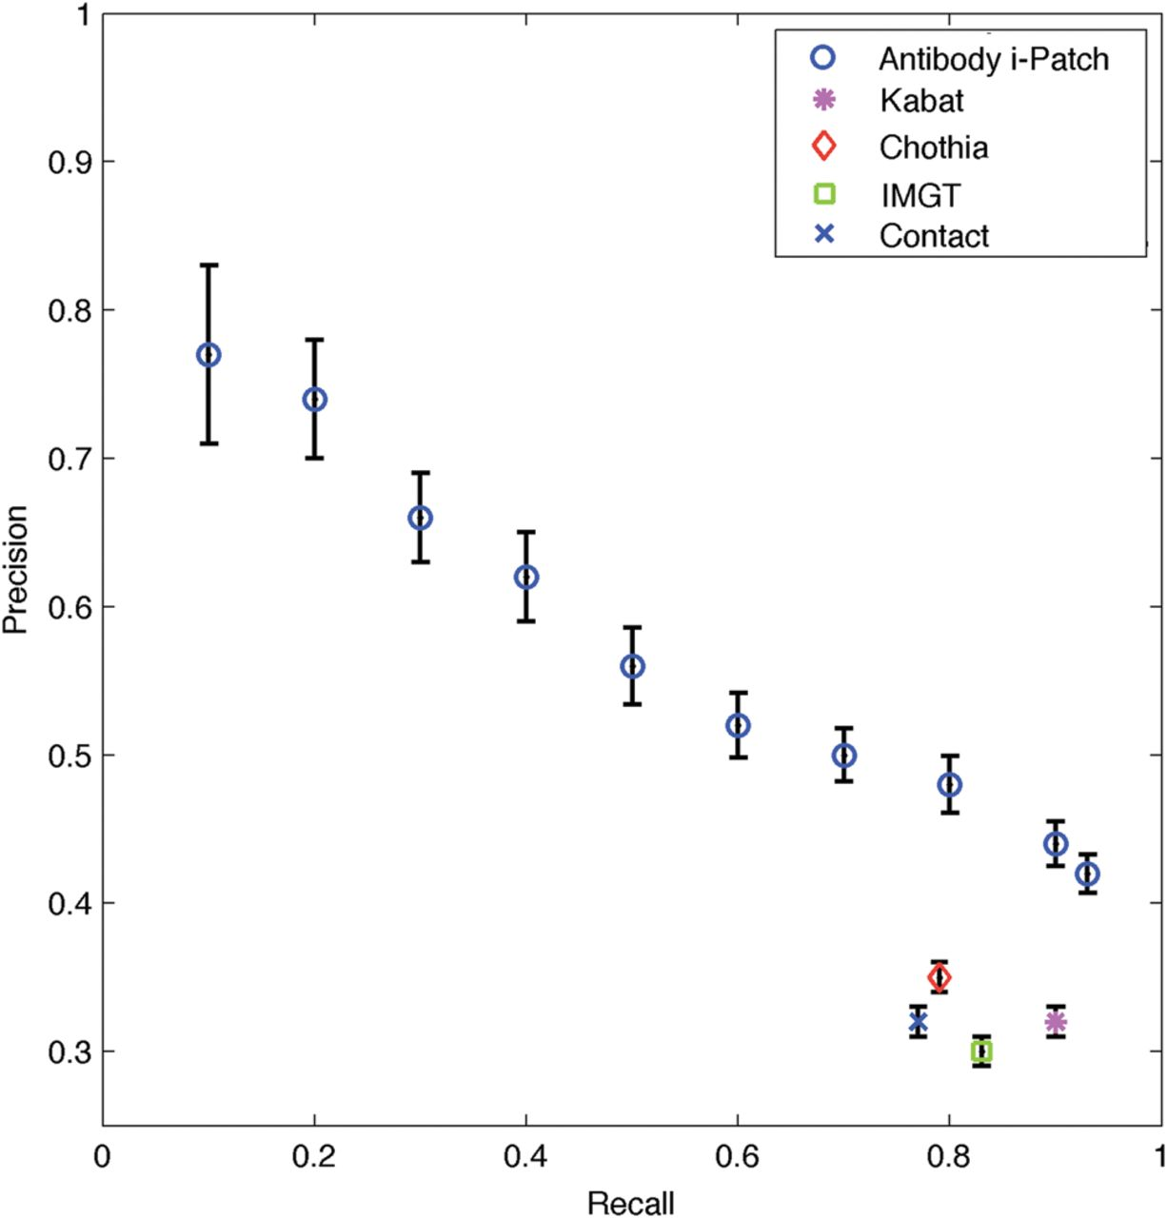
Fig. 2. P-ROC plot of Antibody i-Patch results averaged over 2000 runs. Comparison of the performance of Antibody ...
Notes:
Fig. 2. P-ROC plot of Antibody i-Patch results averaged over 2000 runs. Comparison of the performance of Antibody i-Patch with static antibody-binding site annotation methods for the contact distance of 4.5 Å. Standard error is shown for the values of precision, (recall errors can be found in the Supplementary Information). In contrast to the static antibody-binding site annotation methods of Kabat, Chothia, Contact and the International Immunogenetics Information System (IMGT), Antibody i-Patch produces results for a wide spectrum of precision and recall values. As all the residues outside the window of IMGT definition augmented with two framework residues on either side are considered to be non-binding, the recall starts at 0.93. If the original IMGT definition had been used the same graph would be truncated to the point corresponding to that of IMGT, i.e. recall of 0.83.
Unless provided in the caption above, the following copyright applies to the content of this slide: © The Author 2013. Published by Oxford University Press. All rights reserved. For Permissions, please e-mail: journals.permissions@oup.com

Slide 4
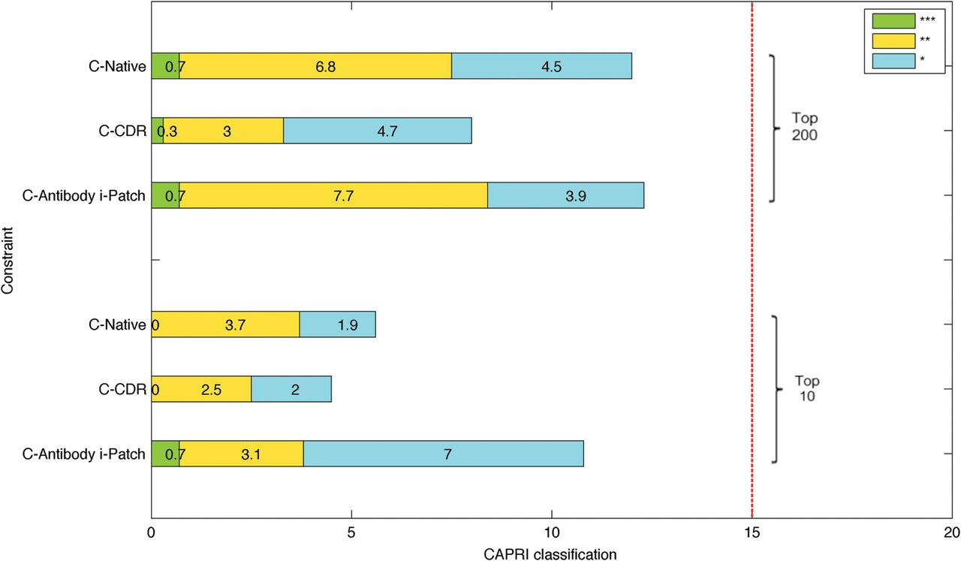
Fig. 5. Results from running our docking pipeline on the test dataset of homology models docking targets SnugDock-H. ...
Notes:
Fig. 5. Results from running our docking pipeline on the test dataset of homology models docking targets SnugDock-H. The results are the averages of the three element vectors given by the CAPRI classification into three quality groups: satisfying (*), medium (**) or good (***) quality. The individual three element vectors were collected over 20 runs of the pipeline on the dataset SnugDock-H. The standard deviations are given in the Supplementary Information.
Unless provided in the caption above, the following copyright applies to the content of this slide: © The Author 2013. Published by Oxford University Press. All rights reserved. For Permissions, please e-mail: journals.permissions@oup.com

Slide 5
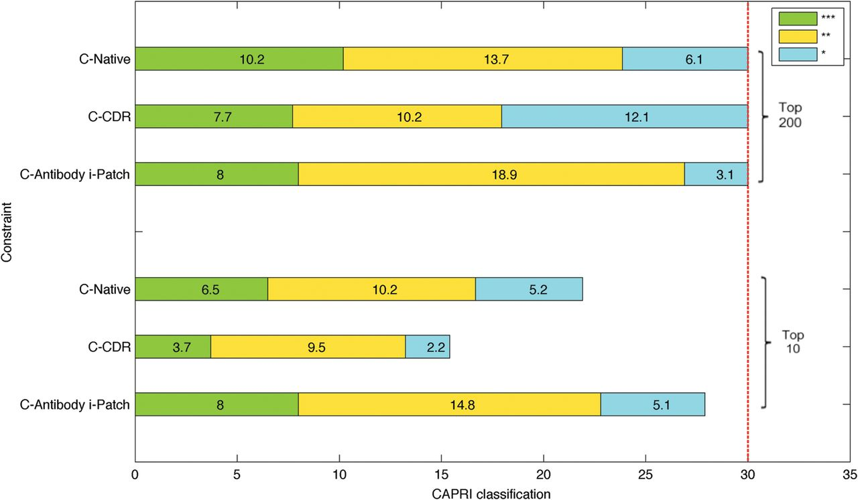
Fig. 4. Results from running our docking pipeline on the test dataset of crystal structures docking targets ...
Notes:
Fig. 4. Results from running our docking pipeline on the test dataset of crystal structures docking targets NR-subset. The results are the averages of the three element vectors given by the CAPRI classification into three quality groups: satisfying (*), medium (**) or good (***) quality. The individual three element vectors were collected over 20 runs of the pipeline on the dataset NR-subset. The standard deviations are given in the Supplementary Information.
Unless provided in the caption above, the following copyright applies to the content of this slide: © The Author 2013. Published by Oxford University Press. All rights reserved. For Permissions, please e-mail: journals.permissions@oup.com

