Slide 1
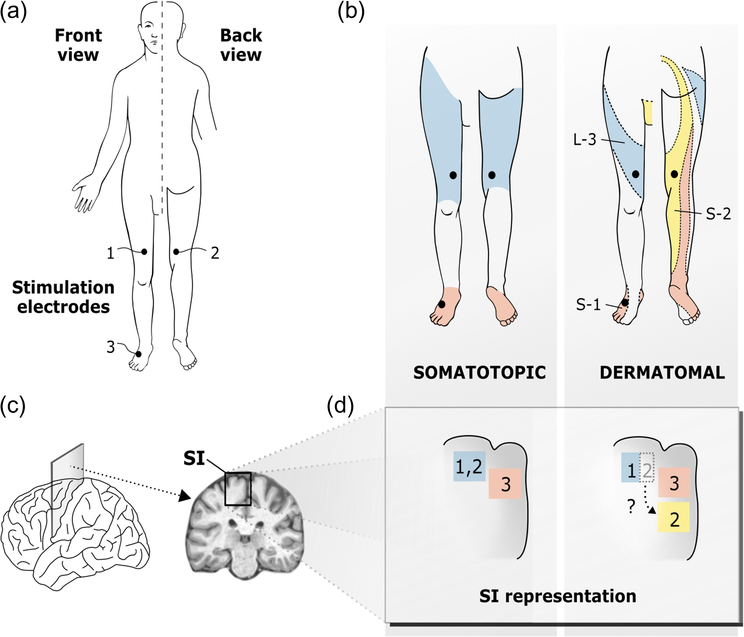
Figure 1. Somatotopic versus dermatomal organization within the primary somatosensory cortex (SI). (a) Positions of the ...
Notes:
Figure 1. Somatotopic versus dermatomal organization within the primary somatosensory cortex (SI). (a) Positions of the stimulation electrodes: 1) front of the right thigh (preaxial), 2) back of the right thigh (postaxial), 3) dorsum of the right foot. (b) Left panel relates positions of electrodes to a somatotopic organization of SI. Somatotopic representation places back and front of the thigh (blue) at the same site in SI (blue) and distinct from the foot's representation (red). Right panel relates positions of electrodes to a dermatomal organization of SI: colored stripes indicate stimulated dermatomes: L-3 (blue), S-1 (red), S-2 (yellow). (c) Section plane through the central sulcus. (d) Schematic zoom section through the postcentral region illustrating the SI representation of the lower limb according to a somatotopic (left) and a dermatomal (right) organization.
Unless provided in the caption above, the following copyright applies to the content of this slide: © The Author 2017. Published by Oxford University Press. All rights reserved. For Permissions, please e-mail: journals.permissions@oup.com

Slide 2
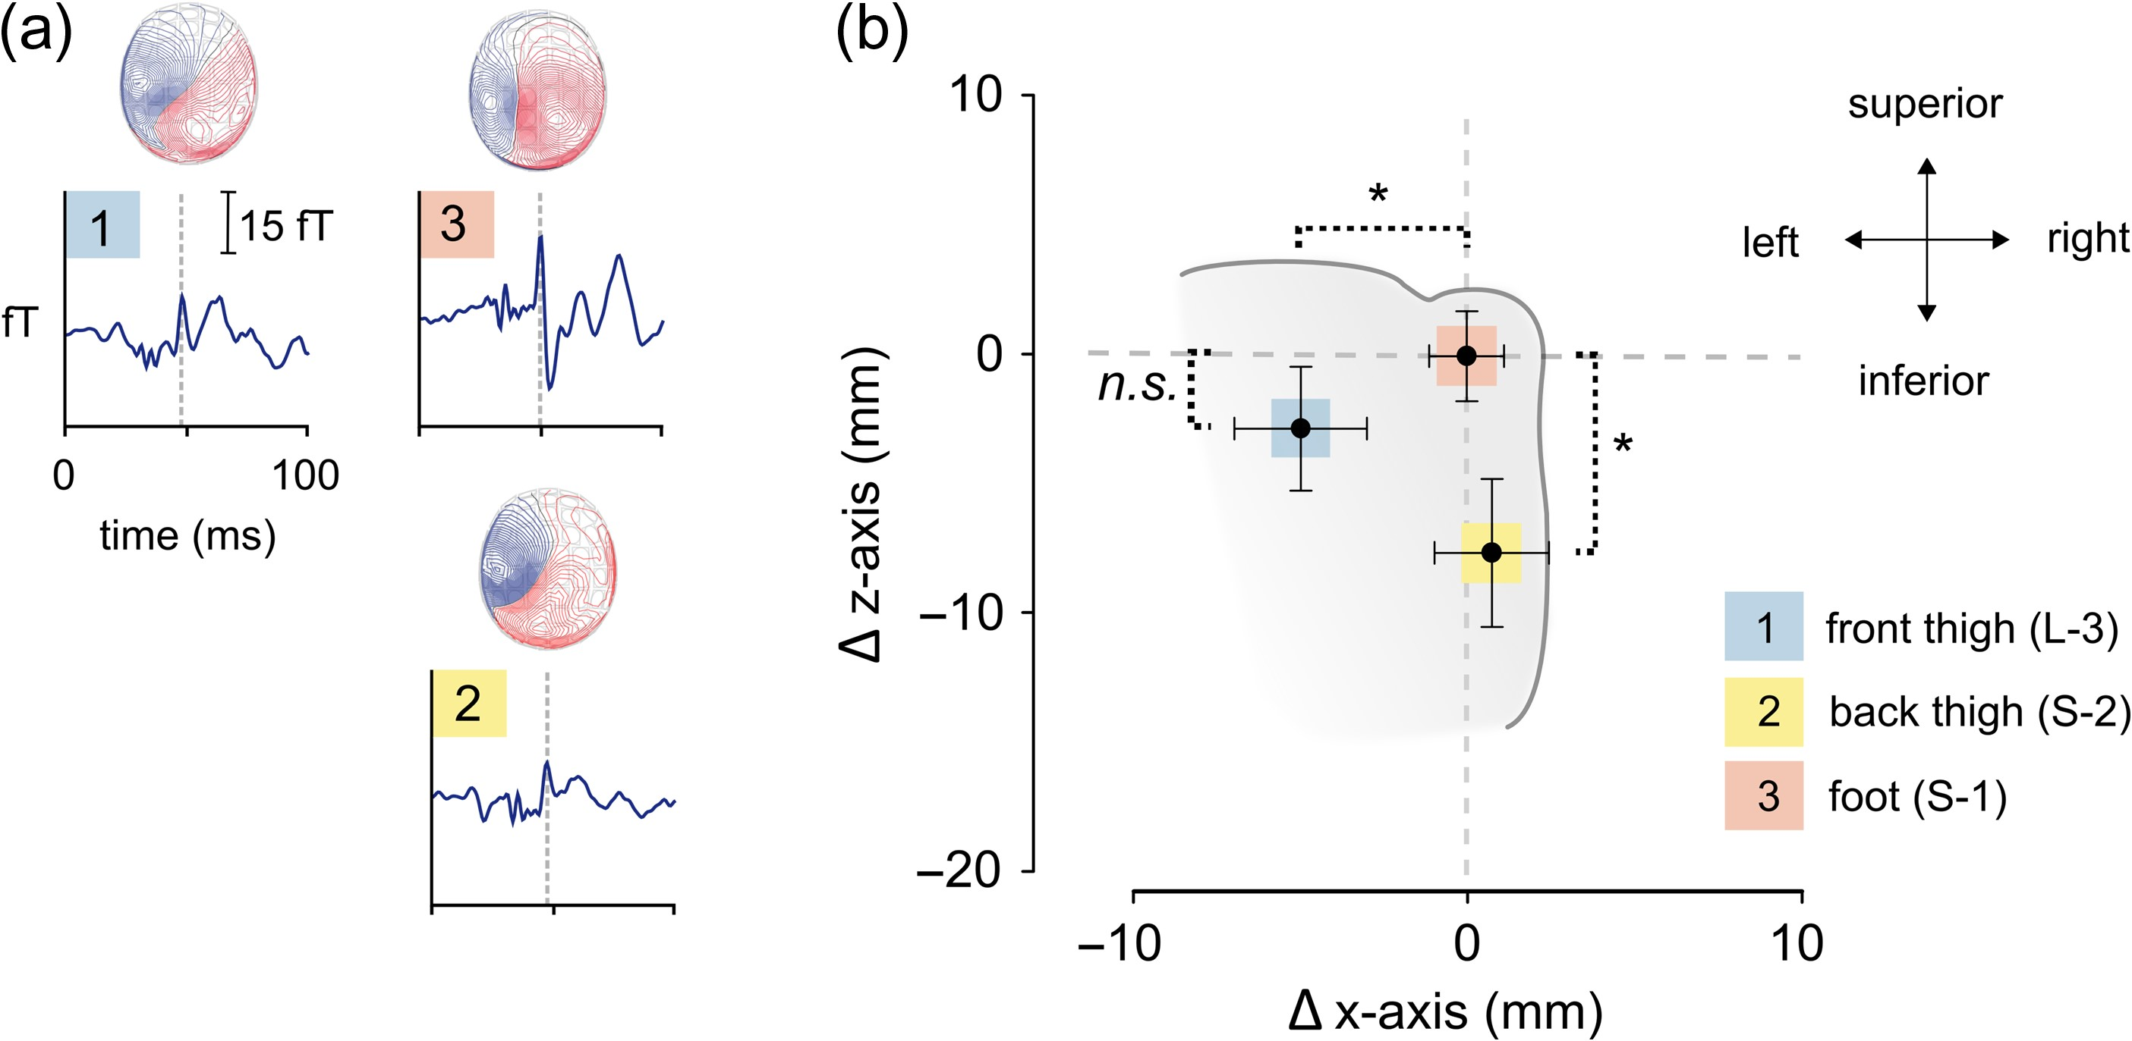
Figure 2. Somatosensory-evoked fields and dipole locations for each stimulation site. (a) Characteristic MEG ...
Notes:
Figure 2. Somatosensory-evoked fields and dipole locations for each stimulation site. (a) Characteristic MEG deflections of one representative subject for each site of stimulation (dermatome) at a left-central planar gradiometer (0.742) and corresponding maps of magnetic flux density: blue box 1, front thigh (L-3); yellow box 2, back thigh (S-2); red box 3, foot (S-1). (b) Group mean dipole locations (black circles) relative to S-1 (Δx-axis, Δz-axis), and bidirectional error bars (standard error of mean in x- and z-direction) for each stimulation site in coronal view (n = 17). The gray colored background schematically represents the parasagittal zone. The z-axis indicates inferior–superior direction. The x-axis is spanned from the left ear toward the right ear. The ECDs are located in the left hemisphere contralateral to the stimulation site.
Unless provided in the caption above, the following copyright applies to the content of this slide: © The Author 2017. Published by Oxford University Press. All rights reserved. For Permissions, please e-mail: journals.permissions@oup.com

Slide 3
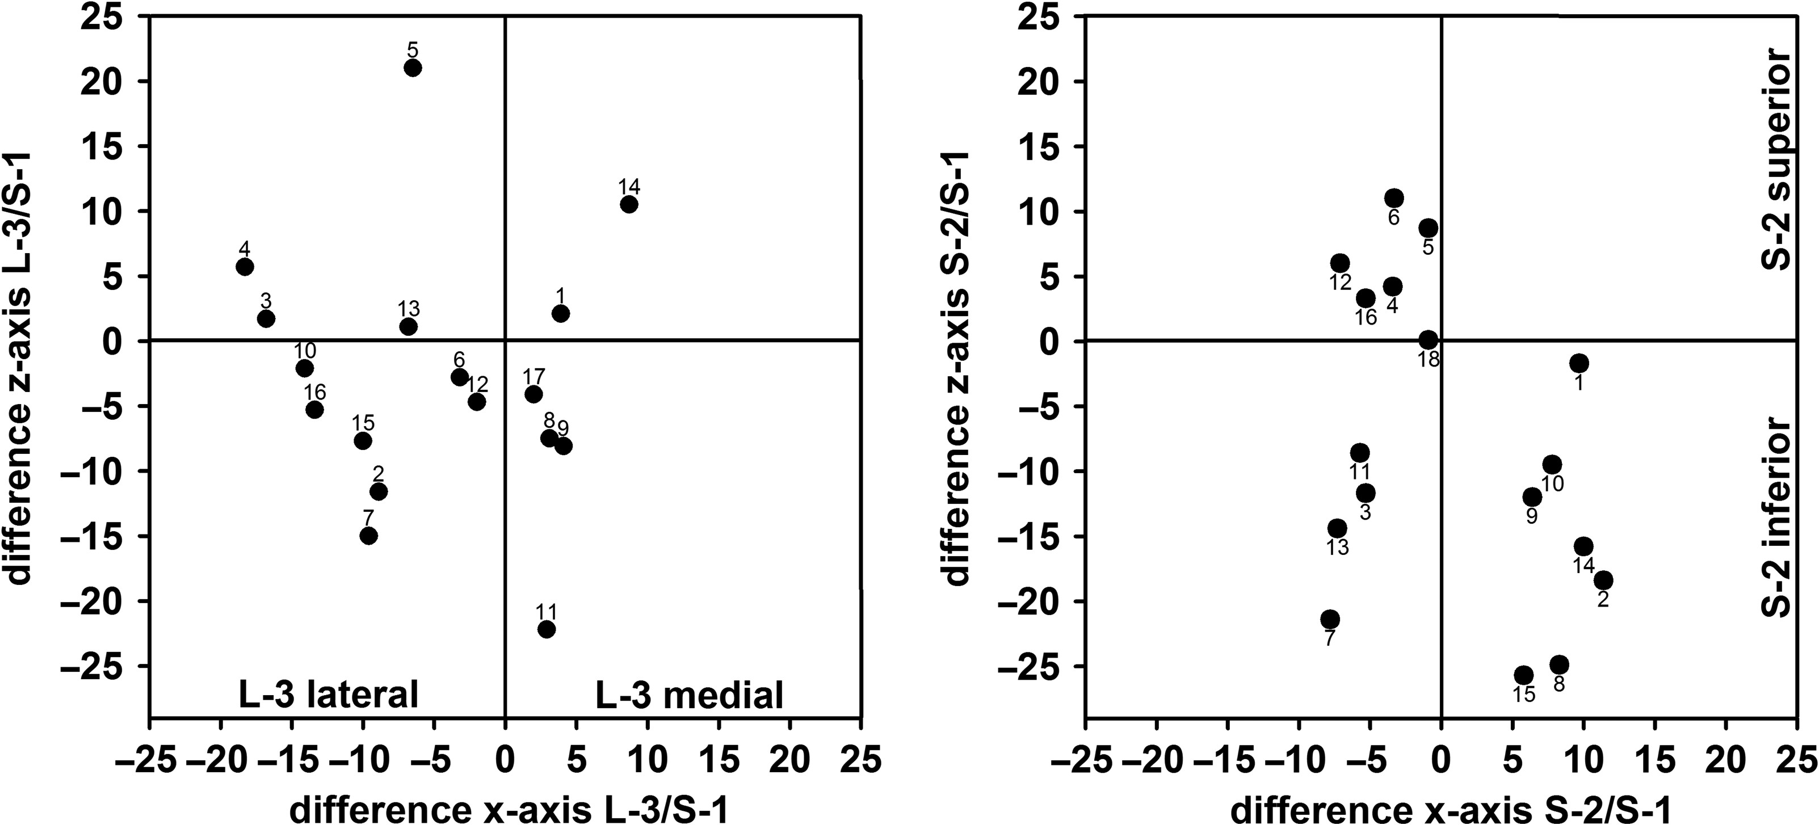
Figure 3. ECD locations of thigh stimulation (L-3/S-2) relative to foot (S-1): (left panel) ECDs of single subjects for ...
Notes:
Figure 3. ECD locations of thigh stimulation (L-3/S-2) relative to foot (S-1): (left panel) ECDs of single subjects for L-3/S-1 stimulation in coronary view. The y-axis shows the position of L-3 relative to S-1 in inferior–superior direction. The reference line (y = 0) indicates zL-3 = zS-1. The x-axis shows the position of L-3 relative to S-1 in lateral–medial direction for the same subjects. The reference line (x = 0) indicates xL-3 = xS-1. (right panel) ECDs of single subjects for S-2/S-1 stimulation in coronary view. The y-axis shows the position of S-2 relative to S-1 in inferior–superior direction. The reference line (y = 0) indicates zS-2 = zS-1. The x-axis shows the position of S-2 relative to S-1 in lateral–medial direction for the same subjects. The reference line (x = 0) indicates xS-2 = xS-1.
Unless provided in the caption above, the following copyright applies to the content of this slide: © The Author 2017. Published by Oxford University Press. All rights reserved. For Permissions, please e-mail: journals.permissions@oup.com

