Slide 1
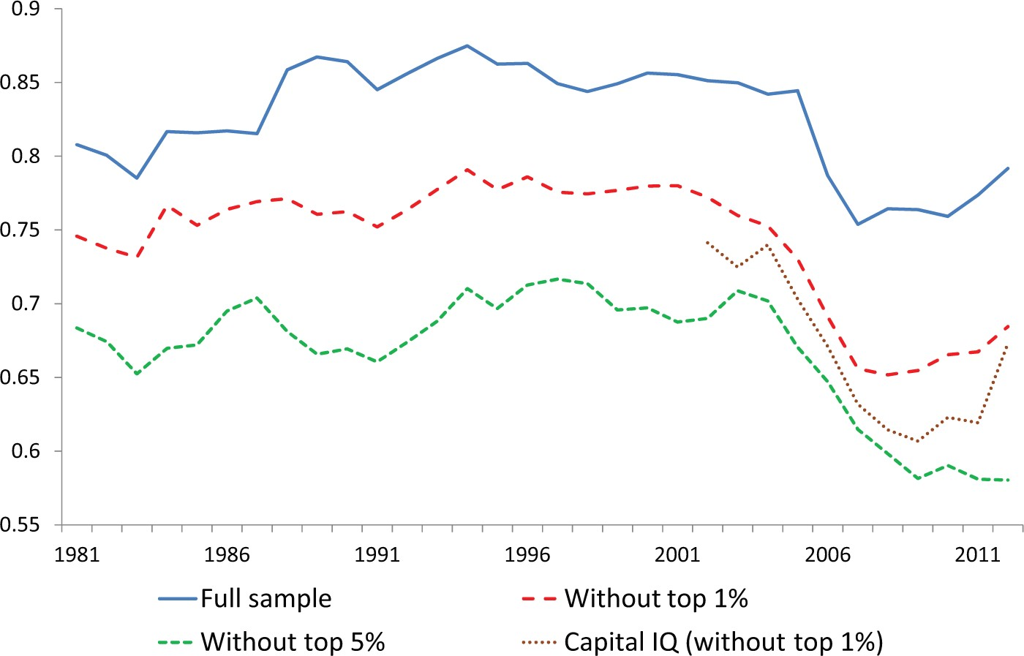
Figure 1 The share of unsecured debt in total debt for firms in Compustat and in Capital IQ
Notes:
Figure 1 The share of unsecured debt in total debt for firms in Compustat and in Capital IQ
Unless provided in the caption above, the following copyright applies to the content of this slide: © The Author 2016. Published by Oxford University Press on behalf of The Review of Economic Studies Limited.

Slide 2
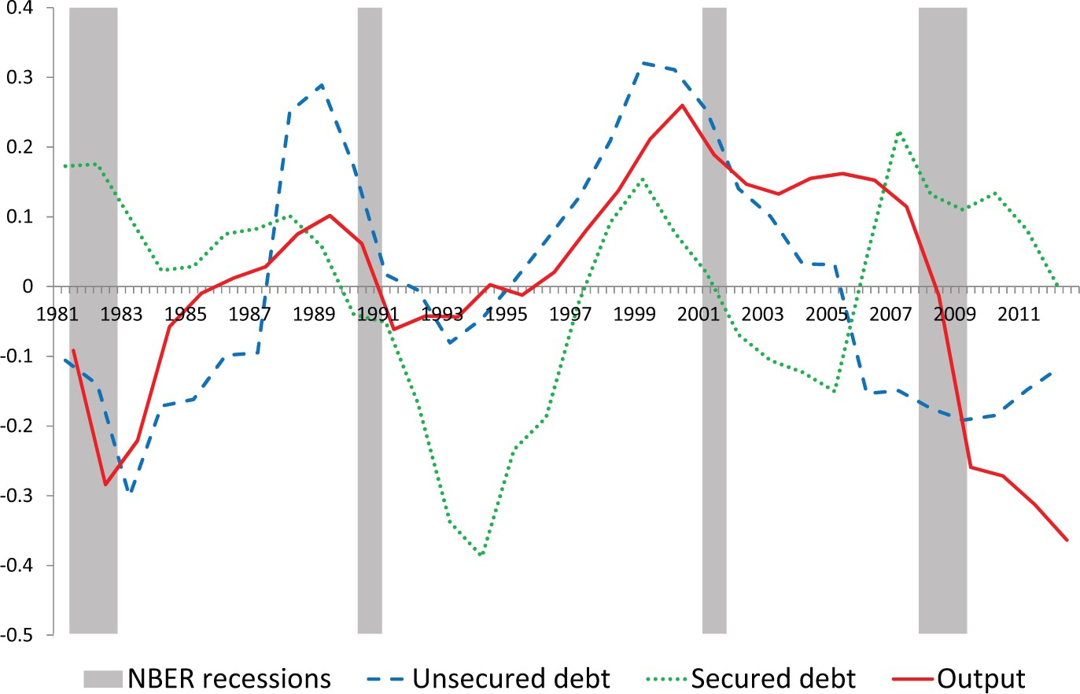
Figure 2 Unsecured and secured debt for Compustat firms, and GDP multiplied by factor four (annual linearly detrended ...
Notes:
Figure 2 Unsecured and secured debt for Compustat firms, and GDP multiplied by factor four (annual linearly detrended series, 1981–2012). Quarters with recessions as determined by the National Bureau of Economic Research (NBER) are in grey bars
Unless provided in the caption above, the following copyright applies to the content of this slide: © The Author 2016. Published by Oxford University Press on behalf of The Review of Economic Studies Limited.

Slide 3
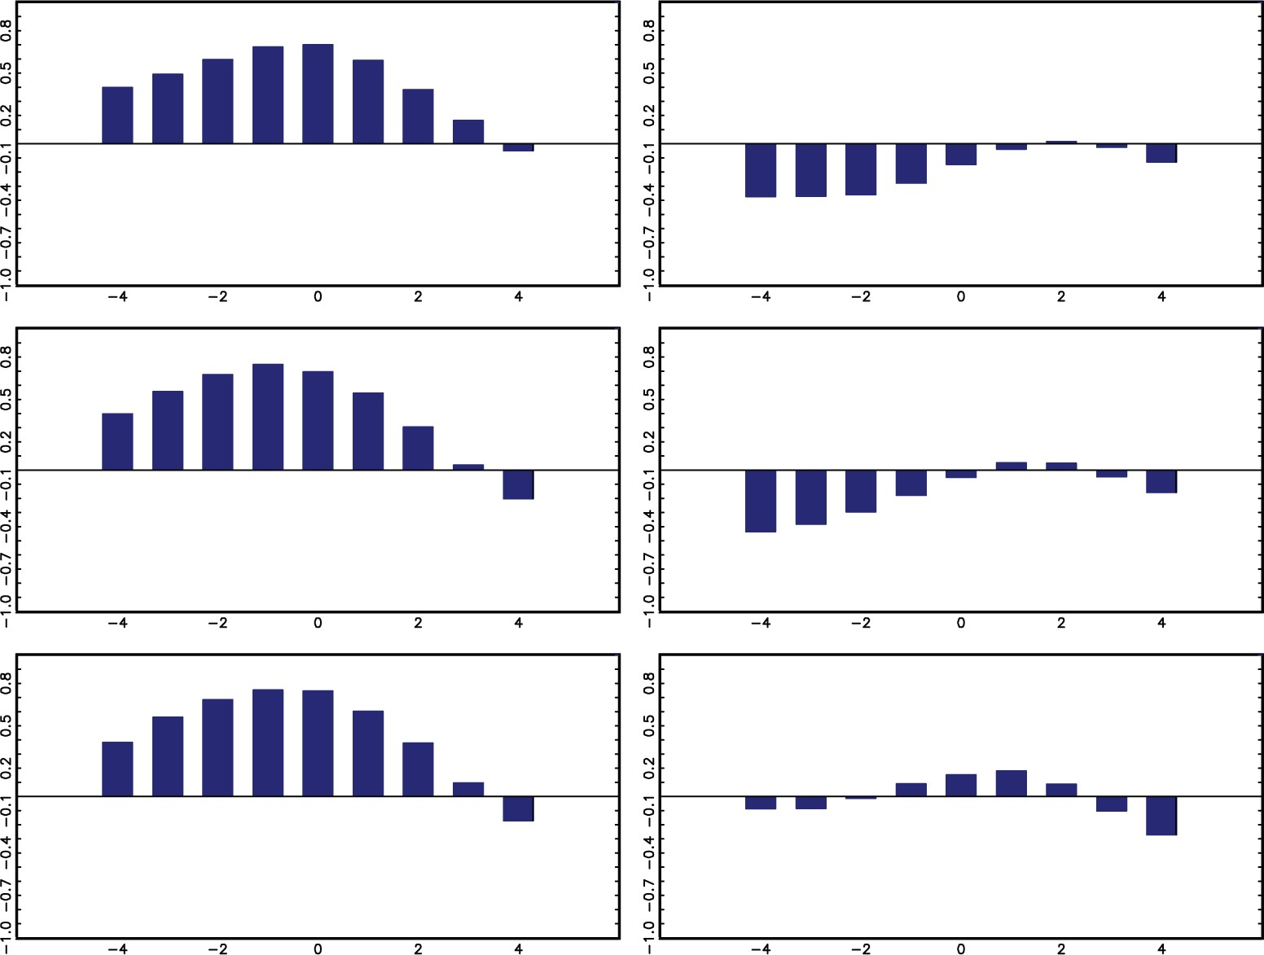
Figure 3 Correlations between GDP yt and debt category dt+j for j∈[−4,4] (left unsecured, right secured). The top ...
Notes:
Figure 3 Correlations between GDP yt and debt category dt+j for j∈[−4,4] (left unsecured, right secured). The top (middle, bottom) graphs are for the full (bottom 99%, bottom 95%) Compustat samples. All variables are deflated and linearly detrended
Unless provided in the caption above, the following copyright applies to the content of this slide: © The Author 2016. Published by Oxford University Press on behalf of The Review of Economic Studies Limited.

Slide 4
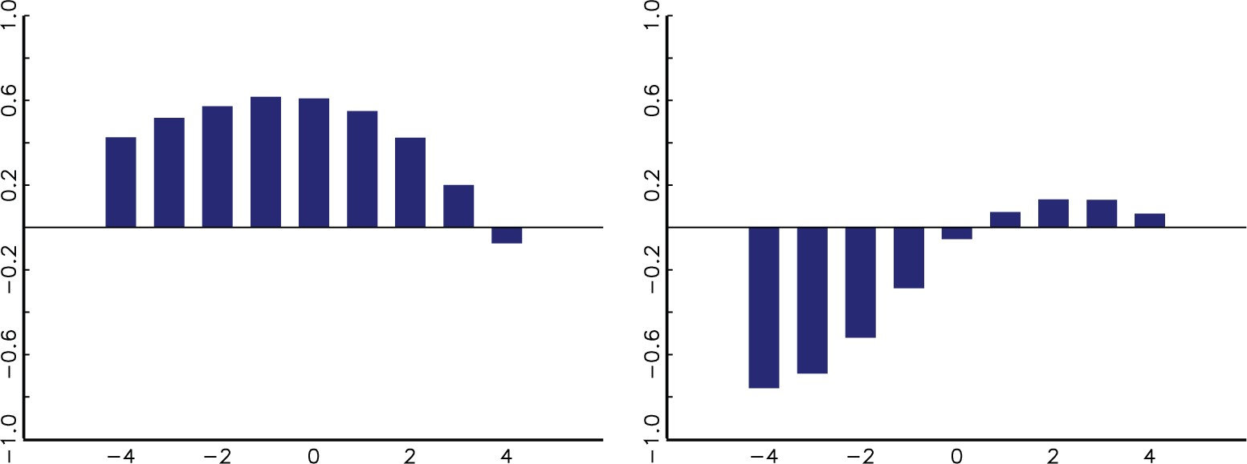
Figure 4 Correlations between GDP at year t and corporate bonds (left) and mortgages (right) at year t+j for ...
Notes:
Figure 4 Correlations between GDP at year t and corporate bonds (left) and mortgages (right) at year t+j for j∈[−4,4]
Unless provided in the caption above, the following copyright applies to the content of this slide: © The Author 2016. Published by Oxford University Press on behalf of The Review of Economic Studies Limited.

Slide 5
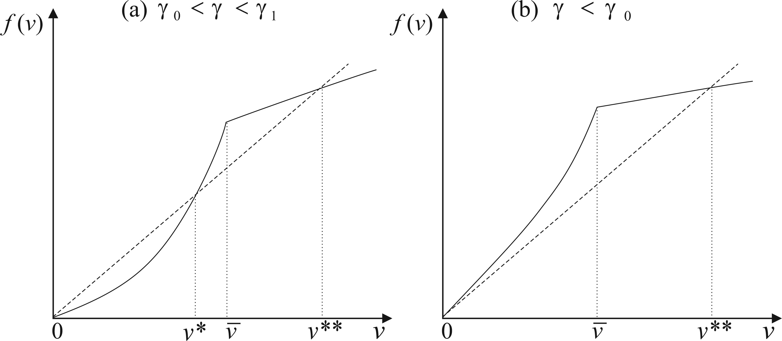
Figure 5 Steady states at v=0,v*,v** . (a) γ0<γ<γ1 ; (b) γ<γ0
Notes:
Figure 5 Steady states at v=0,v*,v** . (a) γ0<γ<γ1 ; (b) γ<γ0
Unless provided in the caption above, the following copyright applies to the content of this slide: © The Author 2016. Published by Oxford University Press on behalf of The Review of Economic Studies Limited.

Slide 6
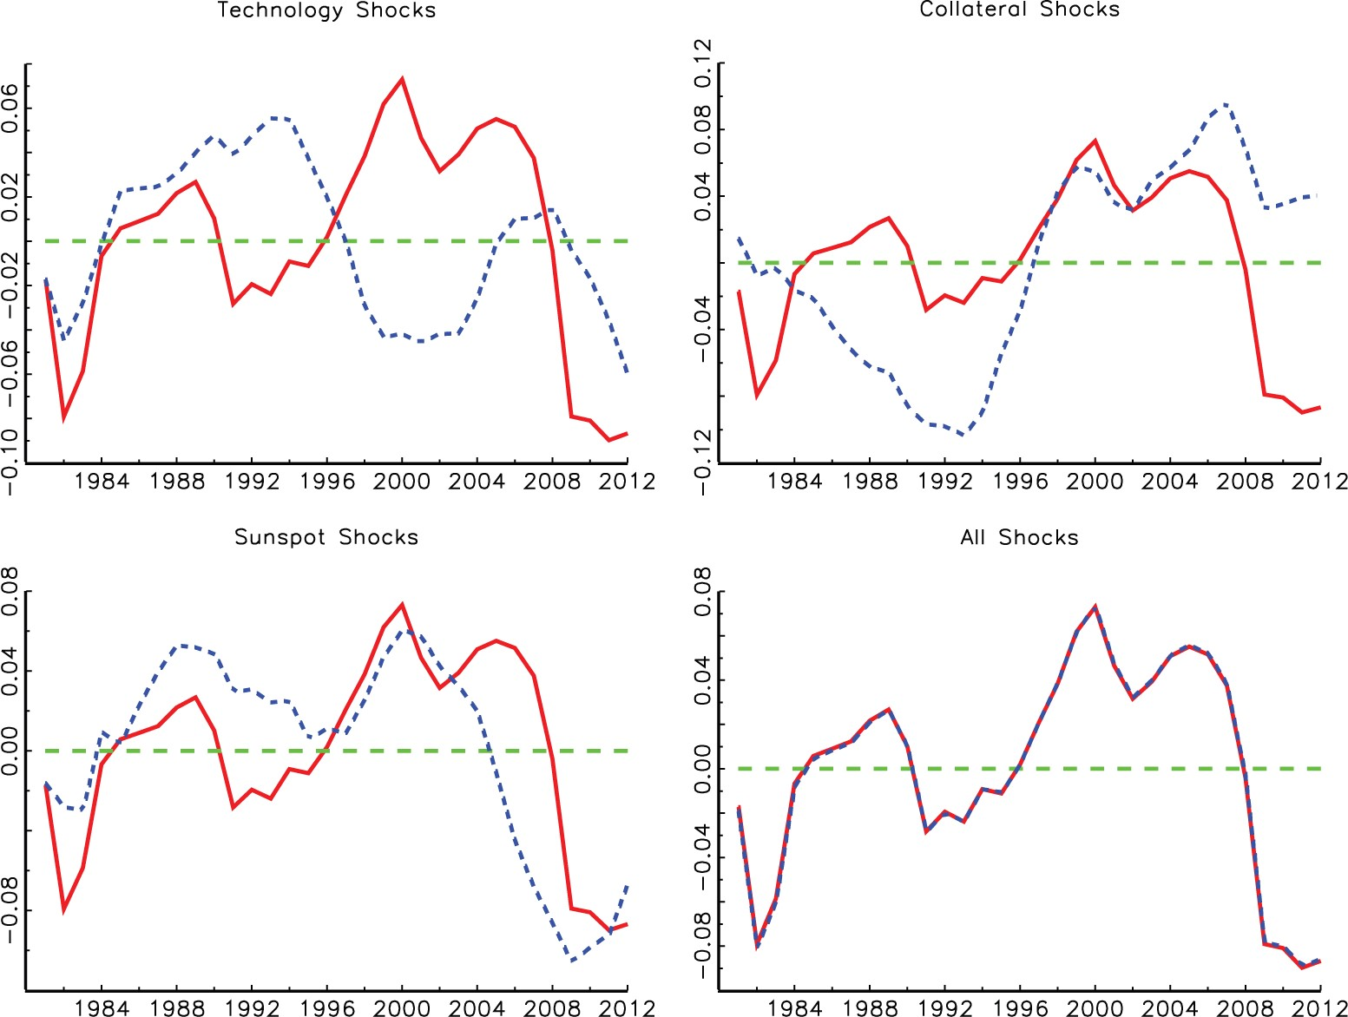
Figure 6 Decomposition of output in the three shocks. The solid curve is data output, and the dashed curves are ...
Notes:
Figure 6 Decomposition of output in the three shocks. The solid curve is data output, and the dashed curves are model-generated output dynamics if only one shock is active (first three graphs). In the bottom right graph, all three shocks are active
Unless provided in the caption above, the following copyright applies to the content of this slide: © The Author 2016. Published by Oxford University Press on behalf of The Review of Economic Studies Limited.

Slide 7
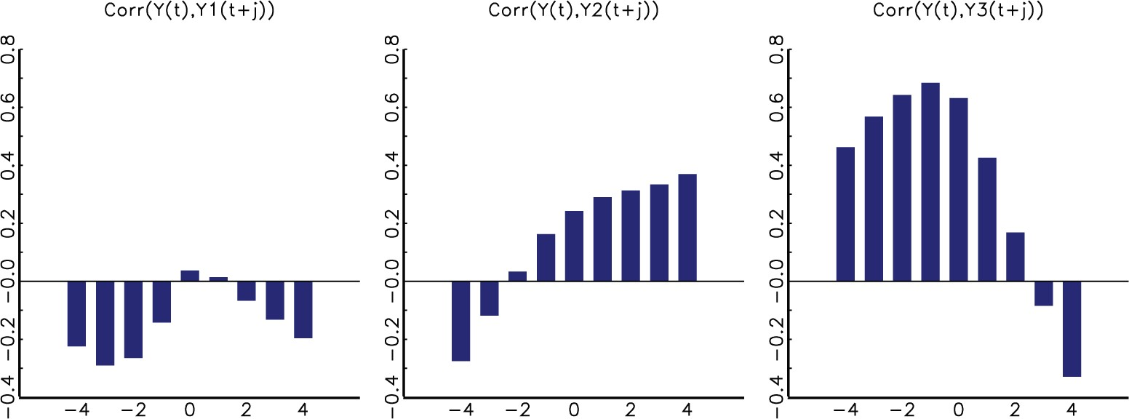
Figure 7 Lead–lag correlation between output Yˆt and the three shock components Yˆi,t+j , where i=1 is technology ...
Notes:
Figure 7 Lead–lag correlation between output Yˆt and the three shock components Yˆi,t+j , where i=1 is technology shocks, i=2 is collateral shocks, and i=3 is sunspot shocks
Unless provided in the caption above, the following copyright applies to the content of this slide: © The Author 2016. Published by Oxford University Press on behalf of The Review of Economic Studies Limited.

Slide 8
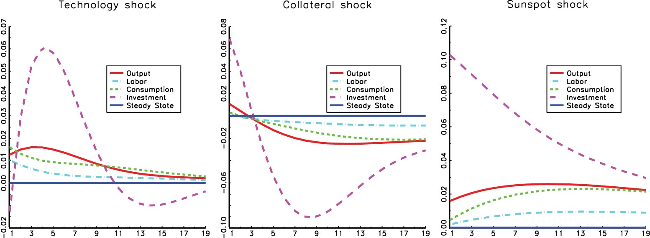
Figure 8 Impulse responses to the three shocks
Notes:
Figure 8 Impulse responses to the three shocks
Unless provided in the caption above, the following copyright applies to the content of this slide: © The Author 2016. Published by Oxford University Press on behalf of The Review of Economic Studies Limited.

Slide 9
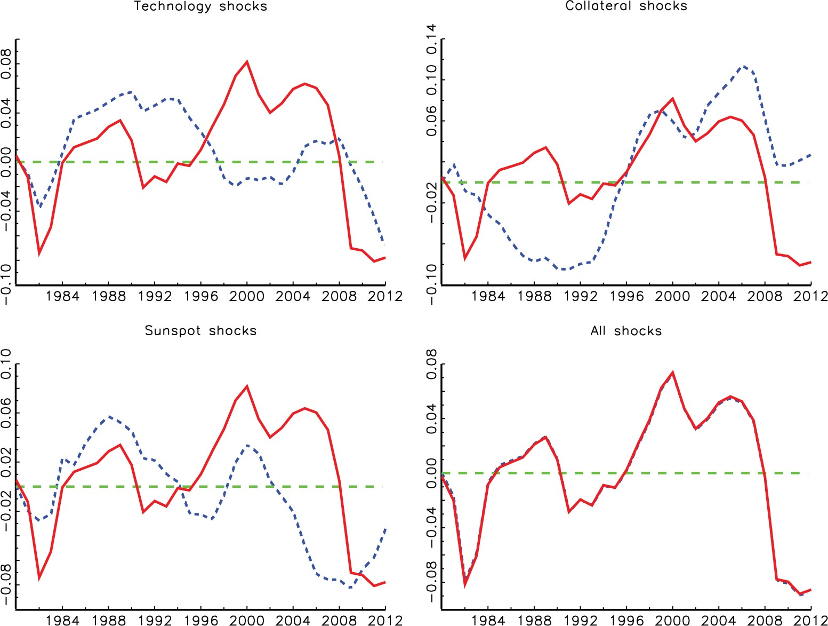
Figure 9 Decomposition of output in the three shocks for the model with autocorrelated firm-specific shocks. The solid ...
Notes:
Figure 9 Decomposition of output in the three shocks for the model with autocorrelated firm-specific shocks. The solid curve is data output, the dashed curves are model-generated output dynamics if only one shock is active (first three graphs). In the bottom right graph, all three shocks are active
Unless provided in the caption above, the following copyright applies to the content of this slide: © The Author 2016. Published by Oxford University Press on behalf of The Review of Economic Studies Limited.

Slide 10
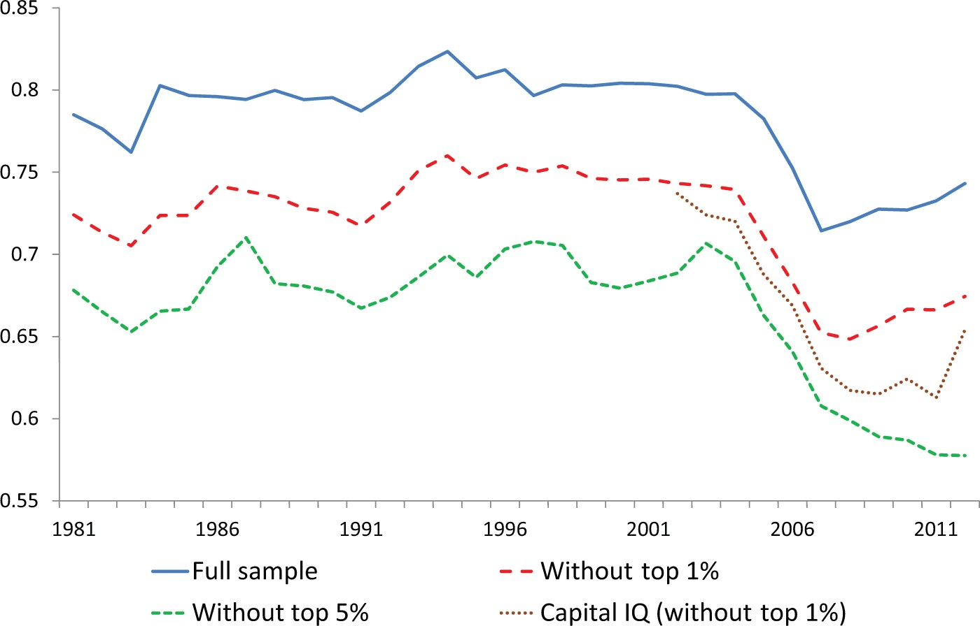
Figure A1 The share of unsecured debt in total debt for firms in Compustat and in Capital IQ (winsorized data)
Notes:
Figure A1 The share of unsecured debt in total debt for firms in Compustat and in Capital IQ (winsorized data)
Unless provided in the caption above, the following copyright applies to the content of this slide: © The Author 2016. Published by Oxford University Press on behalf of The Review of Economic Studies Limited.

Slide 11
Figure A2 Secured and unsecured debt for Compustat (full sample, without 1% and 5% of largest firms) and Capital IQ ...
Notes:
Figure A2 Secured and unsecured debt for Compustat (full sample, without 1% and 5% of largest firms) and Capital IQ (without 1% largest firms). All series are linearly detrended and are based on non-winsorized data
Unless provided in the caption above, the following copyright applies to the content of this slide: © The Author 2016. Published by Oxford University Press on behalf of The Review of Economic Studies Limited.

Slide 12
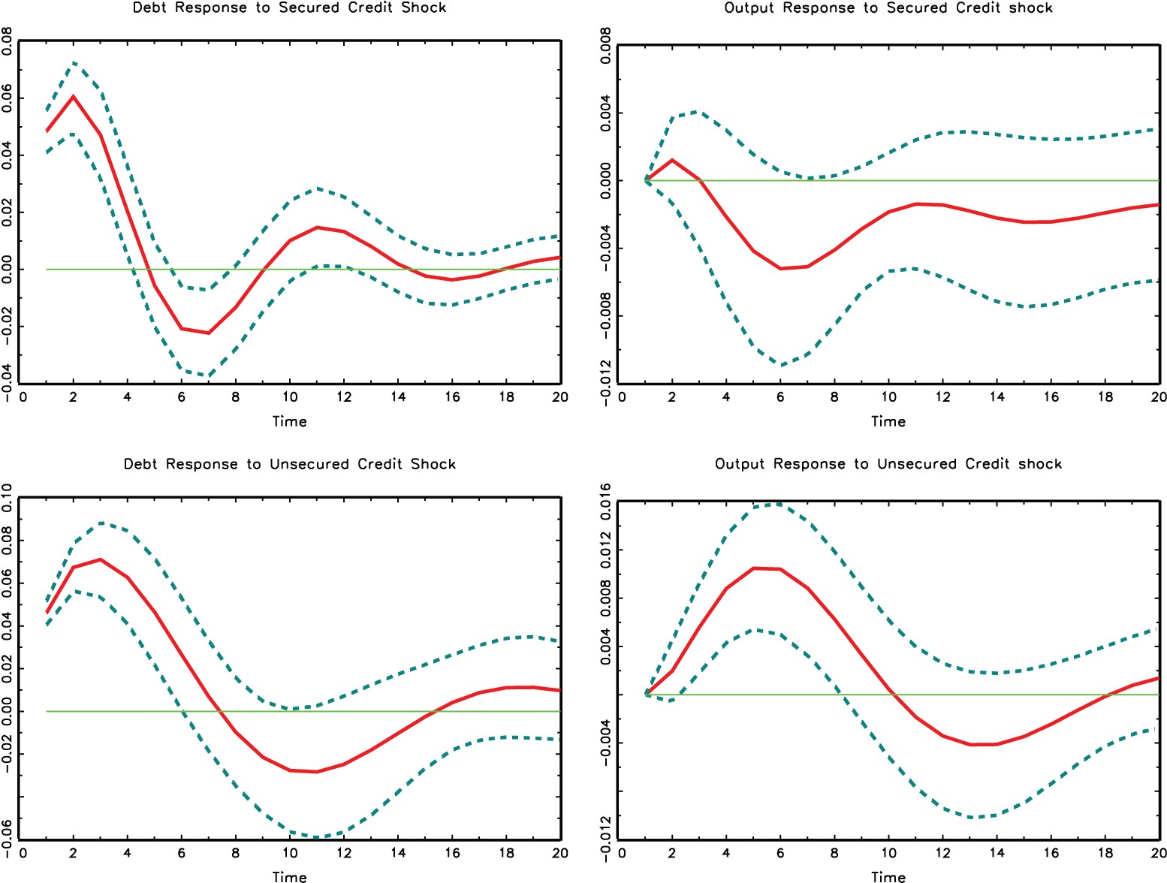
Figure A3 Impulse responses of output and debt to shocks to secured credit (top) and unsecured credit (bottom)
Notes:
Figure A3 Impulse responses of output and debt to shocks to secured credit (top) and unsecured credit (bottom)
Unless provided in the caption above, the following copyright applies to the content of this slide: © The Author 2016. Published by Oxford University Press on behalf of The Review of Economic Studies Limited.

Slide 13
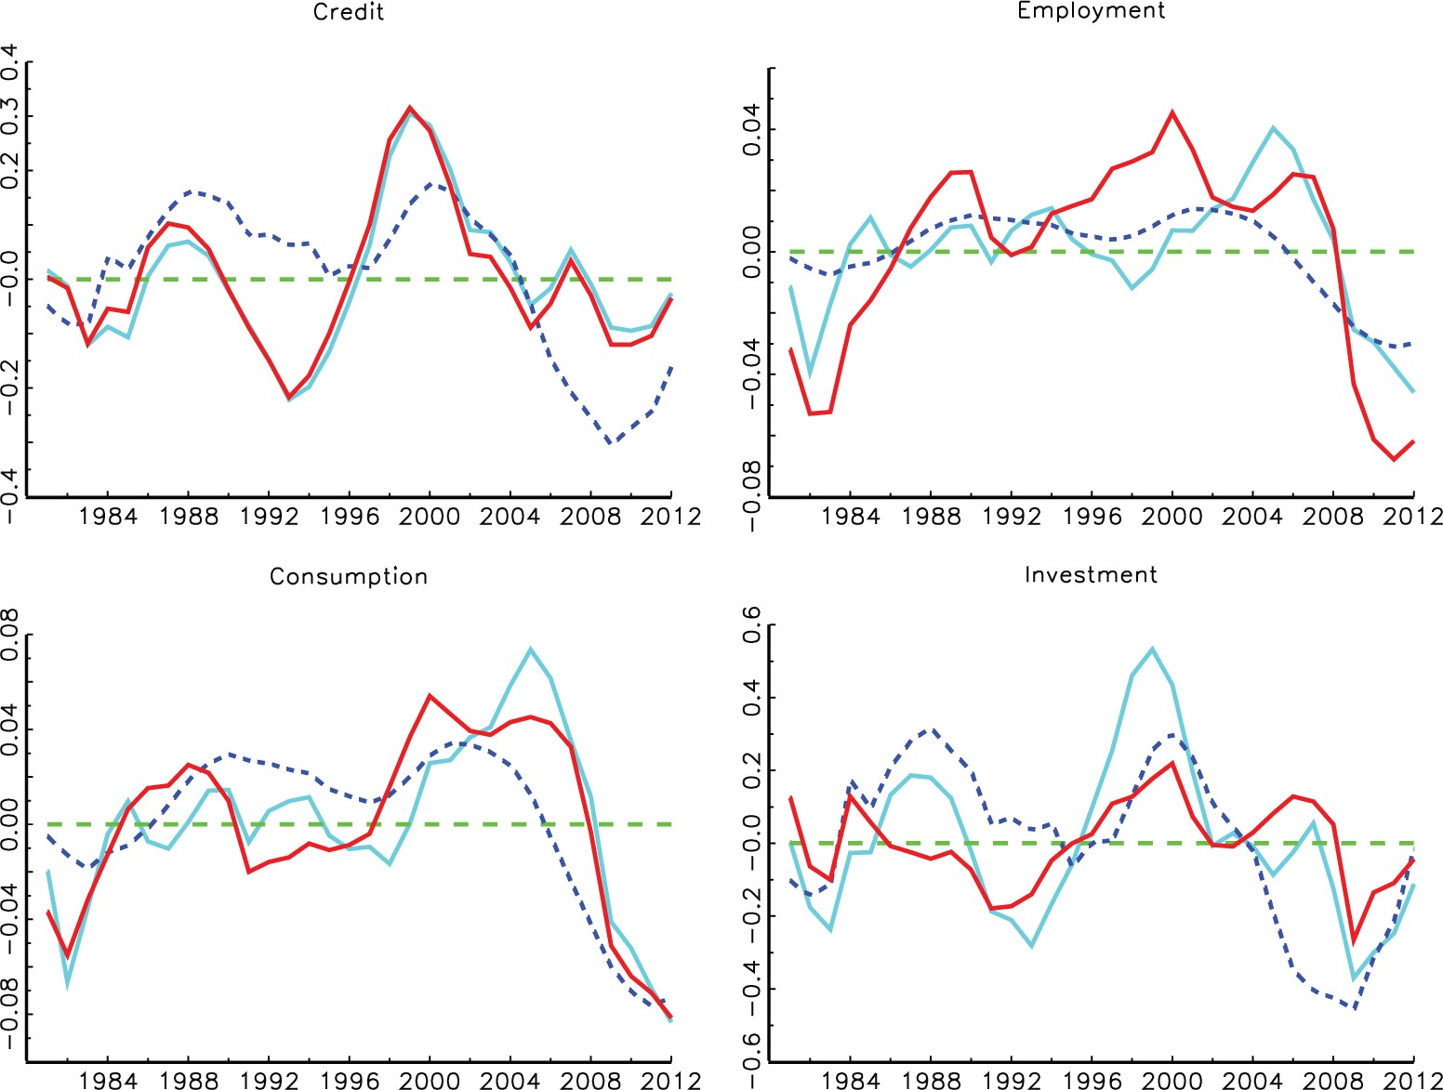
Figure A4 Dynamics of credit, employment, consumption, and investment. The solid curves are U.S. data, the light solid ...
Notes:
Figure A4 Dynamics of credit, employment, consumption, and investment. The solid curves are U.S. data, the light solid curves are model dynamics if all shocks are active, the dashed curves are model dynamics with only sunspot shocks
Unless provided in the caption above, the following copyright applies to the content of this slide: © The Author 2016. Published by Oxford University Press on behalf of The Review of Economic Studies Limited.

Slide 14
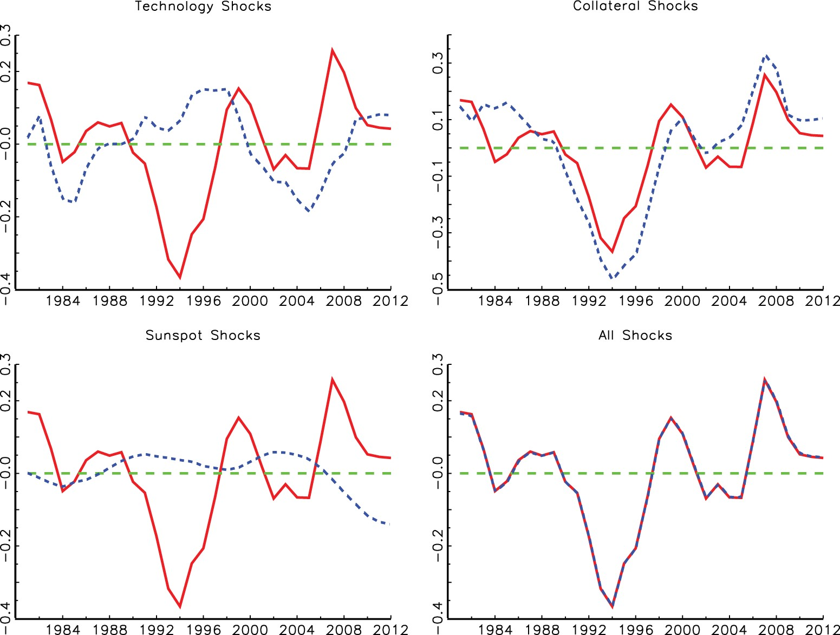
Figure A5 Decomposition of secured credit in the three shocks. The solid curve is the secured credit to capital ratio, ...
Notes:
Figure A5 Decomposition of secured credit in the three shocks. The solid curve is the secured credit to capital ratio, and the dashed curves are model-generated dynamics if only one shock is active (first three graphs). In the bottom right graph, all three shocks are active
Unless provided in the caption above, the following copyright applies to the content of this slide: © The Author 2016. Published by Oxford University Press on behalf of The Review of Economic Studies Limited.

Slide 15
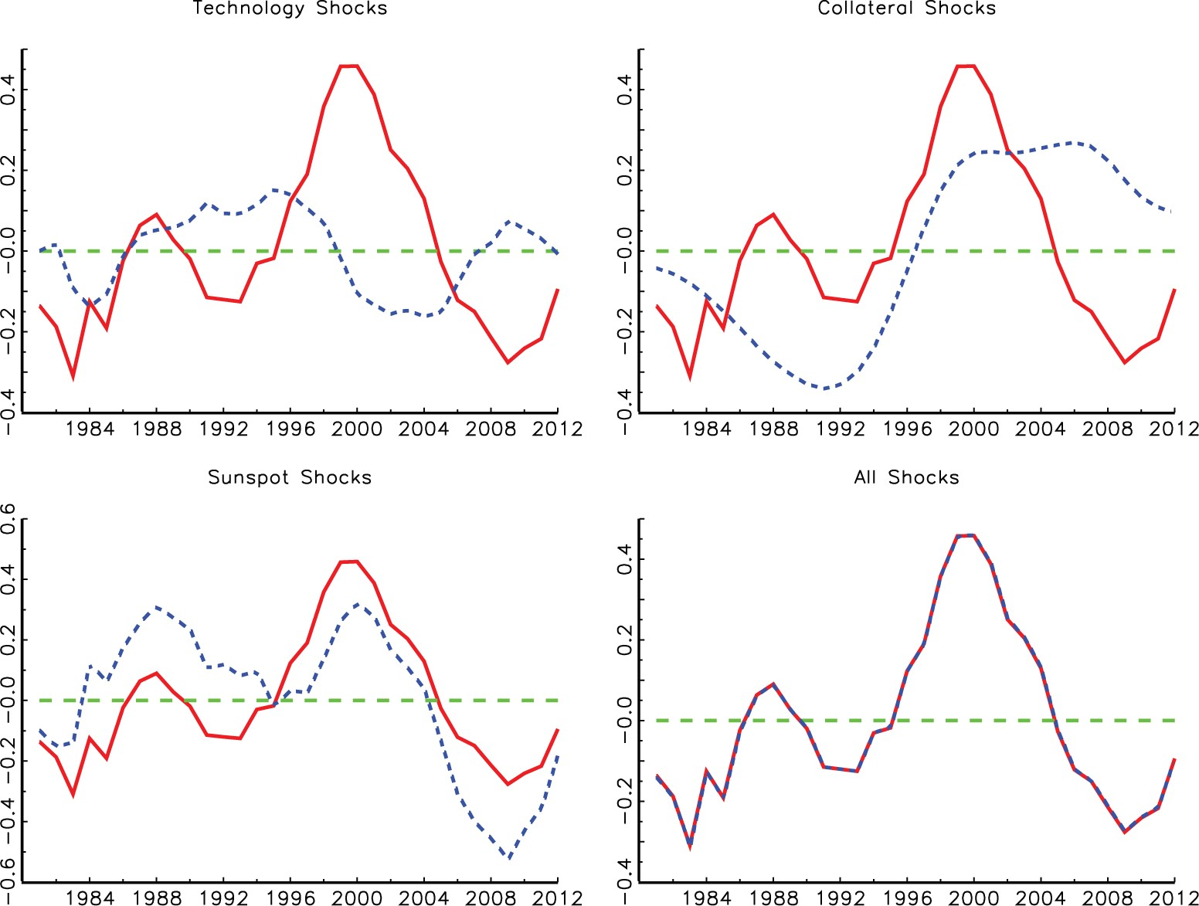
Figure A6 Decomposition of unsecured credit in the three shocks. The solid curve is the unsecured credit to capital ...
Notes:
Figure A6 Decomposition of unsecured credit in the three shocks. The solid curve is the unsecured credit to capital ratio, and the dashed curves are model-generated dynamics if only one shock is active (first three graphs). In the bottom right graph, all three shocks are active
Unless provided in the caption above, the following copyright applies to the content of this slide: © The Author 2016. Published by Oxford University Press on behalf of The Review of Economic Studies Limited.

Slide 16
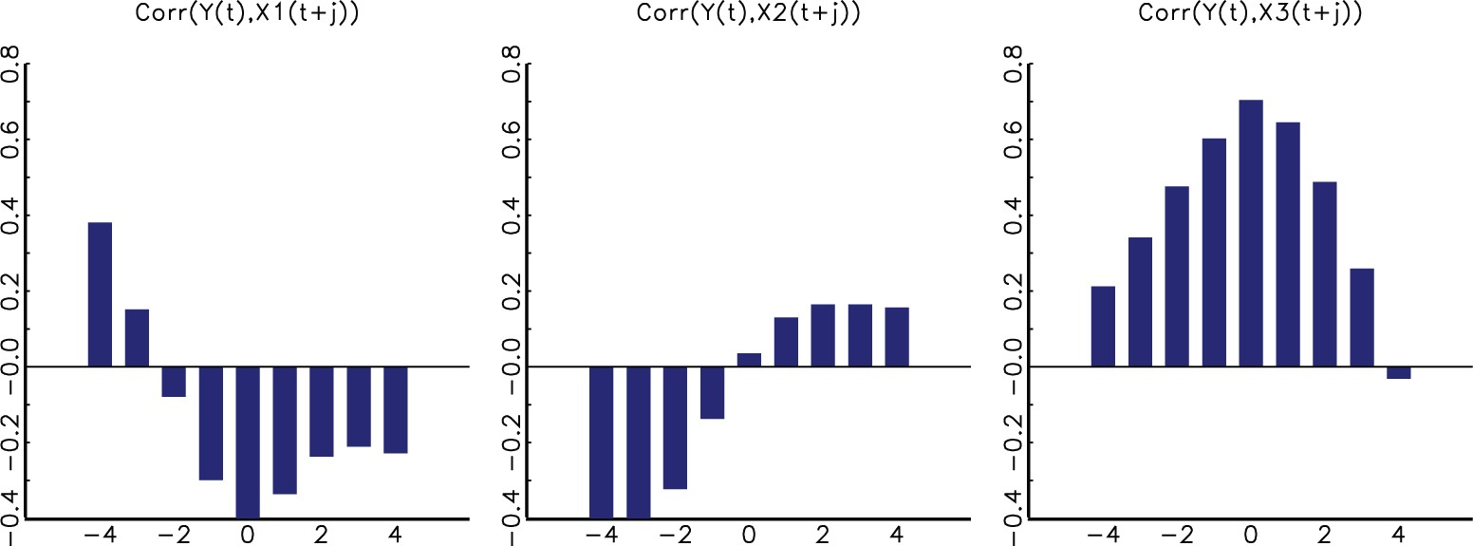
Figure A7 Lead–lag correlation between output Yˆt and the components of secured credit Xˆi,t+j , where i=1 is ...
Notes:
Figure A7 Lead–lag correlation between output Yˆt and the components of secured credit Xˆi,t+j , where i=1 is technology shocks, i=2 is collateral shocks, and i=3 is sunspot shocks
Unless provided in the caption above, the following copyright applies to the content of this slide: © The Author 2016. Published by Oxford University Press on behalf of The Review of Economic Studies Limited.

Slide 17
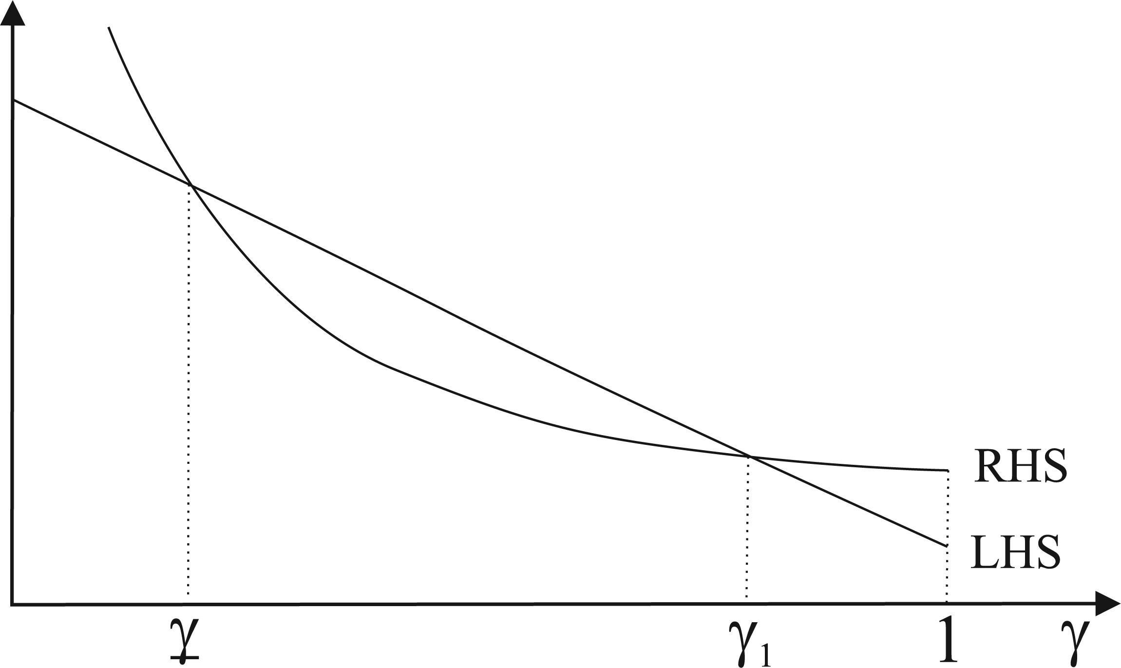
Figure A8 Existence of the threshold γ1
Notes:
Figure A8 Existence of the threshold γ1
Unless provided in the caption above, the following copyright applies to the content of this slide: © The Author 2016. Published by Oxford University Press on behalf of The Review of Economic Studies Limited.

Slide 18
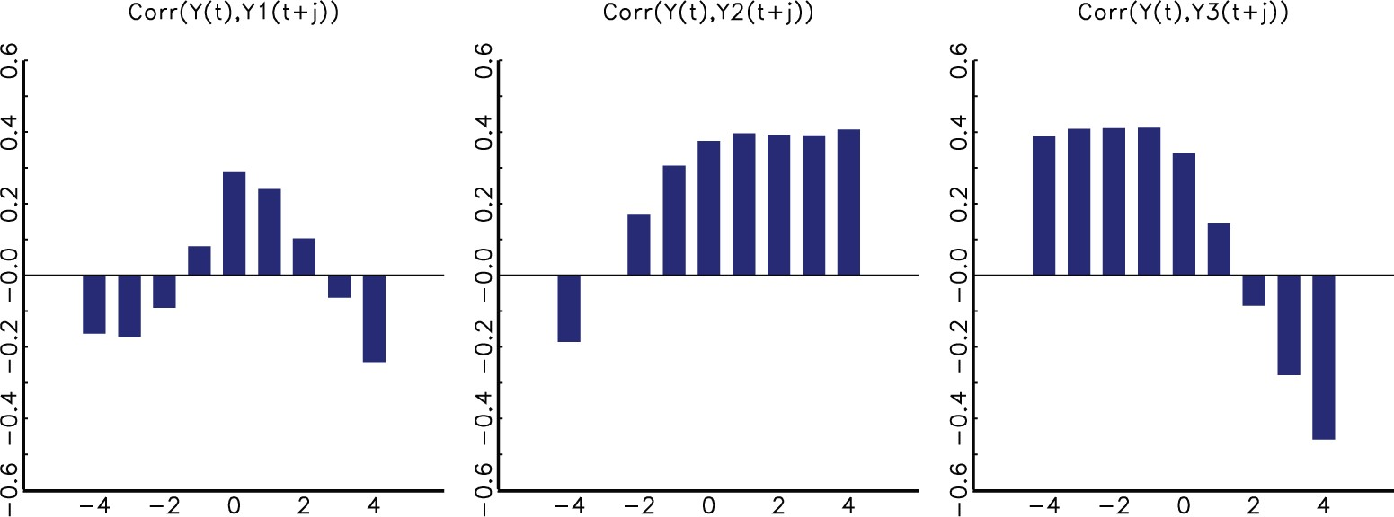
Figure A9 Lead–lag correlation between output Yˆt and the three shock components Yˆi,t+j for the model with ...
Notes:
Figure A9 Lead–lag correlation between output Yˆt and the three shock components Yˆi,t+j for the model with autocorrelated firm-specific shocks, where i=1 is technology shocks, i=2 is collateral shocks, and i=3 is sunspot shocks
Unless provided in the caption above, the following copyright applies to the content of this slide: © The Author 2016. Published by Oxford University Press on behalf of The Review of Economic Studies Limited.

Slide 19
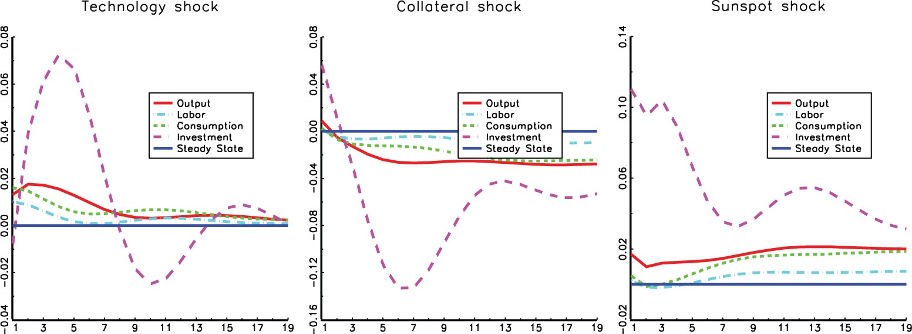
Figure A10 Impulse responses to the three shocks in the model with autocorrelated firm-specific shocks
Notes:
Figure A10 Impulse responses to the three shocks in the model with autocorrelated firm-specific shocks
Unless provided in the caption above, the following copyright applies to the content of this slide: © The Author 2016. Published by Oxford University Press on behalf of The Review of Economic Studies Limited.

