Slide 1
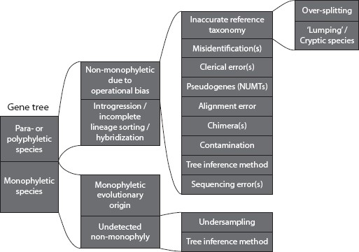
Figure 1. Schematic overview of the different potential reasons for species to be classified as para- or polyphyletic, ...
Notes:
Figure 1. Schematic overview of the different potential reasons for species to be classified as para- or polyphyletic, or false-positively monophyletic in a gene tree.
Unless provided in the caption above, the following copyright applies to the content of this slide: © The Author(s) 2016. Published by Oxford University Press, on behalf of the Society of Systematic Biologists.This is an Open Access article distributed under the terms of the Creative Commons Attribution Non-Commercial License (http://creativecommons.org/licenses/by-nc/4.0/), which permits non-commercial re-use, distribution, and reproduction in any medium, provided the original work is properly cited. For commercial re-use, please contact journals.permissions@oup.com

Slide 2
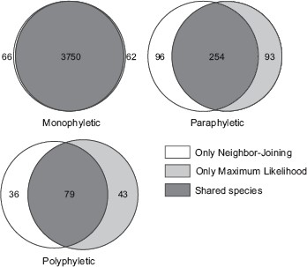
Figure 2. Overlap in species classified as mono-, para-, and polyphyletic using either NJ or ML methods. The number of ...
Notes:
Figure 2. Overlap in species classified as mono-, para-, and polyphyletic using either NJ or ML methods. The number of species is indicated in each partition (the counts for monophyly exclude species represented by singletons).
Unless provided in the caption above, the following copyright applies to the content of this slide: © The Author(s) 2016. Published by Oxford University Press, on behalf of the Society of Systematic Biologists.This is an Open Access article distributed under the terms of the Creative Commons Attribution Non-Commercial License (http://creativecommons.org/licenses/by-nc/4.0/), which permits non-commercial re-use, distribution, and reproduction in any medium, provided the original work is properly cited. For commercial re-use, please contact journals.permissions@oup.com

Slide 3
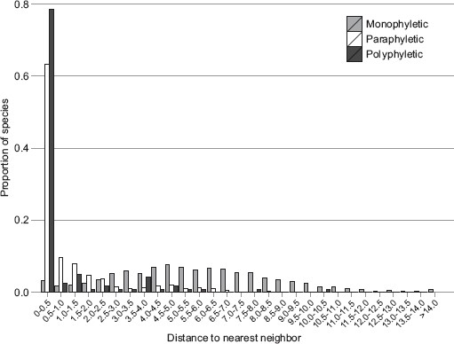
Figure 3. Proportions of species with different minimum K2P distances to their nearest neighbor in mono-, para-, and ...
Notes:
Figure 3. Proportions of species with different minimum K2P distances to their nearest neighbor in mono-, para-, and polyphyletic species. For monophyletic species, singletons were excluded.
Unless provided in the caption above, the following copyright applies to the content of this slide: © The Author(s) 2016. Published by Oxford University Press, on behalf of the Society of Systematic Biologists.This is an Open Access article distributed under the terms of the Creative Commons Attribution Non-Commercial License (http://creativecommons.org/licenses/by-nc/4.0/), which permits non-commercial re-use, distribution, and reproduction in any medium, provided the original work is properly cited. For commercial re-use, please contact journals.permissions@oup.com

Slide 4
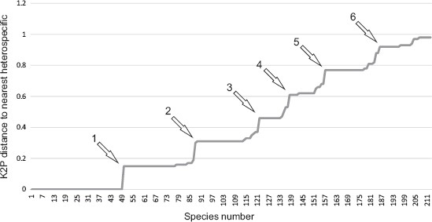
Figure 4. Monophyletic species (215 in total) showing less than 0.01 minimum K2P distance (or less than 7 nucleotide ...
Notes:
Figure 4. Monophyletic species (215 in total) showing less than 0.01 minimum K2P distance (or less than 7 nucleotide substitutions difference) to their closest species. The number of nucleotide substitutions to the nearest neighbors are indicated with arrows. The curve is not cleanly stepped because of slight variation in sequence lengths and because the substitution model employed does not assume equal likelihoods of all substitutions. Forty-eight species having K2P divergence of zero to the closest heterospecific would be rendered non-monophyletic by a single nucleotide substitution.
Unless provided in the caption above, the following copyright applies to the content of this slide: © The Author(s) 2016. Published by Oxford University Press, on behalf of the Society of Systematic Biologists.This is an Open Access article distributed under the terms of the Creative Commons Attribution Non-Commercial License (http://creativecommons.org/licenses/by-nc/4.0/), which permits non-commercial re-use, distribution, and reproduction in any medium, provided the original work is properly cited. For commercial re-use, please contact journals.permissions@oup.com

Slide 5
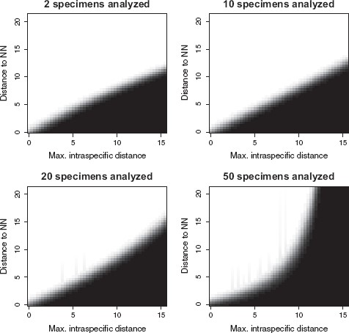
Figure 5. The estimated probability of species non-monophyly from a generalized linear model including as explanatory ...
Notes:
Figure 5. The estimated probability of species non-monophyly from a generalized linear model including as explanatory factors: genetic distance (in percent with 1% distance equaling to 0.01 K2P divergence) to nearest neighbor (vertical axes), maximum within-species K2P genetic distance (horizontal axis) and the number of specimens included in the analysis (the figures show four values). Probability values are indicated by a grayscale gradient with black = 1 and white = 0.
Unless provided in the caption above, the following copyright applies to the content of this slide: © The Author(s) 2016. Published by Oxford University Press, on behalf of the Society of Systematic Biologists.This is an Open Access article distributed under the terms of the Creative Commons Attribution Non-Commercial License (http://creativecommons.org/licenses/by-nc/4.0/), which permits non-commercial re-use, distribution, and reproduction in any medium, provided the original work is properly cited. For commercial re-use, please contact journals.permissions@oup.com

Slide 6
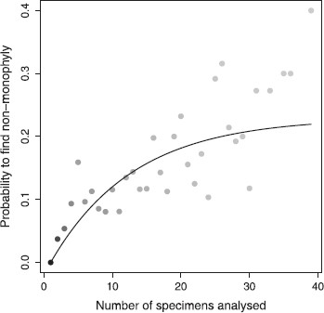
Figure 6. Probability of finding non-monophyly as a function of the number of specimens per species included in the ...
Notes:
Figure 6. Probability of finding non-monophyly as a function of the number of specimens per species included in the analysis. Points indicate proportions of non-monophyletic species in groups of species with equal number of analyzed specimens. The darkness of points indicates weights (inverses of bootstrap standard errors) used in fitting the regression curve, darker colors indicating higher weights. The curve [y=0.23×(1−e−(x−1)e−2.5)] is fitted with nonlinear asymptotic regression (see text for details).
Unless provided in the caption above, the following copyright applies to the content of this slide: © The Author(s) 2016. Published by Oxford University Press, on behalf of the Society of Systematic Biologists.This is an Open Access article distributed under the terms of the Creative Commons Attribution Non-Commercial License (http://creativecommons.org/licenses/by-nc/4.0/), which permits non-commercial re-use, distribution, and reproduction in any medium, provided the original work is properly cited. For commercial re-use, please contact journals.permissions@oup.com

