Slide 1
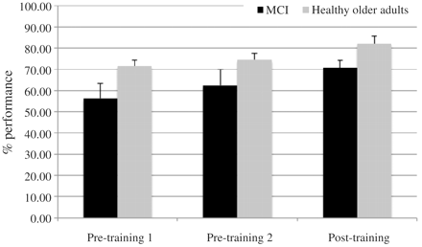
Figure 1 Performance in the scan prior to and after training.
Notes:
Figure 1 Performance in the scan prior to and after training.
Unless provided in the caption above, the following copyright applies to the content of this slide: © The Author (2011). Published by Oxford University Press on behalf of the Guarantors of Brain. All rights reserved. For Permissions, please email: journals.permissions@oup.com

Slide 2
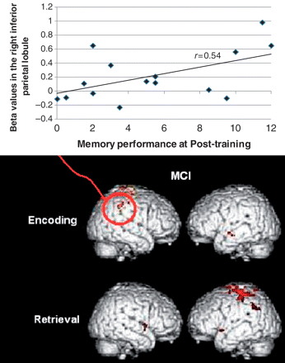
Figure 2 Areas of increased brain activation after training in the MCI group: activated clusters ...
Notes:
Figure 2 Areas of increased brain activation after training in the MCI group: activated clusters (Post-training > Pre-training 2) for both memory encoding and retrieval (P 10 voxels). A scatter plot with fit line shows the significant correlations in subjects with MCI between their memory performances at post-training and the β-values for the encoding condition at post-training in the right inferior parietal lobule.
Unless provided in the caption above, the following copyright applies to the content of this slide: © The Author (2011). Published by Oxford University Press on behalf of the Guarantors of Brain. All rights reserved. For Permissions, please email: journals.permissions@oup.com

