Slide 1
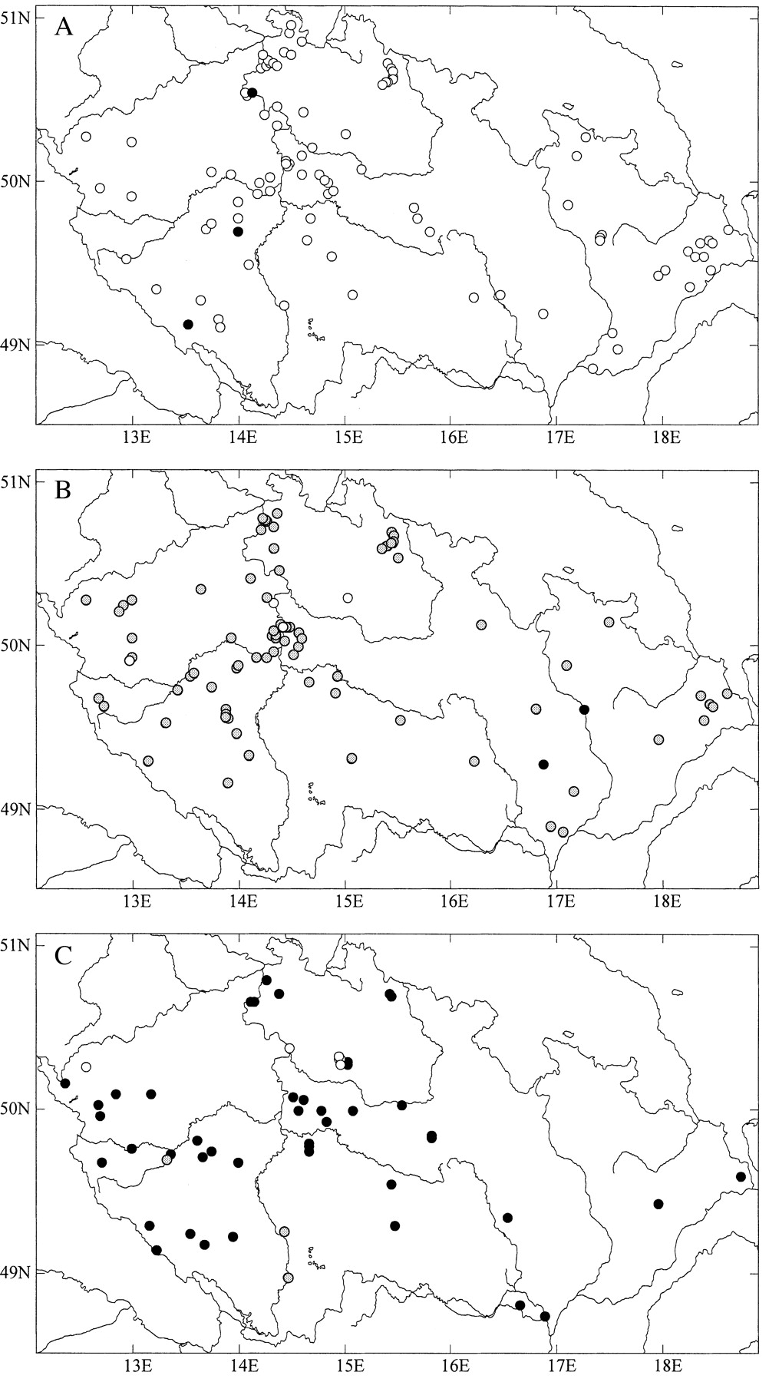
Fig. 1. Distribution of the 257 Reynoutria clones used in this study. A, Reynoutriajaponica var. japonica ...
Notes:
Fig. 1. Distribution of the 257 Reynoutria clones used in this study. A, Reynoutriajaponica var. japonica (white circles) and R. japonica var. compacta (black circles). B, R. ×bohemica; C, R. sachalinensis. Black circles indicate tetraploids (2n = 44), grey circles hexaploids (2n = 66), and open circles octoploids (2n = 88). For localities see Supplementary data: (http://www.aob.oupjournals.org).
Unless provided in the caption above, the following copyright applies to the content of this slide:

Slide 2
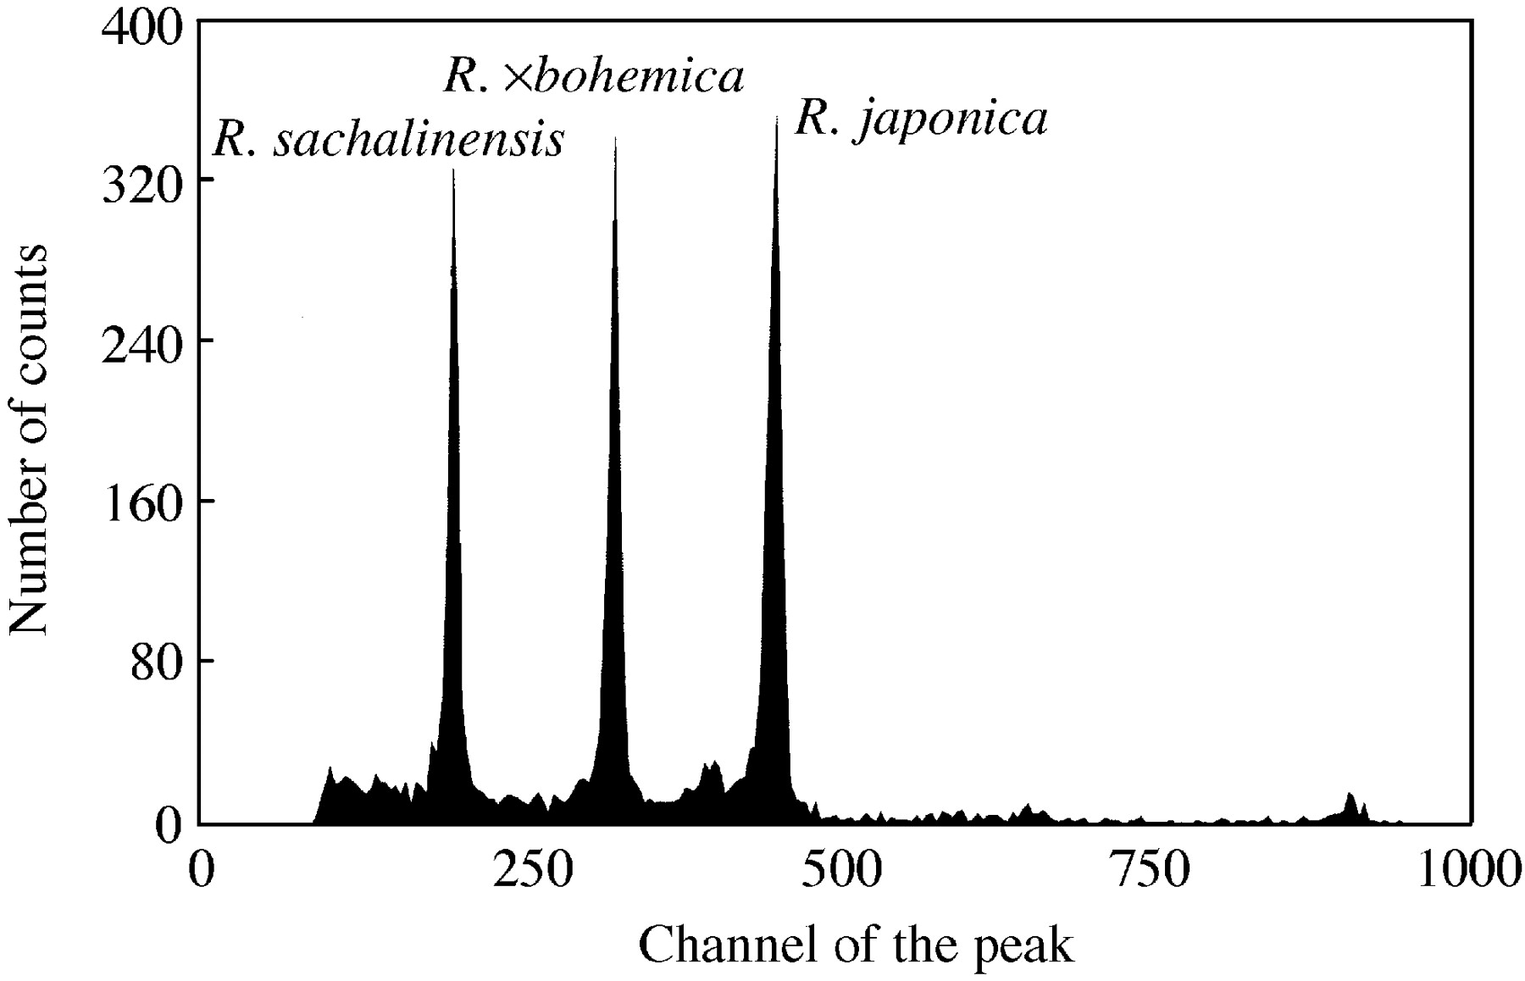
Fig. 2. Histogram of relative nuclear DNA content of particular Reynoutria species. The ...
Notes:
Fig. 2. Histogram of relative nuclear DNA content of particular Reynoutria species. The G0/G1 peak of tetraploid R. sachalinensis was on channel 205, that of hexaploid R. ×bohemica on channel 335 and that of octoploid R. japonica var. japonica on channel 461, i.e. the peak ratios are 1 : 1·63 : 2·25 for R. sachalinensis, R. ×bohemica and R. japonica, respectively.
Unless provided in the caption above, the following copyright applies to the content of this slide:

Slide 3
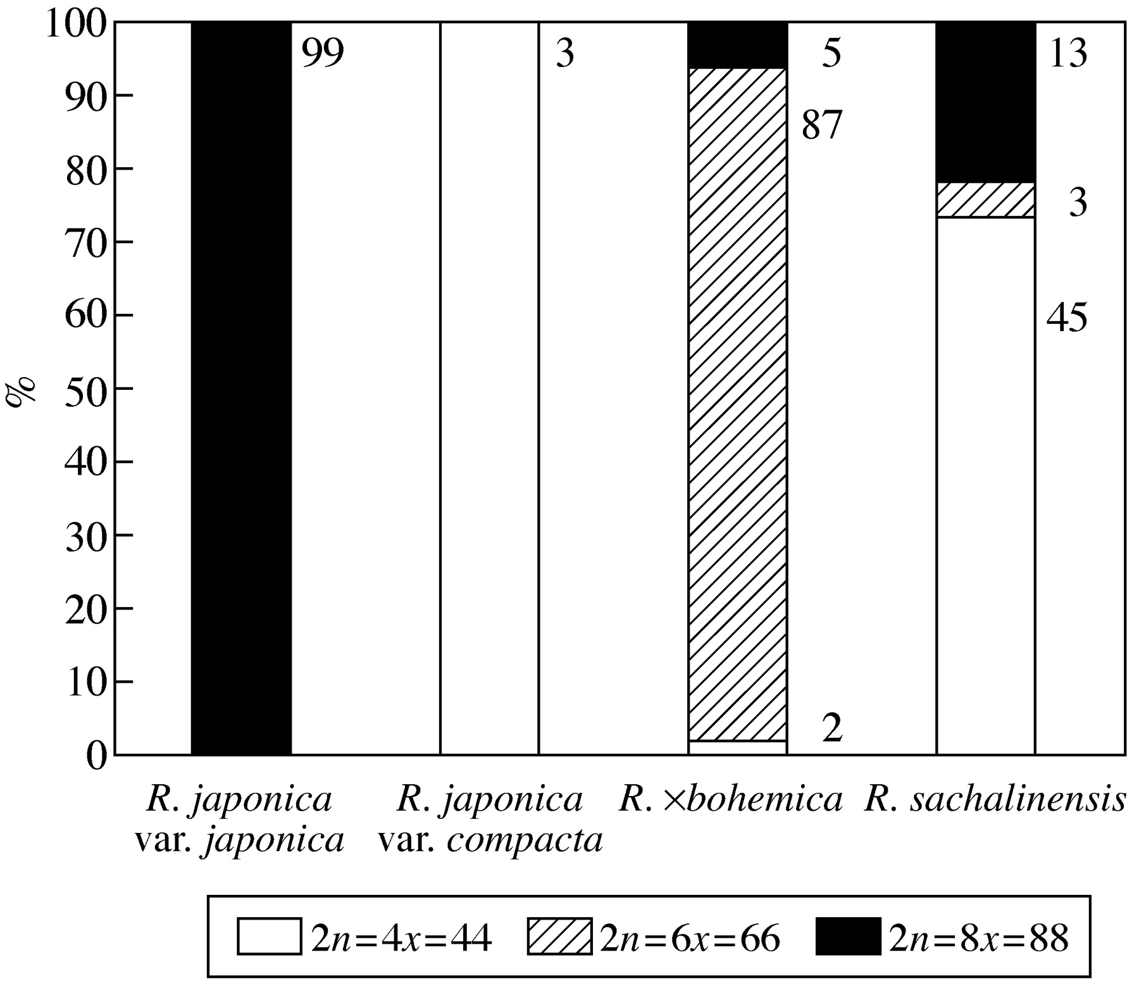
Fig. 3. Ploidy levels in particular Reynoutria taxa. Numbers indicate the number of samples analysed.
Notes:
Fig. 3. Ploidy levels in particular Reynoutria taxa. Numbers indicate the number of samples analysed.
Unless provided in the caption above, the following copyright applies to the content of this slide:

Slide 4
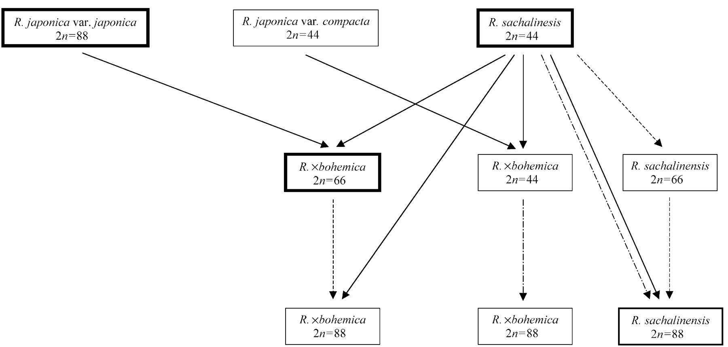
Fig. 4. Schema of hybridization and polyploidization within the genus Reynoutria in the Czech Republic. More ...
Notes:
Fig. 4. Schema of hybridization and polyploidization within the genus Reynoutria in the Czech Republic. More frequent ploidy levels are indicated by wider frames: those with 6–20 localities have intermediate frames, those with more than 20 localities have wide frames. Solid lines indicate origin of particular taxa by hybridization, dashed lines indicate expected fusion of reduced and unreduced gametes, and dot‐and‐dashed lines indicate autopolyploidization.
Unless provided in the caption above, the following copyright applies to the content of this slide:

Slide 5
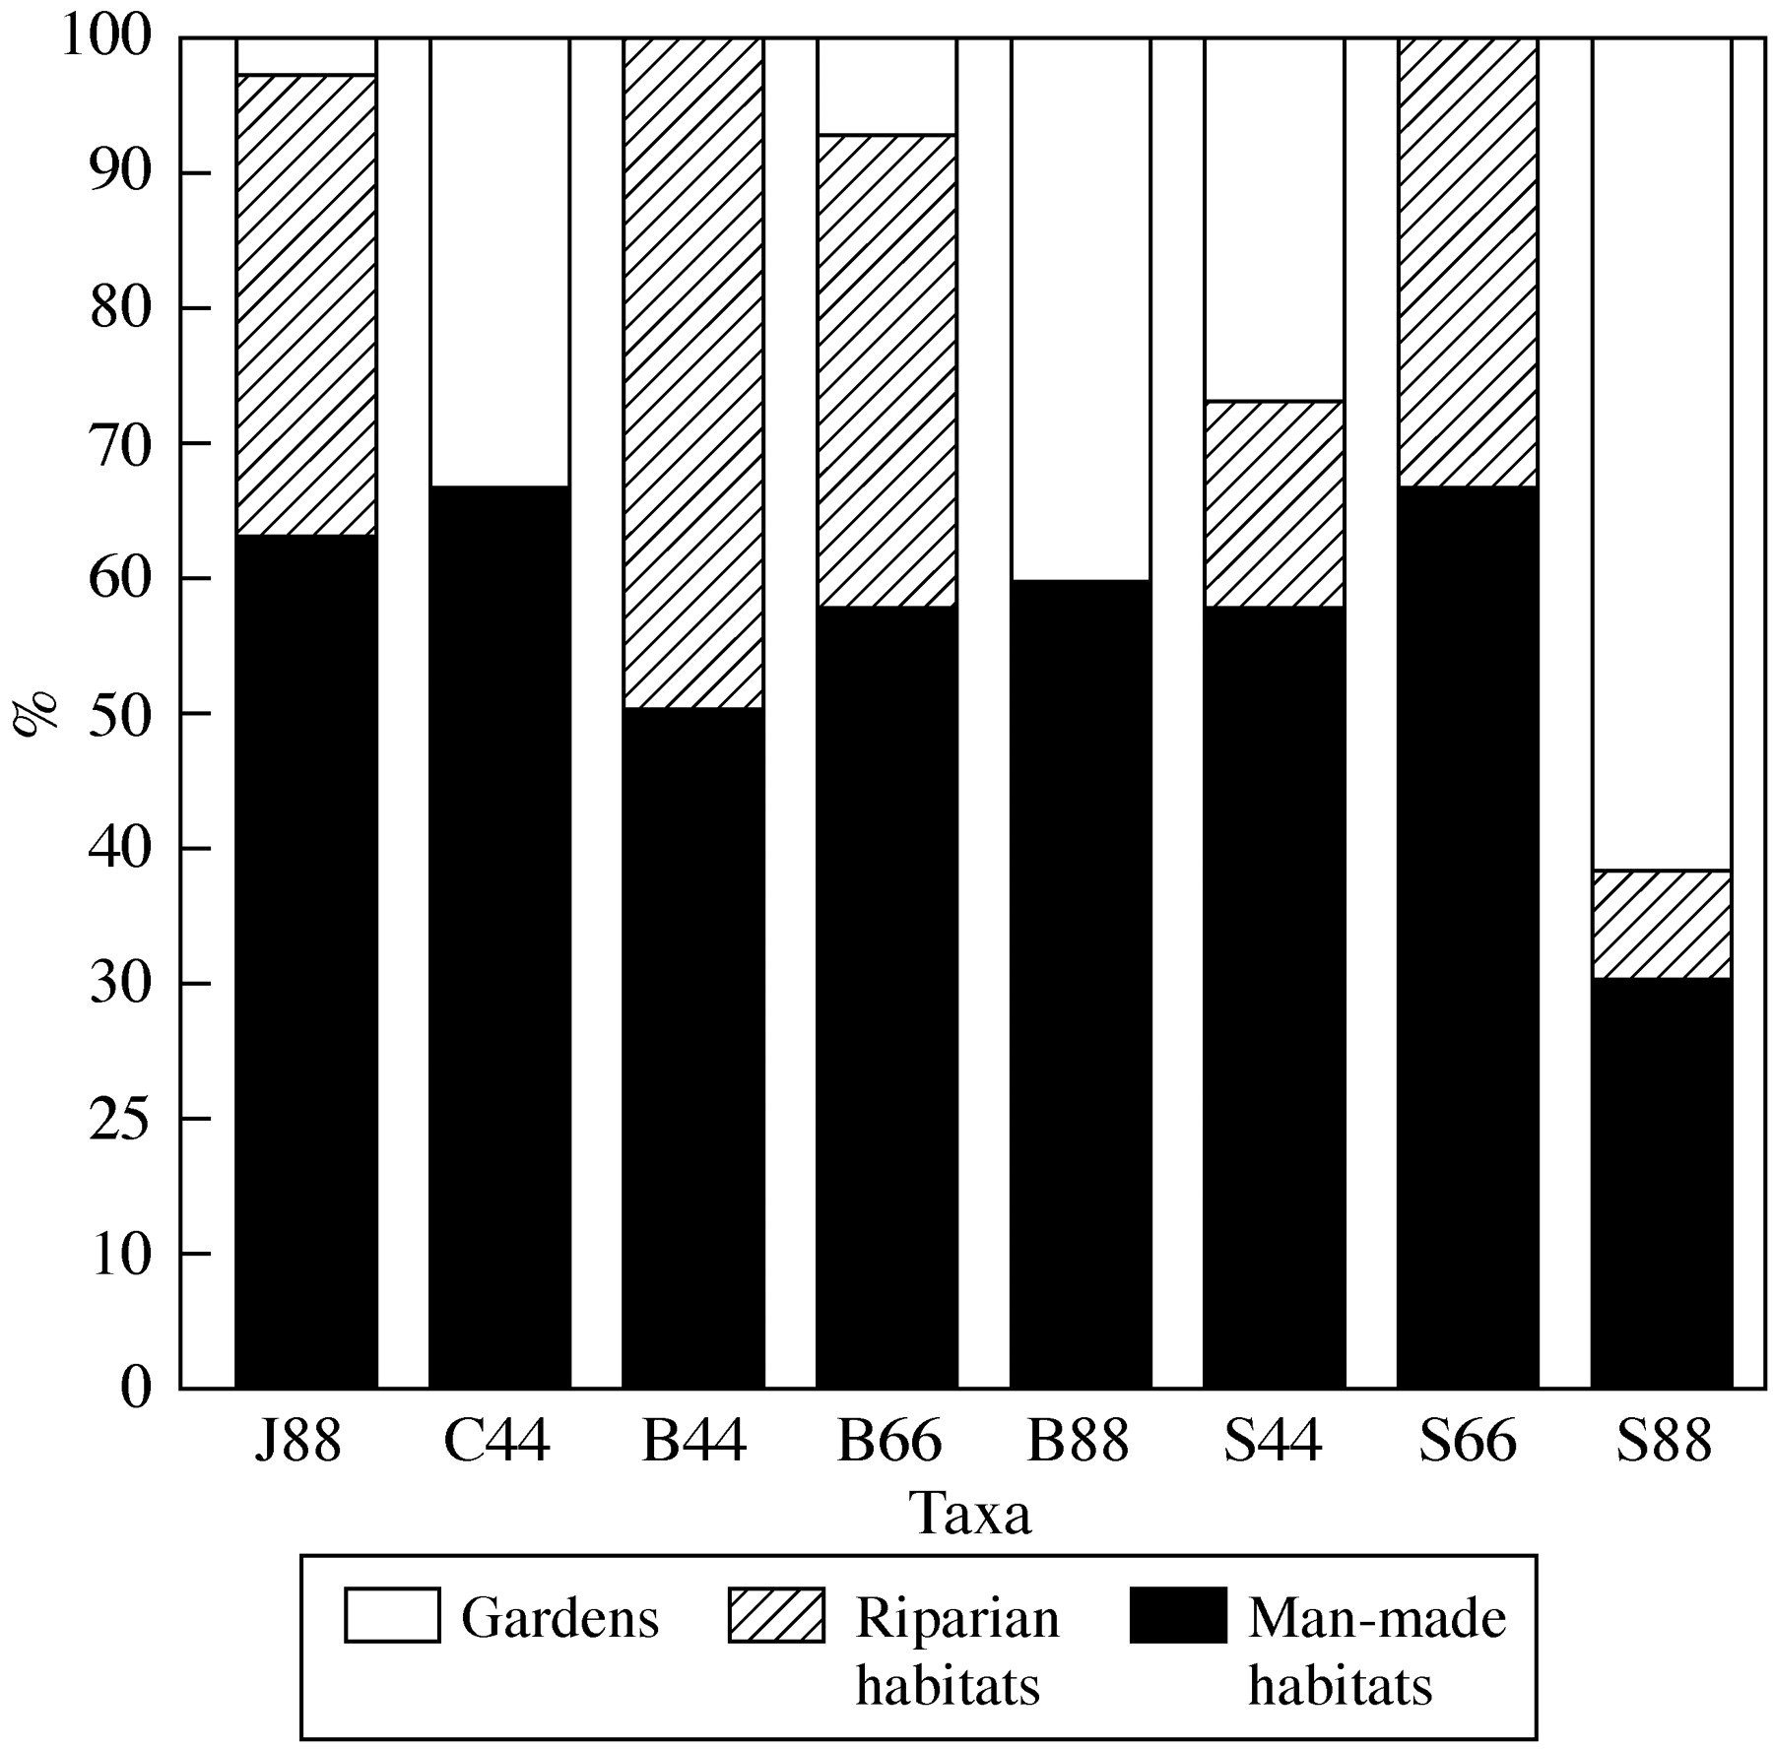
Fig. 5. Contribution of particular habitat types to the total number of localities for particular taxa and ...
Notes:
Fig. 5. Contribution of particular habitat types to the total number of localities for particular taxa and ploidy levels. J88, Reynoutria japonica var. japonica (2n = 88); C44, R. japonica var. compacta (2n = 44); B44, R. ×bohemica (2n = 44); B66, R. ×bohemica (2n = 66); B88, R. ×bohemica (2n = 88); S44, R. sachalinensis (2n = 44); S66, R. sachalinensis (2n = 66); S88, R. sachalinensis (2n = 88).
Unless provided in the caption above, the following copyright applies to the content of this slide:

