Slide 1
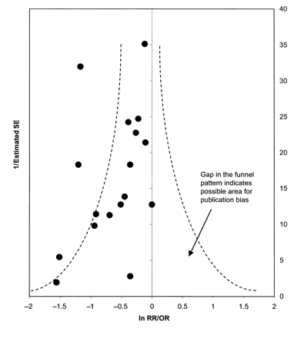
FIGURE 1. Funnel plot indicating publication bias in the studies included in the meta-analyses of the association ...
Notes:
FIGURE 1. Funnel plot indicating publication bias in the studies included in the meta-analyses of the association between garlic consumption and risk of stomach, colorectal, head and neck, lung, breast, and prostate cancers. RR, relative risk; OR, odds ratio.
Unless provided in the caption above, the following copyright applies to the content of this slide: © 2000 American Society for Clinical Nutrition

