Slide 1
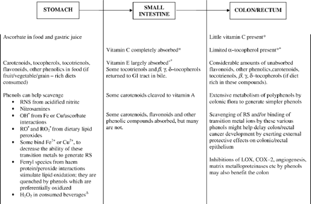
Fig. 1 Dietary antioxidants and the gastrointestinal (GI) tract. *Except when supplements are taken. This figure ...
Notes:
Fig. 1 Dietary antioxidants and the gastrointestinal (GI) tract. *Except when supplements are taken. This figure refers to normal dietary intake. +, There is considerable intersubject variability in the efficiency of GI uptake of vitamin E. ▵Much H2O2 may be removed in the oral cavity by catalase and peroxidases in saliva, and by H2O2 diffusion into the oral and oesophageal epithelium followed by its rapid catabolism. Adapted from [7] with permission from Oxford University Press. RNS Reactive nitrogen species, OH hydroxyl radical, RO alkoxyl radical, RO2 peroxyl radical, RS reactive species, LOX lipoxygenase, COX-2 cyclooxygenase-2.
Unless provided in the caption above, the following copyright applies to the content of this slide: Copyright © 2006, European Society of Cardiology

