Slide 1
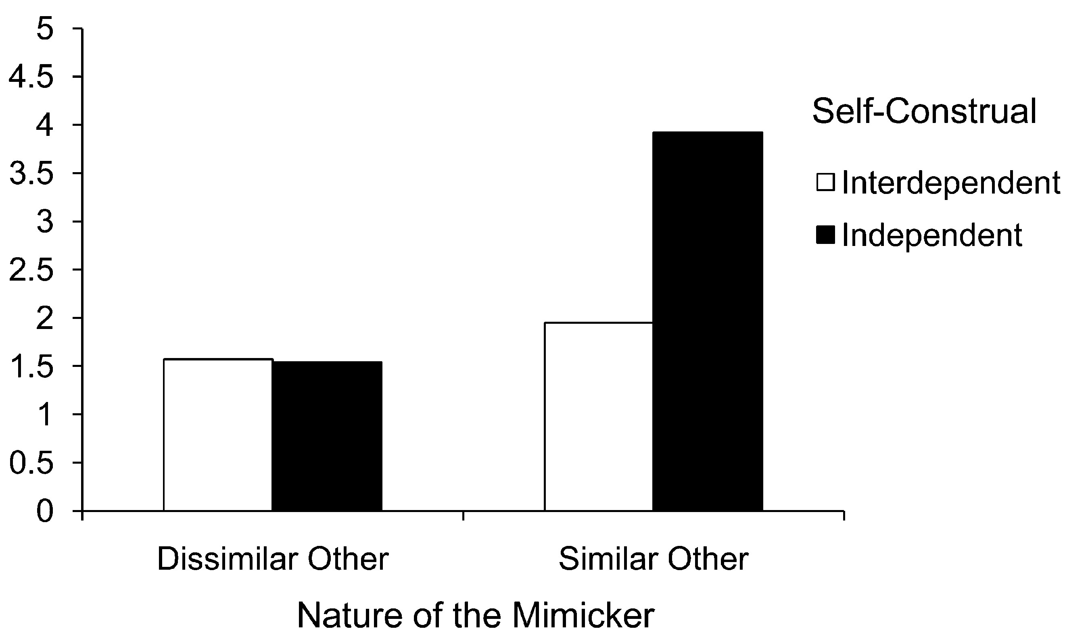
Figure 1. Disposal Intentions as a Function of Self-Construal Priming and Nature of the Mimicker (Study 1)
Notes:
Figure 1. Disposal Intentions as a Function of Self-Construal Priming and Nature of the Mimicker (Study 1)
Unless provided in the caption above, the following copyright applies to the content of this slide: © 2011 by JOURNAL OF CONSUMER RESEARCH, Inc.

Slide 2
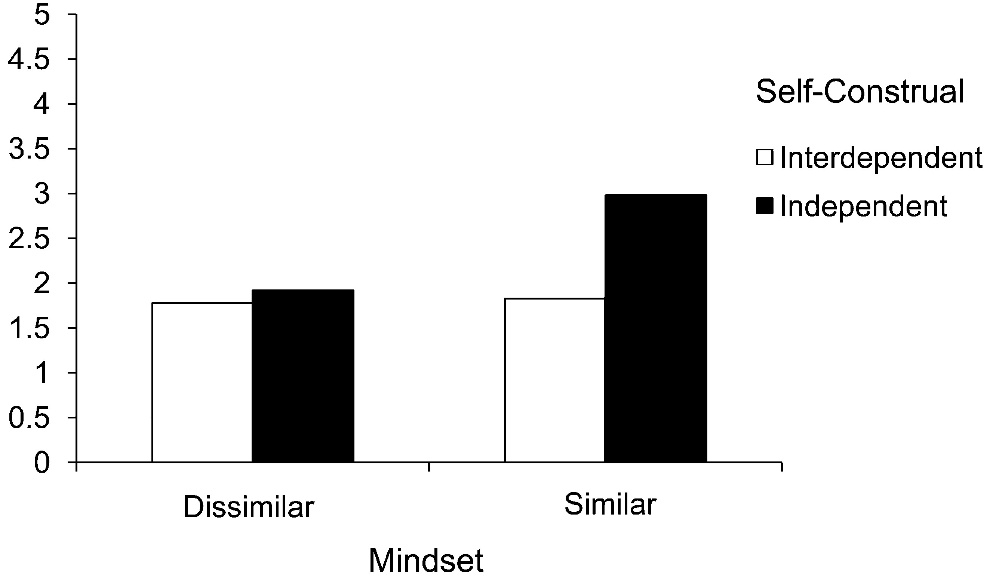
Figure 2. Disposal Intentions as a Function of Self-Construal Priming and Similarity Mind-Set (Study 2)
Notes:
Figure 2. Disposal Intentions as a Function of Self-Construal Priming and Similarity Mind-Set (Study 2)
Unless provided in the caption above, the following copyright applies to the content of this slide: © 2011 by JOURNAL OF CONSUMER RESEARCH, Inc.

Slide 3
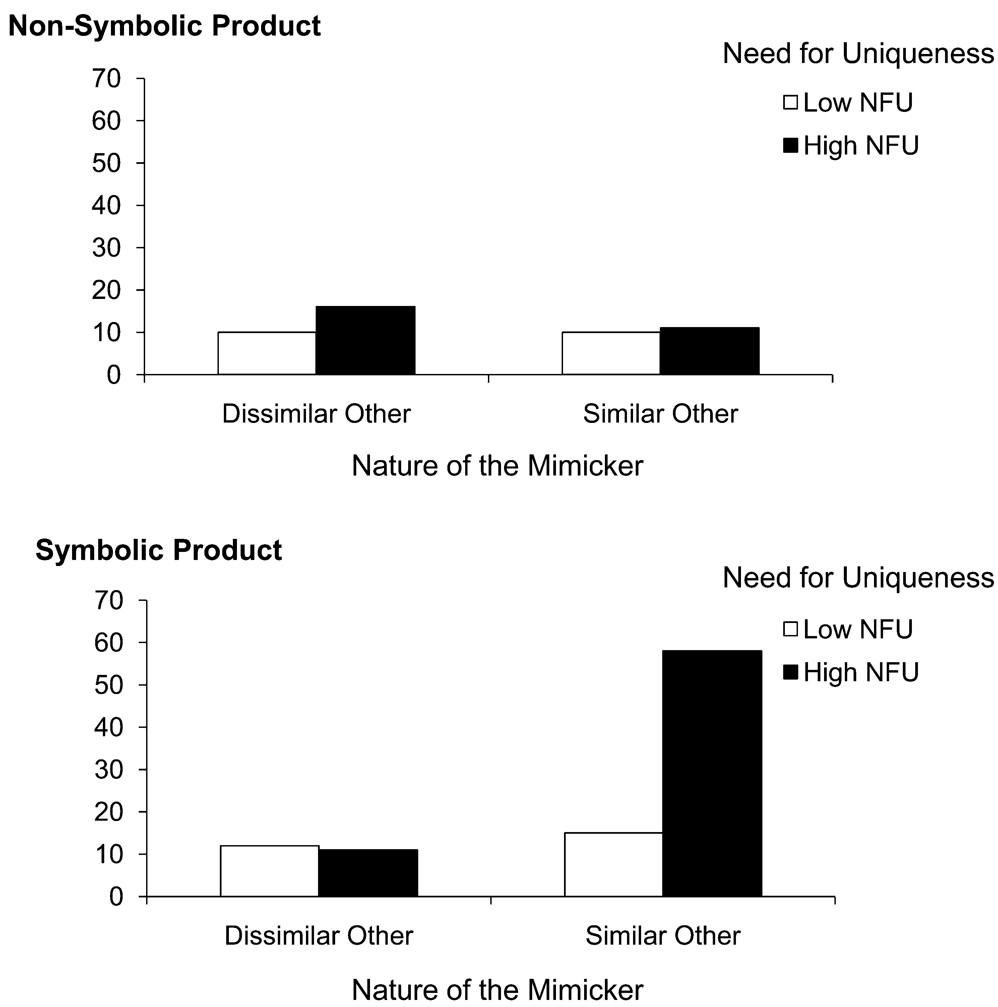
Figure 3. Recustomization Behavior (%) as a Function of Product Type, Nature of the Mimicker, and Need for Uniqueness ...
Notes:
Figure 3. Recustomization Behavior (%) as a Function of Product Type, Nature of the Mimicker, and Need for Uniqueness (Study 3) Note.—Numbers reflect the percentage of people choosing to recustomize their product bundle.
Unless provided in the caption above, the following copyright applies to the content of this slide: © 2011 by JOURNAL OF CONSUMER RESEARCH, Inc.

Slide 4
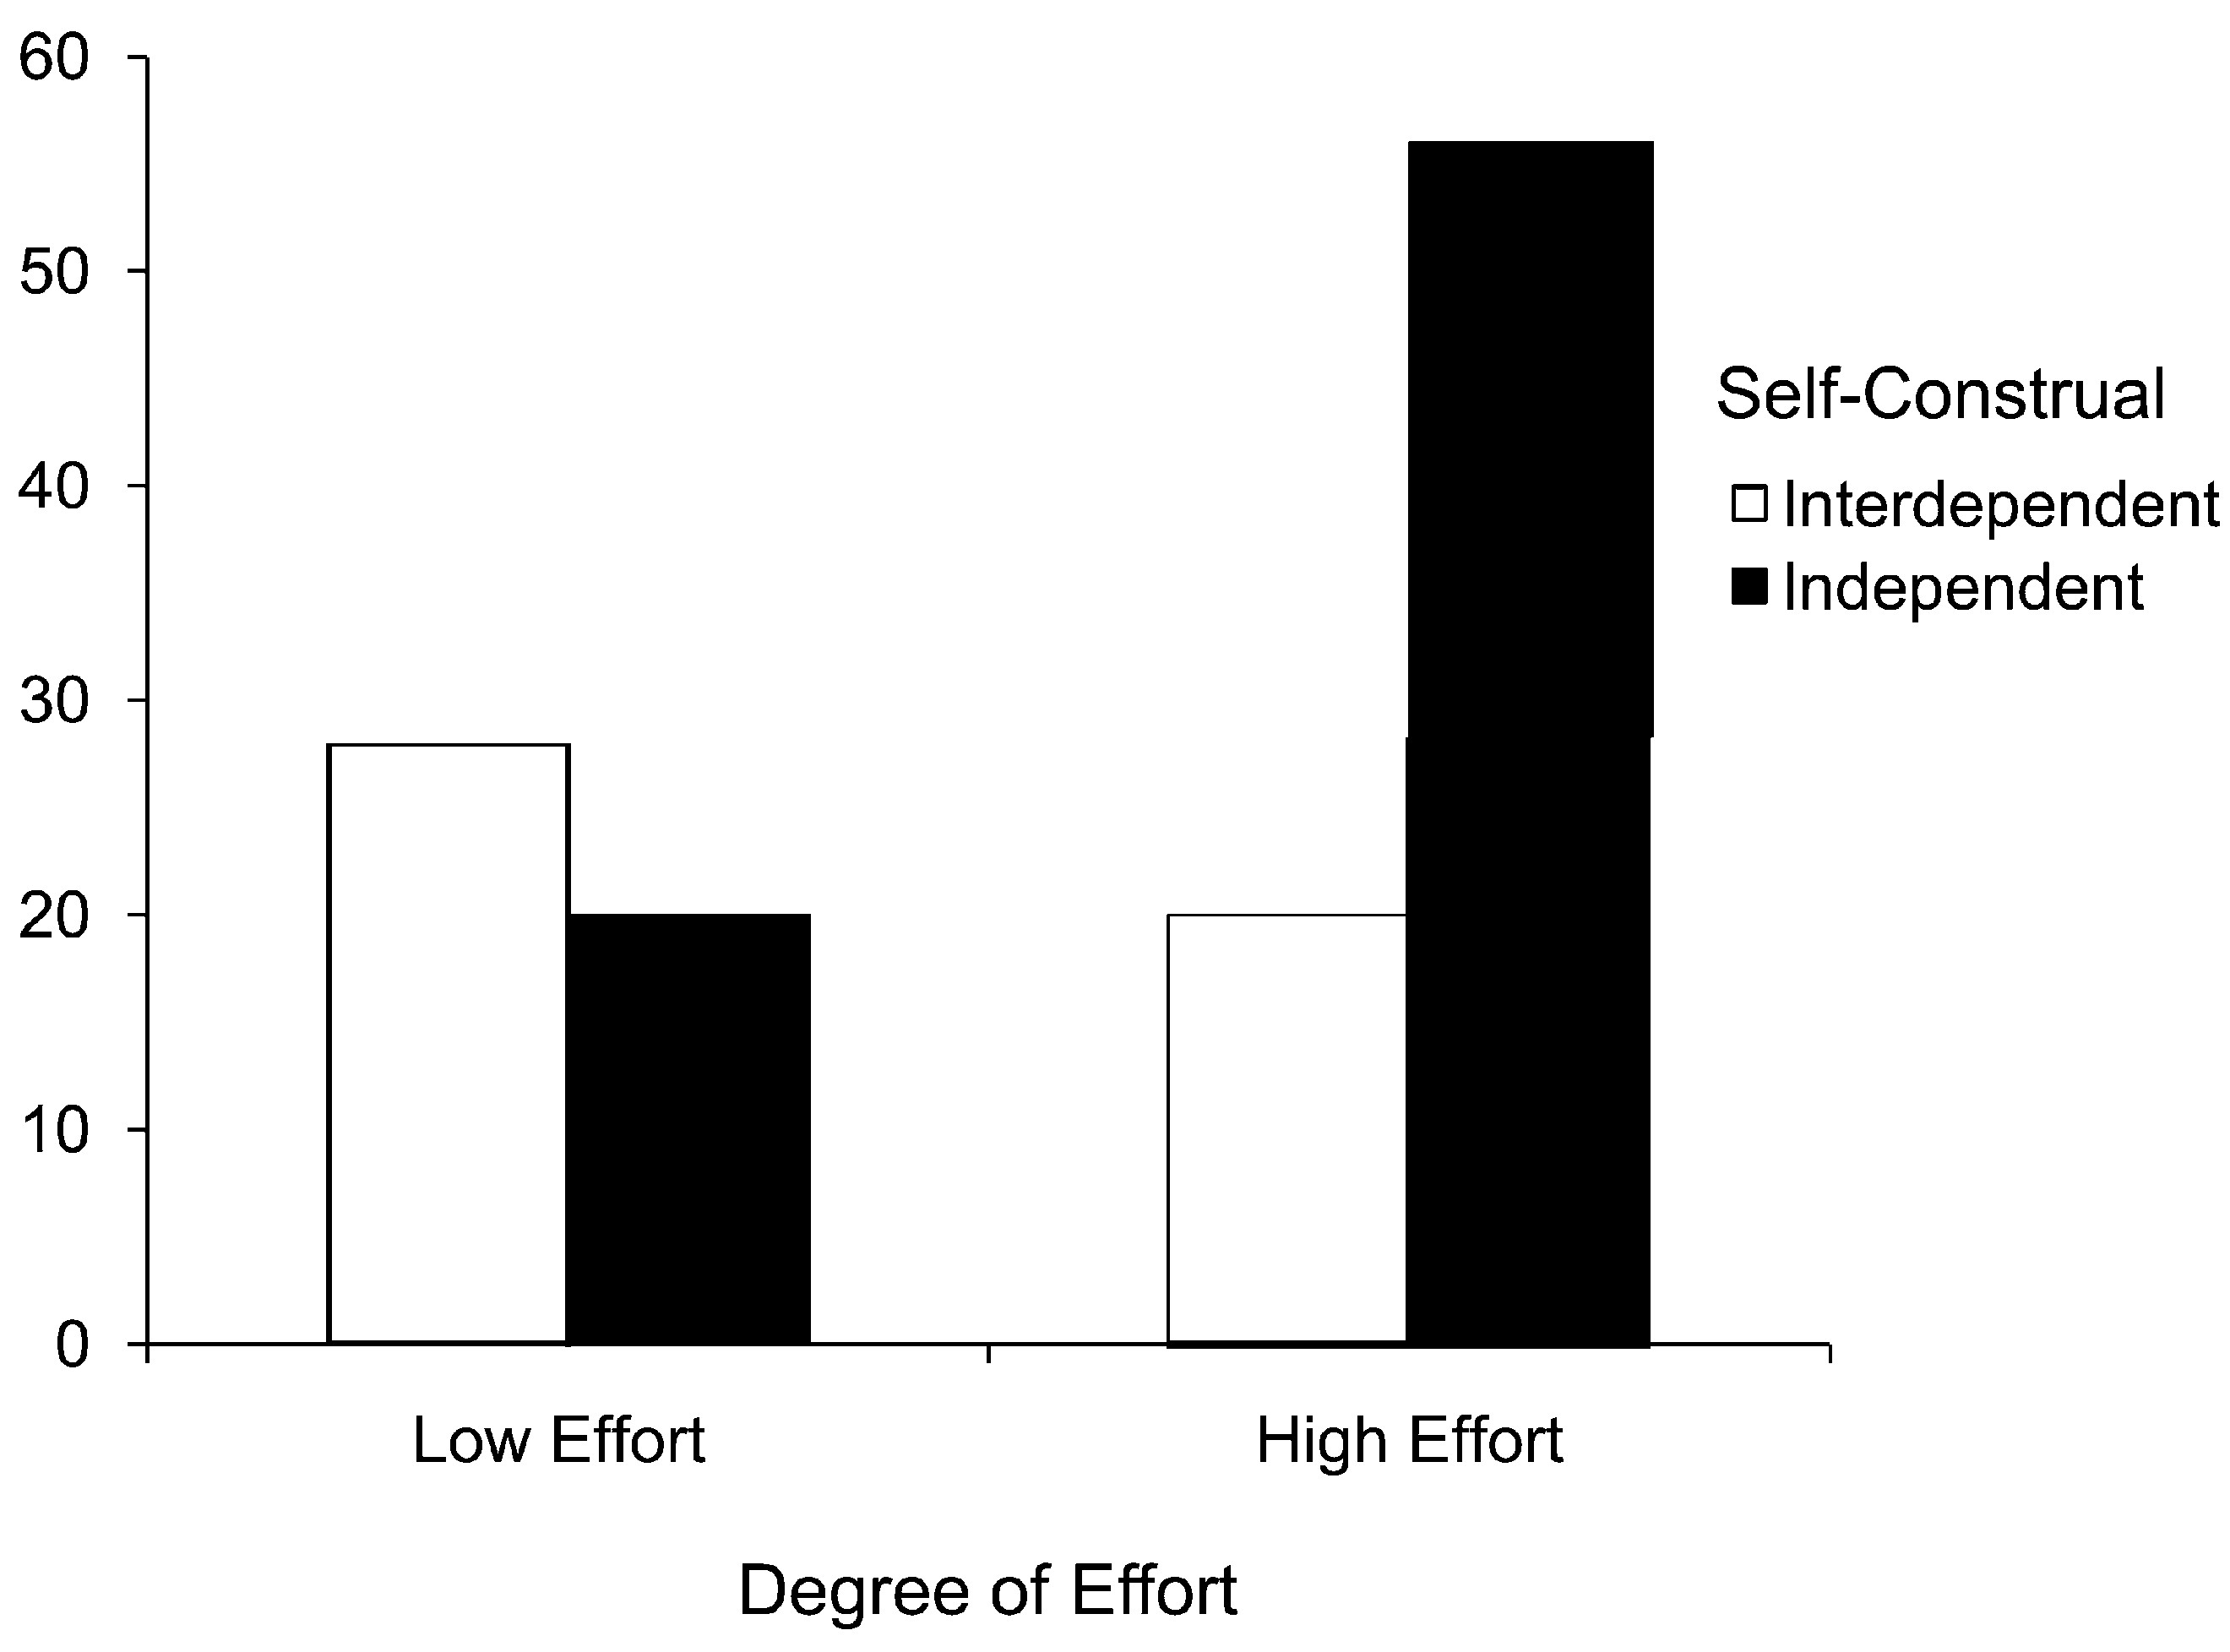
Figure 4. Possession Disposal (%) as a Function of Self-Construal Priming and Degree of Effort (Study 4)
Notes:
Figure 4. Possession Disposal (%) as a Function of Self-Construal Priming and Degree of Effort (Study 4)
Unless provided in the caption above, the following copyright applies to the content of this slide: © 2011 by JOURNAL OF CONSUMER RESEARCH, Inc.

