Slide 1
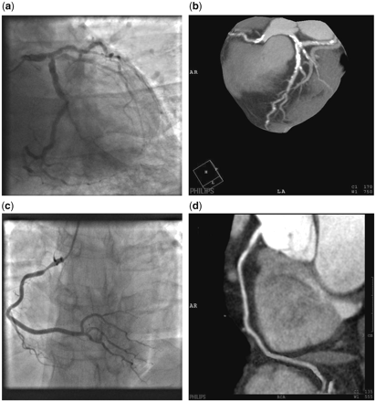
Figure 1. (a) I-CA LAO Caudal view demonstrating significant left main stem, circumflex and left anterior descending ...
Notes:
Figure 1. (a) I-CA LAO Caudal view demonstrating significant left main stem, circumflex and left anterior descending artery stenoses in an elderly gentleman, (b) MSCT-CA volume rendered image of the elderly gentleman in (a) demonstrating heavily calcified arteries which compromised evaluation of luminal stenoses, (c) I-CA of RCA in LAO 30° demonstrating a significant proximal RCA stenosis >50% and (d) MSCT-CA curved multi-planar reconstruction demonstrating the same proximal RCA stenosis as (c) with severity of stenosis easily assessed due to the presence of soft rather than calcified plaque.
Unless provided in the caption above, the following copyright applies to the content of this slide: © The Author 2010. Published by Oxford University Press on behalf of the Association of Physicians. All rights reserved. For Permissions, please email: journals.permissions@oup.com

