Slide 1
Figure 1 Lesion overlay. Lesion overlay map of the 102 patients, showing the coverage of most of the left hemisphere. ...
Notes:
Figure 1 Lesion overlay. Lesion overlay map of the 102 patients, showing the coverage of most of the left hemisphere. Coloured areas are lesioned in at least one patient. Voxels lesioned in >10% of all patients are depicted in yellow. Left hemisphere is left on coronal slice. Numbers refer to MNI coordinates.
Unless provided in the caption above, the following copyright applies to the content of this slide: © The Author (2014). Published by Oxford University Press on behalf of the Guarantors of Brain. All rights reserved. For Permissions, please email: journals.permissions@oup.com

Slide 2
Figure 2 Aphasia syndromes. VLSM-maps showing lesions significantly associated with ‘Broca’s aphasia’ (red) and ...
Notes:
Figure 2 Aphasia syndromes. VLSM-maps showing lesions significantly associated with ‘Broca’s aphasia’ (red) and ‘Wernicke’s aphasia’ (blue) as determined by the non-parametric discriminatory analysis for probabilistic syndrome classification of the AAT (see text). All voxels shown exceeded the critical threshold for significance (indicated by the white line in the colour bars, P < 0.05 FDR-corrected). Lighter colours reflect increasing Z-scores. Numbers indicate MNI coordinates. Maps and statistics are based on all patients in whom syndrome classification was available (Table 1).
Unless provided in the caption above, the following copyright applies to the content of this slide: © The Author (2014). Published by Oxford University Press on behalf of the Guarantors of Brain. All rights reserved. For Permissions, please email: journals.permissions@oup.com

Slide 3
Figure 3 AAT spontaneous speech: ‘Articulation and prosody’. VLSM-maps showing lesions significantly affecting ...
Notes:
Figure 3 AAT spontaneous speech: ‘Articulation and prosody’. VLSM-maps showing lesions significantly affecting performance in the AAT rating of spontaneous speech regarding ‘articulation and prosody’. All voxels shown exceeded the critical threshold for significance (indicated by the white line in the coloiur bar, FDR-corrected P < 0.01). Warmer colors reflect increasing Z-scores. Numbers indicate MNI coordinates. Maps and statistics are based on all patients in whom scoring of ‘articulation and prosody’ were available (Table 1).
Unless provided in the caption above, the following copyright applies to the content of this slide: © The Author (2014). Published by Oxford University Press on behalf of the Guarantors of Brain. All rights reserved. For Permissions, please email: journals.permissions@oup.com

Slide 4
Figure 4 AAT spontaneous speech: ‘Phonematic structure’. VLSM-maps showing lesions significantly affecting performance ...
Notes:
Figure 4 AAT spontaneous speech: ‘Phonematic structure’. VLSM-maps showing lesions significantly affecting performance in the AAT rating of spontaneous speech regarding ‘phonematic structure’. All voxels shown exceeded the critical threshold for significance (indicated by the white line in the colour bar, FDR-corrected P < 0.01). Warmer colours reflect increasing Z-scores. Numbers indicate MNI coordinates. Maps and statistics were performed on all patients in whom ‘phonematic structure’ scores were available (Table 1).
Unless provided in the caption above, the following copyright applies to the content of this slide: © The Author (2014). Published by Oxford University Press on behalf of the Guarantors of Brain. All rights reserved. For Permissions, please email: journals.permissions@oup.com

Slide 5
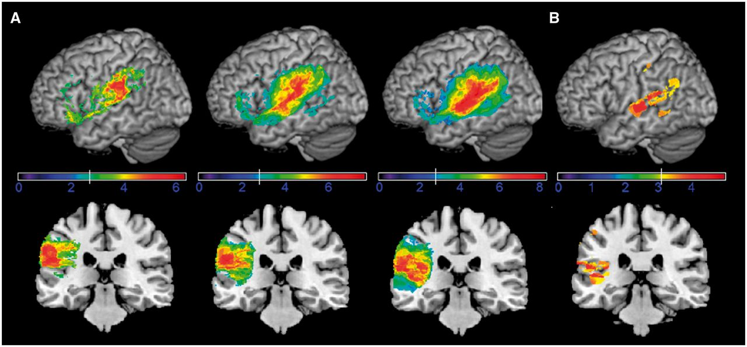
Figure 5 AAT: ‘Speech repetition’. AAT tests for speech repetition. (A) (From left to right): VLSM-maps showing ...
Notes:
Figure 5 AAT: ‘Speech repetition’. AAT tests for speech repetition. (A) (From left to right): VLSM-maps showing significant voxels associated with the impaired repetition of phonemes (left), 1-syllabic words (middle) and sentences (right). (B) VLSM map of sentence repetition with the effect of verbal working memory (digit span forward) partialled out. All voxels shown exceeded the critical threshold for significance (indicated by the white line in the colour bars, FDR-corrected P < 0.01). Warmer colours reflect increasing Z-scores. Upper graphs show a surface rendering lower graphs provide a coronal slice at MNI y = 28. Maps and statistics were performed on all patients in whom ‘speech repetition’ scores (A) and additionally WMS-R values (B) were available (Table 1).
Unless provided in the caption above, the following copyright applies to the content of this slide: © The Author (2014). Published by Oxford University Press on behalf of the Guarantors of Brain. All rights reserved. For Permissions, please email: journals.permissions@oup.com

Slide 6
Figure 6 AAT: ‘Language comprehension’. VLSM-maps showing lesions significantly affecting performance of the AAT test ...
Notes:
Figure 6 AAT: ‘Language comprehension’. VLSM-maps showing lesions significantly affecting performance of the AAT test for language comprehension. All voxels shown exceeded the critical threshold for significance (indicated by the white line in the colour bar, FDR-corrected P < 0.01). Warmer colors reflect increasing Z-scores. Numbers indicate MNI coordinates. Maps and statistics were performed on all patients in whom scores on ‘language comprehension’ were available (Table 1).
Unless provided in the caption above, the following copyright applies to the content of this slide: © The Author (2014). Published by Oxford University Press on behalf of the Guarantors of Brain. All rights reserved. For Permissions, please email: journals.permissions@oup.com

Slide 7
Figure 7 Picture naming (naming battery). Specific tests for picture naming: VLSM-maps showing lesions significantly ...
Notes:
Figure 7 Picture naming (naming battery). Specific tests for picture naming: VLSM-maps showing lesions significantly associated with impaired naming. (A, from left to right): All items, living objects, non-living objects and compound nouns. (B) Naming without time restraint (red colour scale) versus naming under time pressure (blue colour scale). All voxels shown exceeded the critical threshold for significance (indicated by the white line in the colour bar, FDR-corrected P < 0.05, all slices at MNI coordinate x = −46). Maps and statistics are based on all patients who underwent the respective versions of the naming test (Table 1).
Unless provided in the caption above, the following copyright applies to the content of this slide: © The Author (2014). Published by Oxford University Press on behalf of the Guarantors of Brain. All rights reserved. For Permissions, please email: journals.permissions@oup.com

Slide 8
Figure 8 Semantic differentiation and verbal fluency. Specific tests for semantic capabilities and semantic word ...
Notes:
Figure 8 Semantic differentiation and verbal fluency. Specific tests for semantic capabilities and semantic word fluency. VLSM maps showing lesions significantly associated with impaired semantics. From left to right: (A) synonym judgment on nouns (LeMo 25); (B) semantic differentiation of nouns (Semdiff nouns); (C) semantic differentiation of verbs (Semdiff verbs); (D) semantic word fluency (RWT); (E) semantic category shift (RWT). All voxels shown exceeded the critical threshold for significance (indicated by the white line in the colour bar, FDR-corrected P < 0.05, all slices at MNI coordinate x = −45). The different maps and statistics are based on the respective subgroups as specified in Table 1, all patients within each subgroup were included.
Unless provided in the caption above, the following copyright applies to the content of this slide: © The Author (2014). Published by Oxford University Press on behalf of the Guarantors of Brain. All rights reserved. For Permissions, please email: journals.permissions@oup.com

Slide 9
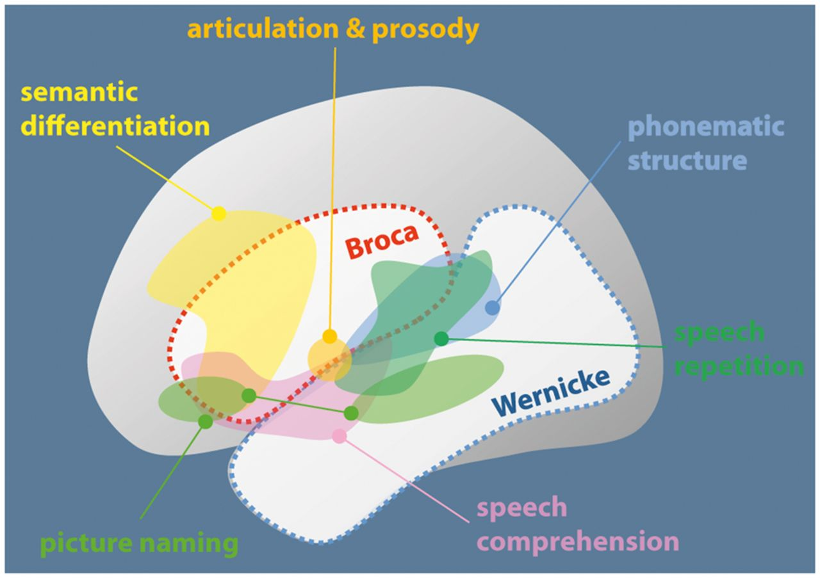
Figure 9 Synopsis of the areas delineated by syndrome-, modality- and specific symptom-based analyses. Note that there ...
Notes:
Figure 9 Synopsis of the areas delineated by syndrome-, modality- and specific symptom-based analyses. Note that there is no substantial overlap between anterior (Broca) and posterior (Wernicke) syndromes, pointing to the vascular origin of this differentiation. On the contrary areas corresponding to modality- or symptom-specific impairment show substantial overlap and are not clearly confined to either vascular territory.
Unless provided in the caption above, the following copyright applies to the content of this slide: © The Author (2014). Published by Oxford University Press on behalf of the Guarantors of Brain. All rights reserved. For Permissions, please email: journals.permissions@oup.com

