Slide 1
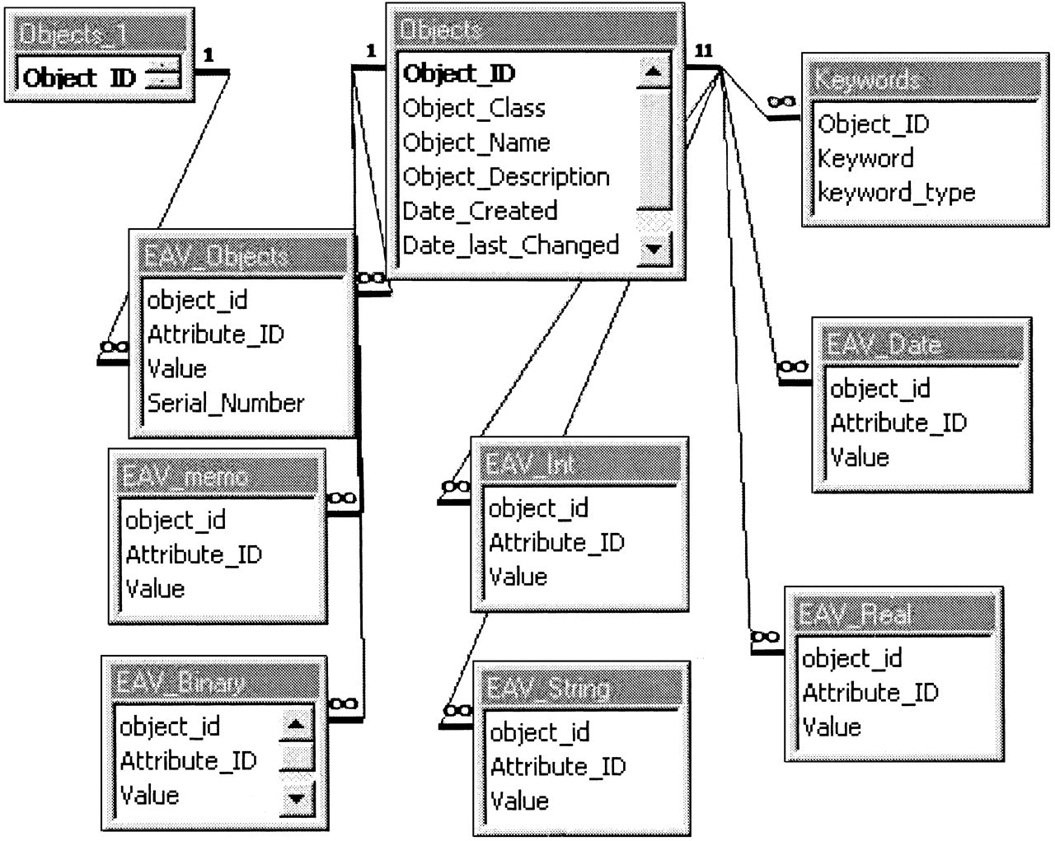
Figure 1 The EAV/CR subschema for data tables. The Objects table stores common information on all objects across all ...
Notes:
Figure 1 The EAV/CR subschema for data tables. The Objects table stores common information on all objects across all classes of data in the system. It has a supporting table, Keywords, to assist in the search for individual objects. Class-specific data are stored in the tables with an EAV_ prefix and are segregated by data type. In particular, the EAV_Objects table records objects that are components of other objects.
Unless provided in the caption above, the following copyright applies to the content of this slide: American Medical Informatics Association

Slide 2
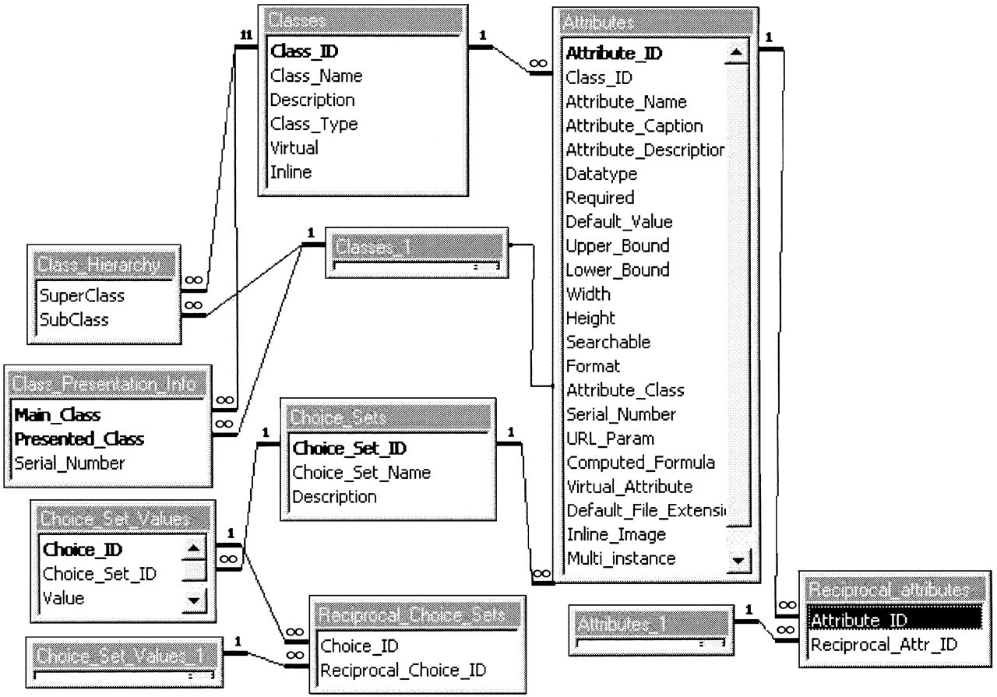
Figure 2 The EAV/CR subschema for metadata tables. The Classes table stores basic descriptions of each class of data, ...
Notes:
Figure 2 The EAV/CR subschema for metadata tables. The Classes table stores basic descriptions of each class of data, while the Attributes table records details on the attributes of each class. Classes may have subclasses, as recorded in the Class_Hierarchy table. The table Class_Presentation_Info indicates which class data are presented when a particular object is displayed in a browsing interface. The values of some attributes may be derived from controlled-vocabulary items, whose contents are recorded in the tables Choice_Sets and Choice_Set_Values. The tables Reciprocal_Attributes and Reciprocal_Choice_Sets record semantic inverses.
Unless provided in the caption above, the following copyright applies to the content of this slide: American Medical Informatics Association

Slide 3
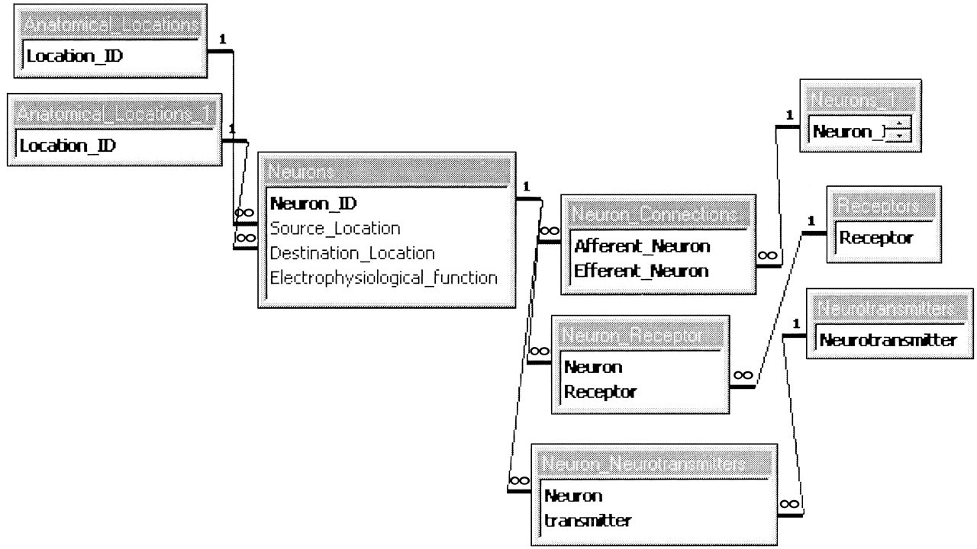
Figure 3 A conventional schema to manage data described in the nigrostriatal neuron example. Even such a small example ...
Notes:
Figure 3 A conventional schema to manage data described in the nigrostriatal neuron example. Even such a small example requires the creation of numerous tables for satisfactory representation.
Unless provided in the caption above, the following copyright applies to the content of this slide: American Medical Informatics Association

