Slide 1
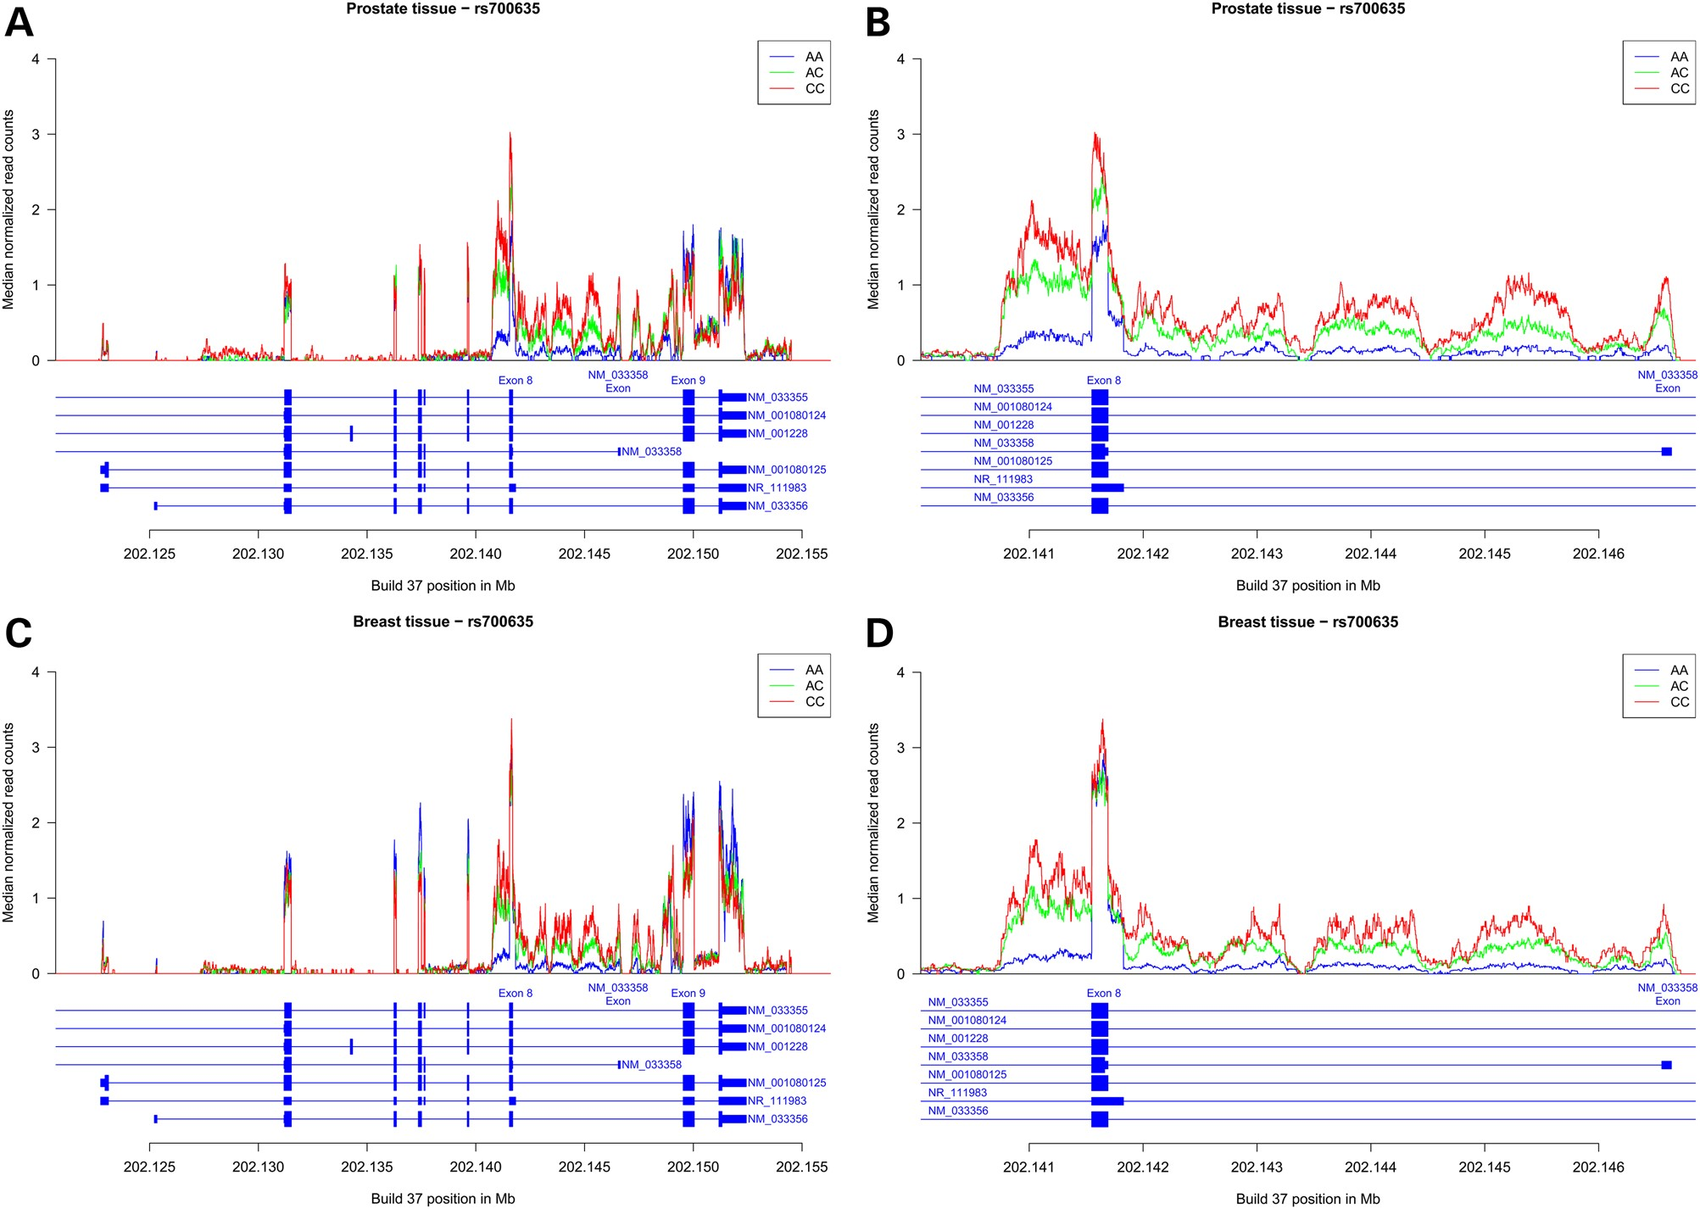
Figure 1. Carriers of the rs700635[C] allele show preferential retention of CASP8 intron 8 sequences. RNA-seq data were ...
Notes:
Figure 1. Carriers of the rs700635[C] allele show preferential retention of CASP8 intron 8 sequences. RNA-seq data were obtained from normal prostate or breast tissue of donors who were genotyped for rs700635. (A) Median normalized read counts (normalized for each individual to the total number of aligned reads) from prostate RNA were stratified by rs700635 genotype and plotted over the genomic region covering the coding exons of CASP8. Data are from n = 6 C/C homozygotes (shown in red), n = 12 A/C heterozygotes (shown in green) and n = 19 A/A homozygotes (shown in blue). The X-axis is the genomic position in Mb (GRCh37/hg19). The structure of RefSeq CASP8 transcripts in the region is shown beneath the X-axis. (B) Zoom showing prostate RNA median normalized read counts by genotype over the region extending from the 3′ end of intron 7, through the 5′ region of intron 8 up to the NM_033358 variant exon. (C) Similarly plotted median normalized read counts from breast RNA. Data are from n = 7 C/C homozygotes, n = 27 A/C heterozygotes and n = 22 A/A homozygotes. (D) Zoom showing breast RNA median-normalized read counts over a region encompassing the 5′ region of CASP8 intron 8. (E) Association between rs700635 genotype and prostate RNA-seq read count in intron 8. For each individual, the median of normalized RNA-seq read counts overlapping the 5′ region of intron 8 [chr2:202141827-202146555 (GRCh37/hg19)] was determined. Association with genotype was then determined by linear regression against rs700635 variant allele count. P = 3.8 × 10−8 and β = 0.33 (SD units). (F) Similarly determined association between rs700635 genotype and prostate RNA-seq read count over all major coding exons of CASP8. P = 0.678 and β = −0.07. (G) Association between rs700635 genotype and breast RNA-seq read count in the 5′ region of intron 8. P = 3.11 × 10−11 and β = 0.36. (H) Association between rs700635 genotype and breast RNA-seq read count over all CASP8 major coding exons. P = 0.0475 and β = −0.30.
Unless provided in the caption above, the following copyright applies to the content of this slide: © The Author 2016. Published by Oxford University Press.This is an Open Access article distributed under the terms of the Creative Commons Attribution License (http://creativecommons.org/licenses/by/4.0/), which permits unrestricted reuse, distribution, and reproduction in any medium, provided the original work is properly cited.

Slide 2
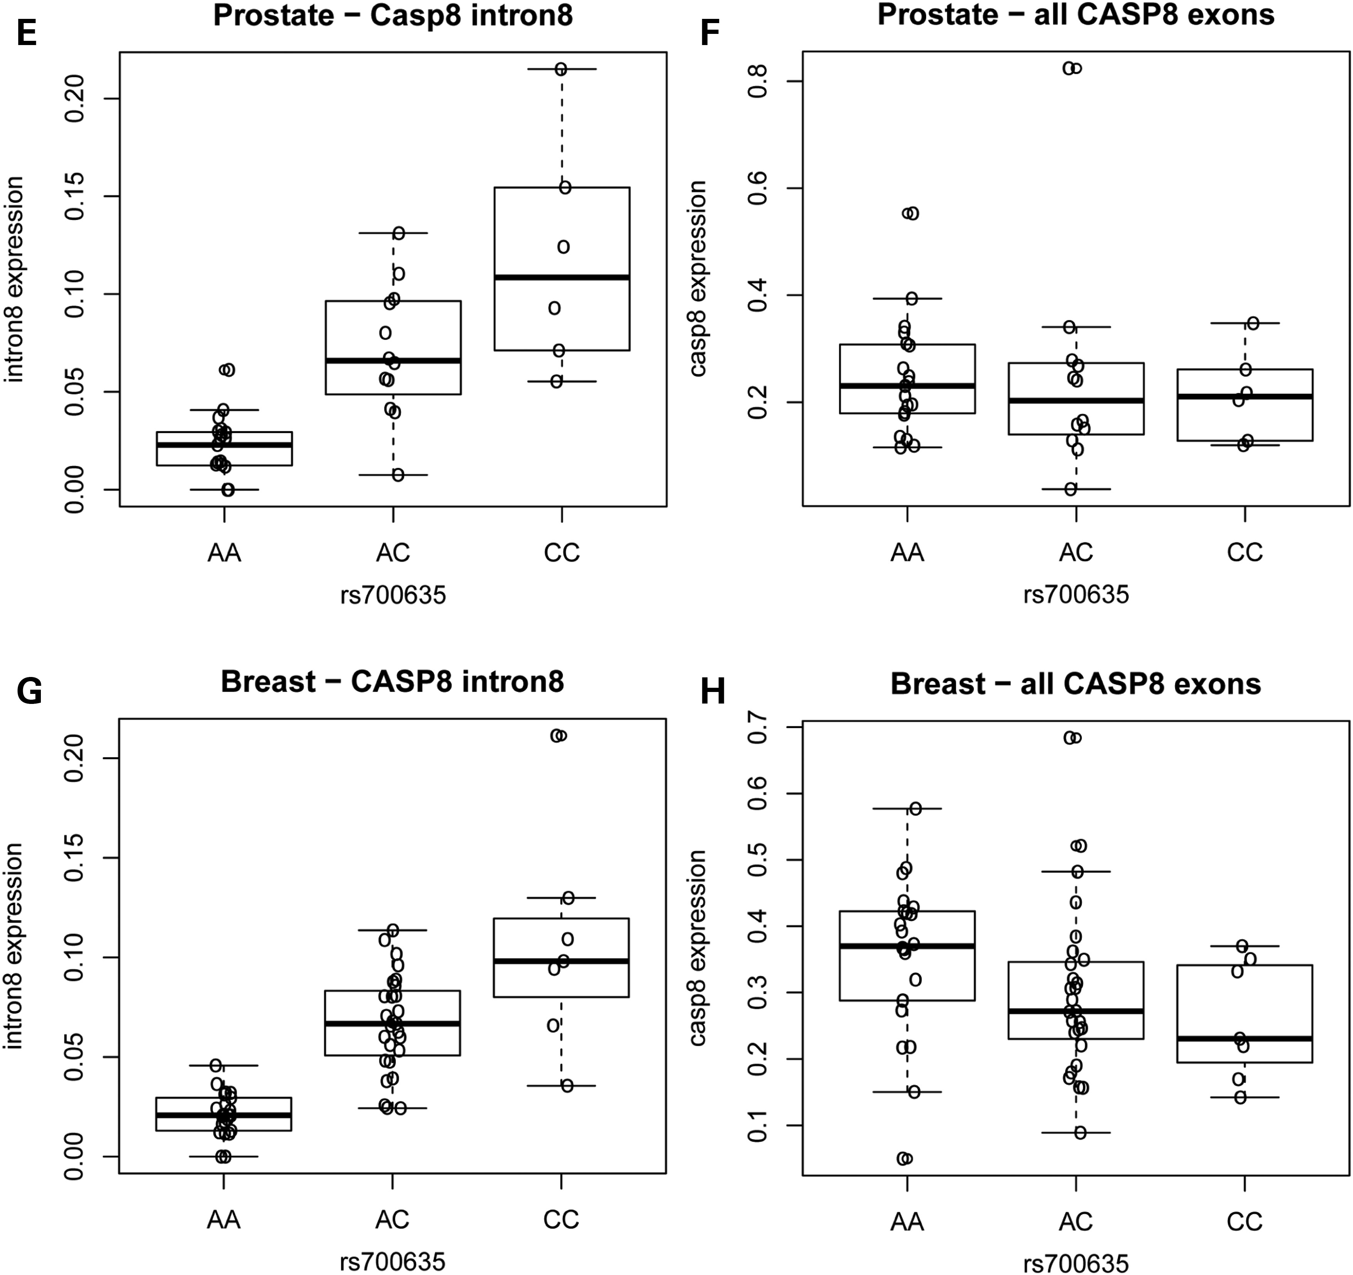
Figure 1 Continued
Notes:
Figure 1 Continued
Unless provided in the caption above, the following copyright applies to the content of this slide: © The Author 2016. Published by Oxford University Press.This is an Open Access article distributed under the terms of the Creative Commons Attribution License (http://creativecommons.org/licenses/by/4.0/), which permits unrestricted reuse, distribution, and reproduction in any medium, provided the original work is properly cited.

Slide 3
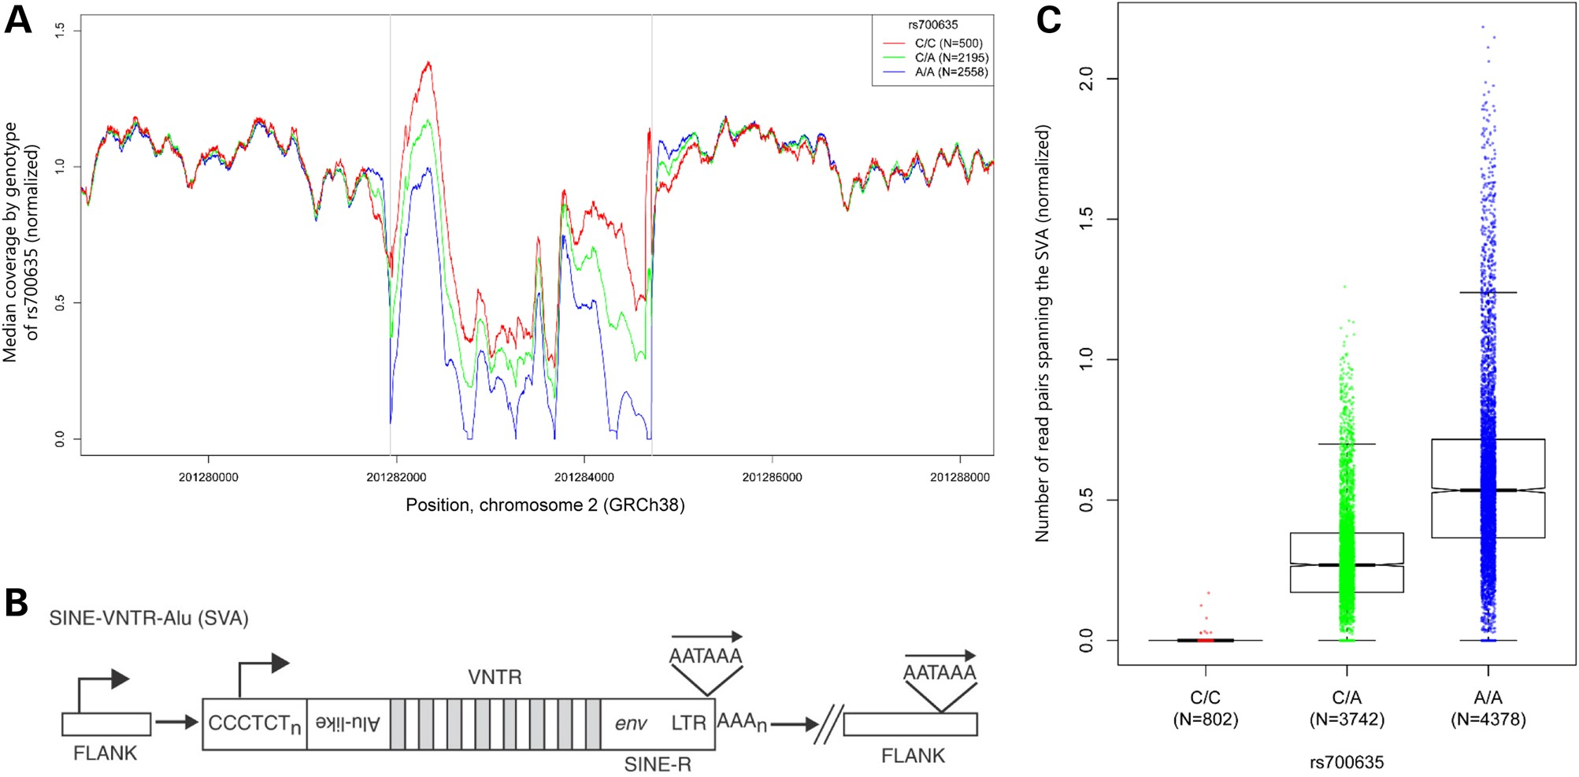
Figure 2. rs700635[C] is associated with insertion of an SVA-E retrotransposon into the CASP8 gene. (A) The DNA ...
Notes:
Figure 2. rs700635[C] is associated with insertion of an SVA-E retrotransposon into the CASP8 gene. (A) The DNA sequence coverage of the CASP8 intron 8 region was normalized and the median coverage for each genotype was plotted at each position. A copy number variation was detected in the region chr2:201281936-201284718 (GRCh38/hg38). Linear regression of mean normalized coverage by SNP genotype showed a significantly higher copy number over this region in association with rs700635[C] (P << 2 × 10−16). (B) The general structure of an SVA element: these non-autonomous retrotransposons consist of a CCCTCT repeat region (which may have RNApolII promoter activity), followed by a series of Alu-like repeats, followed by a VNTR region, followed by a degenerate env gene fragment and long terminal repeat from an extinct endogenous human retrovirus (HERV-K). Transcription in the SVA may utilize a polyadenylation signal within the long terminal repeat, or it may continue into flanking chromosomal sequences (see text). [Image from (17), used with permission.] (C) Boxplot showing association of DNA-sequence read pairs spanning the SVA insertion site with rs700635 genotype: read pairs were selected such that the forward read was in CASP8 sequence within an interval of 1000 bp to the left of the SVA-E insertion site and the paired reverse read was in CASP8 sequence within an interval of 1000 bp to the right of the SVA-E insertion site. Such reads are expected to occur only if the SVA-E retrotransposon is absent. Counts of qualifying reads were normalized and plotted by genotype. Association was assessed by linear regression of read count versus rs700635 genotype (P << 2 × 10−16).
Unless provided in the caption above, the following copyright applies to the content of this slide: © The Author 2016. Published by Oxford University Press.This is an Open Access article distributed under the terms of the Creative Commons Attribution License (http://creativecommons.org/licenses/by/4.0/), which permits unrestricted reuse, distribution, and reproduction in any medium, provided the original work is properly cited.

Slide 4
Figure 3. The SVA-E insertion site in the CASP8 gene on chromosome 2 and the retrotransposition-transduction event on ...
Notes:
Figure 3. The SVA-E insertion site in the CASP8 gene on chromosome 2 and the retrotransposition-transduction event on chromosome 19. Note that all structures are drawn to preserve the genomic orientation of the CASP8 gene and the chr2 SVA-E insertion. Thus, the 5′ end of the SVA-E is to the right in the diagram and chr2 sequences are from the genomic forward strand. (A) The chr2 SVA-E (pale blue bars) is inserted into CASP8 intron 8 between the NM_033358 variant exon and exon 9 (at chr2:201281936-201284718). A copy of the SVA-E is present on chr19 (green bars). The chr19 SVA-E is flanked by a transduced 288 bp segment, including the NM_033358 variant exon, from chr2 (darker green bar). (B) The structure of the chr2 breakpoints: the left panel shows the breakpoint between the transduced sequence and CASP8 intron 8 sequence. The central panel shows the left end of the SVA-E insertion on chr2 (blue bars) with the TSD sequence indicated. The sequence of this junction is the same on the chr19 transduced copy (green bars). The right panel shows the breakpoint between the right end of the SVA-E and native CASP8 intron 8 sequence with the TSD indicated. (C) The structure of the breakpoint between the transduced sequence and native chr19 sequence: the transduced CASP8 intron 8 sequence contains a polyadenylation signal on the reverse strand (appearing here as TTTATT). Moving leftwards on the reverse strand, this is followed by a short polyA sequence (hatched green bar) then a TSD derived from native chr19 sequence. (D) The breakpoint between the 5′ end of the SVA-E and native chr19 sequence, with the TSD sequence indicated. (E) The structure of the chr19 insertion site when the SVA-E is not present. Note that here the TSD sequence is unduplicated.
Unless provided in the caption above, the following copyright applies to the content of this slide: © The Author 2016. Published by Oxford University Press.This is an Open Access article distributed under the terms of the Creative Commons Attribution License (http://creativecommons.org/licenses/by/4.0/), which permits unrestricted reuse, distribution, and reproduction in any medium, provided the original work is properly cited.

