Slide 1
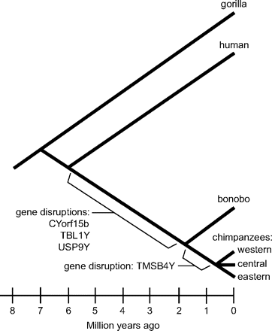
FIG. 1.— Timing of Y-chromosome gene losses during chimpanzee evolution. Disruptions to the coding sequences of 3 ...
Notes:
FIG. 1.— Timing of Y-chromosome gene losses during chimpanzee evolution. Disruptions to the coding sequences of 3 Y-chromosome genes (CYorf15b, TBL1Y, and USP9Y) are estimated to have an origin in the ancestral chimpanzee–bonobo lineage following divergence from the human lineage, whereas the TMSB4Y coding sequence was disrupted in the chimpanzee lineage following chimpanzee–bonobo Y-chromosome divergence, but prior to the separation of chimpanzee subspecies.
Unless provided in the caption above, the following copyright applies to the content of this slide: © The Author 2007. Published by Oxford University Press on behalf of the Society for Molecular Biology and Evolution. All rights reserved. For permissions, please e-mail: journals.permissions@oxfordjournals.org

Slide 2
FIG. 2.— Continued degradation of the USP9Y coding region in bonobos. The USP9Y exon 36 gene region shown for several ...
Notes:
FIG. 2.— Continued degradation of the USP9Y coding region in bonobos. The USP9Y exon 36 gene region shown for several primate species with the 4-bp frameshift deletion (A) that occurred in the chimpanzee–bonobo ancestral lineage, by comparison with the gorilla and human sequences. A second example of more recent gene degradation is shown by a 16-bp frameshift deletion (B) that is unique to the bonobo lineage.
Unless provided in the caption above, the following copyright applies to the content of this slide: © The Author 2007. Published by Oxford University Press on behalf of the Society for Molecular Biology and Evolution. All rights reserved. For permissions, please e-mail: journals.permissions@oxfordjournals.org

