Slide 1
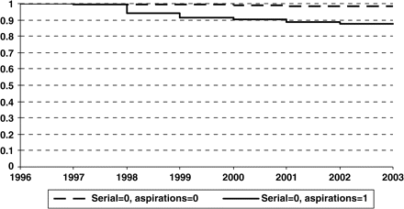
Figure 1 Kaplan-Meier survival functions for persons without past entrepreneurial experience.
Notes:
Figure 1 Kaplan-Meier survival functions for persons without past entrepreneurial experience.
Unless provided in the caption above, the following copyright applies to the content of this slide: © The Author 2007. Published by Oxford University Press on behalf of Associazione ICC. All rights reserved.

Slide 2
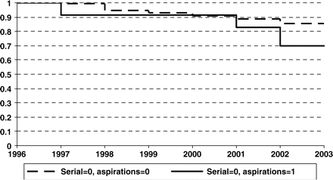
Figure 2 Kaplan-Meier survival functions for persons with past entrepreneurial experience.
Notes:
Figure 2 Kaplan-Meier survival functions for persons with past entrepreneurial experience.
Unless provided in the caption above, the following copyright applies to the content of this slide: © The Author 2007. Published by Oxford University Press on behalf of Associazione ICC. All rights reserved.

