Slide 1
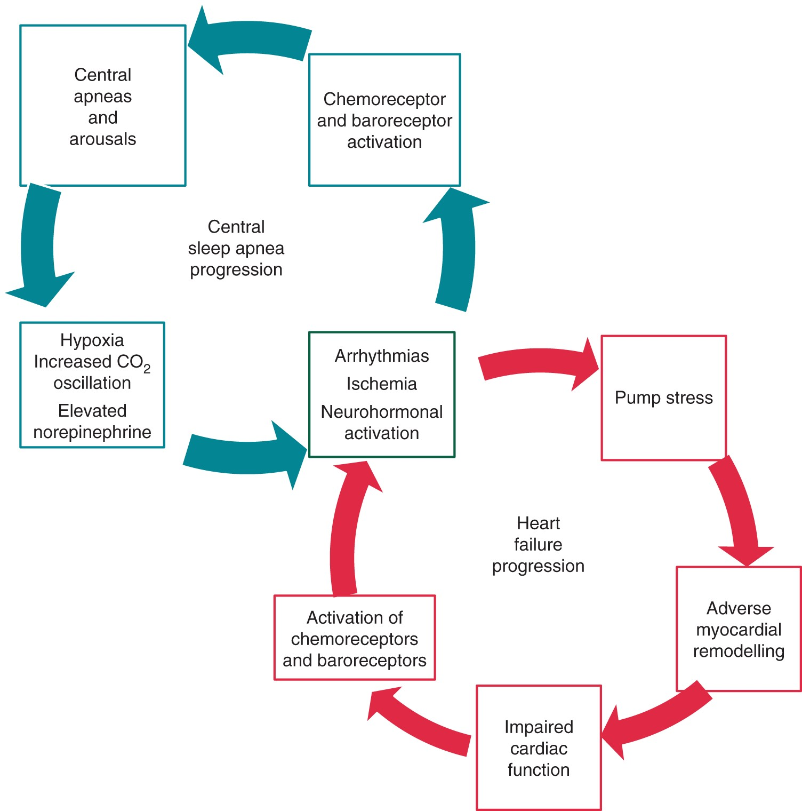
Figure 1 Pathophysiology and the relationship between HF, CSA and arrhythmias: each episode of central apnoea and ...
Notes:
Figure 1 Pathophysiology and the relationship between HF, CSA and arrhythmias: each episode of central apnoea and arousal results in hypoxia, norepinephrine, and wide oscillations in carbon dioxide. Hypoxia results in cardiac ischaemia, plaque rupture, and dementia. Elevated norepinephrine causes atrial and ventricular arrhythmias and activates the renin–angiotensin system resulting in sodium retention and neurohormonal activation. Neurohormonal activation and ischaemia further activate central and peripheral chemoreceptors and baroreceptors further destabilizing breathing and triggering CSA. In addition to CSA, feeding back to continue the CSA cycle, ischaemia, and neurohormonal activation causes additional pump stress leading to adverse myocardial remodelling. With adverse remodelling, cardiac function is further impaired and worsens the downward progression of HF.
Unless provided in the caption above, the following copyright applies to the content of this slide: Published on behalf of the European Society of Cardiology. All rights reserved. © The Author 2016. For permissions please email: journals.permissions@oup.com.

Slide 2
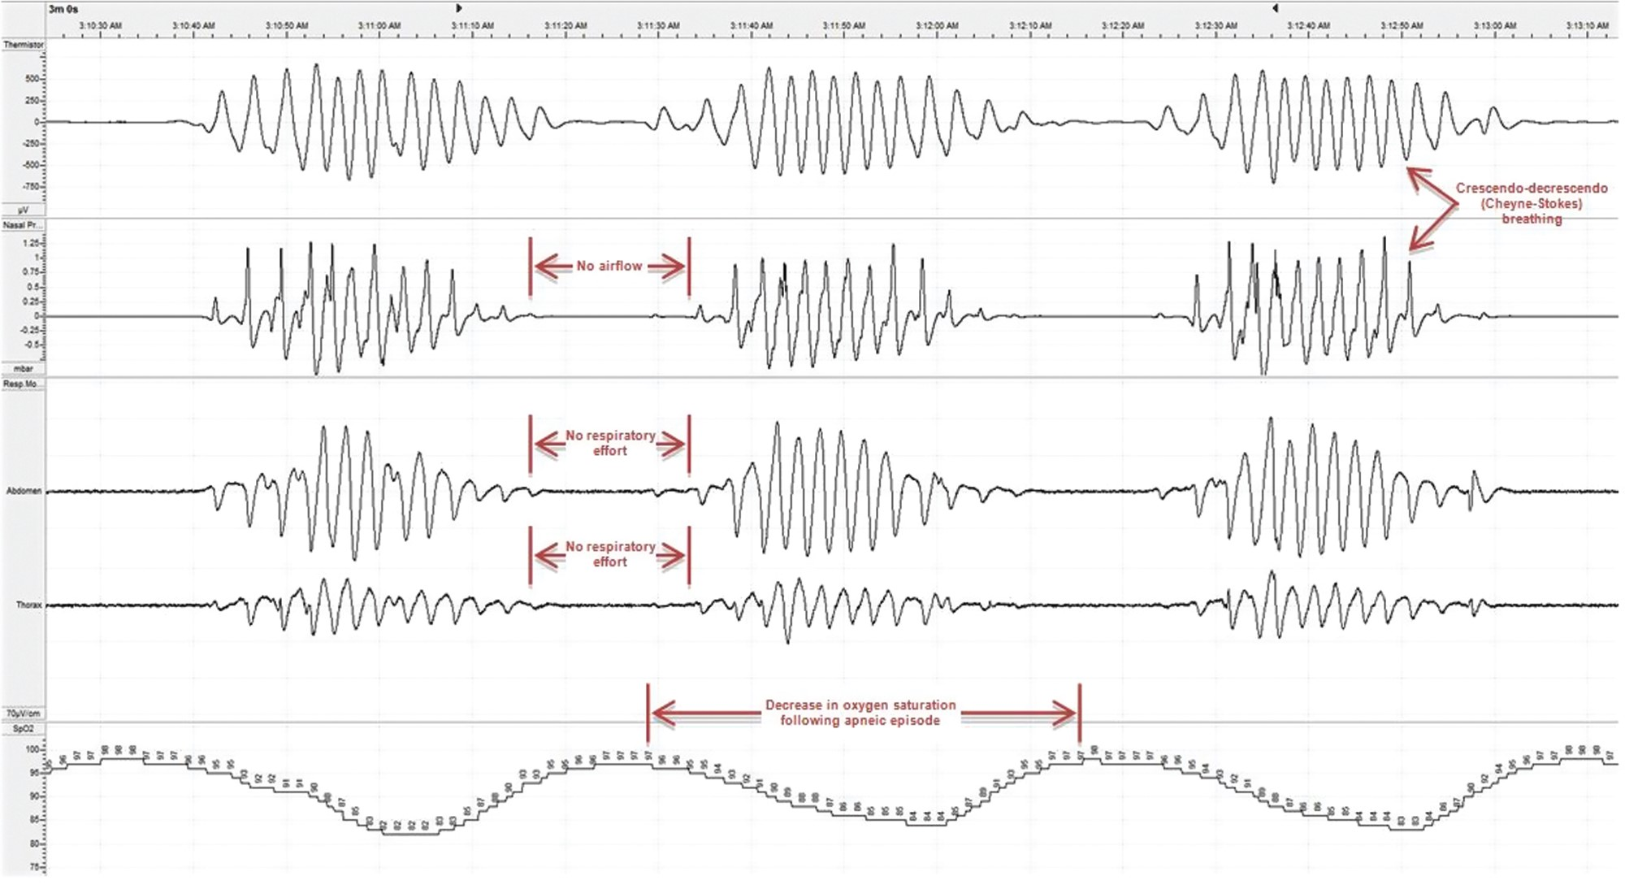
Figure 2 Selected channels of a polysomnogram of a patient with CSA with Cheyne–Stokes breathing.
Notes:
Figure 2 Selected channels of a polysomnogram of a patient with CSA with Cheyne–Stokes breathing.
Unless provided in the caption above, the following copyright applies to the content of this slide: Published on behalf of the European Society of Cardiology. All rights reserved. © The Author 2016. For permissions please email: journals.permissions@oup.com.

Slide 3
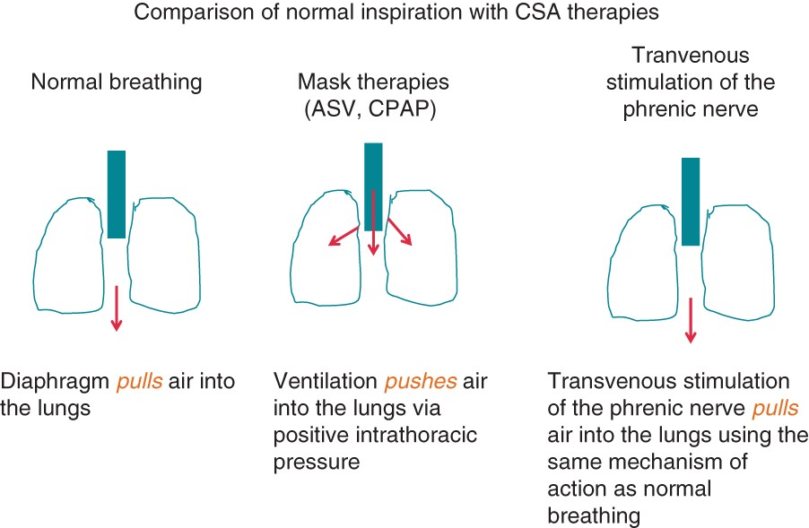
Figure 3 A comparison between the different mechanisms of therapies in patients with CSA.
Notes:
Figure 3 A comparison between the different mechanisms of therapies in patients with CSA.
Unless provided in the caption above, the following copyright applies to the content of this slide: Published on behalf of the European Society of Cardiology. All rights reserved. © The Author 2016. For permissions please email: journals.permissions@oup.com.

Slide 4
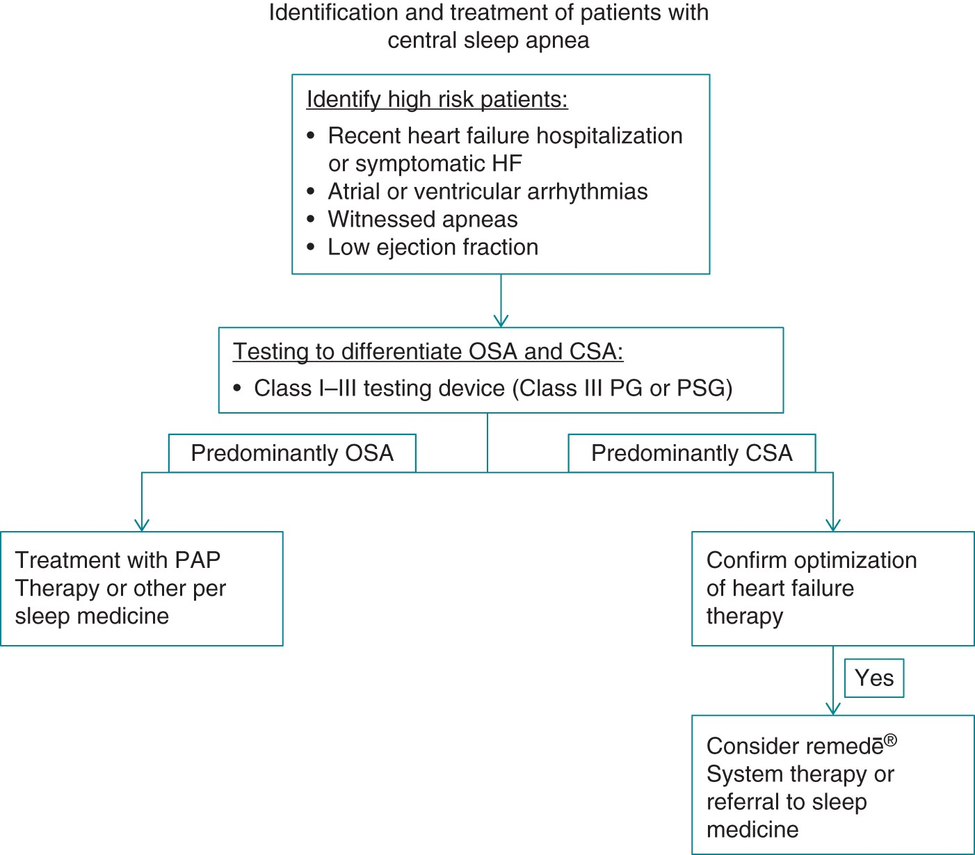
Figure 4 Pathway for the identification and treatment of patients with CSA.
Notes:
Figure 4 Pathway for the identification and treatment of patients with CSA.
Unless provided in the caption above, the following copyright applies to the content of this slide: Published on behalf of the European Society of Cardiology. All rights reserved. © The Author 2016. For permissions please email: journals.permissions@oup.com.

Slide 5
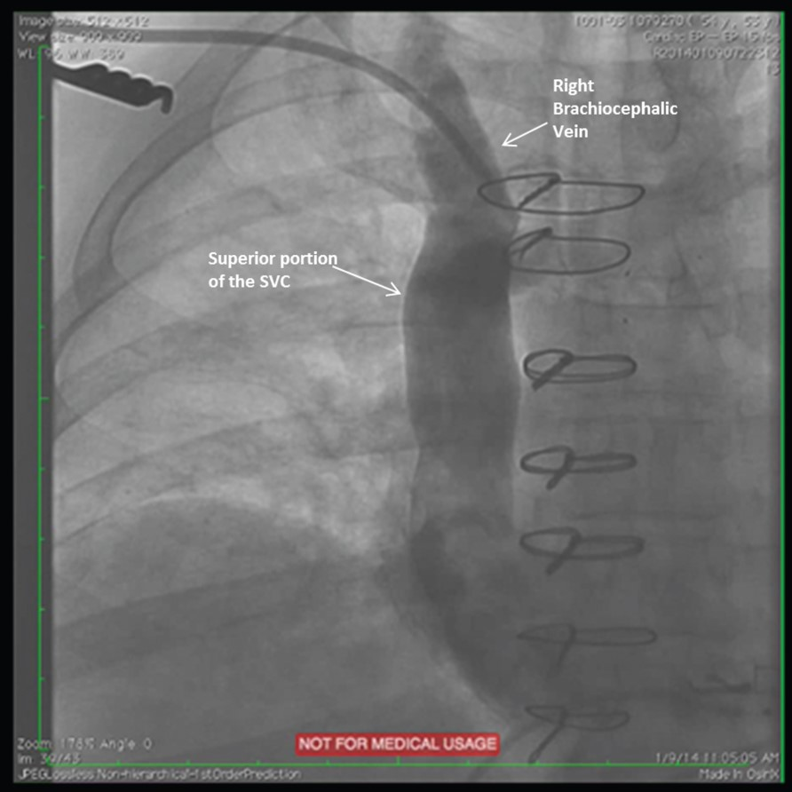
Figure 5 Right brachiocephalic vein venogram.
Notes:
Figure 5 Right brachiocephalic vein venogram.
Unless provided in the caption above, the following copyright applies to the content of this slide: Published on behalf of the European Society of Cardiology. All rights reserved. © The Author 2016. For permissions please email: journals.permissions@oup.com.

Slide 6
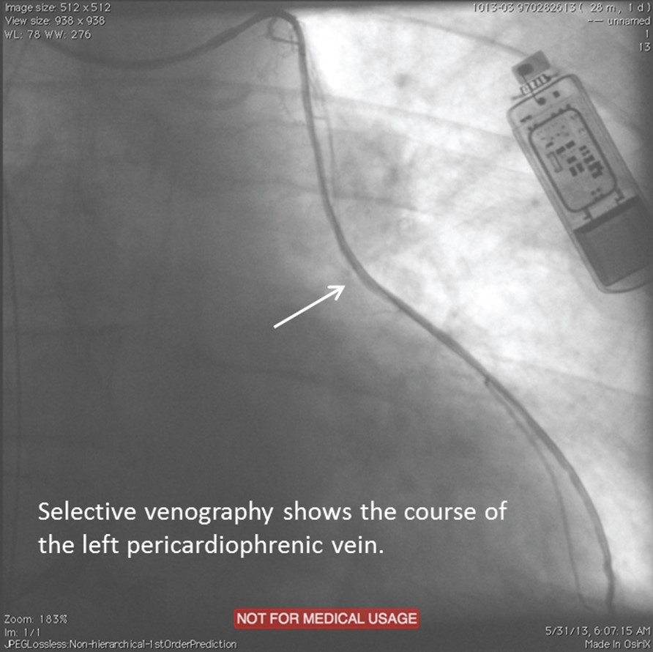
Figure 6 Left pericardiophrenic venogram.
Notes:
Figure 6 Left pericardiophrenic venogram.
Unless provided in the caption above, the following copyright applies to the content of this slide: Published on behalf of the European Society of Cardiology. All rights reserved. © The Author 2016. For permissions please email: journals.permissions@oup.com.

Slide 7
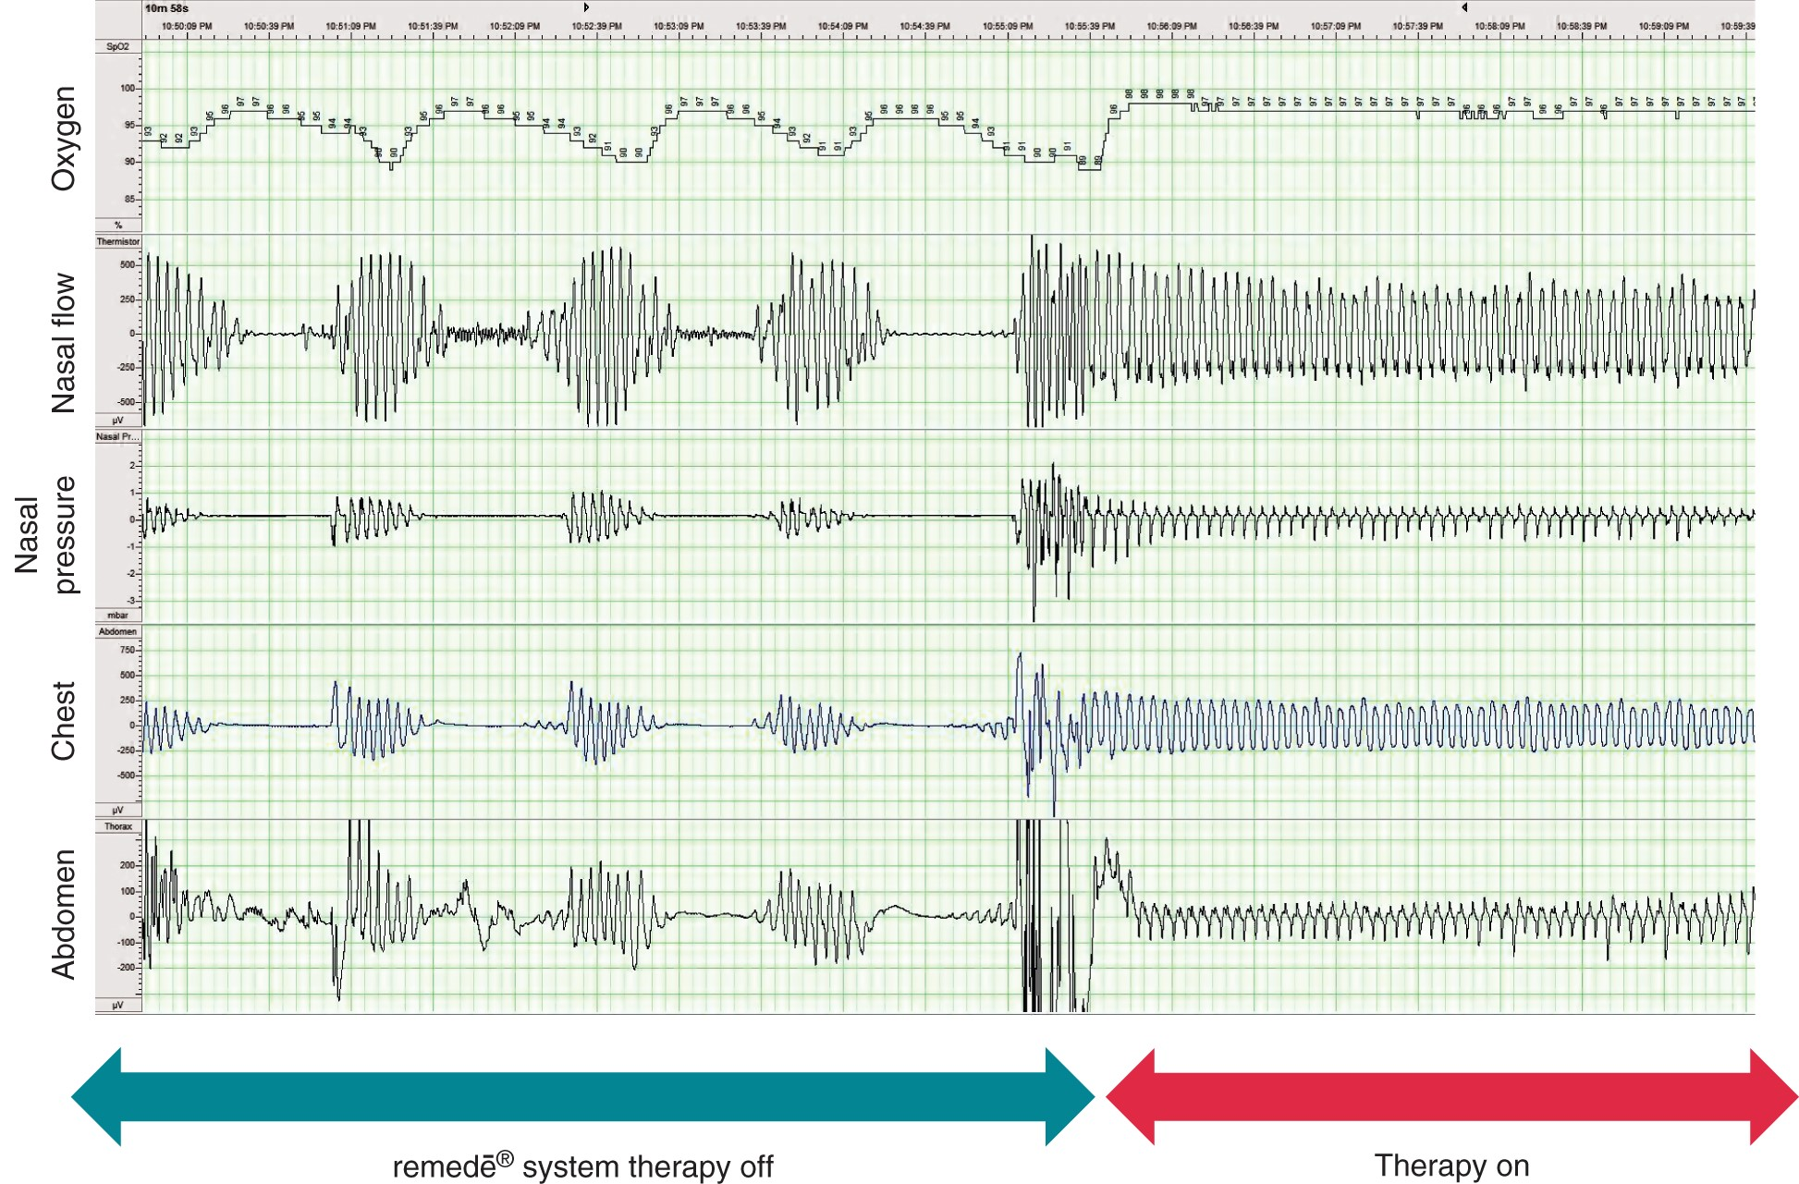
Figure 7 The remedē® system therapy.
Notes:
Figure 7 The remedē® system therapy.
Unless provided in the caption above, the following copyright applies to the content of this slide: Published on behalf of the European Society of Cardiology. All rights reserved. © The Author 2016. For permissions please email: journals.permissions@oup.com.

