Slide 1
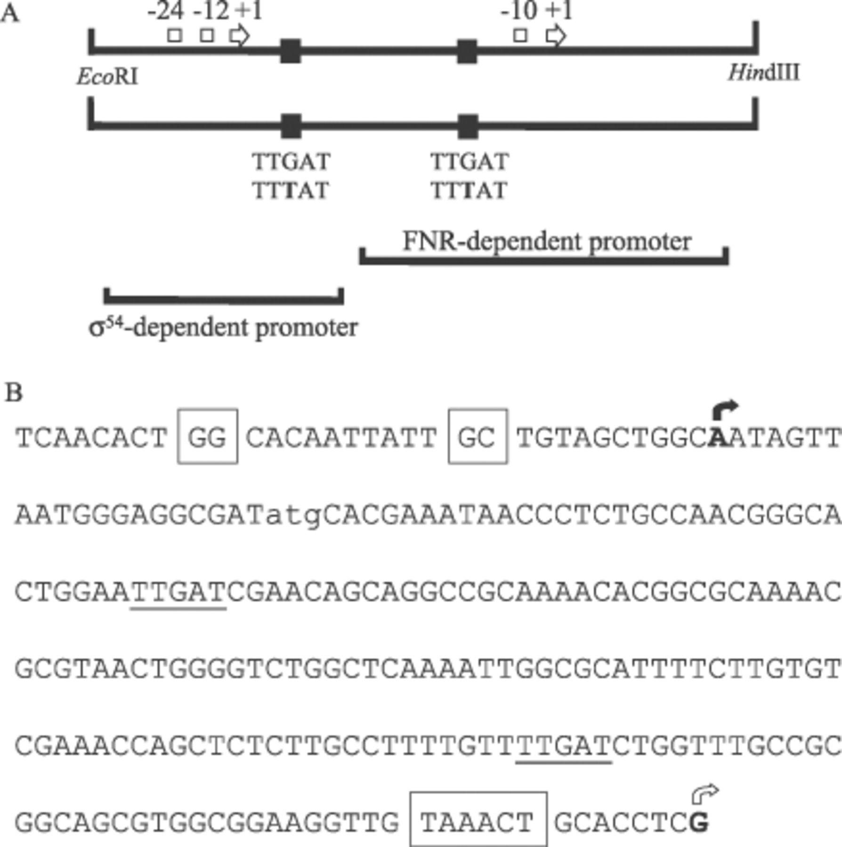
1 E. coli hypA promoter region. A: Schematic representation of the hypA promoter region. The positions of the ...
Notes:
1 E. coli hypA promoter region. A: Schematic representation of the hypA promoter region. The positions of the σ54-dependent promoter (−24, −12 and +1) and the FNR-regulated σ70-dependent internal promoter (−10 and +1) are indicated. The two fragments used to analyse the σ54-dependent promoter and the internal FNR-dependent promoter in isolation are shown. The positions and sequences of two FNR half-site motifs (■; TTGAT) are highlighted along with the sequences of the mutated half-sites (TTTAT). The engineered restriction sites for construction of the lacZ promoter fusions are indicated. B: Nucleotide sequence of the hypA promoter region. The −12 and −24 elements associated with the σ54-dependent promoter are boxed, as is the predicted −10 element associated with the FNR-regulated internal promoter. The corresponding transcript starts are marked by arrows (σ54-dependent transcript start, filled arrow; σ70-dependent transcript start, open arrow). The start codon of the hypA transcript is indicated in lower case (atg). The two FNR half-sites (TTGAT) are underlined.
Unless provided in the caption above, the following copyright applies to the content of this slide: © 2003 Federation of European Microbiological Societies

Slide 2
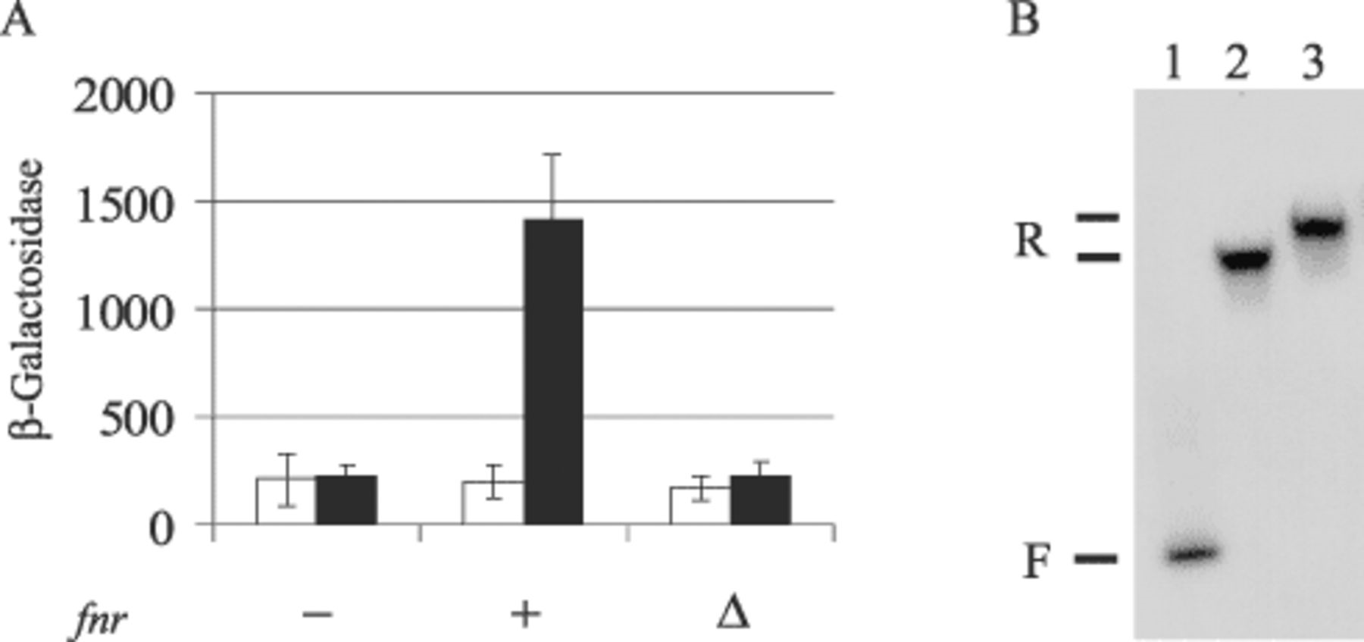
2 FNR-mediated regulation of hypA. A: β-Galactosidase activities (Miller units) expressed from hypA::lacZ ...
Notes:
2 FNR-mediated regulation of hypA. A: β-Galactosidase activities (Miller units) expressed from hypA::lacZ operon fusion in JRG1728 (Δlac Δfnr) transformants grown under aerobic (open bars) and anaerobic (filled bars) conditions. Strains contain: −, pBR322t (vector control); +, pGS196 (fnr+); or Δ, pGS198 (Δ29fnr+); and a compatible low copy number pRW50 derivative (pGS1483) encoding hypA::lacZ operon fusion with the unaltered hyp operon promoter region. The values (Miller units) given are the means of duplicate determinations from at least two independent cultures. The error bars indicate the standard deviation from the mean. B: Binding of FNR to PhypA. Labelled fragments of EcoRI- and HindIII-digested hyp operon promoter region, PCR-amplified from wild-type chromosomal DNA, were incubated with FNR* for gel retardation analysis. Lane 1, no protein; 2, 1.5 µM FNR*; 3, 3 µM FNR*. The positions of the free (F) and FNR* retarded (R) DNA are indicated.
Unless provided in the caption above, the following copyright applies to the content of this slide: © 2003 Federation of European Microbiological Societies

Slide 3
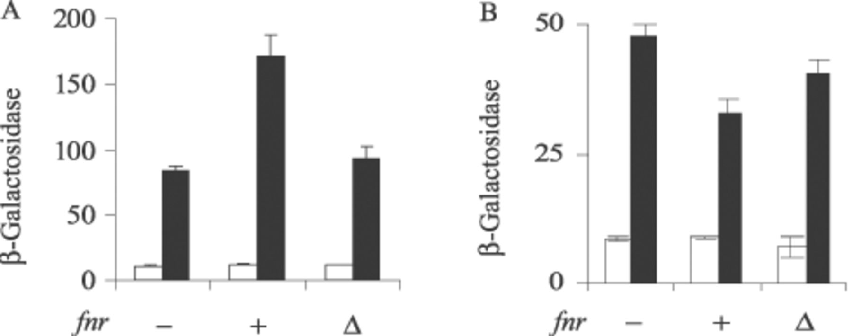
3 FNR-mediated regulation of dissected hyp promoter region. β-Galactosidase activities (Miller units) expressed ...
Notes:
3 FNR-mediated regulation of dissected hyp promoter region. β-Galactosidase activities (Miller units) expressed from the dissected hypA::lacZ operon fusions in JRG1728 (Δlac Δfnr) transformants grown under aerobic (open bars) and anaerobic (filled bars) conditions. Strains contain: −, pBR322t (vector control); +, pGS196 (fnr+); or Δ, pGS198 (Δ29fnr+); and a compatible low copy number pRW50 derivative (either pGS1484, or pGS1485) encoding hypA::lacZ operon fusions with the indicated hyp promoter fragments. A: Activities of the downstream hypA fragment containing the FNR-dependent internal promoter (pGS1484). B: Activities of the upstream hypA fragment containing the σ54-dependent promoter (pGS1485). The values (Miller units) given are the means of duplicate determinations from at least two independent cultures. The error bars indicate the standard deviation from the mean.
Unless provided in the caption above, the following copyright applies to the content of this slide: © 2003 Federation of European Microbiological Societies

Slide 4
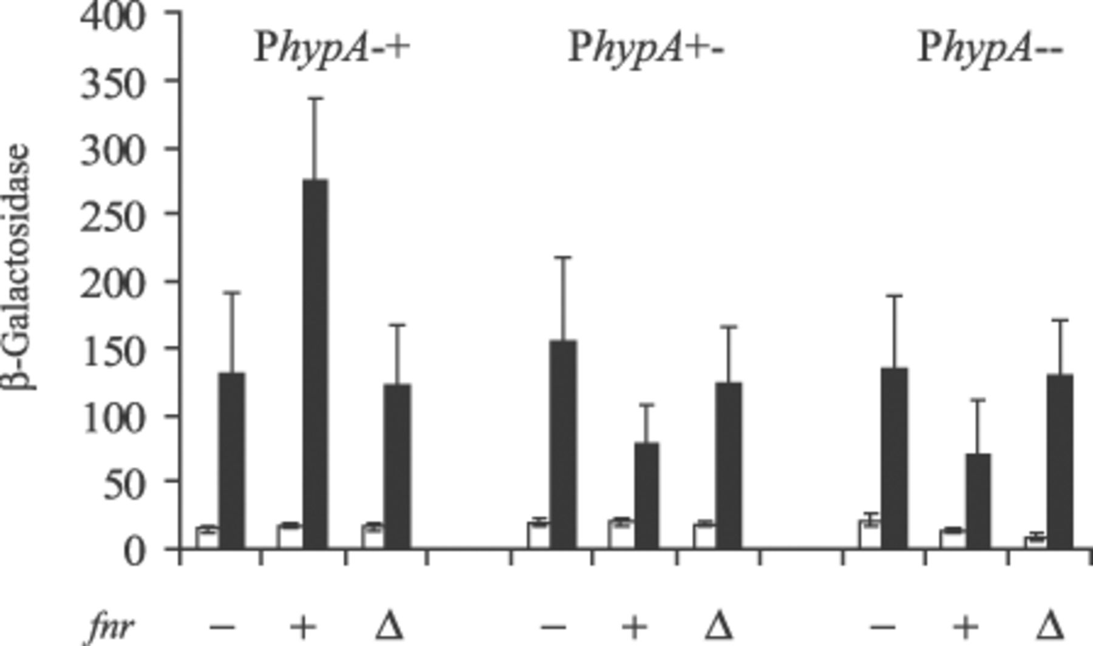
4 FNR-mediated regulation of hyp promoters with mutations in the FNR half-site motifs. β-Galactosidase ...
Notes:
4 FNR-mediated regulation of hyp promoters with mutations in the FNR half-site motifs. β-Galactosidase activities (Miller units) expressed from altered hypA::lacZ operon fusions in JRG1728 (Δlac Δfnr) transformants grown under aerobic (open bars) or anaerobic (filled bars) conditions. Strains contain: −, pBR322t (vector control); +, pGS196 (fnr+); or Δ, pGS198 (Δ29fnr); and a compatible low copy number pRW50 derivative containing the indicated hypA::lacZ operon fusions with altered hyp promoters. PhypA−+, hyp promoter region with an impaired (TTTAT) upstream FNR half-site and an intact (TTGAT) downstream FNR half-site (pGS1486); PhypA+−, hyp promoter region with an intact (TTGAT) upstream FNR half-site and an impaired (TTTAT) downstream FNR half-site (pGS1487); PhypA−−, hyp promoter region with both FNR half-sites impaired (TTTAT) (pGS1488). The values (Miller units) given are the means of duplicate determinations from at least two independent cultures. The error bars indicate the standard deviation from the mean.
Unless provided in the caption above, the following copyright applies to the content of this slide: © 2003 Federation of European Microbiological Societies

Slide 5
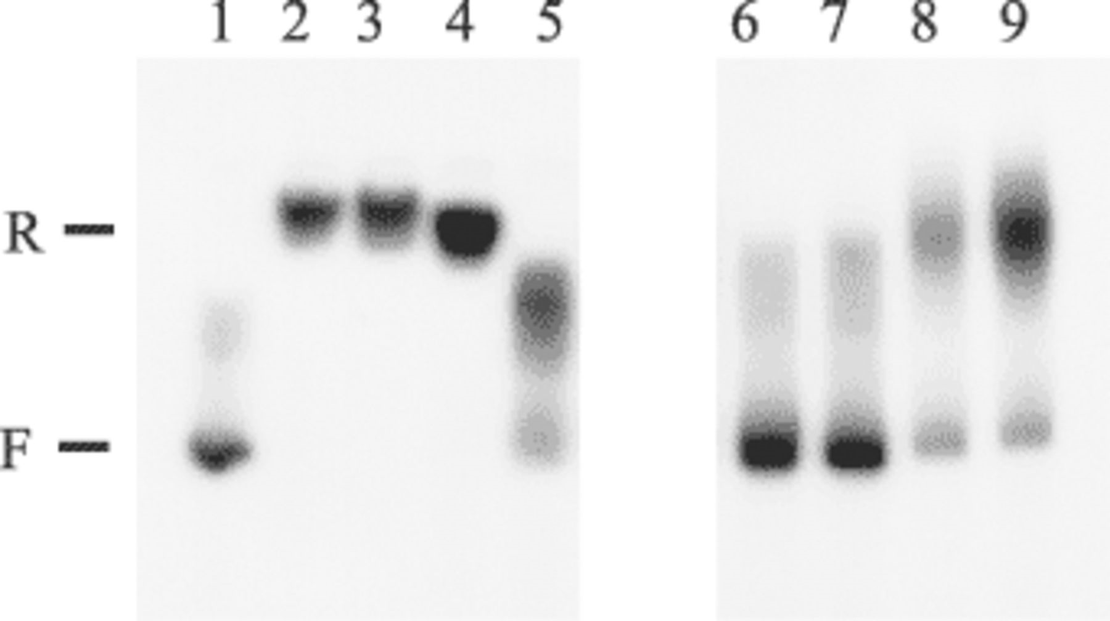
5 Interactions of FNR with hypA promoters. Radiolabelled unaltered (PhypA) and variant promoter fragments (∼30 ...
Notes:
5 Interactions of FNR with hypA promoters. Radiolabelled unaltered (PhypA) and variant promoter fragments (∼30 ng) were incubated with FNR* (0.32 µM) for 10 min at 25°C before separation of FNR*:PhypA complexes by electrophoresis. Lane 1, PhypA no FNR*; 2, PhypA; 3, PhypA−+; 4, PhypA+−; 5, PhypA−−. Similar incubations containing radiolabelled PhypA and a 15-fold molar excess of the indicated unlabelled competitor DNA were also tested. The cold competitor DNA used was: Lane 6, PhypA; 7, PhypA−+; 8, PhypA+−; 9, PhypA−−. For definitions of promoter variants see legend to Fig. 4. The positions of the free (F) and FNR* retarded (R) DNA are indicated.
Unless provided in the caption above, the following copyright applies to the content of this slide: © 2003 Federation of European Microbiological Societies

