Slide 1
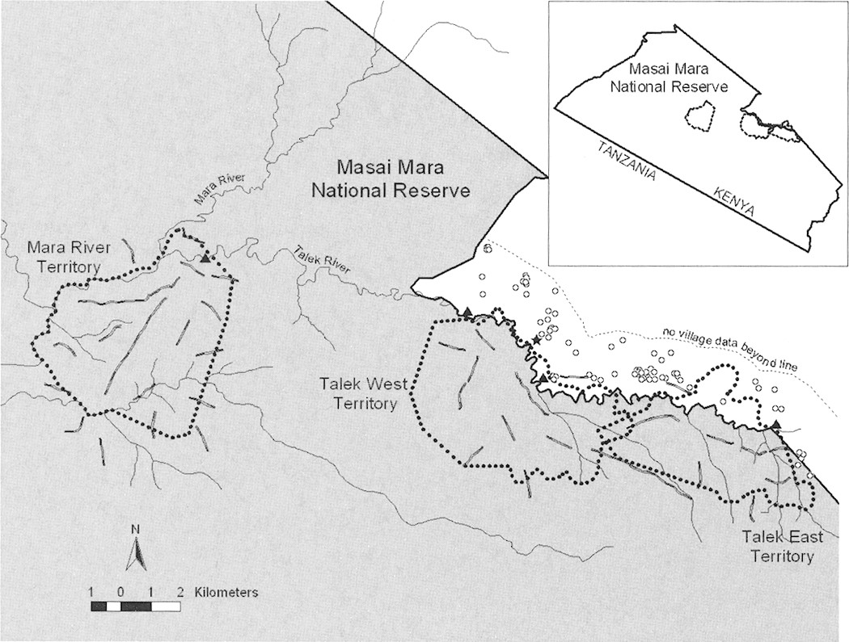
Fig. 1 Territory boundaries (dotted lines) of the 3 monitored spotted hyena (Crocuta crocuta) social groups (clans) ...
Notes:
Fig. 1 Territory boundaries (dotted lines) of the 3 monitored spotted hyena (Crocuta crocuta) social groups (clans) in the Masai Mara National Reserve, Kenya. Triangles indicate the 4 main tourist lodges in the study area, open circles represent Maasai villages, and a star indicates the town of Talek. Prey-sampling transects are indicated with checkered lines.
Unless provided in the caption above, the following copyright applies to the content of this slide: © 2007 American Society of Mammalogists

Slide 2
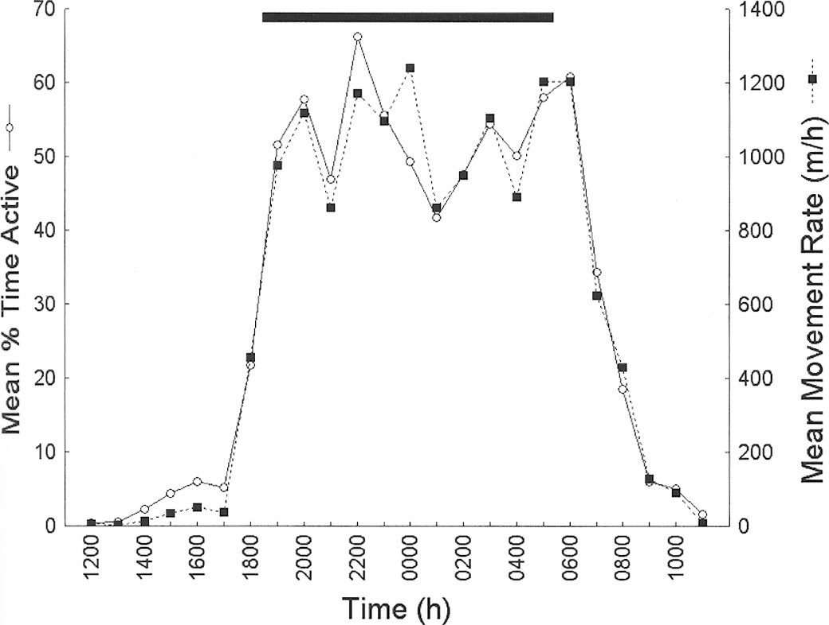
Fig. 2 Activity pattern and movement rates of radiocollared adult spotted hyenas (Crocuta crocuta) in the Masai Mara ...
Notes:
Fig. 2 Activity pattern and movement rates of radiocollared adult spotted hyenas (Crocuta crocuta) in the Masai Mara National Reserve, Kenya. Data are based on direct observations during long-term (2- to 15-h) follows of males and females. Number of individuals sampled varies per hour (n = 15–19). Plotted values for each hour (e.g., 1200 h) represent activity recorded in the following hour block (i.e., 1200–1259 h). The black bar extends over hour blocks characterized by darkness throughout the year.
Unless provided in the caption above, the following copyright applies to the content of this slide: © 2007 American Society of Mammalogists

Slide 3
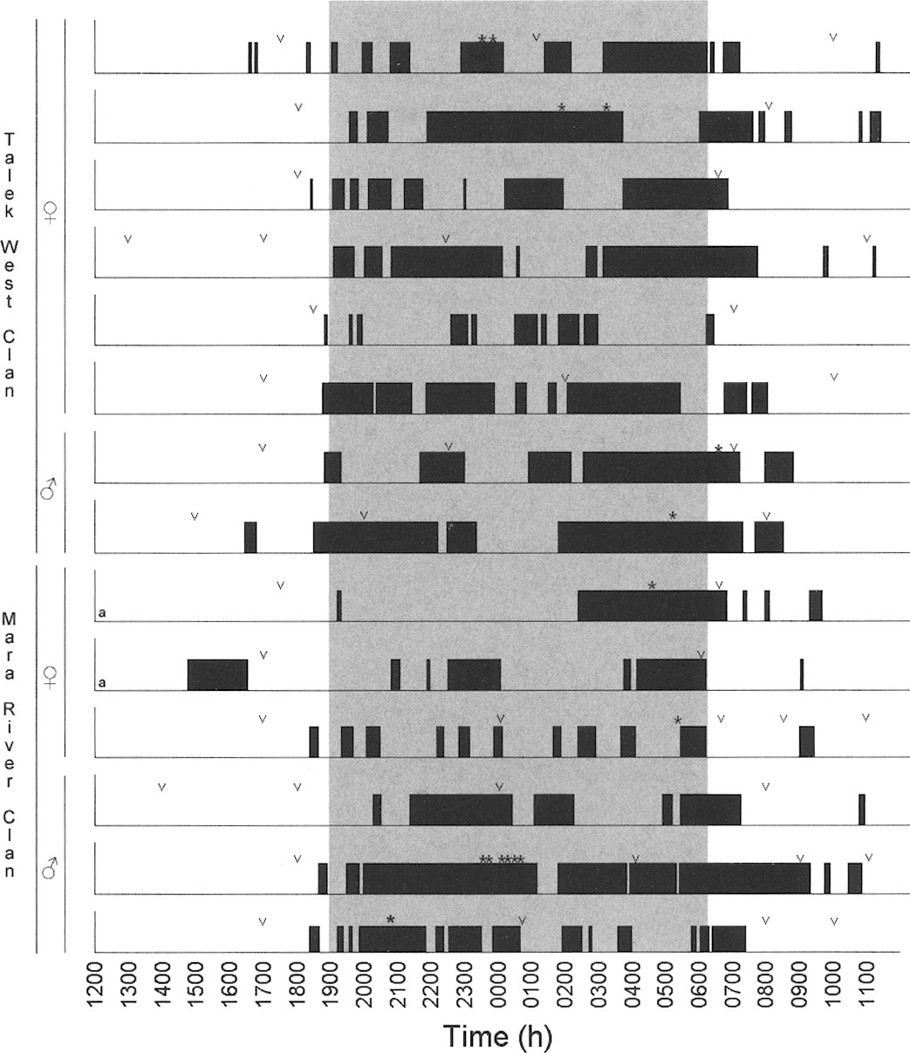
Fig. 3 Bouts of activity during 14 composite 24-h follow cycles for 13 individual radiocollared spotted hyenas ...
Notes:
Fig. 3 Bouts of activity during 14 composite 24-h follow cycles for 13 individual radiocollared spotted hyenas (Crocuta crocuta). Active bouts were >5 consecutive active minutes bounded on both ends by 5 consecutive minutes of inactivity. Pictured 24-h cycles were those for which the night was described by no more than 2 follow segments. The letter “a” indicates a pair of follow cycles conducted on the same individual. Start and end points of each follow segment are indicated by a –v.” For example, the topmost follow cycle is composed of 3 nonconsecutive follow segments conducted from 1730 to 0100 h, 0100 to 1000 h, and 1000 to 1730 h. Asterisks indicate hunts and fresh kills on which the focal hyena fed. Hours of darkness throughout the year fall within the shaded area.
Unless provided in the caption above, the following copyright applies to the content of this slide: © 2007 American Society of Mammalogists

Slide 4
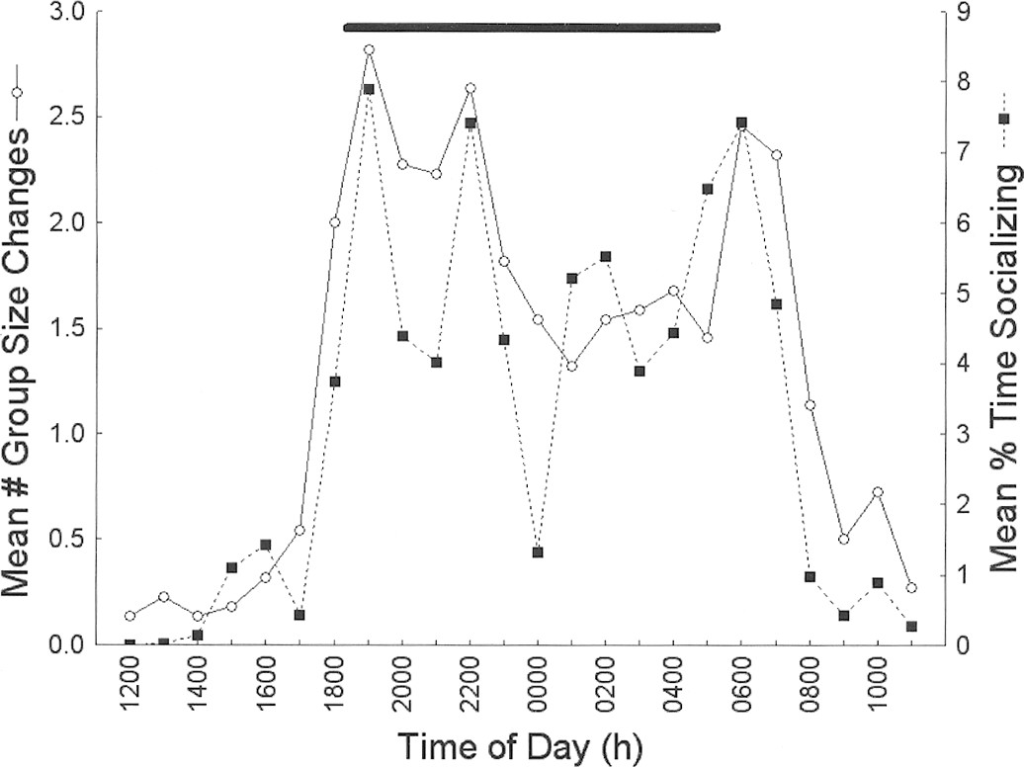
Fig. 4 Mean number of group-size changes observed and mean percent of time spent socializing during follows of ...
Notes:
Fig. 4 Mean number of group-size changes observed and mean percent of time spent socializing during follows of radiocollared spotted hyenas (Crocuta crocuta). Data are from direct observations of 16 different individuals (11 females and 5 males) during 22 composite follows, each covering an entire 24-h period in nonconsecutive segments. Other notation is as in Fig. 2.
Unless provided in the caption above, the following copyright applies to the content of this slide: © 2007 American Society of Mammalogists

Slide 5
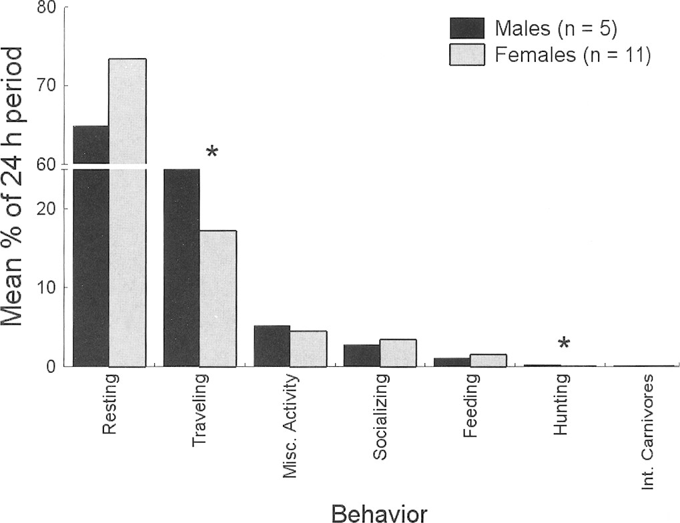
Fig. 5 Mean percent of time spent engaged in various behaviors for 5 male and 11 female spotted hyenas (Crocuta ...
Notes:
Fig. 5 Mean percent of time spent engaged in various behaviors for 5 male and 11 female spotted hyenas (Crocuta crocuta) during follows covering the entire 24-h period in nonconsecutive segments. Miscellaneous activity included standing, and sniffing objects or the ground. Traveling included both directed movement and wandering behavior. Significant differences (Mann-Whitney (U-test, P < 0.05) are indicated by an asterisk.
Unless provided in the caption above, the following copyright applies to the content of this slide: © 2007 American Society of Mammalogists

Slide 6
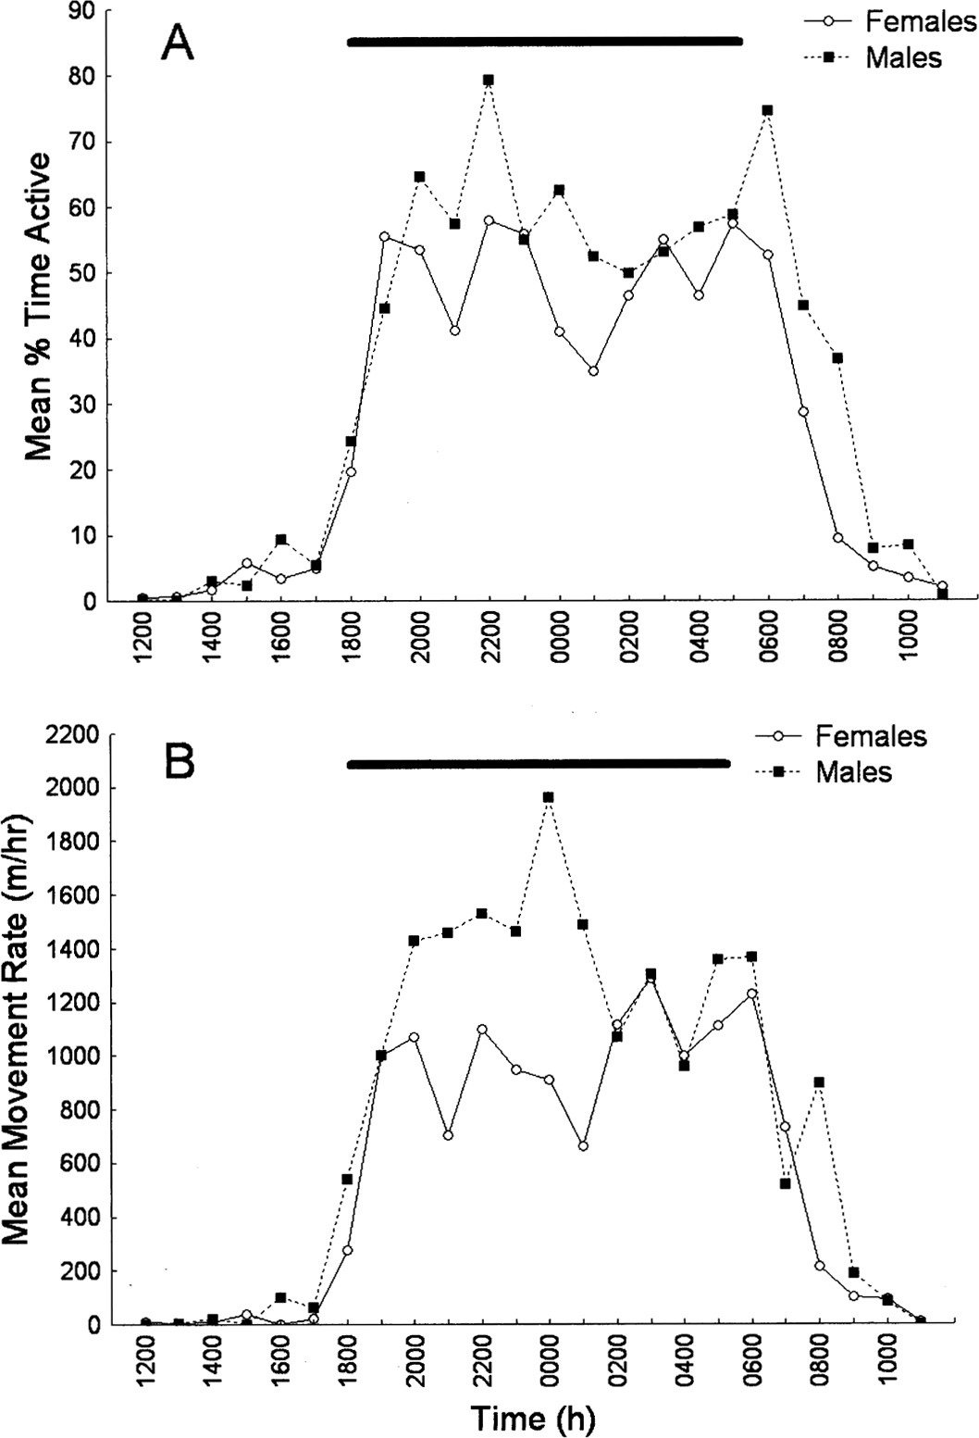
Fig. 6 A) Sex differences in mean percent of time spent active by radiocollared adult spotted hyenas (Crocuta ...
Notes:
Fig. 6 A) Sex differences in mean percent of time spent active by radiocollared adult spotted hyenas (Crocuta crocuta). Data are based on direct observation during long-term (2- to 15-h) follows of males and females. Number of individuals sampled varies per hour (females n = 9–11; males n = 5–8). Figure notation is as in Fig. 2. B) Mean hourly movement rates of radiocollared adult spotted hyenas excluding data collected during hour blocks when focal females nursed their young. Number of individuals sampled varies per hour (females n = 7–11; males n = 5–7).
Unless provided in the caption above, the following copyright applies to the content of this slide: © 2007 American Society of Mammalogists

Slide 7
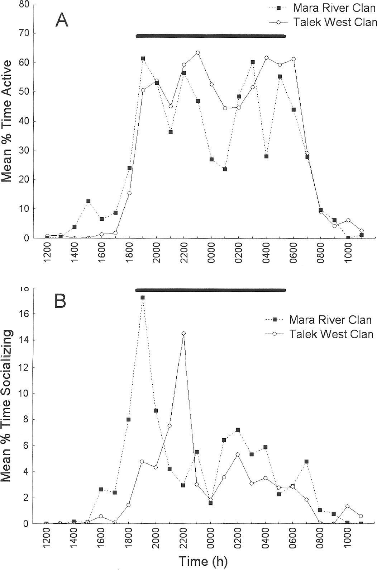
Fig. 7 The mean percent of time spent A) active and B) socializing by radiocollared adult female spotted hyenas ...
Notes:
Fig. 7 The mean percent of time spent A) active and B) socializing by radiocollared adult female spotted hyenas (Crocuta crocuta) from 2 different social groups (clans). Data are based on direct observation during long-term (2- to 15-h) follows. Number of individuals sampled varies per hour (Talek West n = 5 or 6; Mara River n — 4 or 5 for activity and n = 3–5 for socializing). Figure notation is as in Fig. 2.
Unless provided in the caption above, the following copyright applies to the content of this slide: © 2007 American Society of Mammalogists

Slide 8
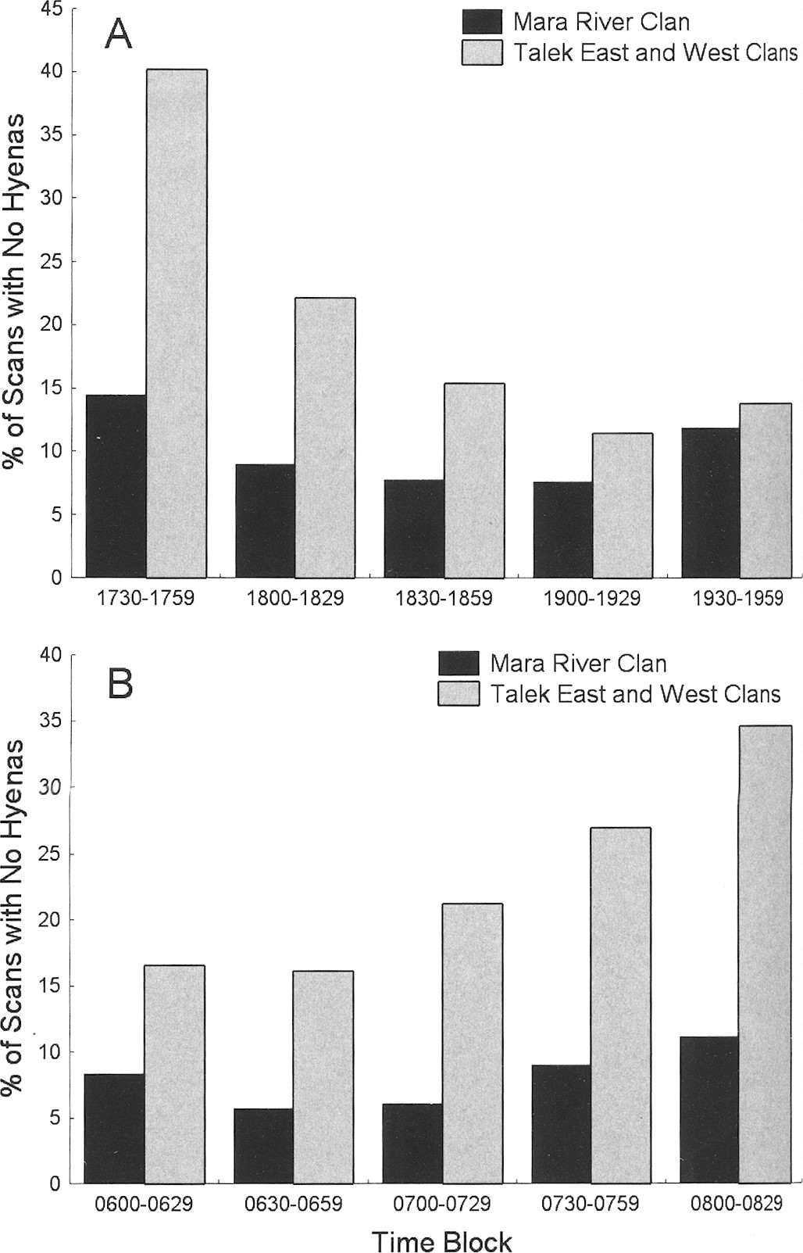
Fig. 8 Percent of A) evening and B) morning scans at active communal dens in which no hyenas were present during ...
Notes:
Fig. 8 Percent of A) evening and B) morning scans at active communal dens in which no hyenas were present during each of 5 half-hour blocks for the Mara River Clan and the Talek East and West clans.
Unless provided in the caption above, the following copyright applies to the content of this slide: © 2007 American Society of Mammalogists

