Slide 1
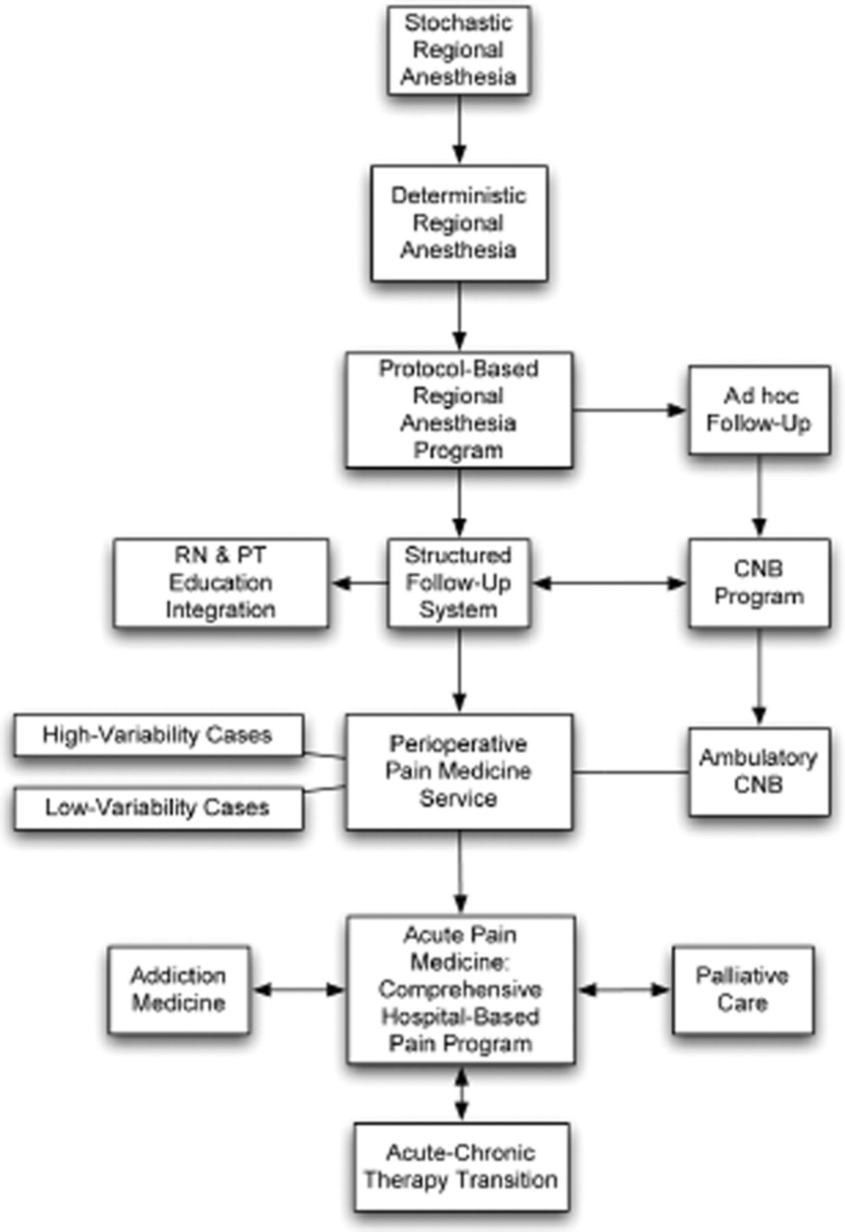
Figure 1 Overview of the progression of regional anesthetic applications into formal acute pain medicine programs. RN ...
Notes:
Figure 1 Overview of the progression of regional anesthetic applications into formal acute pain medicine programs. RN = registered nurse; PT = physical therapy; CNB = central neuraxial block.
Unless provided in the caption above, the following copyright applies to the content of this slide: © 2013 American Academy of Pain Medicine

Slide 2
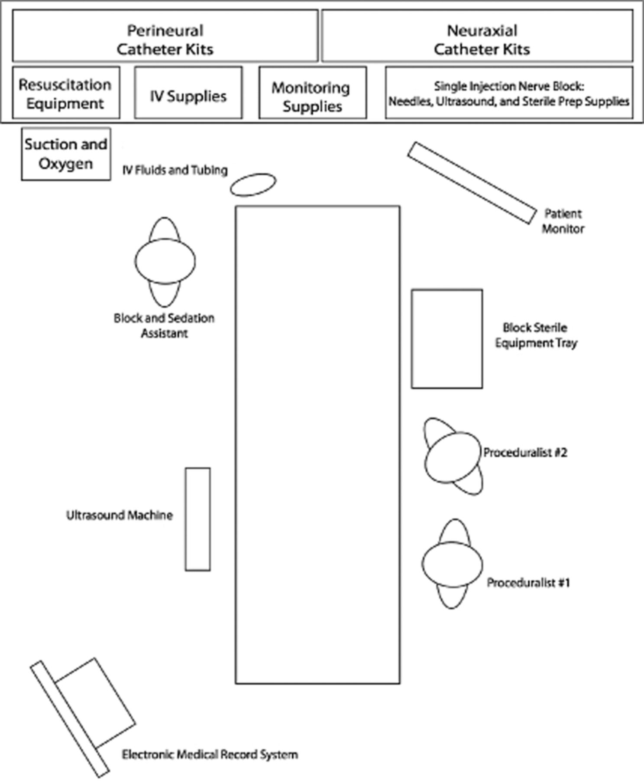
Figure 2 Example of equipment storage and organization within a block room patient care area. Many centers will ...
Notes:
Figure 2 Example of equipment storage and organization within a block room patient care area. Many centers will alternatively employ a mobile “block cart” containing relevant supplies necessary for safe placement of nerve blocks, including those materials found at the head of the bed in this diagram. IV = intravenous.
Unless provided in the caption above, the following copyright applies to the content of this slide: © 2013 American Academy of Pain Medicine

Slide 3
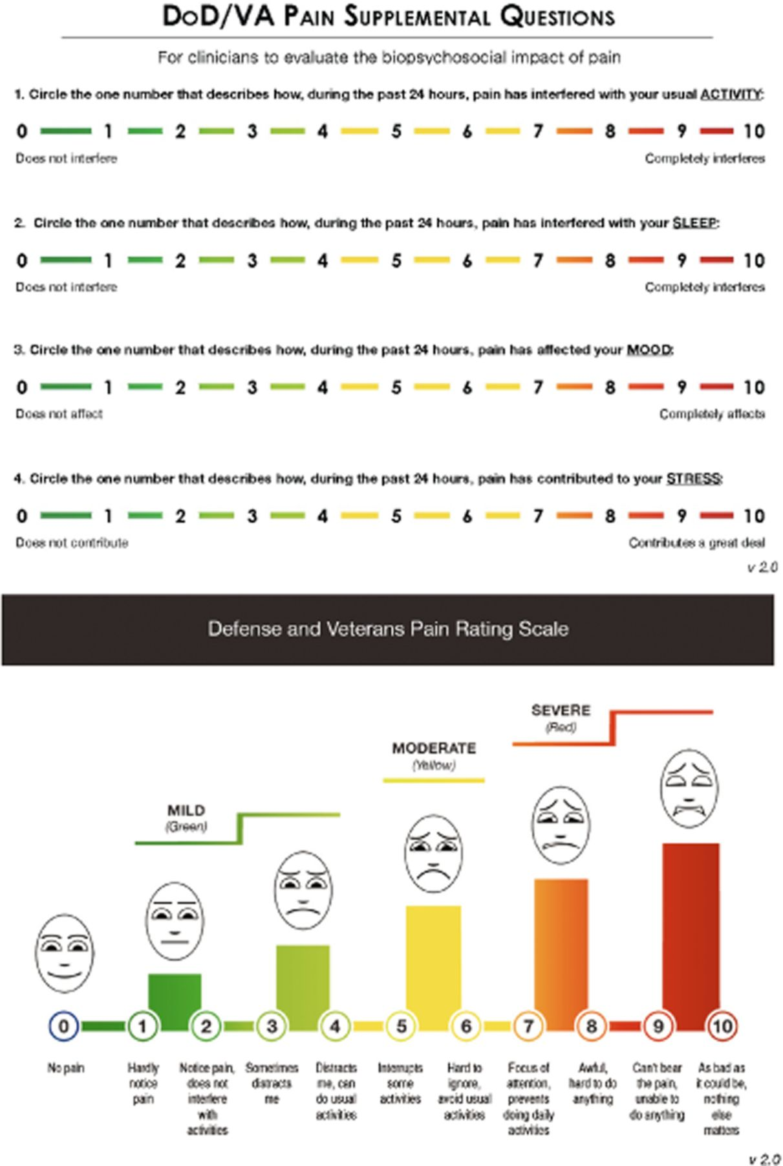
Figure 3 Defense and Veterans Pain Rating Scale .
Notes:
Figure 3 Defense and Veterans Pain Rating Scale .
Unless provided in the caption above, the following copyright applies to the content of this slide: © 2013 American Academy of Pain Medicine

