Slide 1
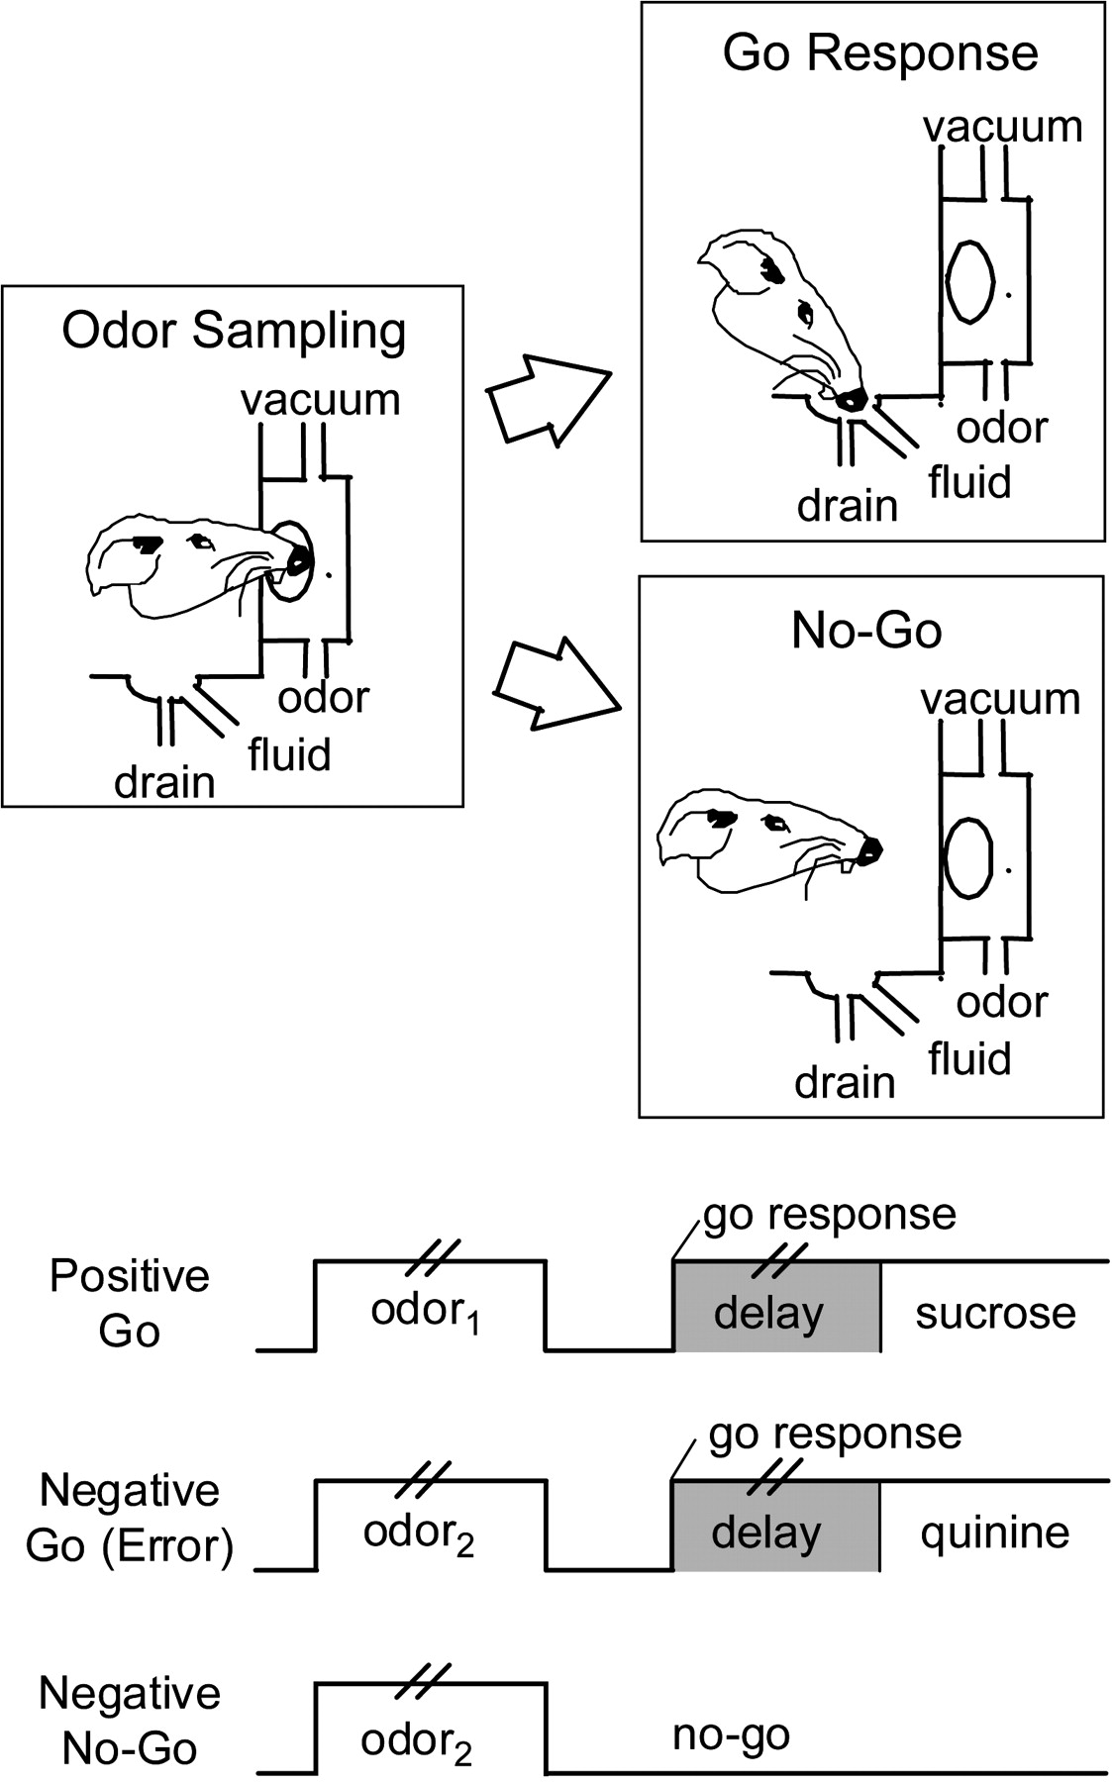
Figure 1. Schematic illustrating behaviors in the task. Pairs of vertical lines during odor presentation and the delay ...
Notes:
Figure 1. Schematic illustrating behaviors in the task. Pairs of vertical lines during odor presentation and the delay between a go response and fluid delivery denote the variable duration of these events; odor sampling typically lasted 250–750 ms, and the delay was programmed to vary from 500 to 1500 ms.
Unless provided in the caption above, the following copyright applies to the content of this slide: © The Author 2006. Published by Oxford University Press. All rights reserved. For permissions, please e-mail: journals.permissions@oxfordjournals.org

Slide 2
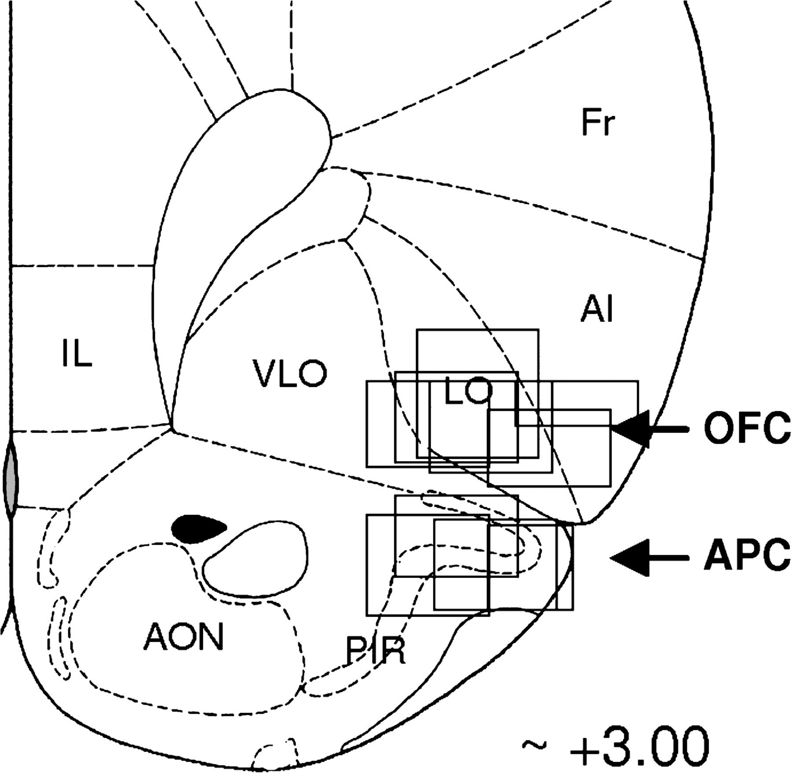
Figure 2. Location of recording sites in OFC and APC. Vertical bars on the drawing indicate the center of the electrode ...
Notes:
Figure 2. Location of recording sites in OFC and APC. Vertical bars on the drawing indicate the center of the electrode track in each rat; boxes indicate approximate extent of recording sessions vertically during transition through each area and give an estimate of lateral (and AP) spread of the wires (∼1 mm).
Unless provided in the caption above, the following copyright applies to the content of this slide: © The Author 2006. Published by Oxford University Press. All rights reserved. For permissions, please e-mail: journals.permissions@oxfordjournals.org

Slide 3
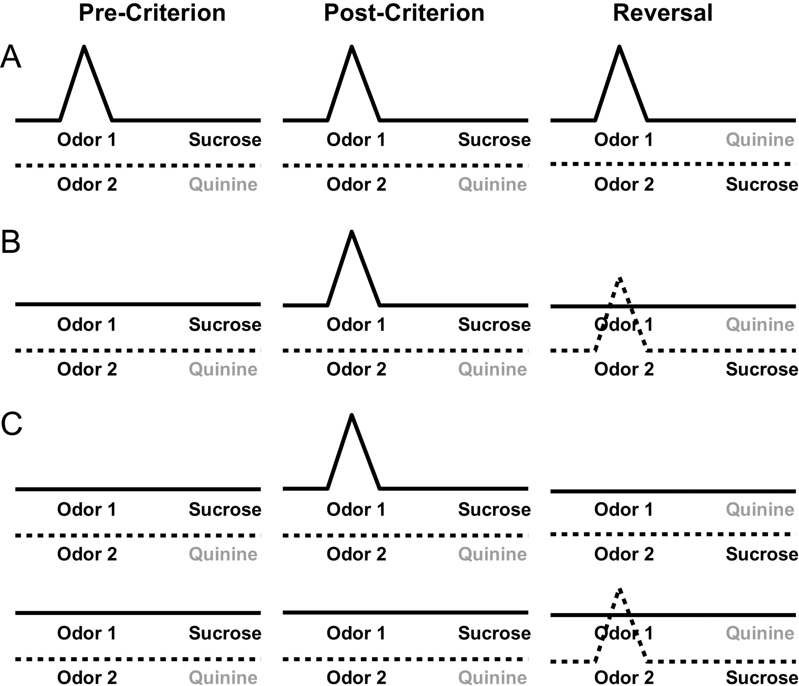
Figure 3. Predicted cue-selective patterns across learning and reversal. (A) Example of putative sensory encoding. (B) ...
Notes:
Figure 3. Predicted cue-selective patterns across learning and reversal. (A) Example of putative sensory encoding. (B) Example of putative associative encoding. (C) Two examples of putative conjunctive encoding of sensory + associative information.
Unless provided in the caption above, the following copyright applies to the content of this slide: © The Author 2006. Published by Oxford University Press. All rights reserved. For permissions, please e-mail: journals.permissions@oxfordjournals.org

Slide 4
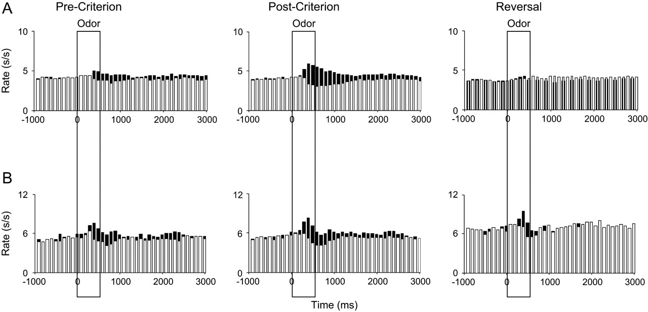
Figure 4. Effect of learning and reversal training on cue-selective firing in OFC and APC. Population histogram shows ...
Notes:
Figure 4. Effect of learning and reversal training on cue-selective firing in OFC and APC. Population histogram shows the average response of neurons that were selective in the postcriterion phase in (A) OFC and (B) APC. Activity is shown separately for trials involving each odor cue during the precriterion, postcriterion, and reversal trial blocks. Black bars show the response to the preferred odor cue in the postcriterion phase. White bars show the response to the nonpreferred odor. Activity is synchronized to odor onset, displayed in 100 ms bins in spikes/second, and box overlays indicate the approximate duration of odor sampling, which was terminated by the rat.
Unless provided in the caption above, the following copyright applies to the content of this slide: © The Author 2006. Published by Oxford University Press. All rights reserved. For permissions, please e-mail: journals.permissions@oxfordjournals.org

Slide 5
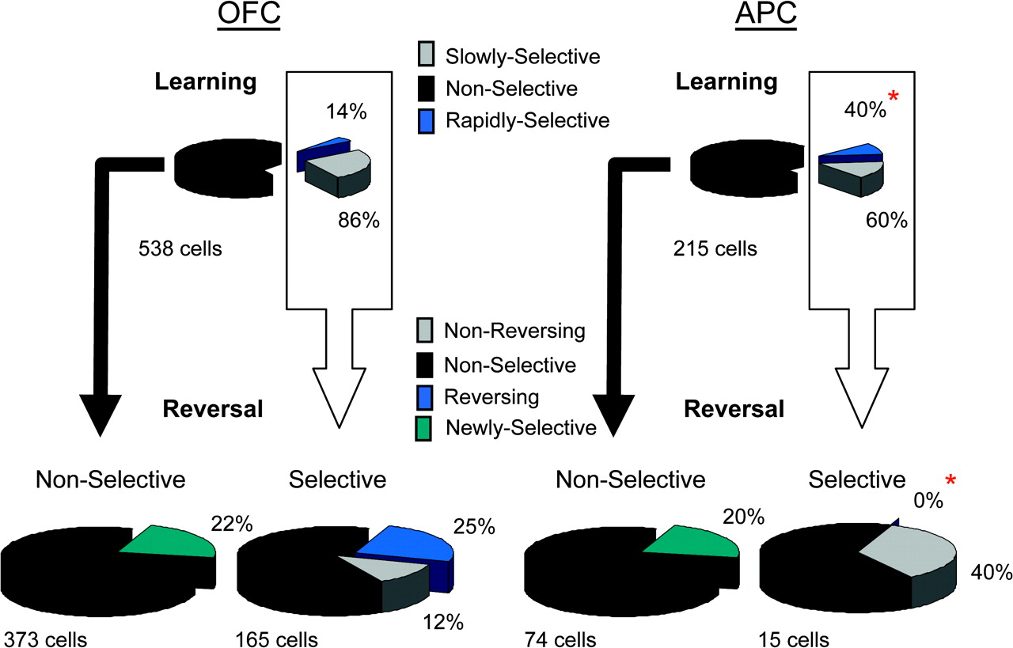
Figure 5. Effect of learning and reversal training on cue-selective firing in OFC and APC. The upper pie charts show ...
Notes:
Figure 5. Effect of learning and reversal training on cue-selective firing in OFC and APC. The upper pie charts show the proportions of all neurons recorded in each area that developed cue-selective firing during odor discrimination learning. Rapidly selective neurons (blue) developed an odor preference in the precriterion phase, which persisted postcriterion; slowly selective neurons (gray) developed an odor preference only in the postcriterion phase. APC had more rapidly selective neurons than OFC (*). The lower pie charts show the odor preferences in selective and nonselective neurons during reversal learning. Nonreversing neurons (gray) maintained the same odor preference during reversal learning; reversing neurons (blue) became selective for the other odor cue during reversal learning. APC had more nonreversing neurons and fewer reversing neurons than OFC (*).
Unless provided in the caption above, the following copyright applies to the content of this slide: © The Author 2006. Published by Oxford University Press. All rights reserved. For permissions, please e-mail: journals.permissions@oxfordjournals.org

Slide 6
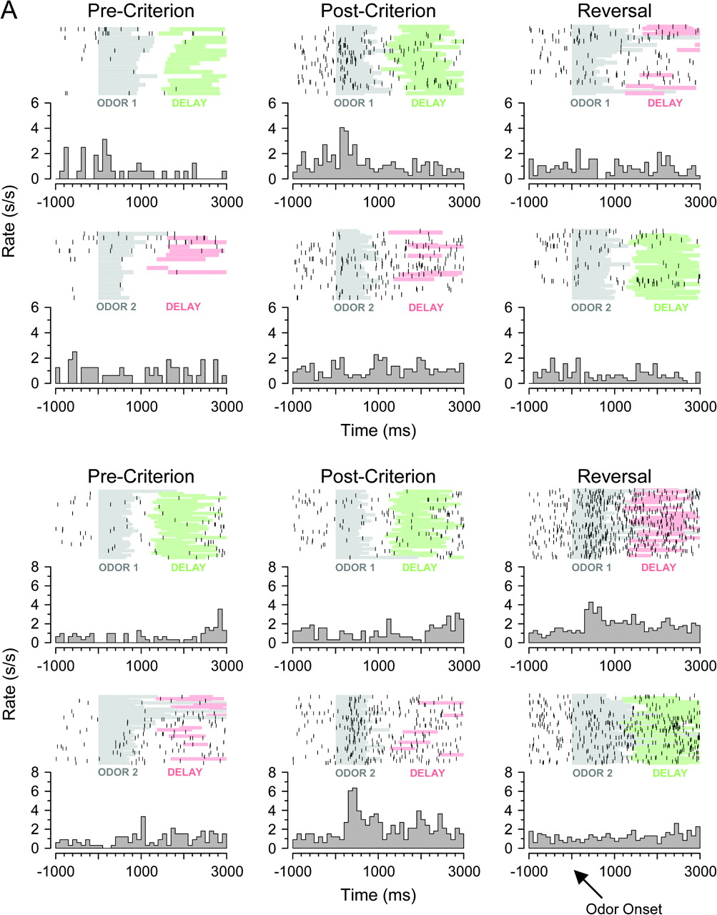
Figure 6. Neural activity during cue sampling, learning, and reversal training. (A) Top panel: OFC neuron with a ...
Notes:
Figure 6. Neural activity during cue sampling, learning, and reversal training. (A) Top panel: OFC neuron with a selective response to the positive odor cue in the postcriterion trials (middle column). This selective response is not present precriterion (left column) or after reversal (right column). Bottom panel: OFC neuron with a selective response to the negative odor cue in the postcriterion trials (middle column). This selective response is not present precriterion (left column), and it switches to the other odor cue after reversal (right column). (B) Top panel, left: APC neuron with a selective response to the positive odor cue in the postcriterion trials (right column). Top panel, right: APC neuron with a selective response to the negative odor cue in the postcriterion trials (right column). In both of these neurons, the response is not significantly different among the odor cues precriterion (left column). Bottom panel: APC neuron with a selective response to the positive odor cue in the postcriterion trials (middle column). The same selective response is present precriterion (left column) and after reversal (right column). Raster displays show neural activity on individual trials, and each histogram shows average activity in spikes/second in 100 ms bins. The timing of odor sampling and the delay after responding are shown by shading on the rasters (odor, gray; delay before sucrose, green; delay before quinine, red).
Unless provided in the caption above, the following copyright applies to the content of this slide: © The Author 2006. Published by Oxford University Press. All rights reserved. For permissions, please e-mail: journals.permissions@oxfordjournals.org

Slide 7
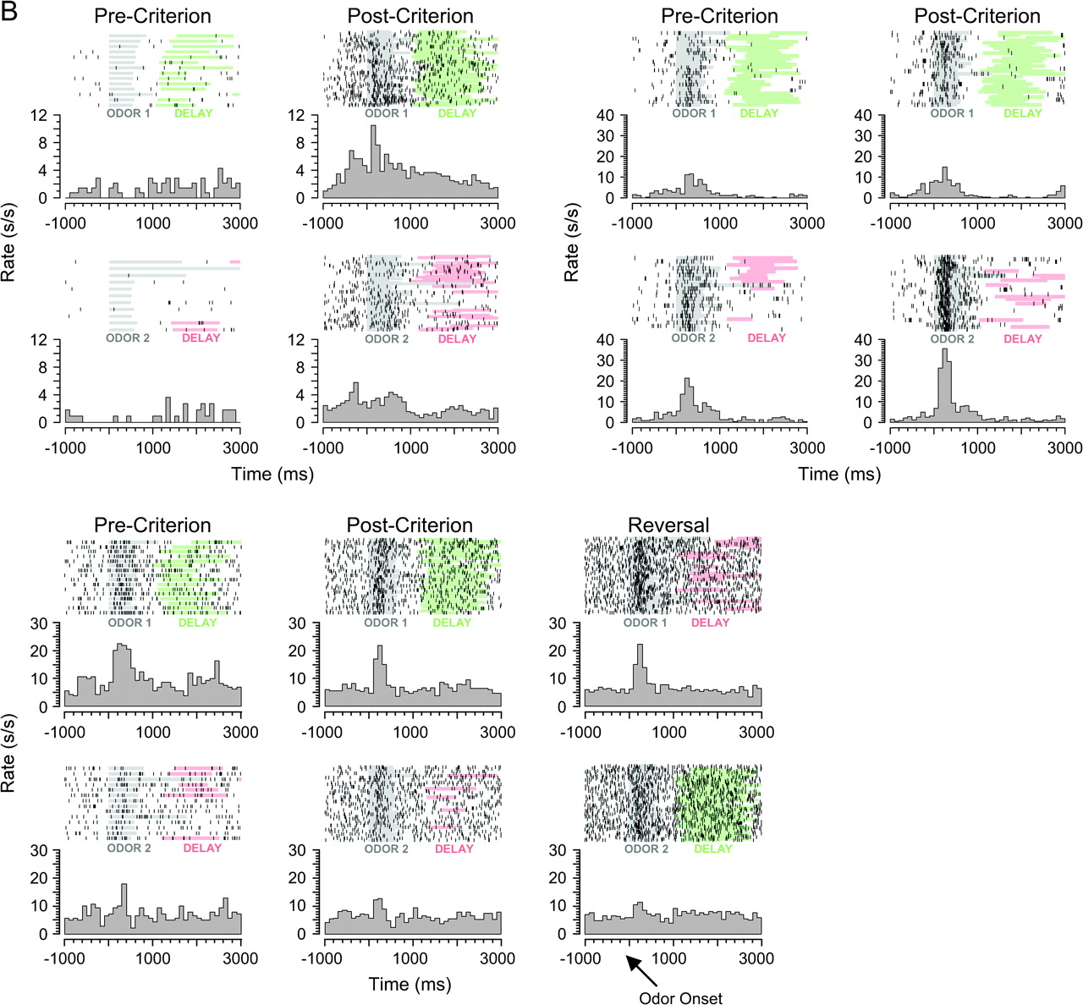
Figure 6. Neural activity during cue sampling, learning, and reversal training. (A) Top panel: OFC neuron with a ...
Notes:
Figure 6. Neural activity during cue sampling, learning, and reversal training. (A) Top panel: OFC neuron with a selective response to the positive odor cue in the postcriterion trials (middle column). This selective response is not present precriterion (left column) or after reversal (right column). Bottom panel: OFC neuron with a selective response to the negative odor cue in the postcriterion trials (middle column). This selective response is not present precriterion (left column), and it switches to the other odor cue after reversal (right column). (B) Top panel, left: APC neuron with a selective response to the positive odor cue in the postcriterion trials (right column). Top panel, right: APC neuron with a selective response to the negative odor cue in the postcriterion trials (right column). In both of these neurons, the response is not significantly different among the odor cues precriterion (left column). Bottom panel: APC neuron with a selective response to the positive odor cue in the postcriterion trials (middle column). The same selective response is present precriterion (left column) and after reversal (right column). Raster displays show neural activity on individual trials, and each histogram shows average activity in spikes/second in 100 ms bins. The timing of odor sampling and the delay after responding are shown by shading on the rasters (odor, gray; delay before sucrose, green; delay before quinine, red).
Unless provided in the caption above, the following copyright applies to the content of this slide: © The Author 2006. Published by Oxford University Press. All rights reserved. For permissions, please e-mail: journals.permissions@oxfordjournals.org

