Slide 1
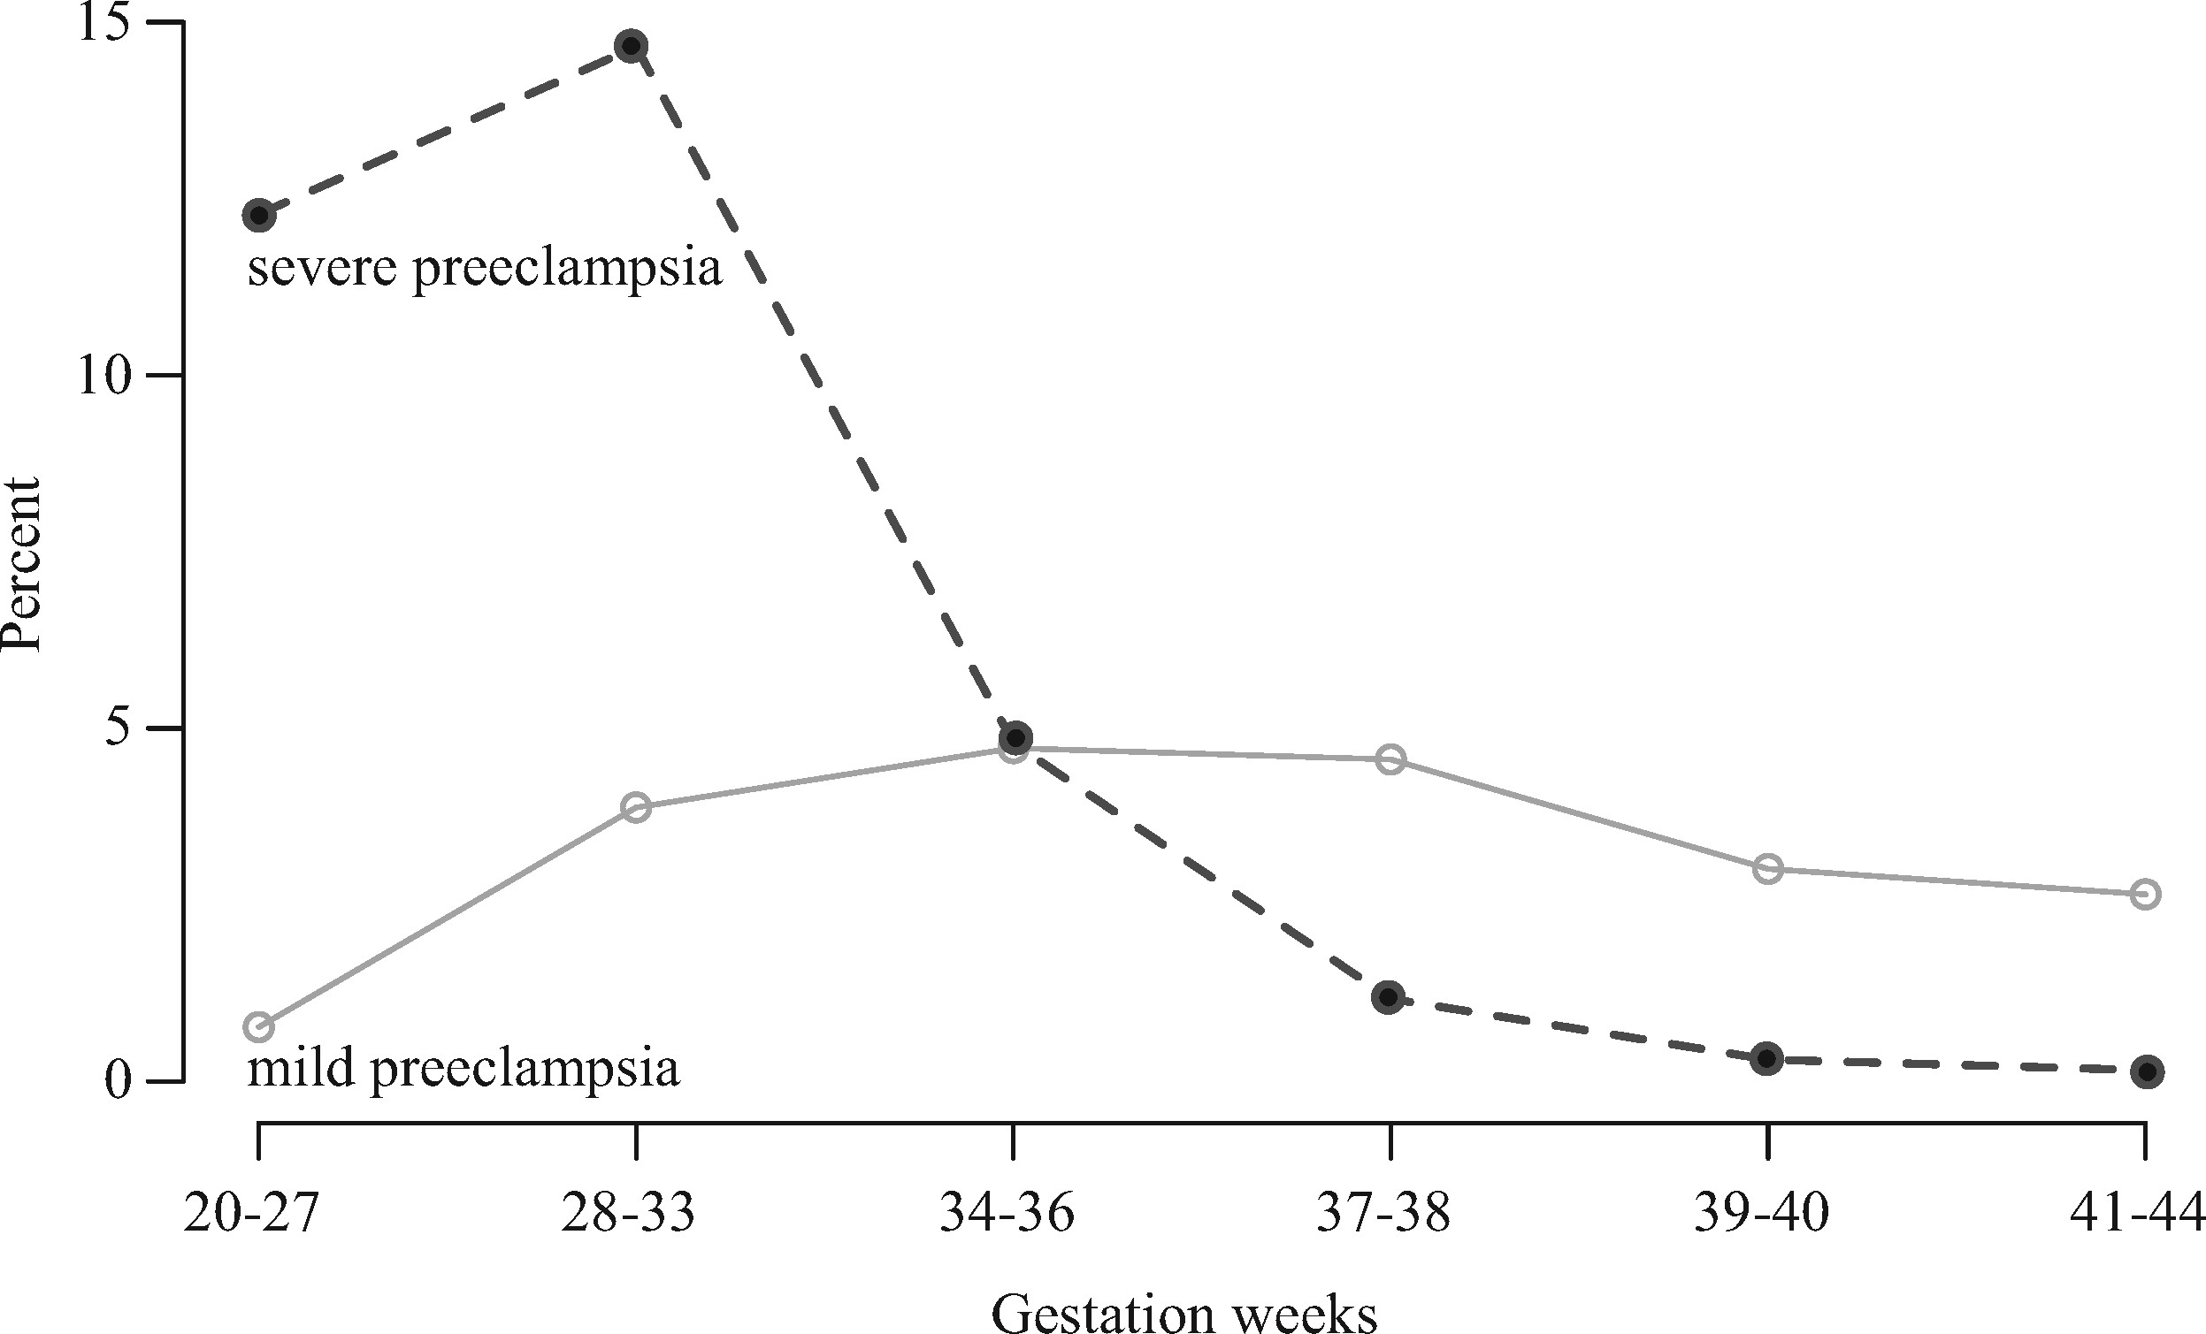
Figure 1. Percentages of Danish women with mild pre-eclampsia (open dots) or severe pre-eclampsia (black dots) ...
Notes:
Figure 1. Percentages of Danish women with mild pre-eclampsia (open dots) or severe pre-eclampsia (black dots) diagnoses across the six time windows of delivery used in our analyses See Table 1 for sample sizes for both disorders
Unless provided in the caption above, the following copyright applies to the content of this slide: © The Author(s) 2017. Published by Oxford University Press on behalf of the Foundation for Evolution, Medicine, and Public Health.This is an Open Access article distributed under the terms of the Creative Commons Attribution License (http://creativecommons.org/licenses/by/4.0/), which permits unrestricted reuse, distribution, and reproduction in any medium, provided the original work is properly cited.

Slide 2
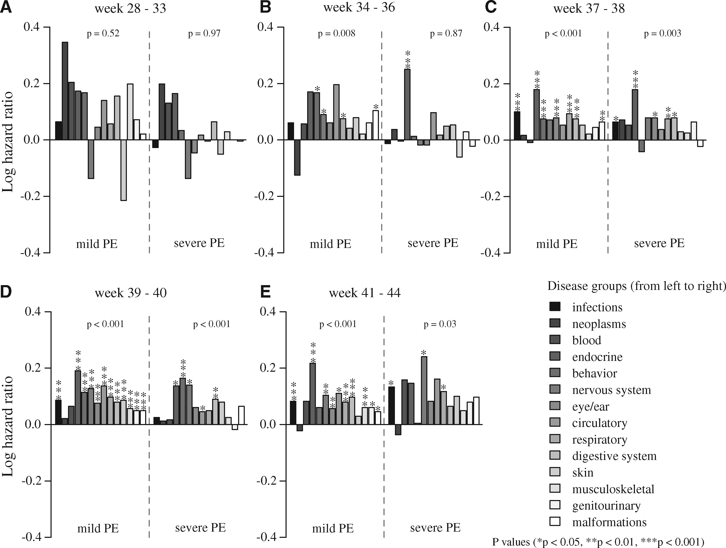
Figure 2. Risk (log hazard ratio) of being diagnosed up to 30 years after birth in each of the 14 disease groups ...
Notes:
Figure 2. Risk (log hazard ratio) of being diagnosed up to 30 years after birth in each of the 14 disease groups (legend at the bottom right) for children born to mothers with either mild or severe pre-eclampsia (PE), relative to unexposed children born to normotensive mothers Logged hazard ratios represent increased (above 0) or decreased (below 0) risks. See Supplementary Table S5 for confidence limits. The gestation time period of 20–27 weeks was excluded due to low sample sizes (see text and Table 1 for details)
Unless provided in the caption above, the following copyright applies to the content of this slide: © The Author(s) 2017. Published by Oxford University Press on behalf of the Foundation for Evolution, Medicine, and Public Health.This is an Open Access article distributed under the terms of the Creative Commons Attribution License (http://creativecommons.org/licenses/by/4.0/), which permits unrestricted reuse, distribution, and reproduction in any medium, provided the original work is properly cited.

Slide 3
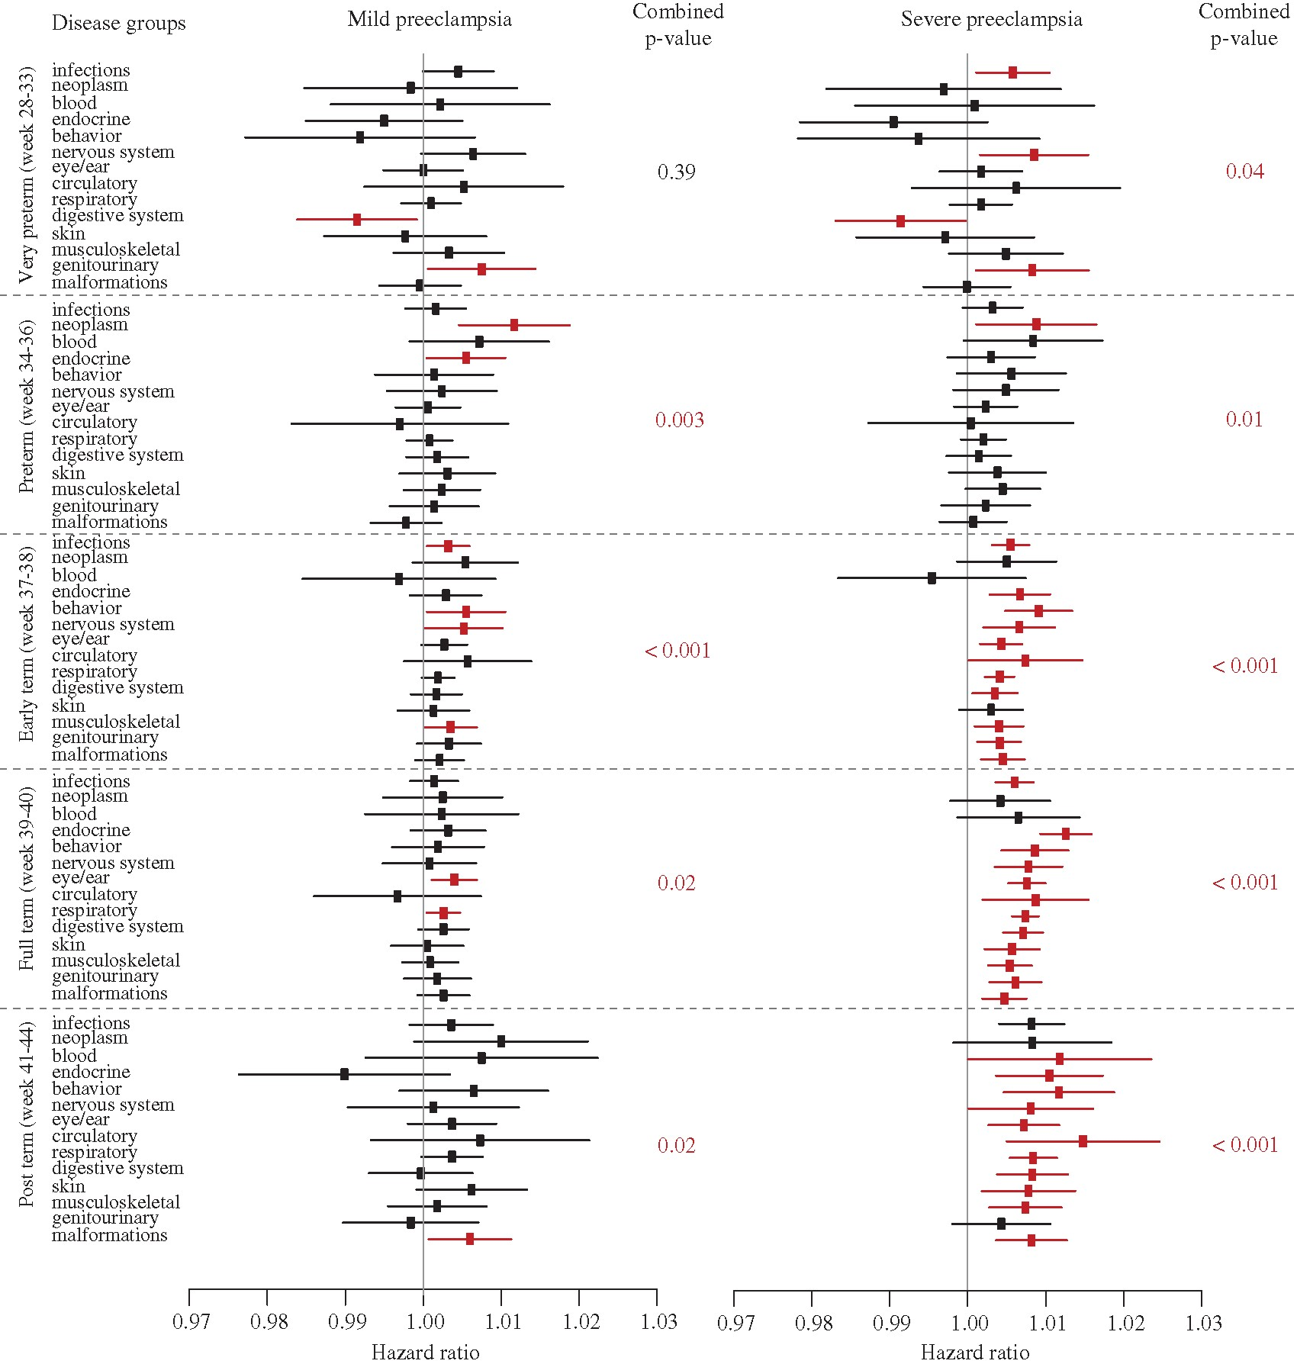
Figure 3. The effect of days of exposure to mild or severe pre-eclampsia (PE) after adjustment for categorical effects ...
Notes:
Figure 3. The effect of days of exposure to mild or severe pre-eclampsia (PE) after adjustment for categorical effects (diagnosis or not) and potentially confounding predictor variables (Table 1 and see Supplementary Table S2) on hazard ratios of child morbidity in five categories of gestational age, based on up to 30 years of follow-up Significant hazard ratios (HR) and their confidence intervals (CI) are plotted in red, but for mild pre-eclampsia all became non-significant after FDR adjustment, except for the neoplasm effect in week 34–36. For severe pre-eclampsia only digestive and genitourinary diseases in week 28–33, circulatory and genitourinary disorders in week 37–38 and blood and nervous system disorders in week 41–44 became non-significant after FDR adjustment. However, for mild pre-eclampsia exposure, the cumulative increases in hazard ratios across the 14 disease groups were all significant, except for the most premature deliveries (weeks 28–33). These cumulative P-values (calculated by a weighted Z-method of combined P-values and sample sizes) are given towards the right of each plot. A more detailed version of this figure with all case specific sample sizes, hazard ratios and the ±95% CIs is also provided (see Supplementary Table S5)
Unless provided in the caption above, the following copyright applies to the content of this slide: © The Author(s) 2017. Published by Oxford University Press on behalf of the Foundation for Evolution, Medicine, and Public Health.This is an Open Access article distributed under the terms of the Creative Commons Attribution License (http://creativecommons.org/licenses/by/4.0/), which permits unrestricted reuse, distribution, and reproduction in any medium, provided the original work is properly cited.

