Slide 1
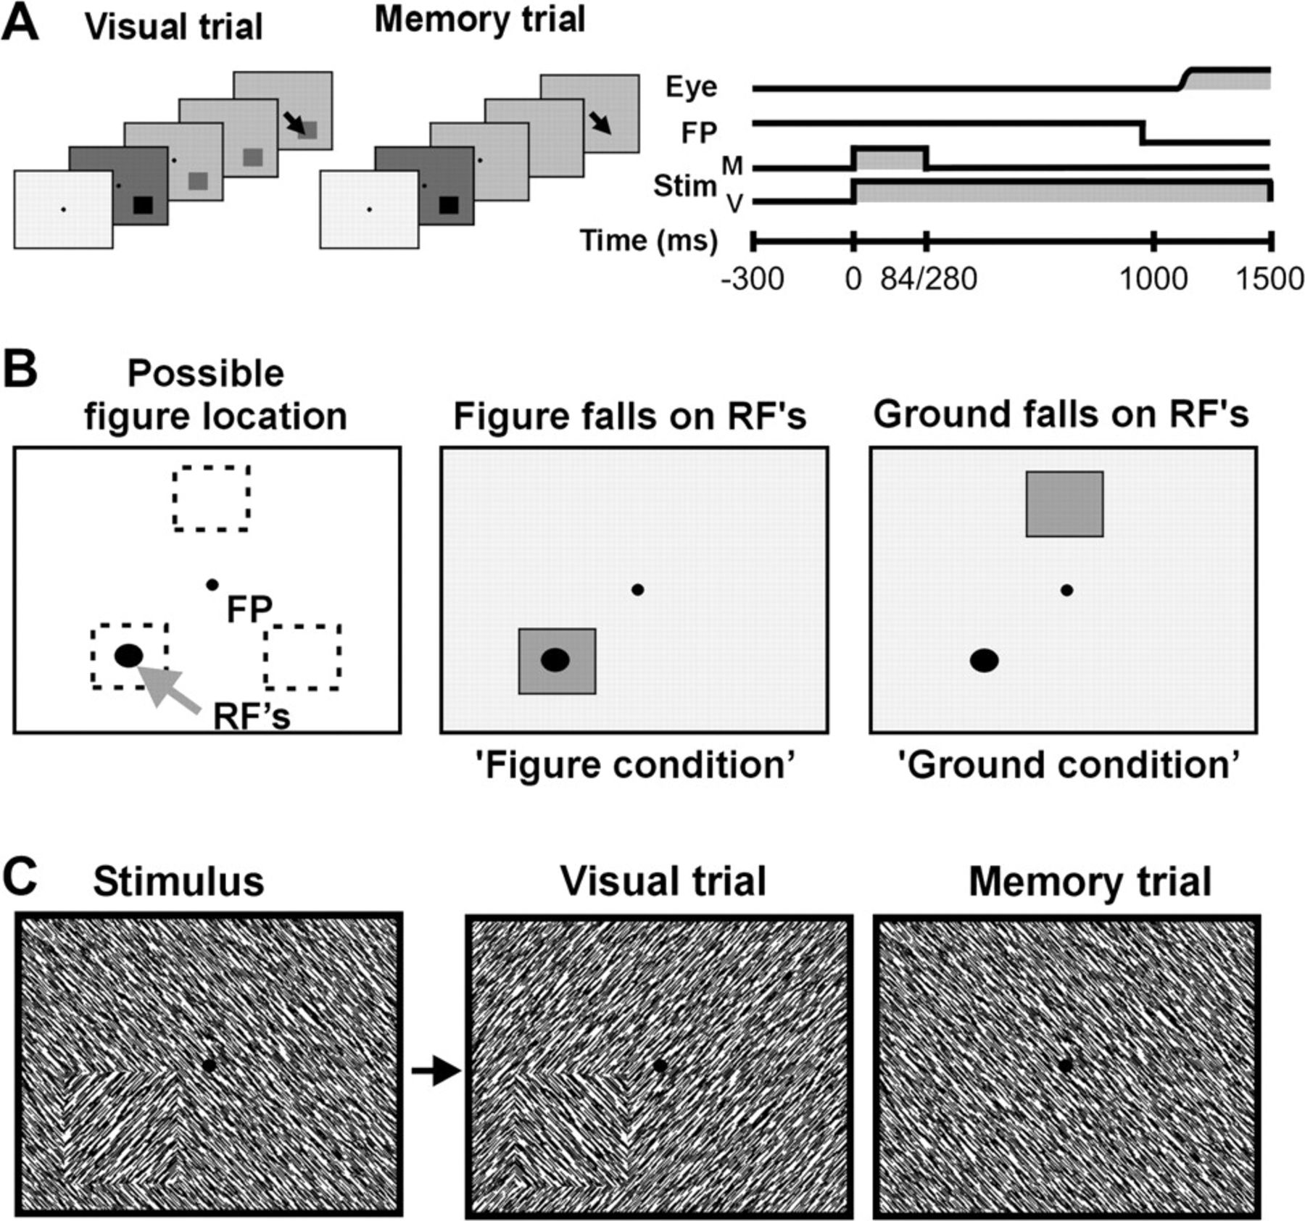
Figure 1. Illustration of the sequence of visual stimulation. (A) Animals fixated at a central point (FP). At stimulus ...
Notes:
Figure 1. Illustration of the sequence of visual stimulation. (A) Animals fixated at a central point (FP). At stimulus onset, a texture appeared containing a figure. The animals made a saccade toward the figure location (arrows left panels) after the offset of the fixation point. Visually guided and memory-guided trials were used. In visually guided trials, the figure-ground texture was replaced by a different figure-ground texture, with a figure of the same size at the same location. In memory-guided trials, a homogeneous texture replaced the figure-ground texture. For 1 monkey (U), the replacements were at 84 ms. For the other monkey (T), they were at 280 ms. (B) The figure could appear in 1 out of 3 possible locations (indicated by dotted squares in left panel). RF denotes the position of the aggregate of the receptive fields. When the figure was overlying the receptive field, responses to “figure” were recorded. In the 2 other figure locations, “ground” responses were obtained. (C) Illustration of visual stimulation. We used complementary stimulus pairs so that the receptive field stimulus was identical for all conditions.
Unless provided in the caption above, the following copyright applies to the content of this slide: © The Author 2006. Published by Oxford University Press. All rights reserved. For permissions, please e-mail: journals.permissions@oxfordjournals.org

Slide 2
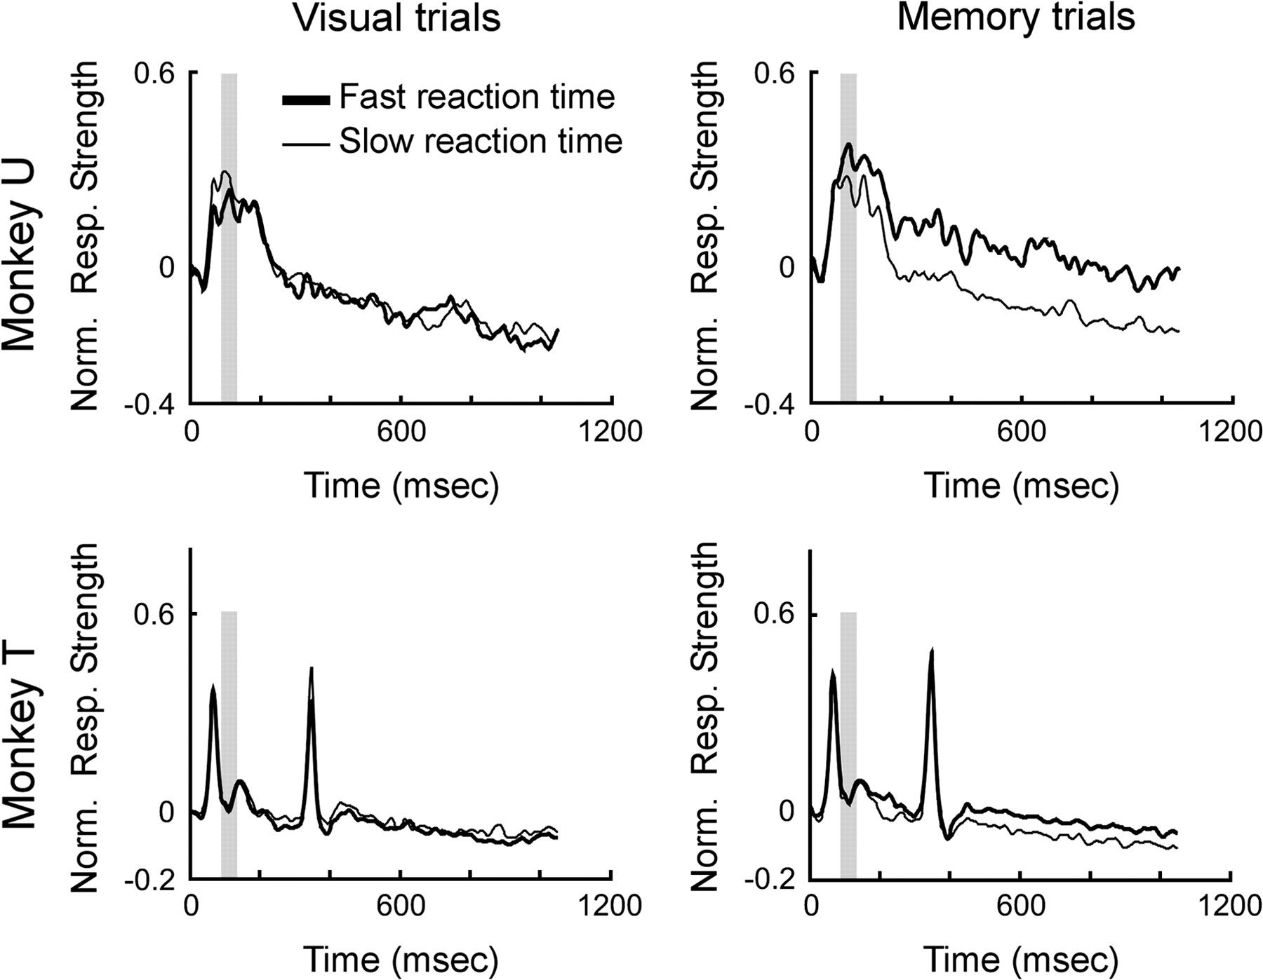
Figure 2. Sensory responses for fast and slow saccadic reaction times. This figure shows the average population (from ...
Notes:
Figure 2. Sensory responses for fast and slow saccadic reaction times. This figure shows the average population (from 16 electrodes per animal) responses for monkey U and monkey T separately during visually guided and memory-guided trials for fast and slow reaction time groups. The 2 peaks in the neural responses of monkey T correspond to the change in stimulus configuration (see Methods). For monkey U, the peak to the second texture overlaps with the late response to the first texture. Gray bars indicate the window of analysis of data shown in Figures 3 and 5.
Unless provided in the caption above, the following copyright applies to the content of this slide: © The Author 2006. Published by Oxford University Press. All rights reserved. For permissions, please e-mail: journals.permissions@oxfordjournals.org

Slide 3
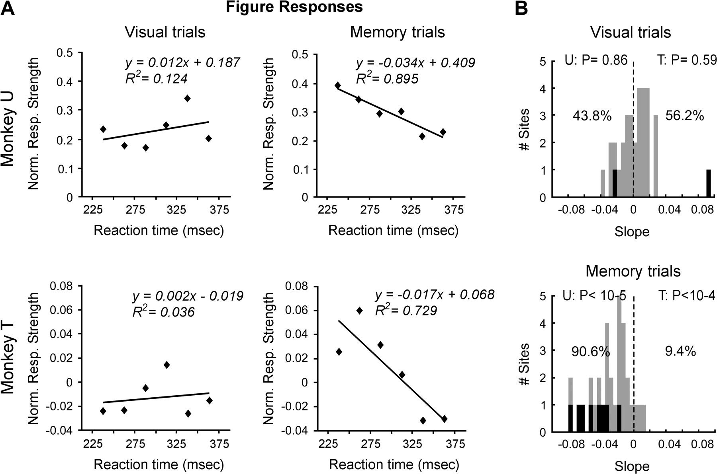
Figure 3. Correlation between figure responses and saccadic reaction times. (A) Left panels: Correlation functions ...
Notes:
Figure 3. Correlation between figure responses and saccadic reaction times. (A) Left panels: Correlation functions (Pearson) for figure responses and saccadic reaction times. Data show the population average of animals U and T (16 electrodes per animal). The lines are linear regression lines. (B) Data per recording site of both animals showing the strength and sign of the slope of the correlation functions between neural responses and saccadic reaction time. The percentages indicate the relative number of all recording sites that show positive and negative slopes. The black bars represent significant correlation strengths. P values per animal are obtained from a 1-tailed t-test to test the distribution. U and T denote the animal.
Unless provided in the caption above, the following copyright applies to the content of this slide: © The Author 2006. Published by Oxford University Press. All rights reserved. For permissions, please e-mail: journals.permissions@oxfordjournals.org

Slide 4
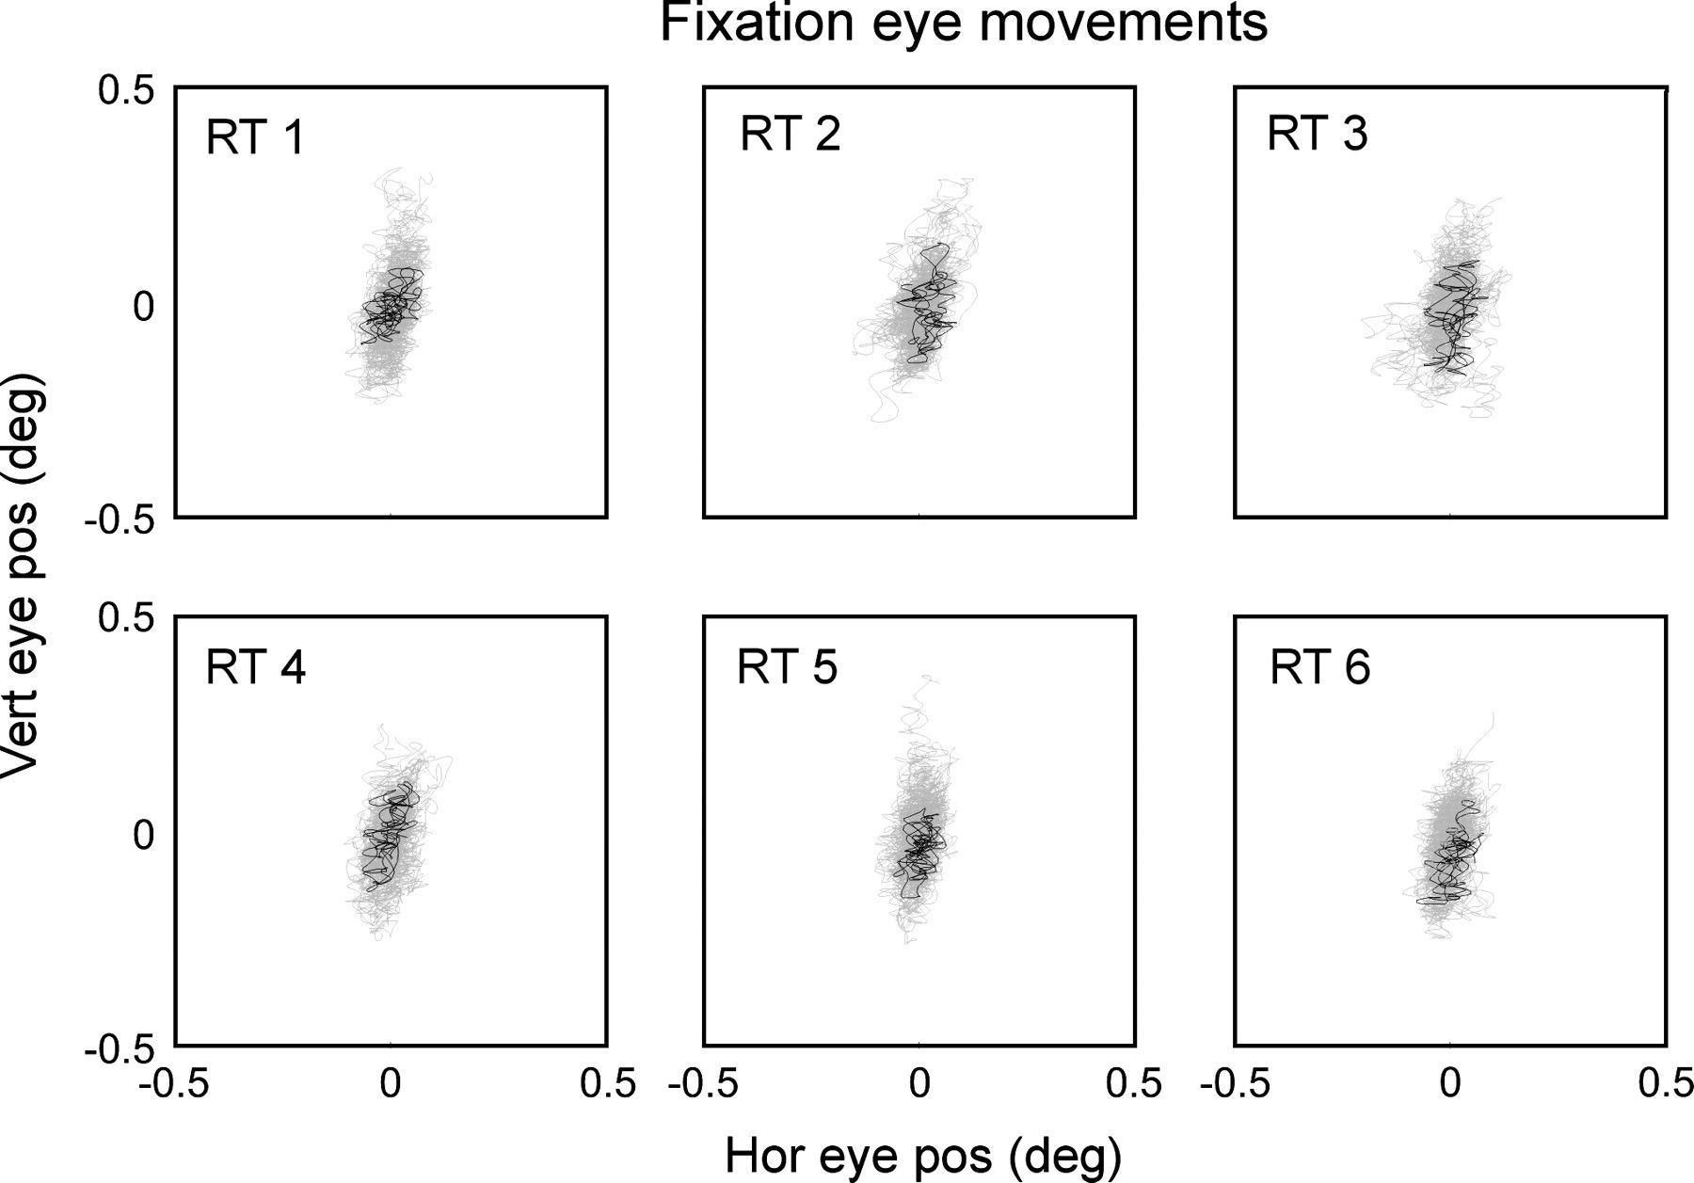
Figure 4. Eye positions during fixation period. Examples of eye positions from 0 to 1000 ms after stimulus onset (black ...
Notes:
Figure 4. Eye positions during fixation period. Examples of eye positions from 0 to 1000 ms after stimulus onset (black traces), superimposed on 25 random other similar fixations (gray). Fixation patterns are separated according to the reaction time groups (RT). Axes are the size of the fixation window.
Unless provided in the caption above, the following copyright applies to the content of this slide: © The Author 2006. Published by Oxford University Press. All rights reserved. For permissions, please e-mail: journals.permissions@oxfordjournals.org

Slide 5
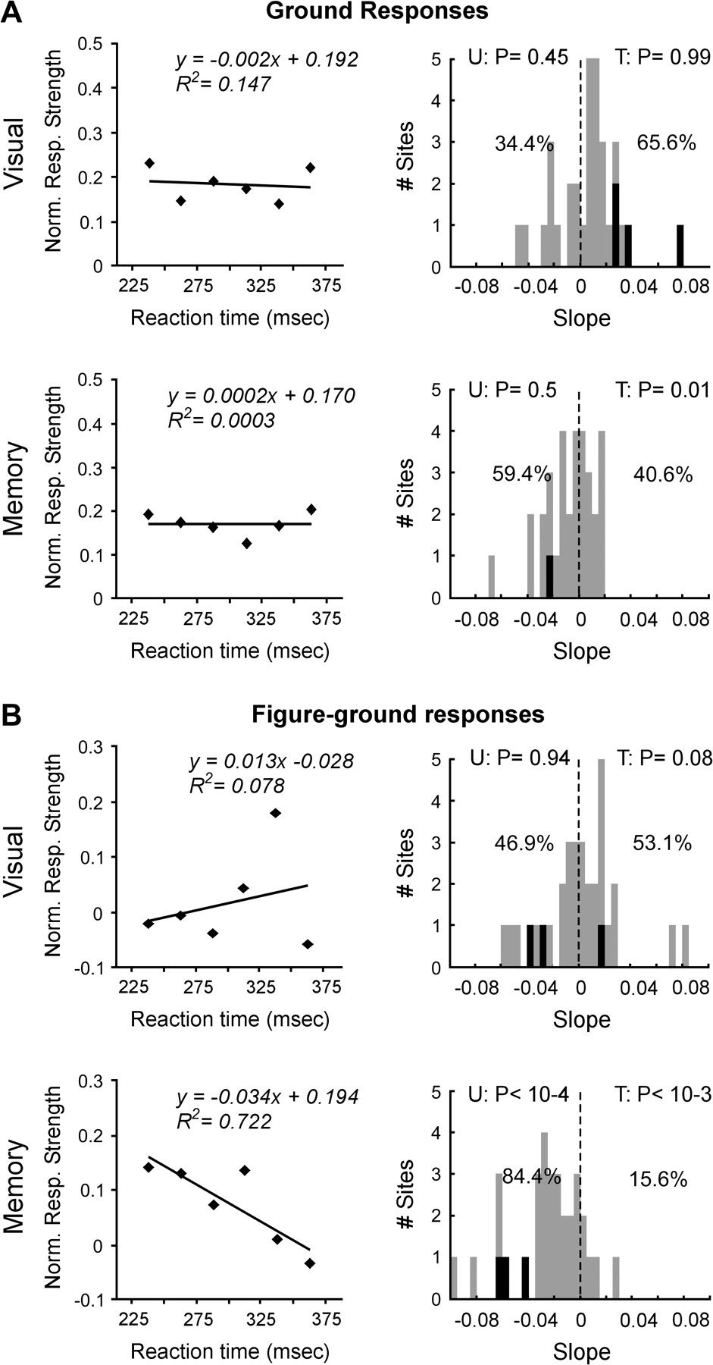
Figure 5. Correlation between ground/figure-ground responses and saccadic reaction times. Correlation functions ...
Notes:
Figure 5. Correlation between ground/figure-ground responses and saccadic reaction times. Correlation functions (Pearson) for ground responses (A) and figure-ground responses (B) with saccadic reaction time. Data show the population average of animal U (from all 16 electrodes). Right panels display the data per recording site of both animals, showing the strength and sign of the slope of the correlation function between neural responses and saccadic reaction time. The percentages indicate the relative number of all recording sites that show positive and negative slopes. Same convention as Figure 3.
Unless provided in the caption above, the following copyright applies to the content of this slide: © The Author 2006. Published by Oxford University Press. All rights reserved. For permissions, please e-mail: journals.permissions@oxfordjournals.org

Slide 6
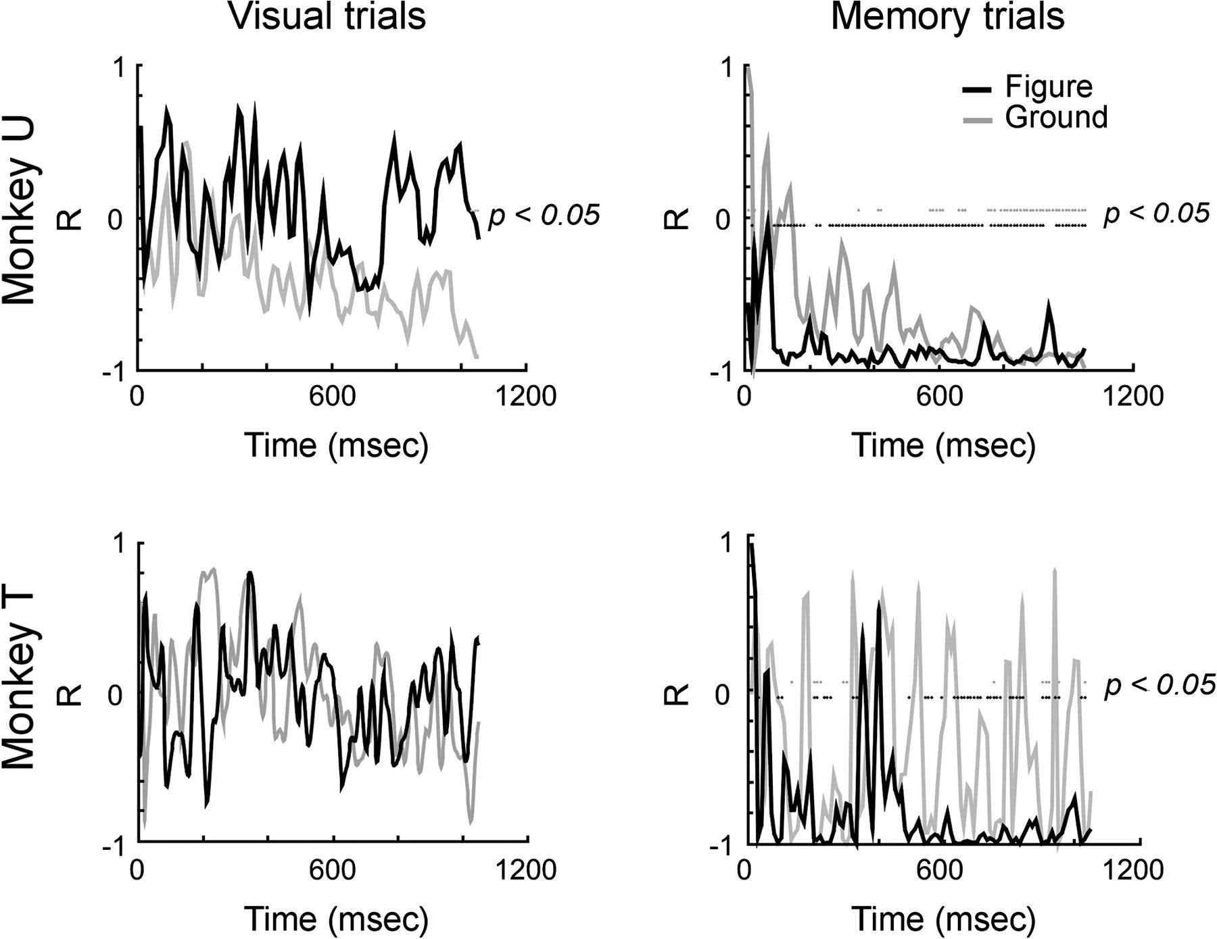
Figure 6. Temporal evolution of correlation responses with saccadic reaction times. The correlation strength between ...
Notes:
Figure 6. Temporal evolution of correlation responses with saccadic reaction times. The correlation strength between sensory responses and saccadic reaction times over time for visually guided and memory-guided trials. The times when correlations are significant are indicated by dots (black: figure, gray: ground). This figure shows the average population figure and the ground data for both animals separately.
Unless provided in the caption above, the following copyright applies to the content of this slide: © The Author 2006. Published by Oxford University Press. All rights reserved. For permissions, please e-mail: journals.permissions@oxfordjournals.org

Slide 7
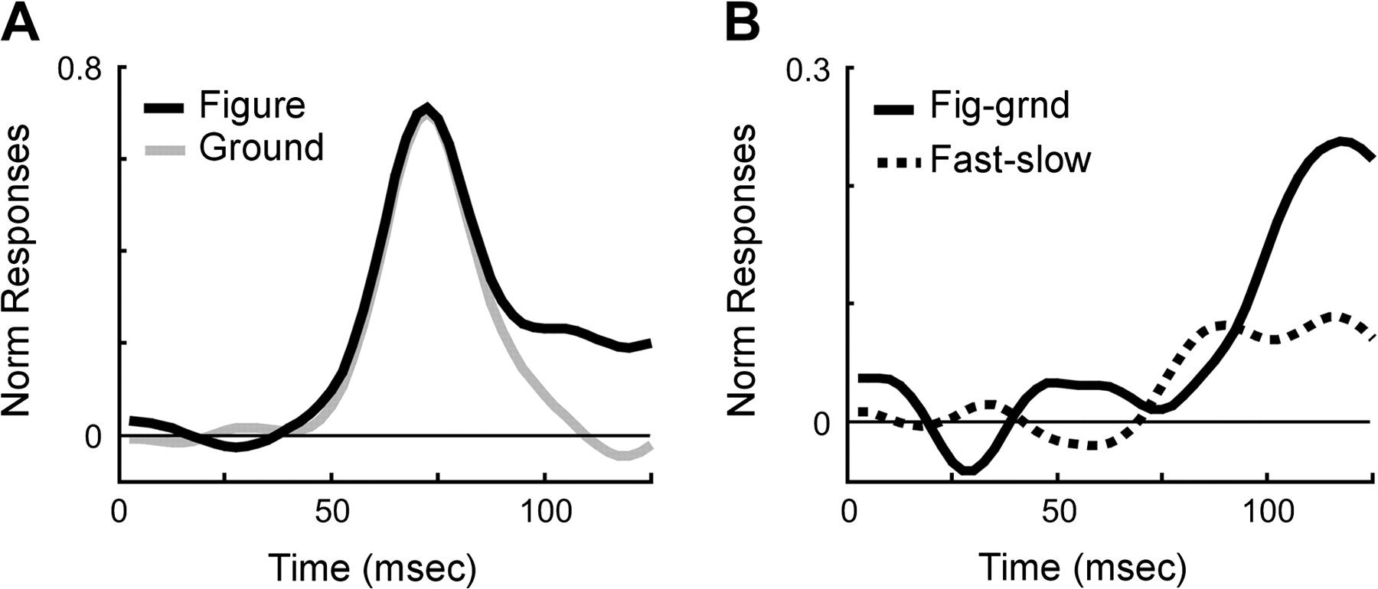
Figure 7. The onset of figure-ground activity and predictive activity. (A, B) The average population data from one ...
Notes:
Figure 7. The onset of figure-ground activity and predictive activity. (A, B) The average population data from one recording electrode showing figure and ground responses (A) and the difference between these responses (B). The same figure responses are also separated into fast and slow saccadic reaction time groups. The difference between these 2 response groups is indicated by the dotted line. Times are from stimulus onset.
Unless provided in the caption above, the following copyright applies to the content of this slide: © The Author 2006. Published by Oxford University Press. All rights reserved. For permissions, please e-mail: journals.permissions@oxfordjournals.org

Slide 8
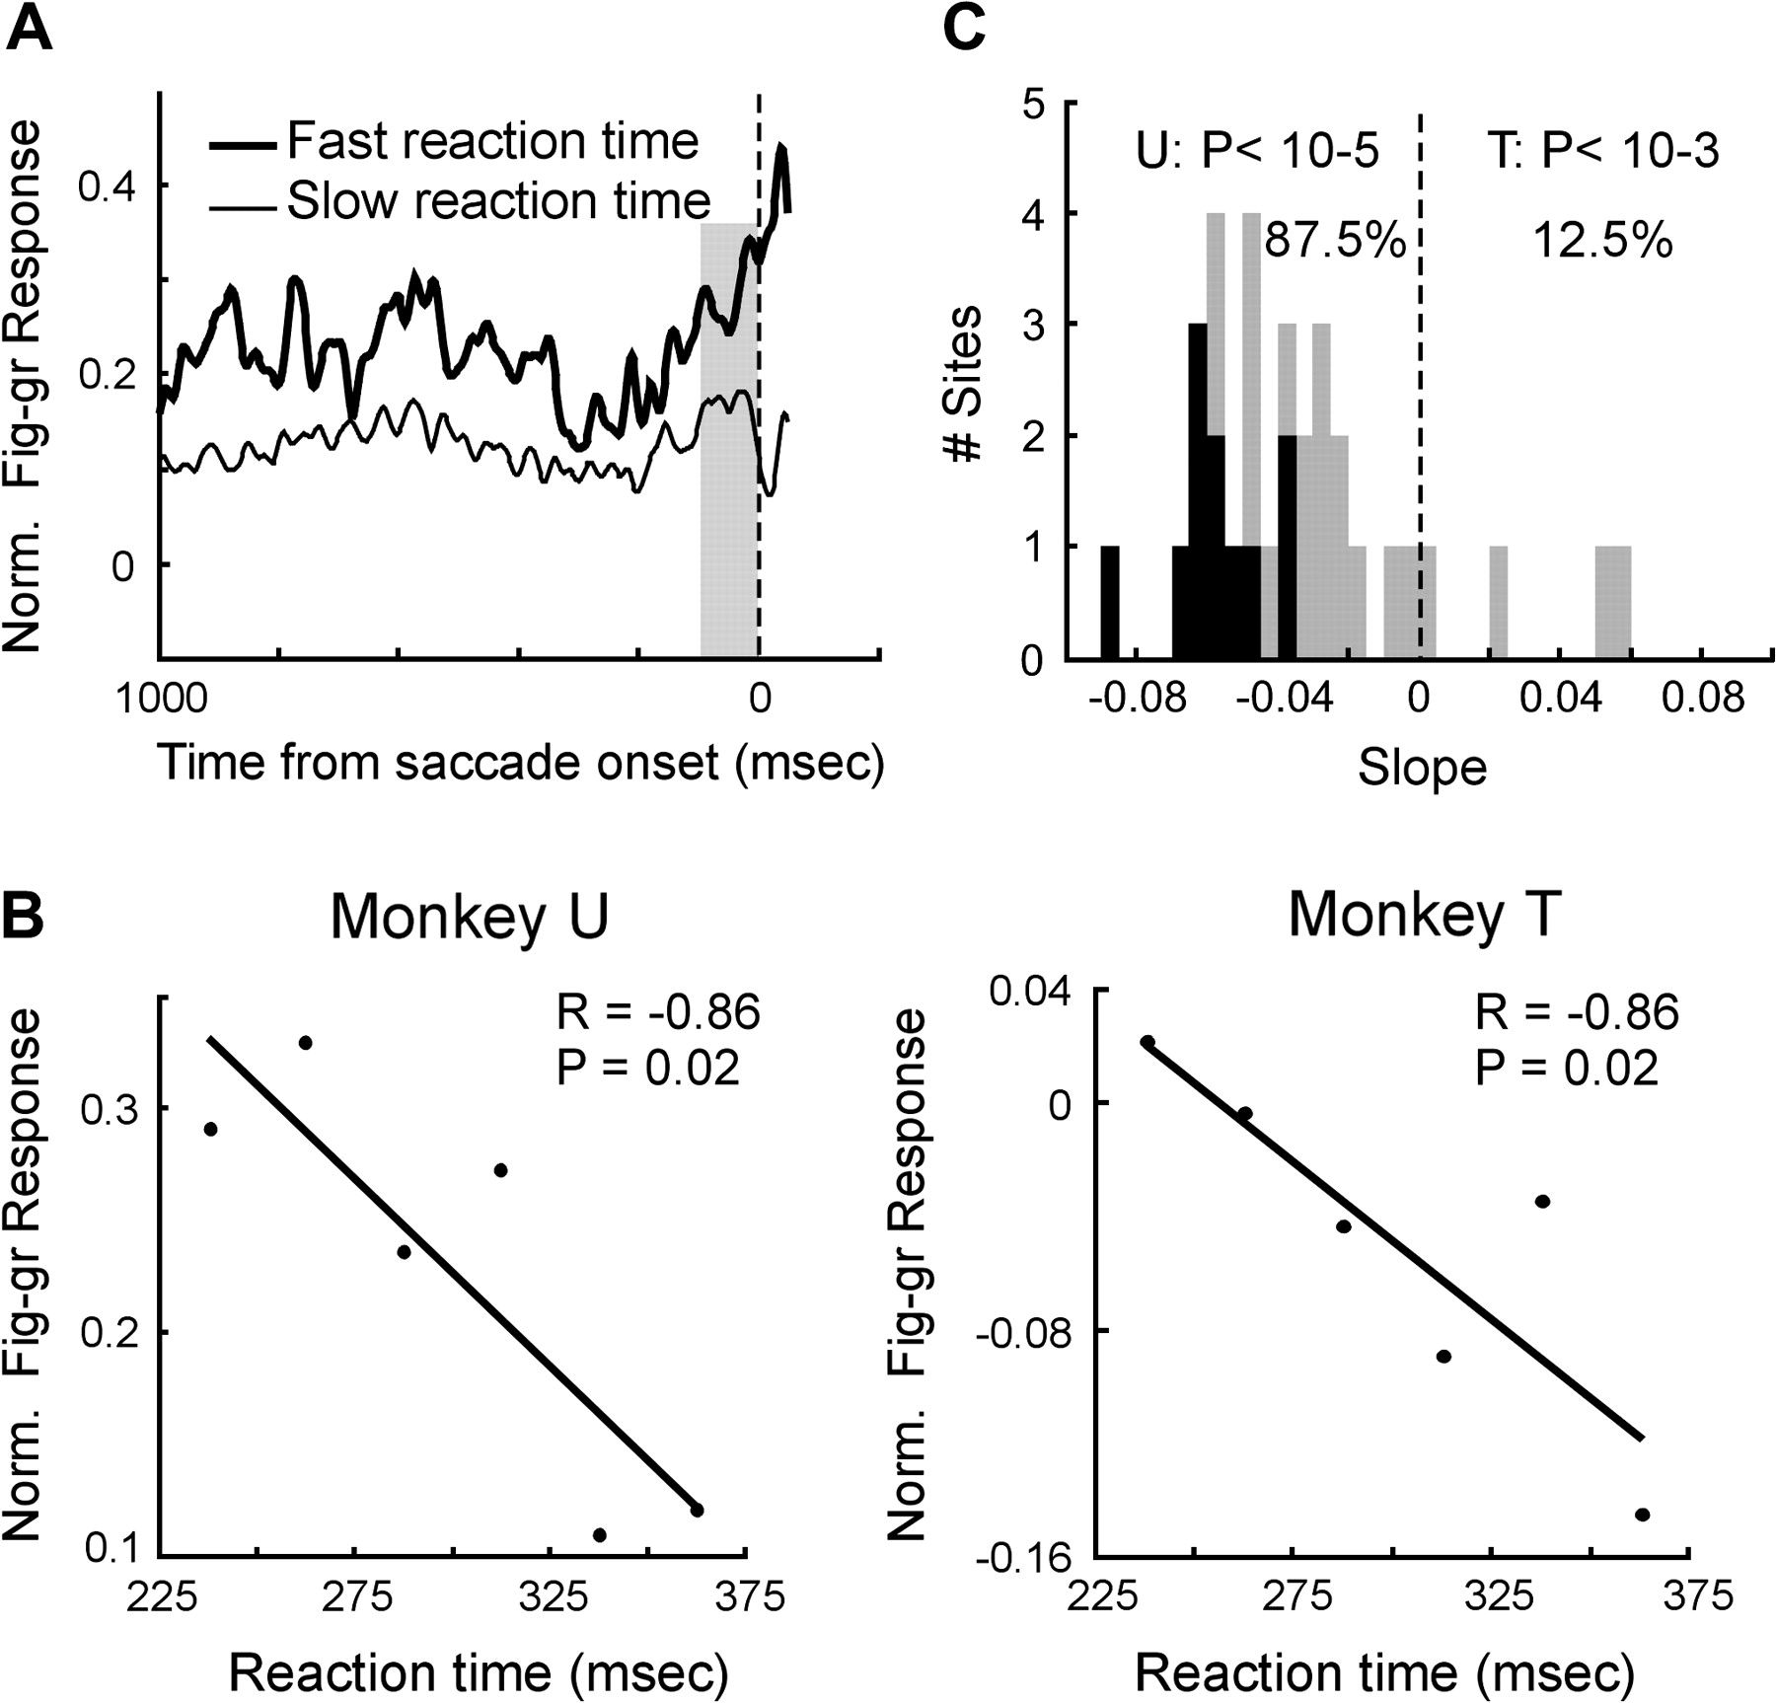
Figure 8. Presaccadic activity and correlation with saccadic reaction times. (A) The average responses from one ...
Notes:
Figure 8. Presaccadic activity and correlation with saccadic reaction times. (A) The average responses from one recording site during memory-guided trials. The vertical dashed line indicates saccade onset. (B) The correlation strength between the strength of the presaccadic figure-ground responses (100-ms period before saccade onset indicated by gray bar in A) and the saccadic reaction times for memory-guided trials. The figure shows the averaged population data (from 16 electrodes per animal). The line is the linear regression line (Pearson). (C) The distribution of slopes of the correlation functions per site of both animals. The percentages indicate the relative number of all recording sites that show positive and negative slopes. Same convention as Figure 3.
Unless provided in the caption above, the following copyright applies to the content of this slide: © The Author 2006. Published by Oxford University Press. All rights reserved. For permissions, please e-mail: journals.permissions@oxfordjournals.org

Slide 9
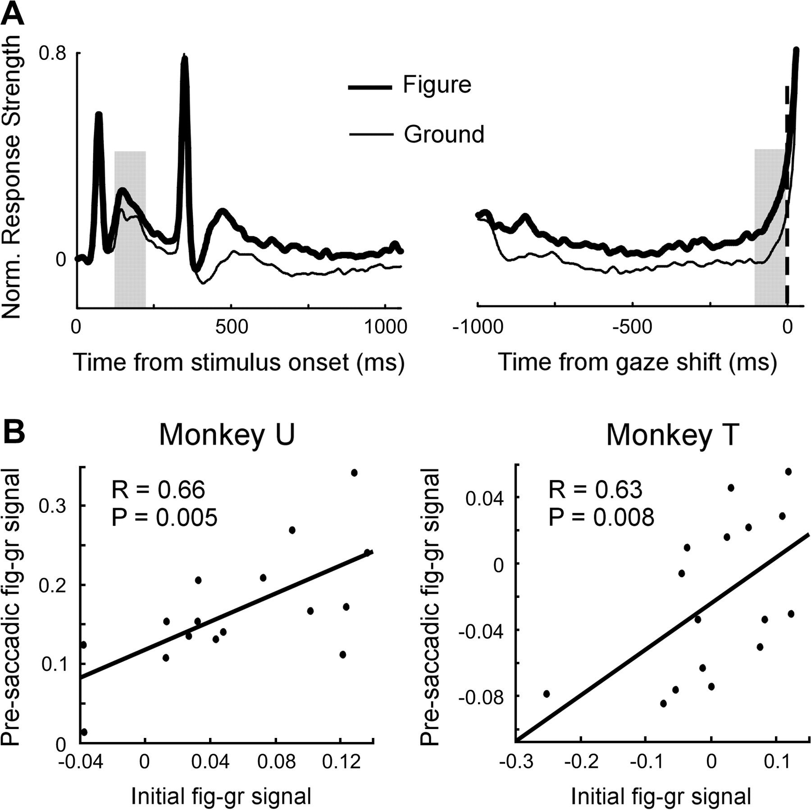
Figure 9. The correlation between perceptual activity and presaccadic activity. (A) Example of figure-ground responses ...
Notes:
Figure 9. The correlation between perceptual activity and presaccadic activity. (A) Example of figure-ground responses aligned on stimulus onset (left panel) and saccade onset (right panel). (B) Correlation functions between the initial strength of figure-ground segregation (i.e., a window of 85–135 ms as illustrated by the gray bar in left panel in A) and the strength of presaccadic figure-ground enhancement (i.e., 100-ms period before saccade onset as illustrated by the gray bar in the right panel in A). Dots represent the average data from individual recording sites. Lines are linear regression lines (Pearson).
Unless provided in the caption above, the following copyright applies to the content of this slide: © The Author 2006. Published by Oxford University Press. All rights reserved. For permissions, please e-mail: journals.permissions@oxfordjournals.org

