Slide 1
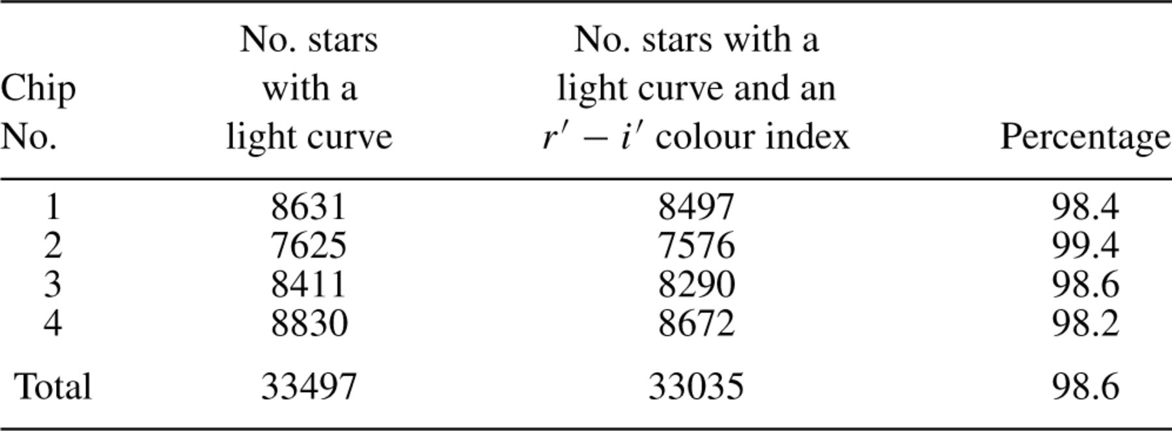
Table 3 Number of stars with a Sloan r′ light curve, and the number of such stars with a Sloan r′−i′ colour index.
Notes:
Table 3 Number of stars with a Sloan r′ light curve, and the number of such stars with a Sloan r′−i′ colour index.
Unless provided in the caption above, the following copyright applies to the content of this slide: © 2005 RAS

Slide 2
Table 2 Magnitude offsets and added to the light-curve data points from the 1999–06 and 1999–07 runs, ...
Notes:
Table 2 Magnitude offsets and added to the light-curve data points from the 1999–06 and 1999–07 runs, respectively.
Unless provided in the caption above, the following copyright applies to the content of this slide: © 2005 RAS

Slide 3
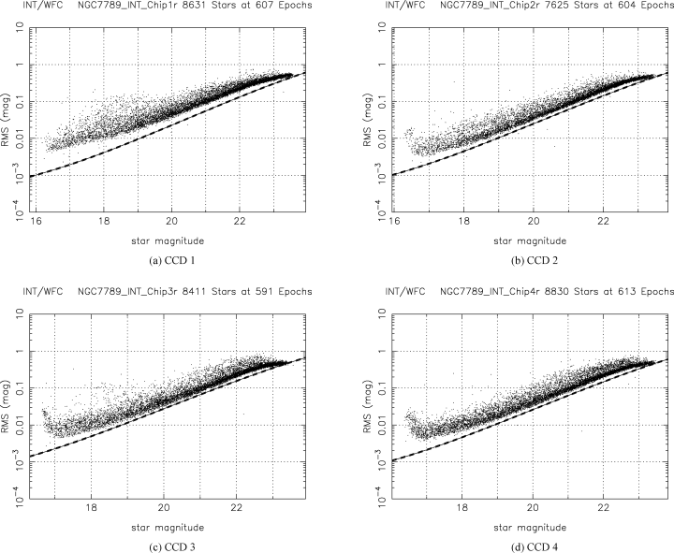
Figure 1 Plots of standard deviation (rms) of the light curves against mean instrumental Sloan r′ magnitude for all ...
Notes:
Figure 1 Plots of standard deviation (rms) of the light curves against mean instrumental Sloan r′ magnitude for all stars from each chip for the 2000–09 run. The lower curve in each diagram represents the theoretical noise limit for photon and readout noise.
Unless provided in the caption above, the following copyright applies to the content of this slide: © 2005 RAS

Slide 4
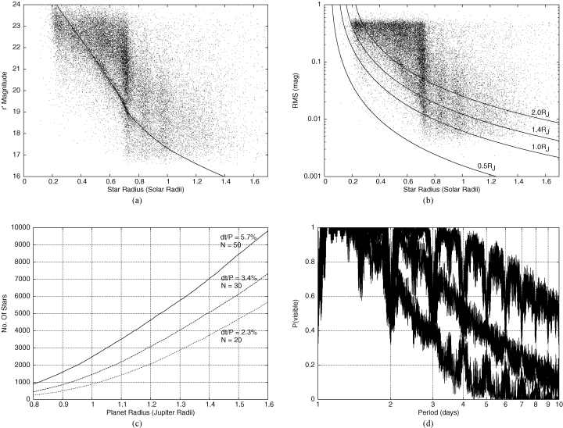
Figure 3 (a) A plot of r′ magnitude against star radius for all four chips. The continuous line is the theoretical ...
Notes:
Figure 3 (a) A plot of r′ magnitude against star radius for all four chips. The continuous line is the theoretical cluster main sequence. (b) Standard deviation (rms) of the light curves against star radius for all four chips. The continuous curves are the detection limits for an HD 209458-like planet of the quoted radius as a function of star radius (see Section 4.5). (c) Number of stars in our survey that have an rms accuracy better than that required for a S/N ≈ 10 detection with N data points during transit as a function of planetary radius. (d) A plot of P(visible) against orbital period for M= 1 (upper curve), M= 2 (middle curve) and M= 3 (lower curve). P(visible) is the probability that at least M transits have a time of mid-transit that occurs during our observations.
Unless provided in the caption above, the following copyright applies to the content of this slide: © 2005 RAS

Slide 5
Table 1 Properties of the open cluster NGC 7789. Data taken from http://obswww.unige.ch/webda by J. C. Mermilliod and ...
Notes:
Table 1 Properties of the open cluster NGC 7789. Data taken from http://obswww.unige.ch/webda by J. C. Mermilliod and the Simbad data base.
Unless provided in the caption above, the following copyright applies to the content of this slide: © 2005 RAS

Slide 6
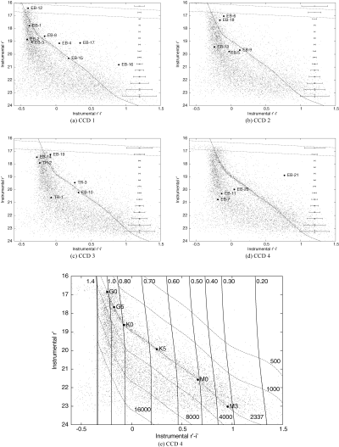
Figure 2 (a)–(d) Instrumental CMDs for all stars from each chip for the 2000–09 run. The main sequence is visible on ...
Notes:
Figure 2 (a)–(d) Instrumental CMDs for all stars from each chip for the 2000–09 run. The main sequence is visible on each chip, and the theoretical cluster main sequence is overlaid as the dashed line. The straight dotted lines are the faint limits for giant stars assuming no extinction and the law relating extinction to distance in equation (8). The transit candidates of Section 6 are marked as solid circles. The error bars on the right-hand side of each diagram represent the mean error bar on each measurement for 0.5 mag bins. (e) Instrumental CMD for chip 4 (see Section 4.4). The numbers along the top are masses in units of M⊙ and the numbers along the bottom and right are distances in parsecs.
Unless provided in the caption above, the following copyright applies to the content of this slide: © 2005 RAS

Slide 7
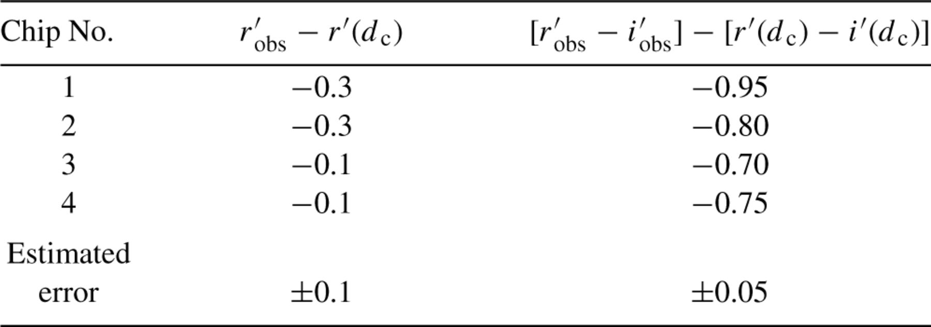
Table 4 Offsets determined by eye between observed r′_{obs} and r′_{obs}−i′_{obs} magnitudes, ...
Notes:
Table 4 Offsets determined by eye between observed r′obs and r′obs−i′obs magnitudes, and theoretical r′(dc) and r′(dc) −i′(dc) main-sequence magnitudes for the cluster distance dc.
Unless provided in the caption above, the following copyright applies to the content of this slide: © 2005 RAS

Slide 8
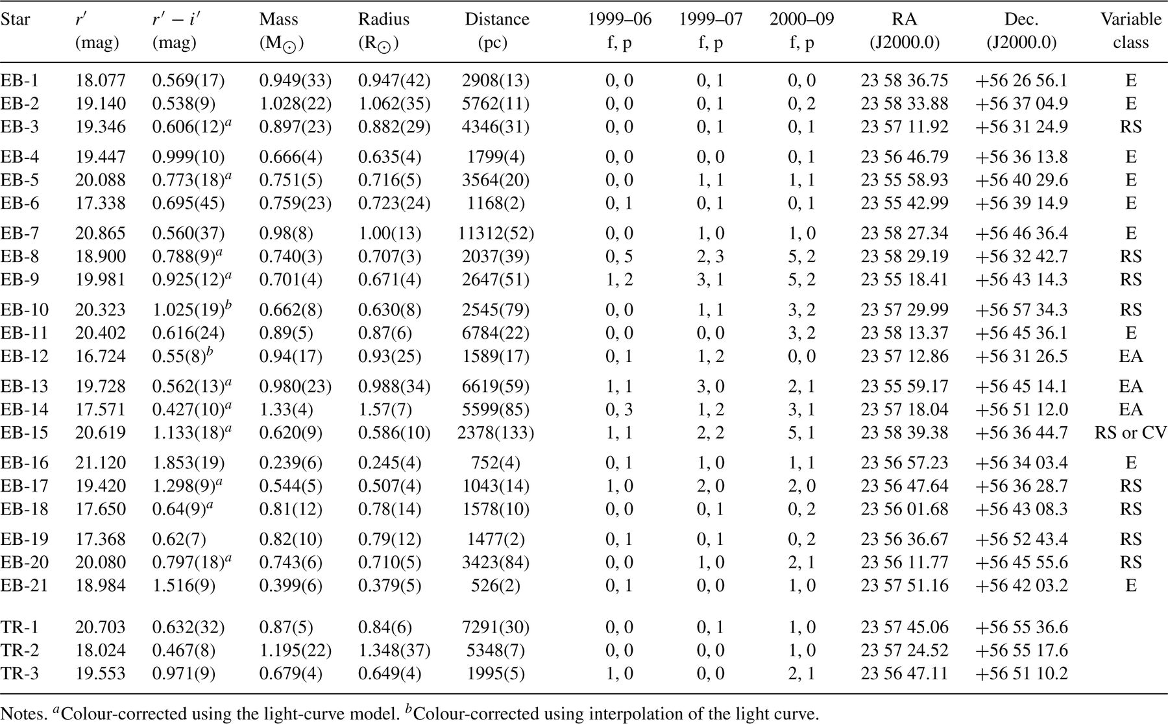
Table 6 Star and light-curve properties for the transit candidates. The numbers in parentheses indicate the ...
Notes:
Table 6 Star and light-curve properties for the transit candidates. The numbers in parentheses indicate the uncertainty on the last decimal place. Columns 2 and 3 are calibrated r′ and r′−i′ using the shifts in Table 4. Columns 7–9 indicate the number of fully and partially observed eclipses ‘(f, p)’ that are present in the light curve of the corresponding run. The eclipsing stellar binaries are classified into the following categories: E = eclipsing binary; EA = Algol-type eclipsing binary; RS = RS Canum Venaticorum-type eclipsing binary; CV = cataclysmic variable.
Unless provided in the caption above, the following copyright applies to the content of this slide: © 2005 RAS

Slide 9
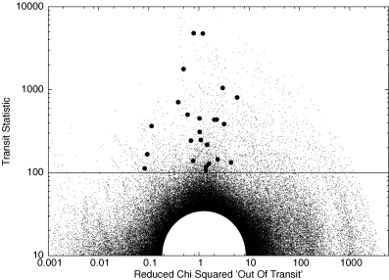
Figure 5 The transit detection statistic S²_{tra} against the out-of-transit reduced chi-squared ...
Notes:
Figure 5 The transit detection statistic S2tra against the out-of-transit reduced chi-squared χ2out/(Nout− 1). The initial transit detection threshold shown by the horizontal line is set at S2tra= 100. The strongest transits detected in the light curves of the 24 stars that survived subsequent data quality tests are plotted as solid circles. The blank semicircular region is saturated with test points.
Unless provided in the caption above, the following copyright applies to the content of this slide: © 2005 RAS

Slide 10
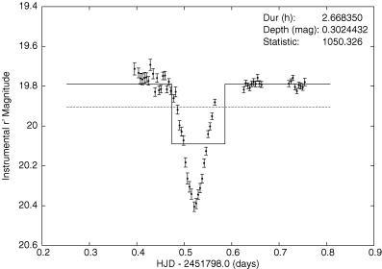
Figure 4 An example boxcar transit fit showing the in-transit and out-of-transit zones (continuous line) and the ...
Notes:
Figure 4 An example boxcar transit fit showing the in-transit and out-of-transit zones (continuous line) and the constant fit (dashed line). The horizontal axis is time (days) and the vertical axis instrumental Sloan r′ magnitude. ‘Statistic’ is the value of the transit statistic S2tra for this fit.
Unless provided in the caption above, the following copyright applies to the content of this slide: © 2005 RAS

Slide 11
Table 5 Number of raw transit candidates and remaining transit candidate light curves after the weeding process for ...
Notes:
Table 5 Number of raw transit candidates and remaining transit candidate light curves after the weeding process for each chip over the two runs.
Unless provided in the caption above, the following copyright applies to the content of this slide: © 2005 RAS

Slide 12
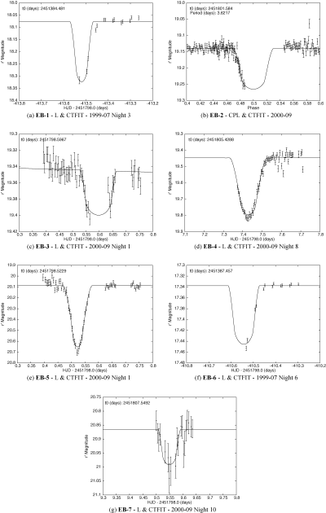
Figure 6 Eclipsing binaries with undetermined periods.
Notes:
Figure 6 Eclipsing binaries with undetermined periods.
Unless provided in the caption above, the following copyright applies to the content of this slide: © 2005 RAS

Slide 13
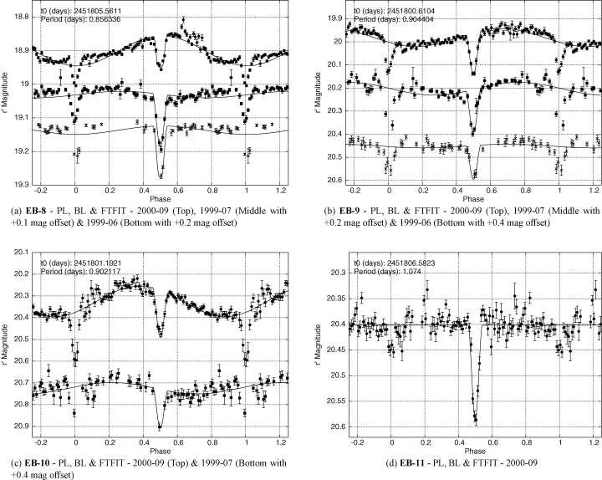
Figure 7 Eclipsing binaries exhibiting secondary eclipses.
Notes:
Figure 7 Eclipsing binaries exhibiting secondary eclipses.
Unless provided in the caption above, the following copyright applies to the content of this slide: © 2005 RAS

Slide 14
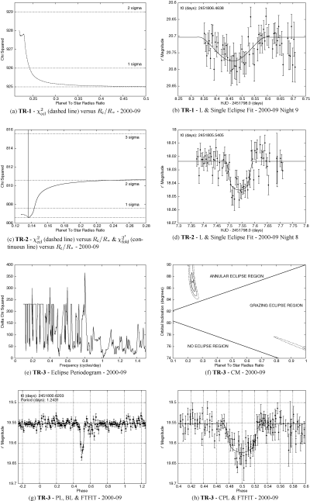
Figure 12 Planetary transit candidates TR-1, TR-2 and TR-3.
Notes:
Figure 12 Planetary transit candidates TR-1, TR-2 and TR-3.
Unless provided in the caption above, the following copyright applies to the content of this slide: © 2005 RAS

Slide 15
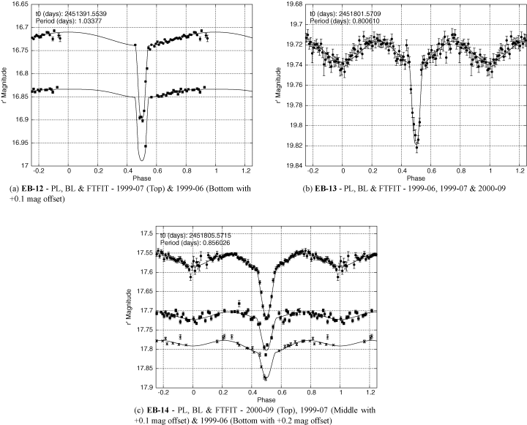
Figure 8 Eclipsing binaries exhibiting ellipsoidal variations and heating effects.
Notes:
Figure 8 Eclipsing binaries exhibiting ellipsoidal variations and heating effects.
Unless provided in the caption above, the following copyright applies to the content of this slide: © 2005 RAS

Slide 16
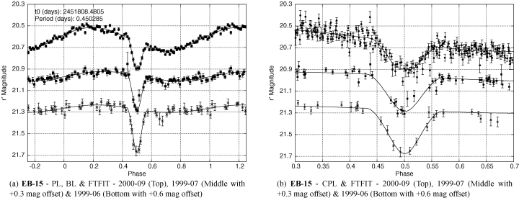
Figure 9 Possible long-period cataclysmic variables.
Notes:
Figure 9 Possible long-period cataclysmic variables.
Unless provided in the caption above, the following copyright applies to the content of this slide: © 2005 RAS

Slide 17
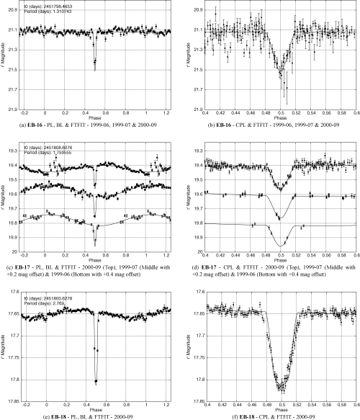
Figure 10 EB-16, EB-17 and EB-18.
Notes:
Figure 10 EB-16, EB-17 and EB-18.
Unless provided in the caption above, the following copyright applies to the content of this slide: © 2005 RAS

Slide 18
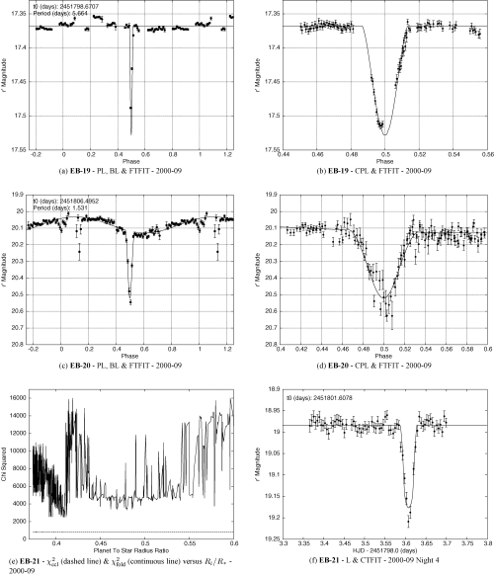
Figure 11 EB-19, EB-20 and EB-21.
Notes:
Figure 11 EB-19, EB-20 and EB-21.
Unless provided in the caption above, the following copyright applies to the content of this slide: © 2005 RAS

Slide 19
Table 7 Star, companion and light-curve properties for TR-3 as obtained from the various fits detailed in Section ...
Notes:
Table 7 Star, companion and light-curve properties for TR-3 as obtained from the various fits detailed in Section 6.9. Column 4 is calibrated r′ magnitude. Mc and Rc are the companion mass and radius, respectively. The ratio fc/f* is the flux ratio of the companion to the primary star in the Sloan r′ waveband. The quantity d is the distance to the system.
Unless provided in the caption above, the following copyright applies to the content of this slide: © 2005 RAS

Slide 20
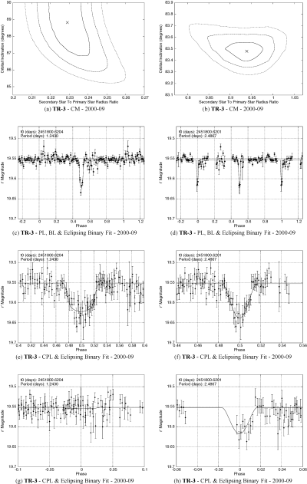
Figure 13 Eclipsing binary fits for TR-3.
Notes:
Figure 13 Eclipsing binary fits for TR-3.
Unless provided in the caption above, the following copyright applies to the content of this slide: © 2005 RAS

Slide 21
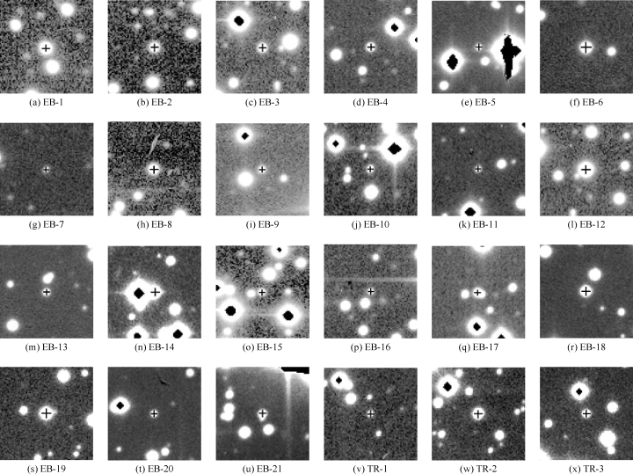
Figure 14 Finding charts taken from the reference frames; north is up and east is to the right. The stamps are of size ...
Notes:
Figure 14 Finding charts taken from the reference frames; north is up and east is to the right. The stamps are of size 27 × 27 arcsec2. Each eclipsing binary/transit candidate lies at the centre of its stamp and is marked by a cross.
Unless provided in the caption above, the following copyright applies to the content of this slide: © 2005 RAS

