Slide 1
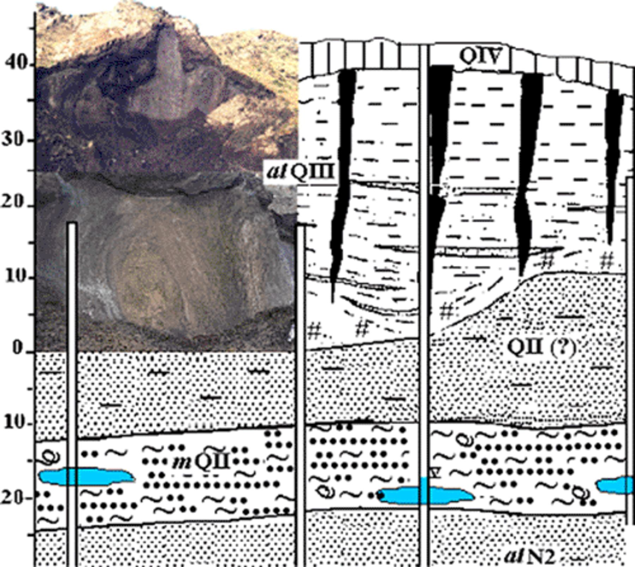
1 Geological cross-section: cryopegs and embedding sediments.
Notes:
1 Geological cross-section: cryopegs and embedding sediments.
Unless provided in the caption above, the following copyright applies to the content of this slide: © 2005 Federation of European Microbiological Societies. Published by Elsevier B.V. All rights reserved.

Slide 2
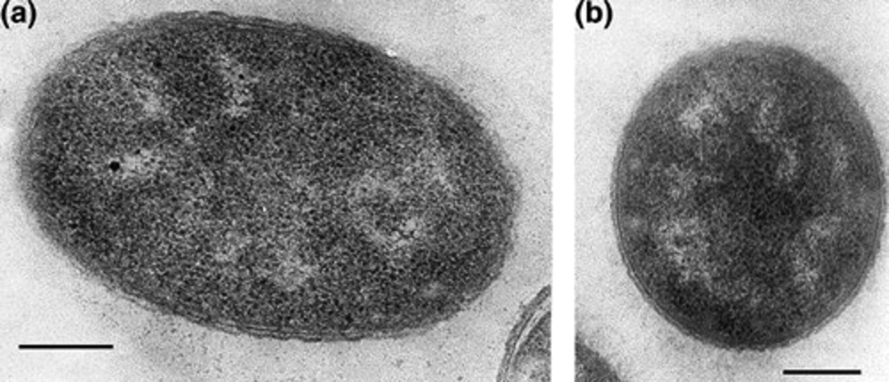
2 Ultrathin sections of Psychrobacter strain cells: (a) 1pS; (b) 2pS. Scale bar is 5 μm.
Notes:
2 Ultrathin sections of Psychrobacter strain cells: (a) 1pS; (b) 2pS. Scale bar is 5 μm.
Unless provided in the caption above, the following copyright applies to the content of this slide: © 2005 Federation of European Microbiological Societies. Published by Elsevier B.V. All rights reserved.

Slide 3
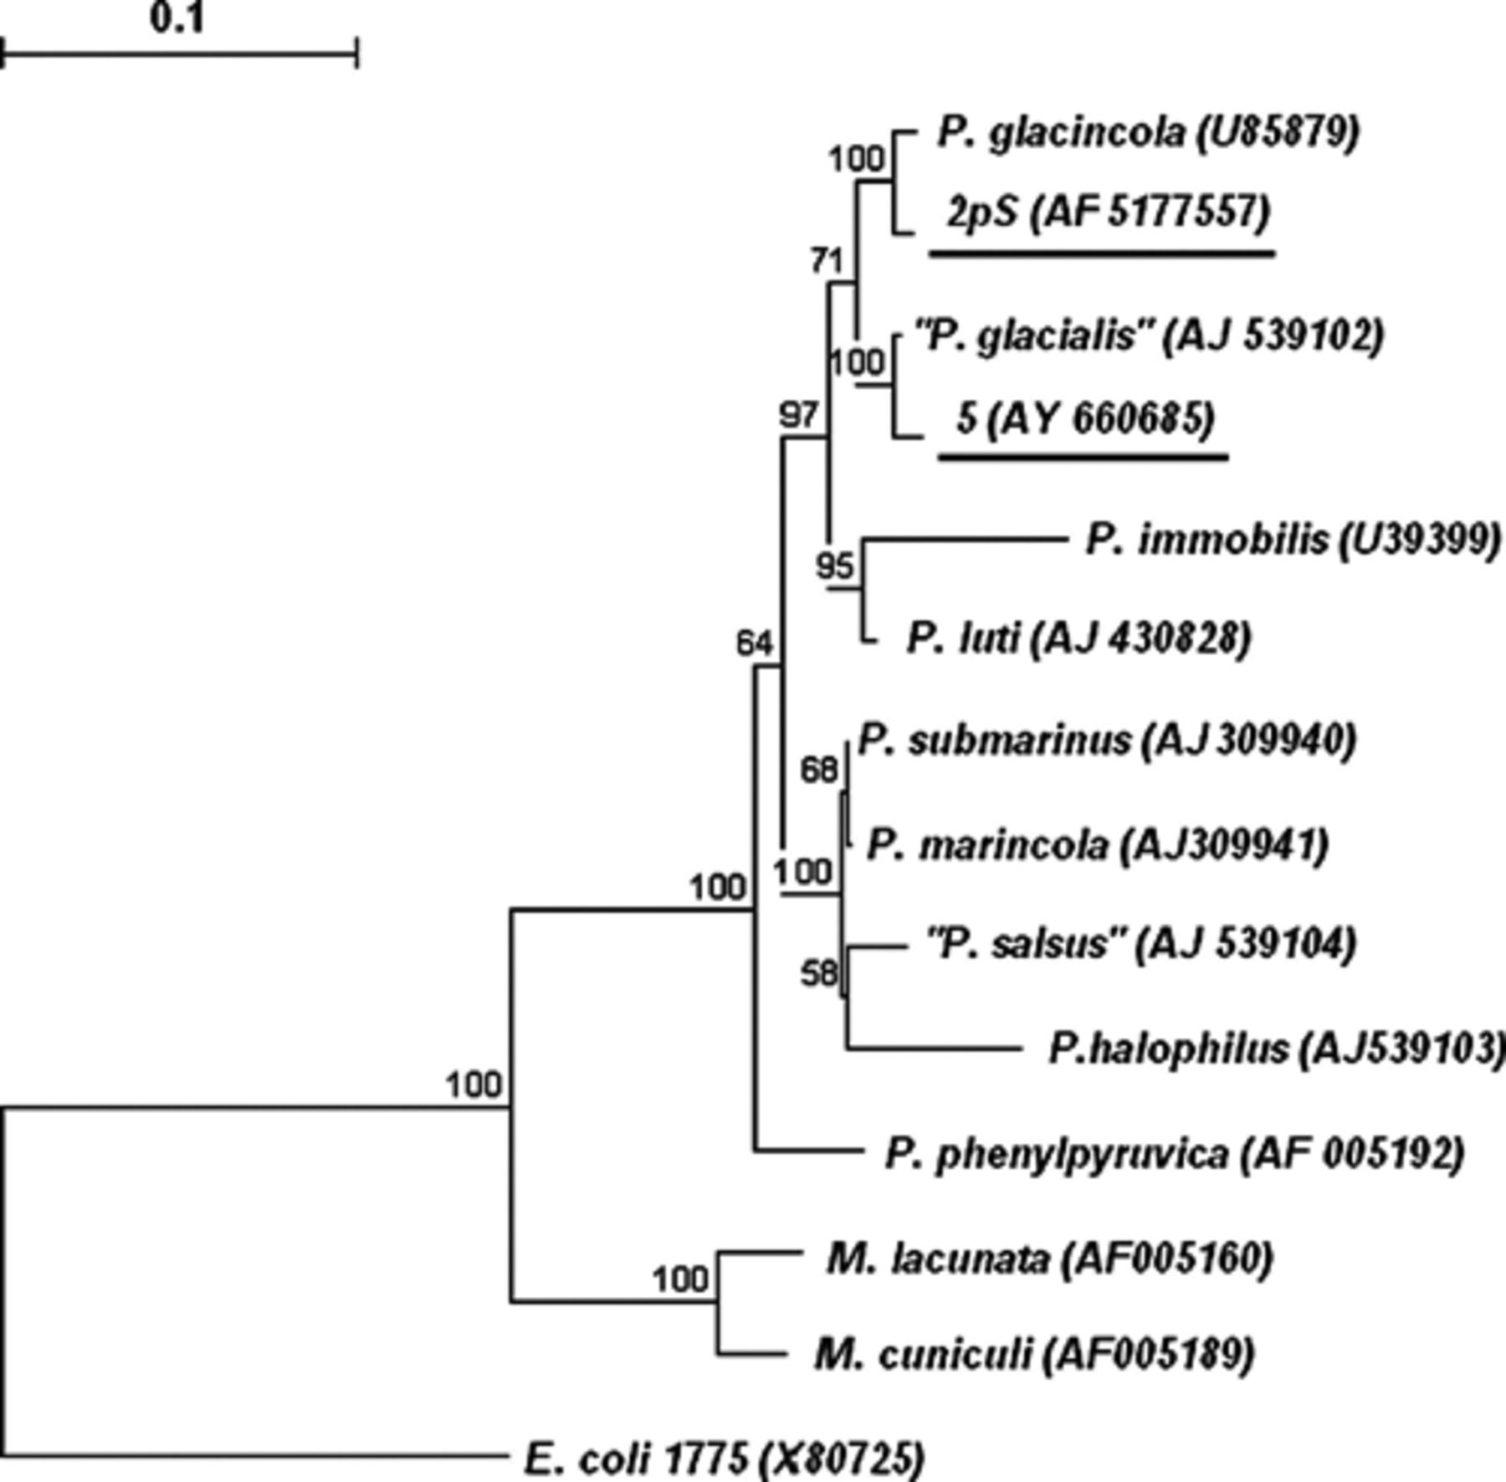
3 Positions of the new Psychrobacter sp. strains among closely related species based on 16S rRNA phylogenetic ...
Notes:
3 Positions of the new Psychrobacter sp. strains among closely related species based on 16S rRNA phylogenetic analysis. The accession numbers of strains are shown in parentheses. Tree was constructed with neighbor-joined method by using the Jukes–Cantor distance estimation. The significance of each branch is indicated by a bootstrap value. The scale bar is estimated substitutions per nucleotide position.
Unless provided in the caption above, the following copyright applies to the content of this slide: © 2005 Federation of European Microbiological Societies. Published by Elsevier B.V. All rights reserved.

Slide 4
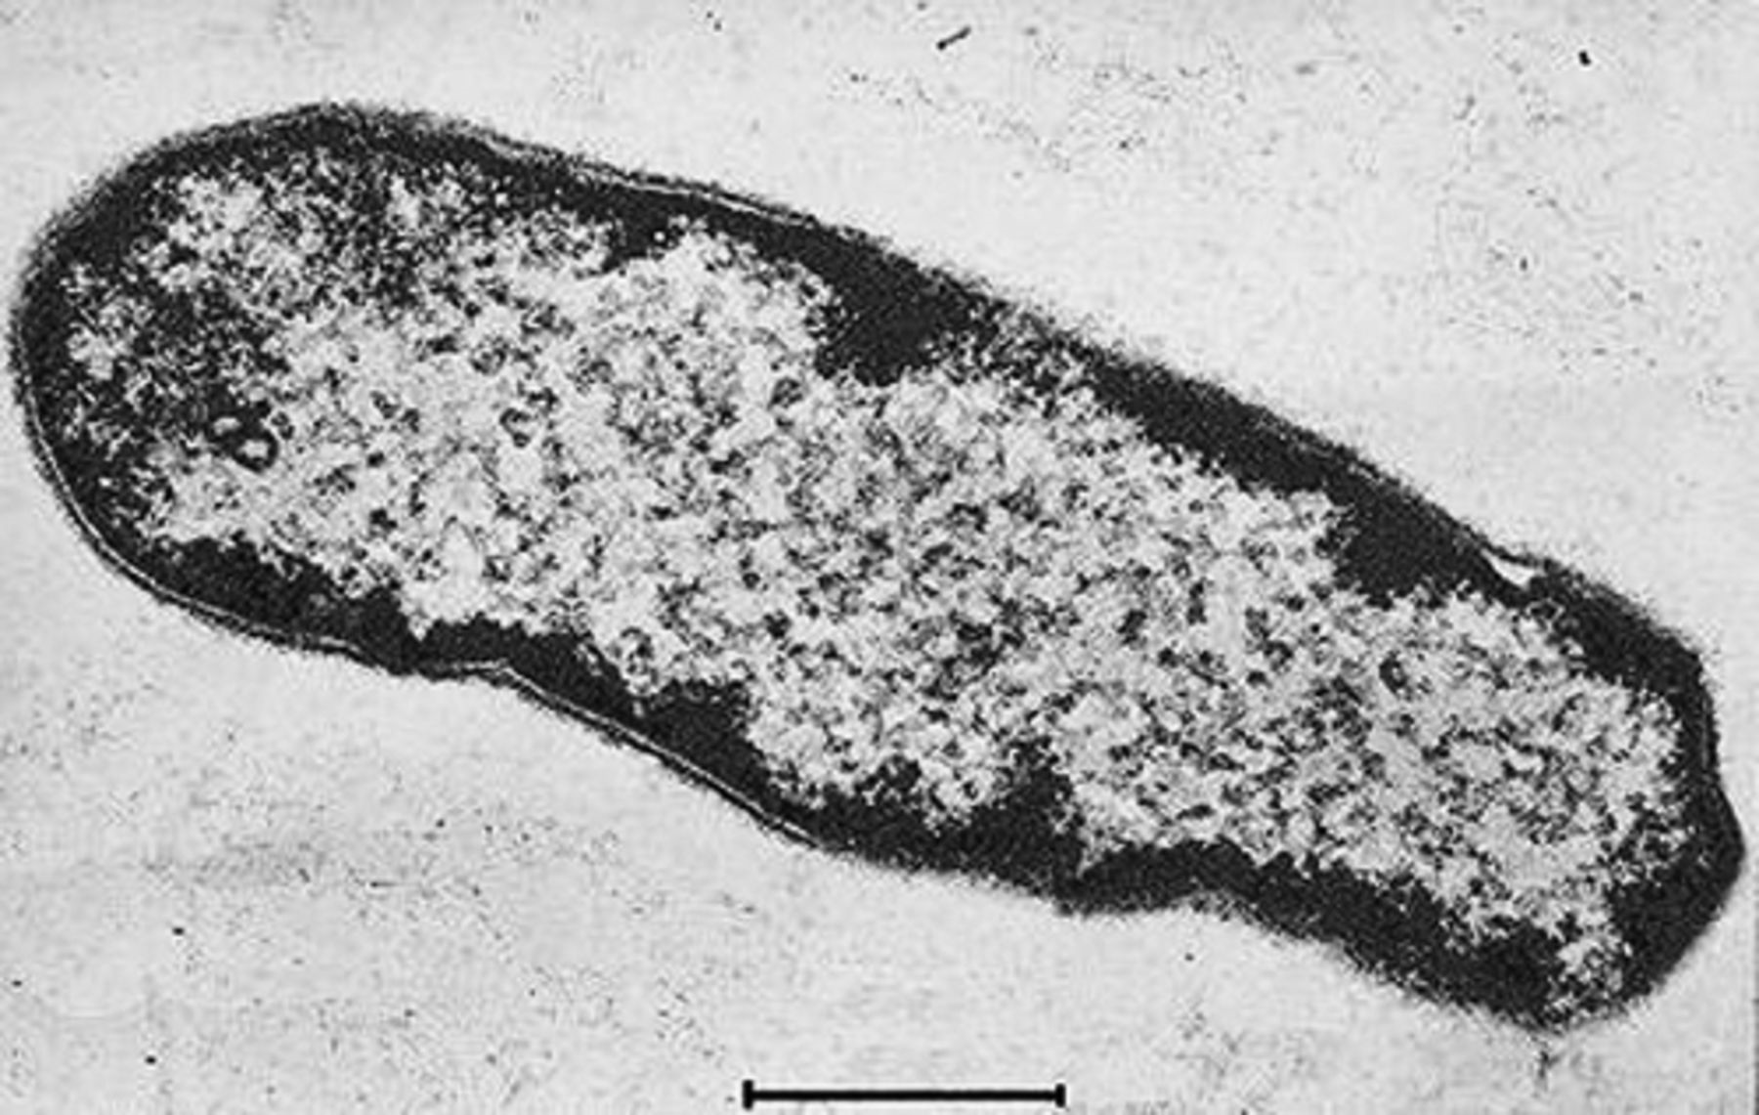
4 Ultrathin sections of Clostridium sp. cell.
Notes:
4 Ultrathin sections of Clostridium sp. cell.
Unless provided in the caption above, the following copyright applies to the content of this slide: © 2005 Federation of European Microbiological Societies. Published by Elsevier B.V. All rights reserved.

Slide 5
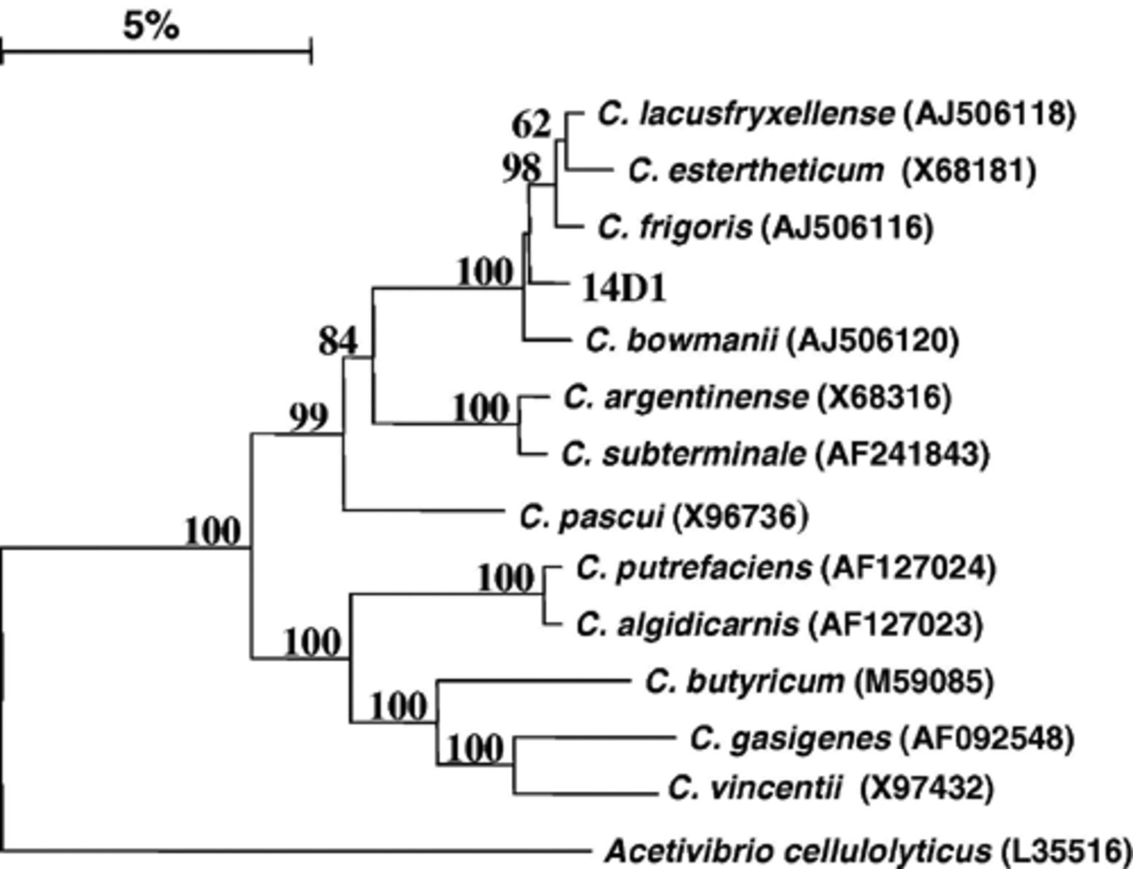
5 Position of the strain 14D1 among closely related species of the genus Clostridium, based on 16S rRNA ...
Notes:
5 Position of the strain 14D1 among closely related species of the genus Clostridium, based on 16S rRNA phylogenetic analysis. The accession numbers of type strains are shown in parentheses. Tree was constructed with the neighbor-joined method by using the Jukes–Cantor distance estimation. The significance of each branch is indicated by a bootstrap value. The scale bar is estimated substitutions per nucleotide position.
Unless provided in the caption above, the following copyright applies to the content of this slide: © 2005 Federation of European Microbiological Societies. Published by Elsevier B.V. All rights reserved.

Slide 6
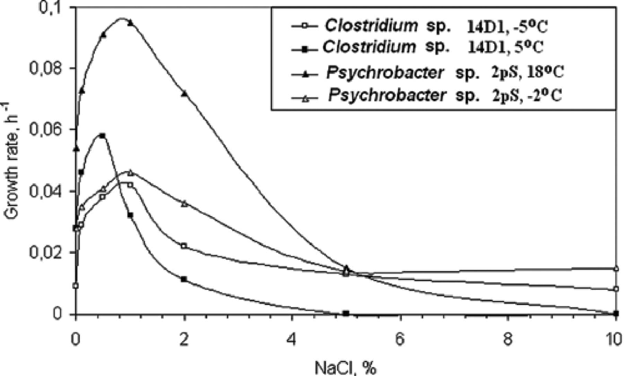
6 NaCl effect on the cryopeg’ s isolates growth.
Notes:
6 NaCl effect on the cryopeg’ s isolates growth.
Unless provided in the caption above, the following copyright applies to the content of this slide: © 2005 Federation of European Microbiological Societies. Published by Elsevier B.V. All rights reserved.

Slide 7
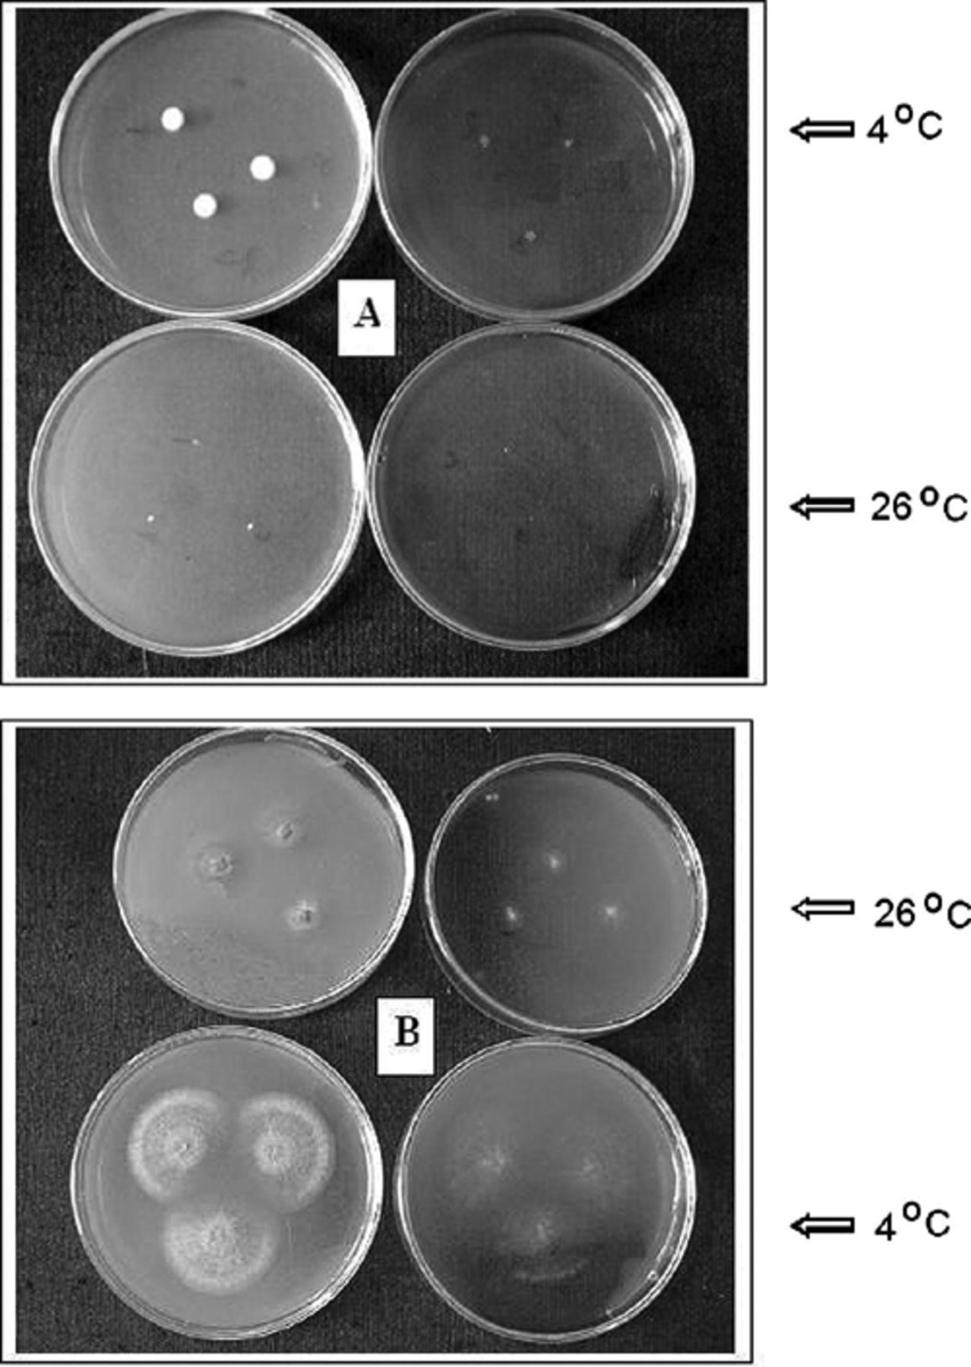
7 Growth of the strain Geomyces pannorum var. pannorum on the media with 10% (A) and without salt (B). The ...
Notes:
7 Growth of the strain Geomyces pannorum var. pannorum on the media with 10% (A) and without salt (B). The growth on rich media is submitted in the left column, on pure media – right column.
Unless provided in the caption above, the following copyright applies to the content of this slide: © 2005 Federation of European Microbiological Societies. Published by Elsevier B.V. All rights reserved.

