Slide 1
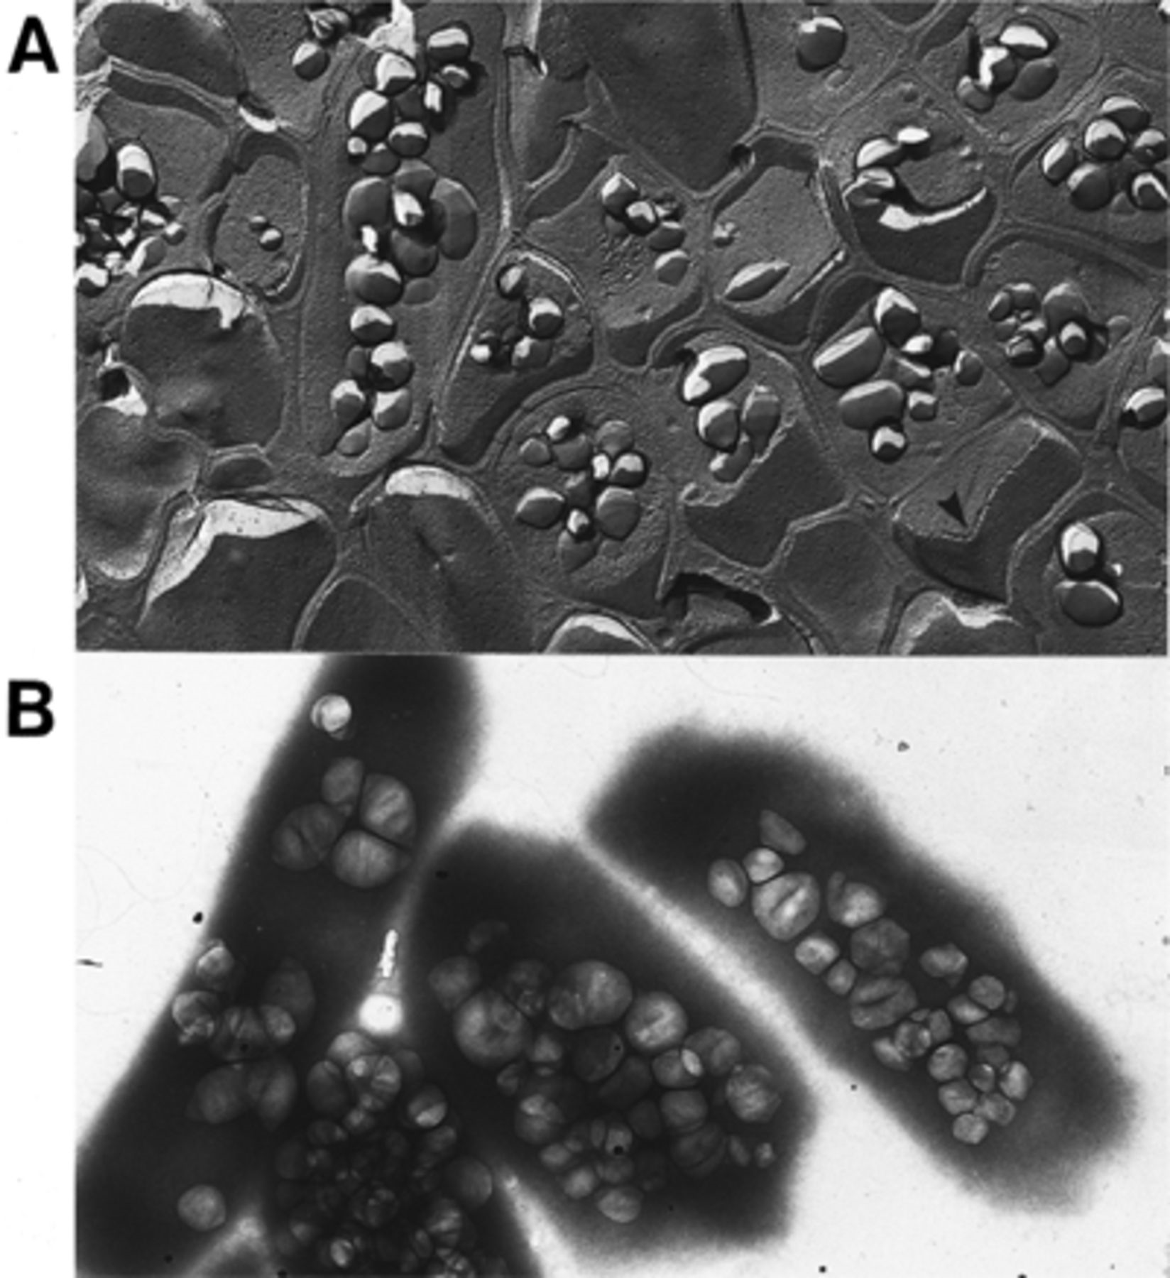
1 Micrographs of Halobacterium NRC-1 containing gas vesicles. A: Freeze-fracture micrograph of a cell pellet ...
Notes:
1 Micrographs of Halobacterium NRC-1 containing gas vesicles. A: Freeze-fracture micrograph of a cell pellet with a large number of gas vesicles visible where the fracture plane has broken through cells. The arrowhead indicates the direction of shadowing. B: Negatively stained cells containing large numbers of gas vesicles. Vesicles are visible as distinct particles within cell ghosts.
Unless provided in the caption above, the following copyright applies to the content of this slide: © 1997 Federation of European Microbiological Societies. Published by Elsevier Science B.V.

Slide 2
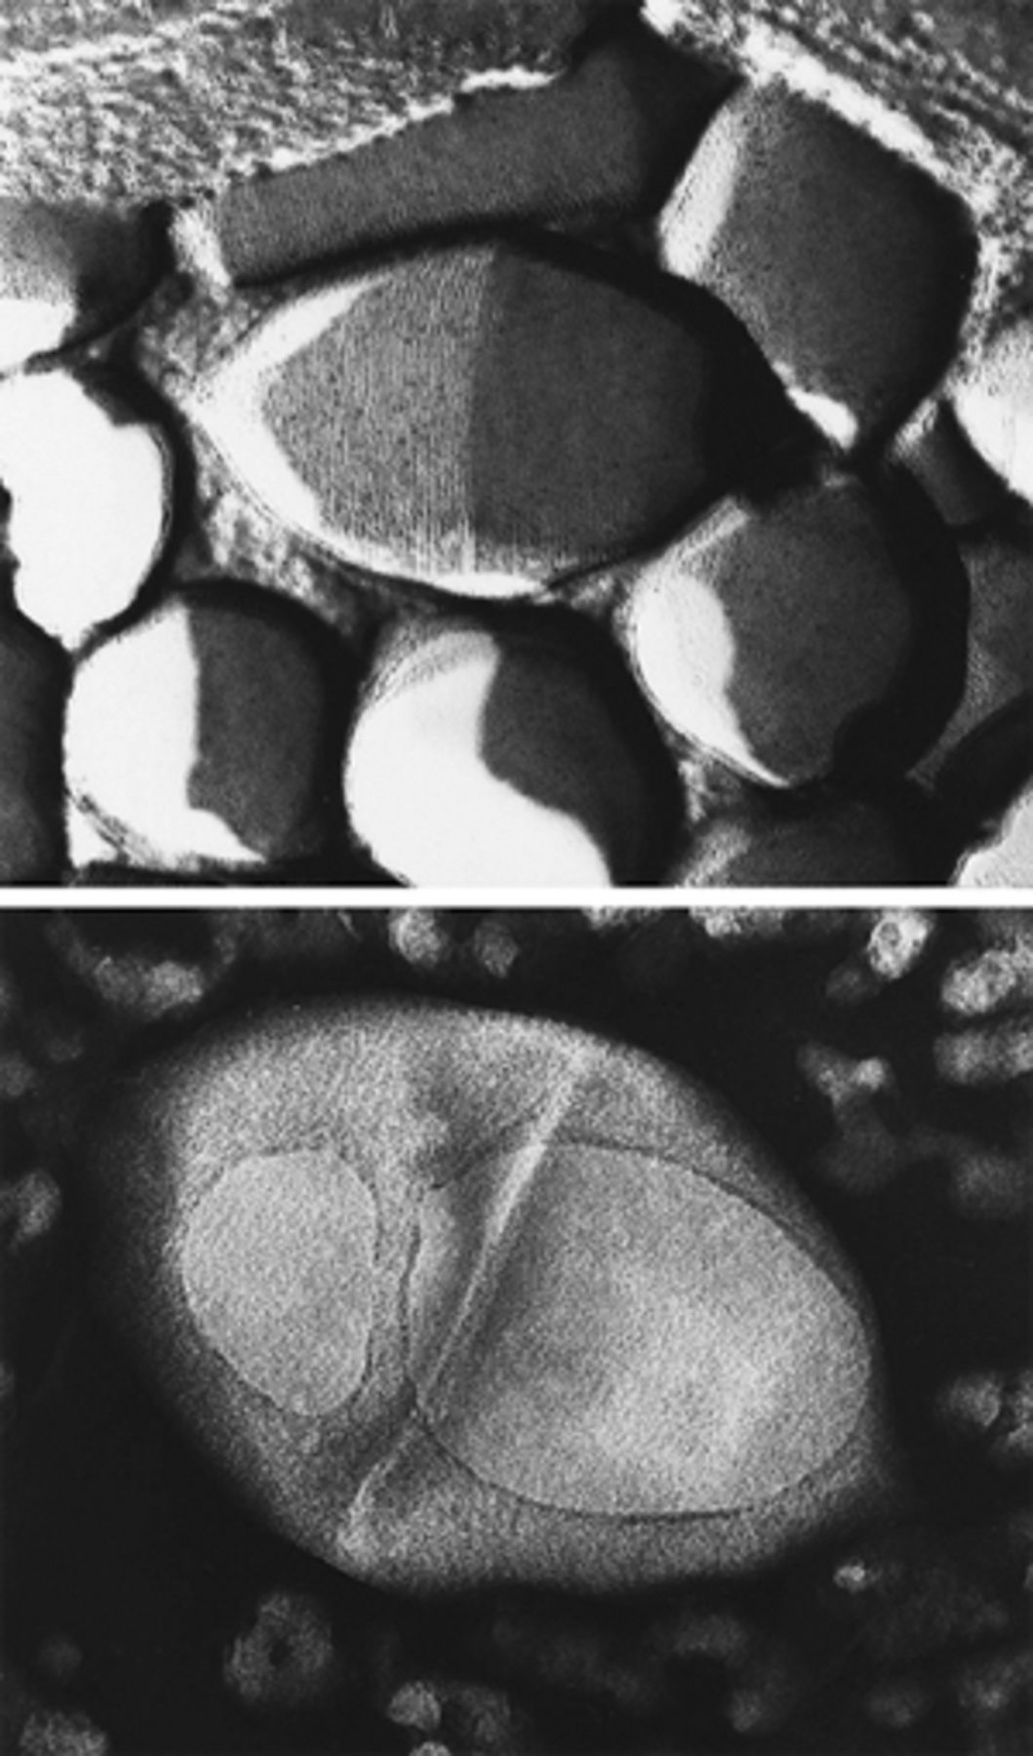
2 Micrographs of lemon-shaped gas vesicles of Halobacterium NRC-1. The upper panel is taken from a ...
Notes:
2 Micrographs of lemon-shaped gas vesicles of Halobacterium NRC-1. The upper panel is taken from a freeze-fracture specimen of cells. Rings or shallow spirals of protein subunits, probably GvpA and GvpC, are visible. The lower panel shows a negatively stained gas vesicle. The gas vesicle contains two large holes but has not accumulated stain internally, presumably because of hydrophobic forces, and has maintained a turgid structure, likely due to the rigidity of the membrane.
Unless provided in the caption above, the following copyright applies to the content of this slide: © 1997 Federation of European Microbiological Societies. Published by Elsevier Science B.V.

Slide 3
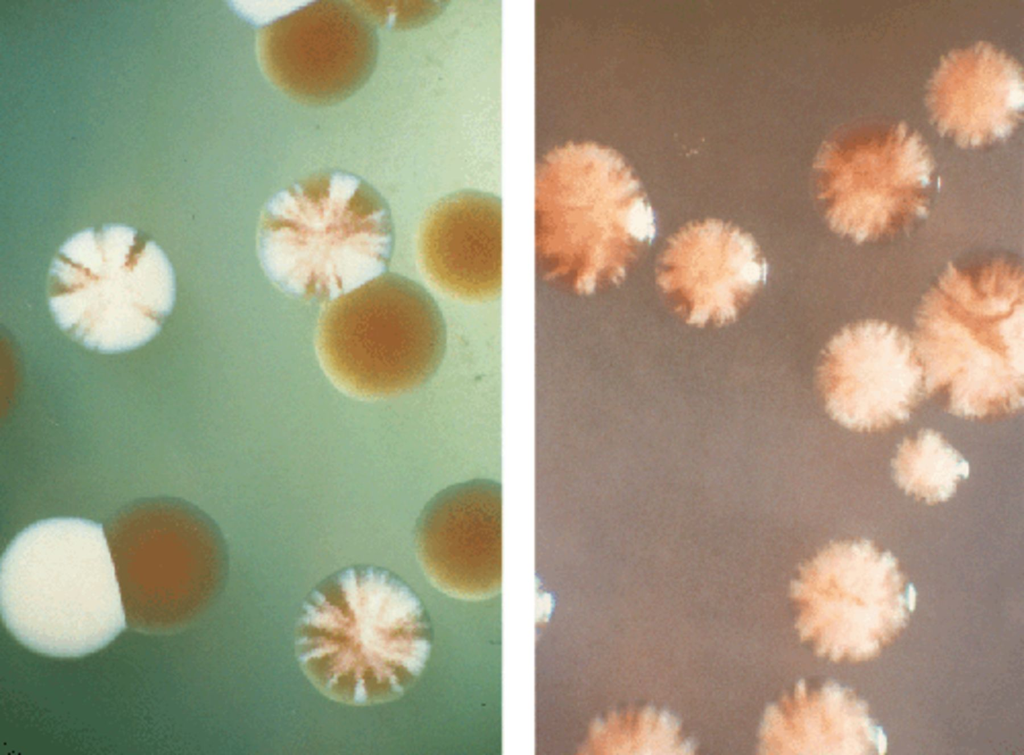
3 Colonies of Halobacterium producing or lacking gas vesicles on agar plates. The left panel shows colonies of ...
Notes:
3 Colonies of Halobacterium producing or lacking gas vesicles on agar plates. The left panel shows colonies of strain NRC-1 which have Vac+ (milky, opaque), Vac− (orange, translucent), and sectored Vac+/Vac− phenotypes. Here, sectoring is the result of recombinational activities promoted by transposable elements. The colonies on the right panel are formed by strain SD109 containing the entire pNRC100 gvp gene cluster on a recombinant plasmid (pFL2[38]) plated under non-selective conditions. In this case, sectoring is the result of frequent loss of the recombinant plasmid during cell division.
Unless provided in the caption above, the following copyright applies to the content of this slide: © 1997 Federation of European Microbiological Societies. Published by Elsevier Science B.V.

Slide 4
4 The gvp gene cluster of Halobacterium. The gvp genes are designated by boxes. The approximate locations of ...
Notes:
4 The gvp gene cluster of Halobacterium. The gvp genes are designated by boxes. The approximate locations of divergent promoters in the gvp A–D intergenic region are indicated by arrows. The leftward operon contains putative regulatory genes (gvp D and E) and minor structural or assembly genes (gvp F, G, H, I, J, K, L and M), and the rightward operon contains structural genes (gvp A and C, and also gvp N). Another open reading frame, gvp O, with a possible regulatory role is present downstream of gvp N.
Unless provided in the caption above, the following copyright applies to the content of this slide: © 1997 Federation of European Microbiological Societies. Published by Elsevier Science B.V.

