Slide 1
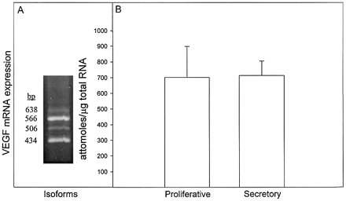
Figure 1. RT–PCR analysis of VEGF mRNA isoforms (A) and VEGF mRNA levels (B) in human endometrium during the ...
Notes:
Figure 1. RT–PCR analysis of VEGF mRNA isoforms (A) and VEGF mRNA levels (B) in human endometrium during the menstrual cycle. (A) Total RNA (1 µg) was reverse transcribed and amplified for 25 cycles using VEGF primers that spanned the alternative splice site to yield the individual isoforms. (B) Mean (±SEM) VEGF mRNA levels in whole endometrial tissue obtained from six women in the proliferative phase and four women in the secretory phase of the menstrual cycle. VEGF was analysed by competitive RT–PCR using primers upstream from the alternative splice site to yield a single 323 bp product that represented collective expression of all isoforms.
Unless provided in the caption above, the following copyright applies to the content of this slide:

Slide 2
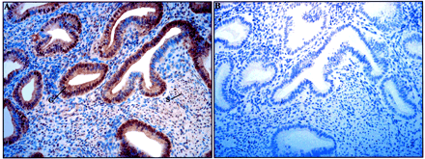
Figure 2. (A) Representative photomicrograph of VEGF immunocytochemistry in the human endometrium during the ...
Notes:
Figure 2. (A) Representative photomicrograph of VEGF immunocytochemistry in the human endometrium during the early secretory phase of the menstrual cycle. (B) Primary antibody pre‐absorbed with excess recombinant VEGF. S, stroma; G, glandular epithelium. Final magnification, 100×.
Unless provided in the caption above, the following copyright applies to the content of this slide:

Slide 3
Figure 3. Immunocytochemistry of flt‐1 and KDR/flk‐1 receptors in human myometrial microvascular endothelial ...
Notes:
Figure 3. Immunocytochemistry of flt‐1 and KDR/flk‐1 receptors in human myometrial microvascular endothelial cells (HMMECs). HMMECs were grown for a pre‐confluent period of 5–7 days, plated on chamber slides and incubated in EBM supplemented with 4% FBS for 24 h at 37°C with antibodies to flt‐1 (A), KDR/flk‐1 (B) or goat immunoglobulins (C). Magnification, 400×.
Unless provided in the caption above, the following copyright applies to the content of this slide:

Slide 4
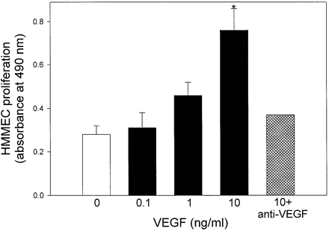
Figure 4. Effect of VEGF on HMMEC proliferation. HMMECs were grown for a pre‐confluent period of 5–7 days ...
Notes:
Figure 4. Effect of VEGF on HMMEC proliferation. HMMECs were grown for a pre‐confluent period of 5–7 days then cultured for 24 h at 37°C in EBM supplemented with 4% FBS alone, and then for 96 h in the presence/absence of recombinant hVEGF (0.1–10 ng/ml) and/or anti‐human VEGF antibody (1 µg/ml). Values are the means (±SEM) of 3–8 different cultures, except for anti‐VEG/PF antibody where n = 2. *Significantly different (P < 0.01) from 0, 0.1 and 1 ng/ml VEGF groups (ANOVA and Newman–Keuls multiple comparisons test).
Unless provided in the caption above, the following copyright applies to the content of this slide:

Slide 5
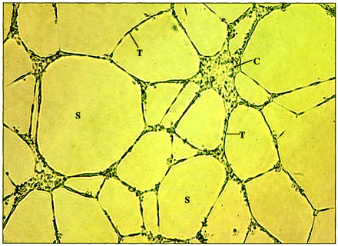
Figure 5. Tube formation by HMMECs after culture with VEGF. HMMECs were prepared as described in the legends ...
Notes:
Figure 5. Tube formation by HMMECs after culture with VEGF. HMMECs were prepared as described in the legends to Figures 3 and 4, attached to Matrigel‐coated inserts and incubated in EBM for 24 h at 37°C in the presence of 50 ng/ml hVEGF. HMMEC images were captured using an inverted microscope coupled to a digital camera. T, elongated tubule; C, cell aggregate; S, space. Magnification, 40×.
Unless provided in the caption above, the following copyright applies to the content of this slide:

Slide 6
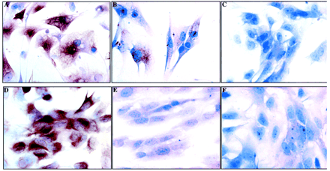
Figure 6. Immunocytochemistry of cytokeratin and vimentin in dispersed human glandular epithelial and stromal ...
Notes:
Figure 6. Immunocytochemistry of cytokeratin and vimentin in dispersed human glandular epithelial and stromal cells. Endometrial tissue was obtained from women in the secretory phase of the menstrual cycle and dispersed in DMEM/F12 containing collagenase, hyaluronidase, protease and DNase. Enriched populations of glandular epithelial and stromal cells were obtained by filtration and plated onto chamber slides in DMEM/F12 supplemented with 4% FBS and incubated at 37°C for 7 days with medium change every other day. Cells were fixed in formalin, incubated with antibodies to cytokeratin 7 or vimentin, DAB as chromagen, and counterstained with Harris haematoxylin and lithium carbonate. Glandular epithelial cells incubated with antibodies to cytokeratin (A), vimentin (B) or goat immunglobulin (C). Stromal cells incubated with antibodies to vimentin (D), cytokeratin (E) or goat immunoglobulin (F). Magnification, 400×.
Unless provided in the caption above, the following copyright applies to the content of this slide:

Slide 7
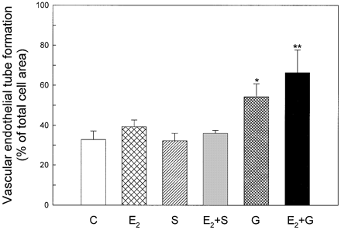
Figure 7. HMMEC tube formation, expressed as endothelial tube area/total endothelial cell area × 100 (%), ...
Notes:
Figure 7. HMMEC tube formation, expressed as endothelial tube area/total endothelial cell area × 100 (%), after culture with medium alone (C), 17β‐estradiol (E2) and/or human stromal (S) or glandular epithelial (G) cells. Human endometrial tissue was obtained from women in the secretory phase (n = 6) of the menstrual cycle, and enriched populations of glandular epithelial and stromal cells obtained as detailed in the legend to Figure 6. HMMECs were pre‐incubated for a pre‐confluent period of 5–7 days with medium change to EBM and 4% FBS for 24 h and 25 × 103 cells/0.5 ml added to Matrigel‐coated cell inserts. Glandular epithelial and stromal cells (2–4 × 105/ml each) were incubated for 7 days in DMEM/F12 medium and 4% FBS alone, and then co‐incubated with HMMEC in EBM and 4% FBS with/without 10–6 mol/l E2 for 24 h at 37°C. Values are the means (±SEM) of the six separate endometrial cultures. Significantly different at *P < 0.05 and **P < 0.01 when analysed and compared with data obtained from HMMECs cultured with medium alone (ANOVA and Neuman–Keul’s multiple comparisons test).
Unless provided in the caption above, the following copyright applies to the content of this slide:

Slide 8
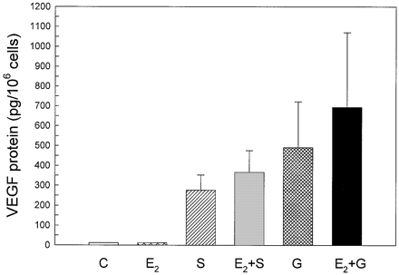
Figure 8. VEGF protein levels determined by ELISA in conditioned medium from the co‐cultures of human stromal ...
Notes:
Figure 8. VEGF protein levels determined by ELISA in conditioned medium from the co‐cultures of human stromal (S) or glandular epithelial (G) cells and HMMECs on which tube formation is shown in Figure 7. C, medium alone; E2, estradiol. Values are the means (±SEM) expressed in pg/106 glandular epithelial or stromal cells.
Unless provided in the caption above, the following copyright applies to the content of this slide:

Slide 9
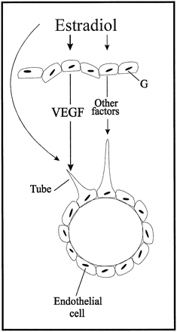
Figure 9. Proposed model for the role of estrogen in promoting, via endometrial glandular epithelial (G) cell ...
Notes:
Figure 9. Proposed model for the role of estrogen in promoting, via endometrial glandular epithelial (G) cell expression of VEGF and/or other factors or synergistically with VEGF, angiogenesis (i.e. microvascular endothelial cell tube formation) in a co‐cultivation system.
Unless provided in the caption above, the following copyright applies to the content of this slide:

