Slide 1
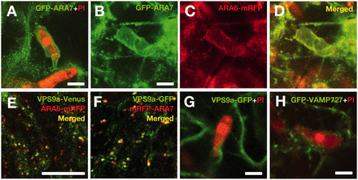
Fig. 4 The EHM is a modified host endosomal membrane. (A) Maximum intensity projection of serial confocal sections ...
Notes:
Fig. 4 The EHM is a modified host endosomal membrane. (A) Maximum intensity projection of serial confocal sections of GFP–ARA7 around the PI-stained Go haustorium. Scale bar = 10 μm. (B–D) Co-visualization of GFP–ARA7 and ARA6–mRFP. Pictures are maximum intensity projections of serial confocal images. Scale bar = 10 μm. (E and F) Co-visualization of VPS9a–Venus and ARA6–mRFP in addition to VPS9a–GFP and mRFP–ARA7 in the cytoplasm. Images of single confocal sections are presented. Scale bar = 10 μm. (G) A confocal image of VPS9a–GFP around the Go haustorium. Fifteen haustoria were observed in three independent experiments, and a representative image is presented. Scale bar = 10 μm. (H) A confocal image of GFP–VAMP727 around the haustorium. Twelve haustoria were observed in three independent experiments, and a representative image is shown. Scale bar = 10 μm.
Unless provided in the caption above, the following copyright applies to the content of this slide: © The Author 2016. Published by Oxford University Press on behalf of Japanese Society of Plant Physiologists. All rights reserved. For permissions, please email: journals.permissions@oup.com

Slide 2
Fig. 3 ARA6–GFP is excluded from the EHM of Go haustorium encased with callosic encasement and from that of a ...
Notes:
Fig. 3 ARA6–GFP is excluded from the EHM of Go haustorium encased with callosic encasement and from that of a Blumeria graminis f.sp. hordei (Bgh) haustorium that is briefly formed before host cell death. (A–C) A single confocal section of ARA6–GFP around a haustorium (Ha) that is partially surrounded by the haustorial encasement (En). The haustorium in the primarily infected cell was observed at 3 dpi. Both haustorium and encasement are stained with PI. The assumed EHM position is indicated by a white dotted line (A). Scale bar = 10 μm. (D) Maximum intensity projection of serial confocal sections of ARA6–GFP around a non-adapted Bgh haustorium at 17 hpi. The dotted line illustrates the Bgh conidium and germ tube. Ha, haustorium. Scale bar = 10 μm.
Unless provided in the caption above, the following copyright applies to the content of this slide: © The Author 2016. Published by Oxford University Press on behalf of Japanese Society of Plant Physiologists. All rights reserved. For permissions, please email: journals.permissions@oup.com

Slide 3
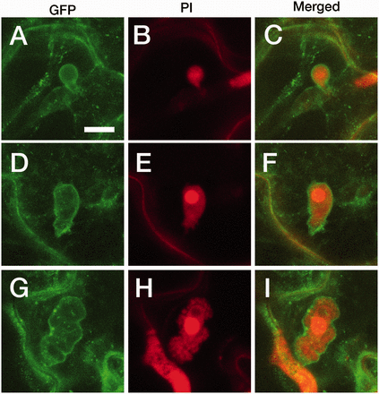
Fig. 2 ARA6–GFP around the Go haustorium retains membranous localization throughout the course of haustorium ...
Notes:
Fig. 2 ARA6–GFP around the Go haustorium retains membranous localization throughout the course of haustorium development. (A–C) Maximum intensity projection of serial confocal sections of a haustorium (stained with PI) that has just emerged from the invasion site of an Arabidopsis plant expressing ARA6–GFP. (D–F) Maximum intensity projection of serial confocal sections of a developing haustorium. (G–I) Maximum intensity projection of serial confocal sections of a mature haustorium with lobes. (A), (D), (G) Images of GFP. (B), (E), (H) Images of PI. (C), (F), (I) Merged images. Scale bar = 10 μm.
Unless provided in the caption above, the following copyright applies to the content of this slide: © The Author 2016. Published by Oxford University Press on behalf of Japanese Society of Plant Physiologists. All rights reserved. For permissions, please email: journals.permissions@oup.com

Slide 4
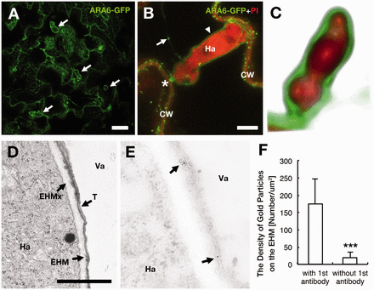
Fig. 1 The Arabidopsis plant-specific RAB5 ARA6 localizes to the extrahaustorial membrane (EHM) of Golovinomyces ...
Notes:
Fig. 1 The Arabidopsis plant-specific RAB5 ARA6 localizes to the extrahaustorial membrane (EHM) of Golovinomyces orontii (Go). (A) Maximum intensity projection of serial confocal sections of a transgenic Arabidopsis leaf expressing ARA6–GFP infected with Go. Arrows indicate ARA6–GFP-labeled round structures observed only in Go-infected leaves. Scale bar = 50 μm. (B) Maximum intensity projection of serial confocal sections of ARA6–GFP around a Go haustorium (Ha, stained with PI). An arrow indicates the ARA6–GFP-labeled endosome, and an arrowhead indicates a ARA6–GFP-labeled membrane around the haustorium. An asterisk indicates the basal part of the haustorium, showing a discontinuity of membranous ARA6–GFP localization with the plasma membrane. CW, cell wall. Scale bar = 10 μm. (C) Three-dimensional modeling of ARA6–GFP localization around the haustorium. (D and E) A transmission electron micrograph (D) and an immunoelectron micrograph (E) of a part of the haustorium (Ha) in a cell of an Arabidopsis plant expressing ARA6–GFP. Arrows in (E) indicate gold particle labeling. EHM, extrahaustorial membrane; EHMx, extrahaustorial matrix; T, tonoplast; Va, vacuole. Scale bar = 200 nm. (F) The density of gold particles on the EHM quantified for samples treated either with or without the primary antibody. The results are presented as the means ± SD. ***P < 0.001, Student’s t-test, 10 haustoria examined.
Unless provided in the caption above, the following copyright applies to the content of this slide: © The Author 2016. Published by Oxford University Press on behalf of Japanese Society of Plant Physiologists. All rights reserved. For permissions, please email: journals.permissions@oup.com

Slide 5
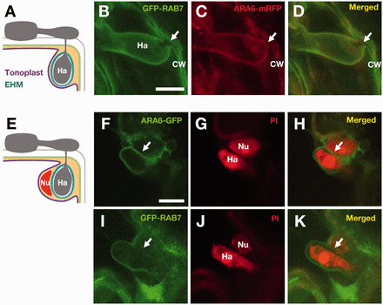
Fig. 5 RAB7 does not localize to the EHM. (A) A diagram of the topological configuration of the tonoplast, ...
Notes:
Fig. 5 RAB7 does not localize to the EHM. (A) A diagram of the topological configuration of the tonoplast, haustorium (Ha), the extrahaustorial membrane (EHM) and the cell wall. (B–D) Co-visualization of GFP–RAB7 and ARA6–mRFP around a haustorium located near the cell periphery. The arrows indicate the areas at which the haustorium (Ha) is located close to the host cell wall (CW). Images are maximum intensity projection of serial confocal sections. Six haustoria were observed, and representative images are shown. (E) A diagram of the topological configuration of the tonoplast, the nucleus (Nu) and the haustorium (Ha). (F–H) Maximum intensity projections of serial confocal sections of ARA6–GFP. (I–K) A single confocal section of GFP–RAB7. The arrows indicate the boundary between the haustorium (Ha) and the nucleus (Nu), both of which were stained with PI. Three haustoria that were closely associated with the nucleus were observed, and representative images are shown. Scale bars = 10 μm.
Unless provided in the caption above, the following copyright applies to the content of this slide: © The Author 2016. Published by Oxford University Press on behalf of Japanese Society of Plant Physiologists. All rights reserved. For permissions, please email: journals.permissions@oup.com

Slide 6
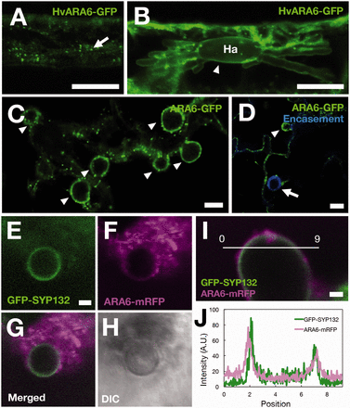
Fig. 6 The localization of ARA6 to the plant–pathogen interface is conserved in other obligate biotrophs but not in ...
Notes:
Fig. 6 The localization of ARA6 to the plant–pathogen interface is conserved in other obligate biotrophs but not in the hemibiotroph. (A) A single confocal section of a barley epidermal cell expressing GFP-tagged barley ARA6 (HvARA6). An arrow indicates HvARA6–GFP-labeled compartments in the cytosol. (B) Maximum intensity projection of serial confocal sections of the membrane around the Bgh haustorium (Ha) (indicated by an arrowhead) in a barley epidermal cell expressing HvARA6–GFP. Scale bars = 20 μm. (C) A single confocal image of Hyaloperonospora arabidopsidis (Hpa) Noco2 haustoria (arrowheads) in transgenic plants expressing ARA6–GFP at 4 dpi. Scale bar = 10 μm. (D) A spectral imaging micrograph of ARA6–GFP around haustoria with (arrow) or without (arrowhead) an autofluoresced Hpa haustorial encasement at 6 dpi. Scale bar = 10 μm. (E–I) Co-visualization of GFP–SYP132 and ARA6–mRFP around a biotrophic primary hypha of the hemibiotrophic fungus Colletotrichum higginsianum (Ch). Single confocal images are presented. Scale bars = 2 μm. Ten hyphae were observed in three independent experiments, and representative images are shown. (J) A plot of the fluorescence intensities of GFP and mRFP around a Ch biotrophic hypha on the line shown in (I).
Unless provided in the caption above, the following copyright applies to the content of this slide: © The Author 2016. Published by Oxford University Press on behalf of Japanese Society of Plant Physiologists. All rights reserved. For permissions, please email: journals.permissions@oup.com

