Slide 1
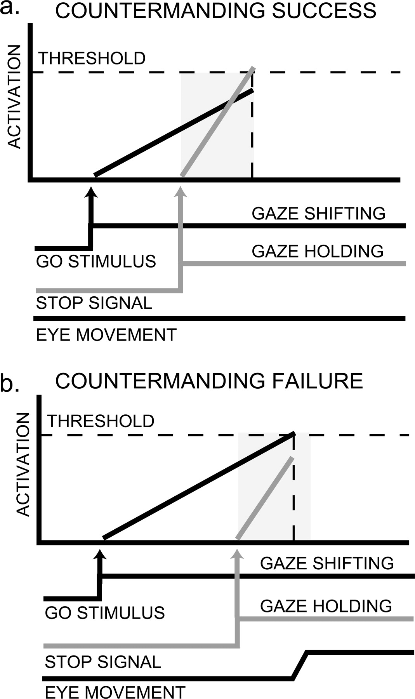
Figure 1. Race model of countermanding task. Performance on the countermanding task has been conceptualized to be a ...
Notes:
Figure 1. Race model of countermanding task. Performance on the countermanding task has been conceptualized to be a race between GO and STOP processes. The activation of neural GO processes related to shifting gaze (black line) race against the activation of neural STOP processes related to holding gaze (gray line) toward a winner-take-all threshold (dashed horizontal line) that determines whether a saccade is triggered or not. The gray bar represents the time needed to cancel a saccade after a stop signal has been emitted, a time known as the stop signal reaction time (SSRT) a. If the processes leading to holding gaze reach a critical threshold before the processes that lead to shifting gaze, then successful saccade cancellation will occur. b. However, if the gaze shifting processes reach threshold first, then a saccade will be triggered. Notice that in b. the stop signal delay was longer, which resulted in less time for the processes leading to holding gaze to grow to threshold. Manipulating this delay can reliably affect successful saccade countermanding.
Unless provided in the caption above, the following copyright applies to the content of this slide: © Oxford University Press 2005; all rights reserved

Slide 2
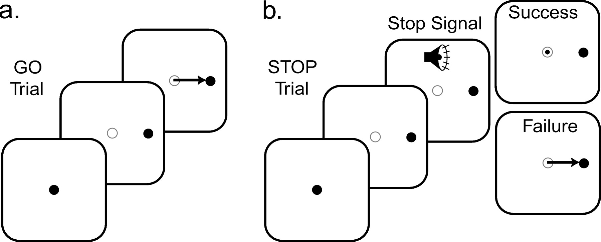
Figure 2. Countermanding task trial schematic. All trials began with central fixation. a. On GO trials, subjects made ...
Notes:
Figure 2. Countermanding task trial schematic. All trials began with central fixation. a. On GO trials, subjects made speeded saccades (depicted by arrow) to the appearance of a peripheral target to the left or right of fixation. This type of trial occurred 60% of the time. b. On STOP trials, an auditory stop signal tone was emitted after a period of time known as the stop signal delay. This signaled the subject to cancel the planned movement. Sometimes the subject was successful and sometimes failed at canceling the planned saccade. Stop trials were relatively rare and occurred on 20% of the trials unpredictably. Twenty percent of the trials were CATCH trials (not depicted) in which no peripheral target appeared and the subject simply remained at fixation.
Unless provided in the caption above, the following copyright applies to the content of this slide: © Oxford University Press 2005; all rights reserved

Slide 3
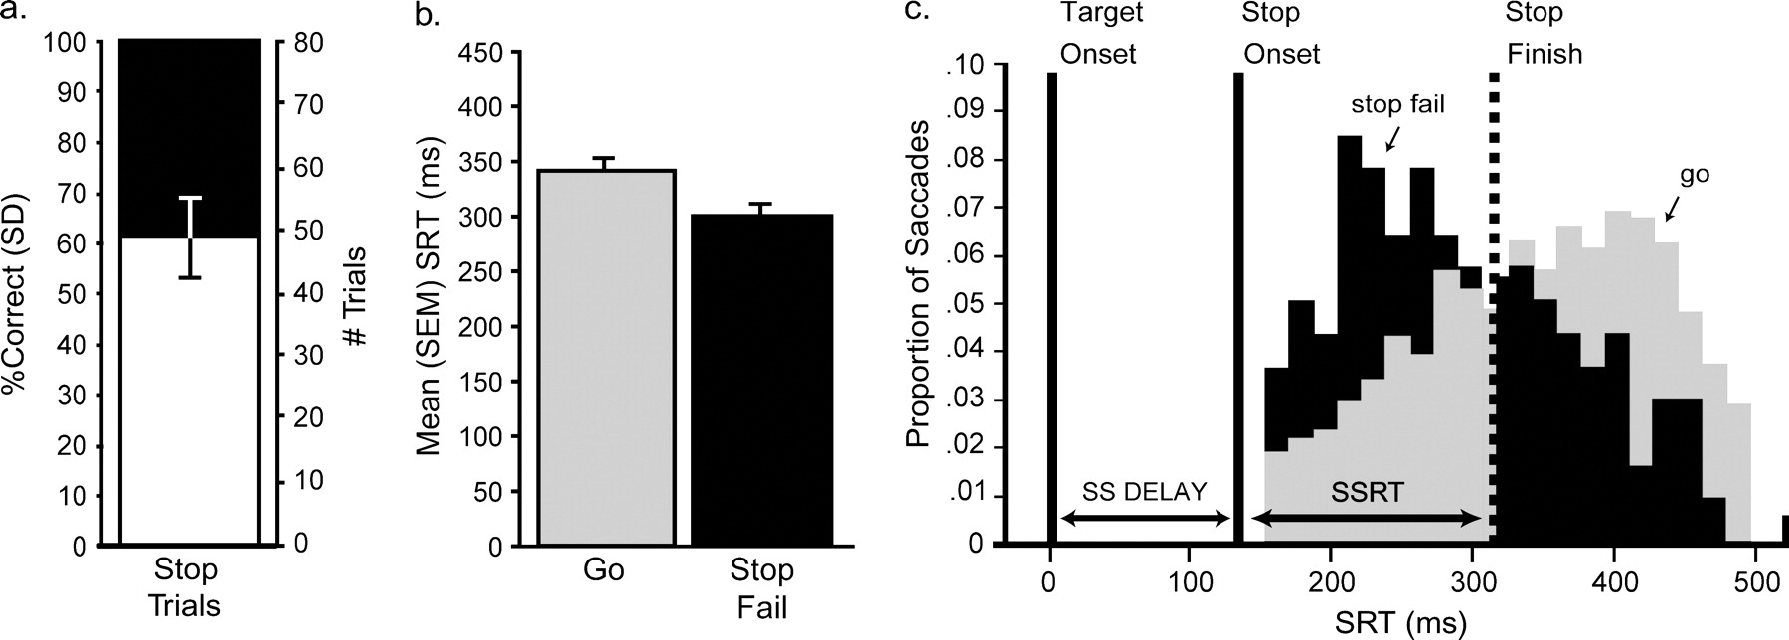
Figure 3. Oculomotor performance on the countermanding task. a. Pretesting and occasionally slight adjustments to the ...
Notes:
Figure 3. Oculomotor performance on the countermanding task. a. Pretesting and occasionally slight adjustments to the stop signal delay during scanning resulted in a 40% failure rate in canceling the planned saccade after the stop signal was emitted. Black and white areas of the bar denote failed and successful saccade cancellation, respectively, and the error bar represents the SD. The mean stop signal delay used across subjects was 157 ms. b. Saccadic reaction times (SRT) were significantly longer for GO trials (gray) compared to STOP trials in which the subject was unsuccessful at canceling the saccade (black). Bars represent means ±SEM. c. The relationship between stop signal delay (SS delay), the stop signal reaction time (SSRT), and the distribution of SRTs for GO trials (gray) and STOP failure trials (black). Presenting the stop signal shortly after the saccade target onset, a delay known as the stop signal delay, initiates the STOP process. The STOP process theoretically reaches its finish line or threshold in a period of time referred to as the SSRT, or the mean time needed to cancel a planned action. According to the race model, the GO trials in which the saccade occurred before the estimated SSRT would not have been cancelled if a stop signal had been given, while the trials in which the saccade occurred after the SSRT would have been successfully canceled. Given the estimated SSRT, about 40% of the GO trials would not have been cancelled. The distribution of SRTs on STOP failure trials, in which 60% of the trials fall within the SSRT, further supports the adherence of the saccade data to the assumptions of the race model of voluntary control of action. Note that SRTs on STOP failure trials are occasionally longer than the estimated SSRT because of natural variability in the estimated SSRT and a mixture of SSRTs across subjects.
Unless provided in the caption above, the following copyright applies to the content of this slide: © Oxford University Press 2005; all rights reserved

Slide 4
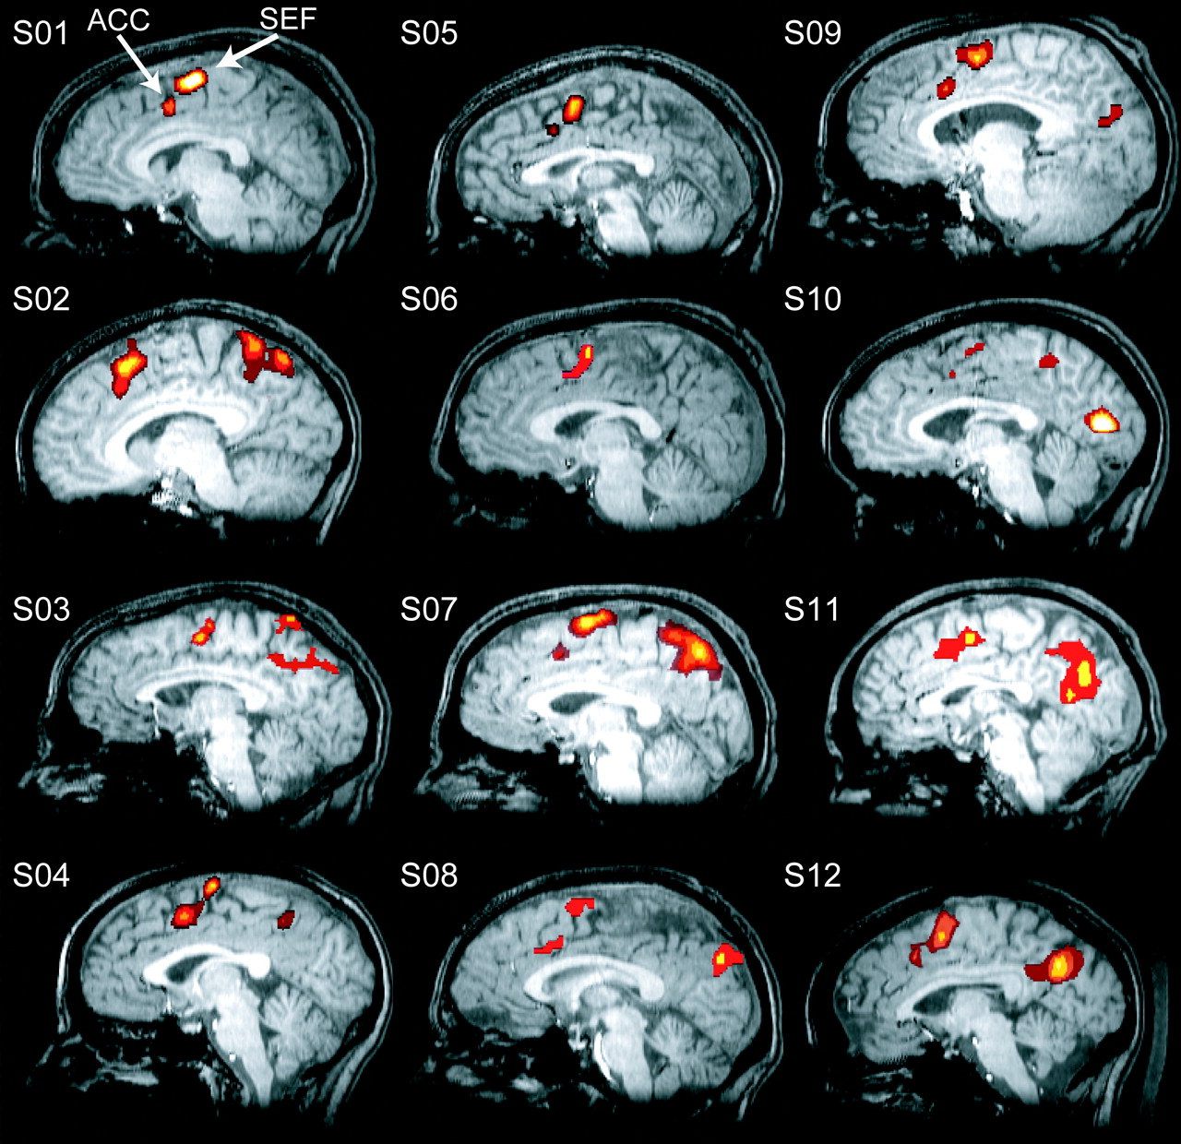
Figure 4. Activations along the dorsomedial wall for each of the 12 subjects. Notice that all subjects showed activity ...
Notes:
Figure 4. Activations along the dorsomedial wall for each of the 12 subjects. Notice that all subjects showed activity in the paracentral sulcus, corresponding to the supplementary eye fields (SEF), and the cingulate sulcus, corresponding to the dorsal anterior cingulate (ACC). Only one sagittal slice is shown for each subject, but other slices could further illustrate the separation between these two areas. Color overlay represents the main effect of time in a 2-way ANOVA and is thresholded at a minimum of p<0.001. This statistic identifies which voxels showed some response to the task, regardless of the trial type and regardless of the response shape. These voxels made up the SEF and ACC ROIs. The same method was used to identify frontal eye field (FEF) and intraparietal sulcus (IPS) ROIs.
Unless provided in the caption above, the following copyright applies to the content of this slide: © Oxford University Press 2005; all rights reserved

Slide 5
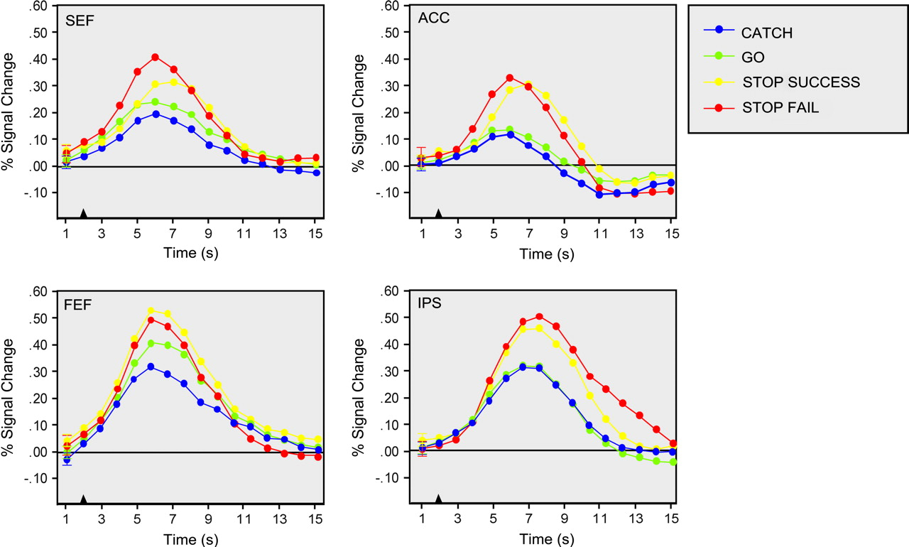
Figure 5. Time courses for each trial type. Each line represents the estimated time course for each trial type, plotted ...
Notes:
Figure 5. Time courses for each trial type. Each line represents the estimated time course for each trial type, plotted separately for each ROI, in units of percent signal change. The average standard error for the estimated time points are depicted on the first time point for each line. The black triangle at the bottom indicates when the saccade target appeared. See the text for a description of which time courses show a significant trial type by time interaction.
Unless provided in the caption above, the following copyright applies to the content of this slide: © Oxford University Press 2005; all rights reserved

Slide 6
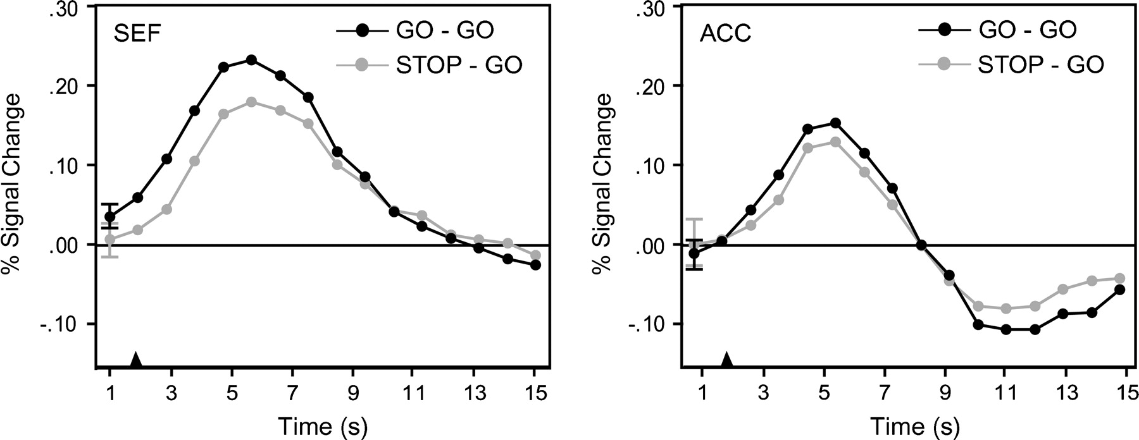
Figure 6. Time courses for GO trials sorted according to trial history. Each line represents the estimated time course ...
Notes:
Figure 6. Time courses for GO trials sorted according to trial history. Each line represents the estimated time course for each trial type, plotted separately for the SEF and ACC, in units of percent signal change. The average standard error for the estimated time points are depicted on the first time point for each line. The black triangle at the bottom indicates when the saccade target appeared. In the SEF, but not ACC, responses evoked during GO trials were larger if the preceding trial was a GO trial (GO-GO) compared to if the preceding trial was a STOP trial (STOP-GO). A significantly longer SRT accompanied this increased signal change.
Unless provided in the caption above, the following copyright applies to the content of this slide: © Oxford University Press 2005; all rights reserved

Slide 7
Figure 7. Schematic cycle of processes engaged during the countermanding task. Each trial can be broken down into ...
Notes:
Figure 7. Schematic cycle of processes engaged during the countermanding task. Each trial can be broken down into stages of processing in which visual signals are transformed into motor commands whose consequences must be evaluated.
Unless provided in the caption above, the following copyright applies to the content of this slide: © Oxford University Press 2005; all rights reserved

