Slide 1
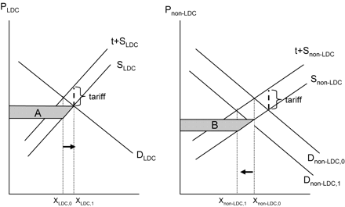
Figure 1. Impact of a Tariff Preference
Notes:
Figure 1. Impact of a Tariff Preference
Unless provided in the caption above, the following copyright applies to the content of this slide: © The Author 2006. Published by Oxford University Press on behalf of the International Bank for Reconstruction and Development / THE WORLD BANK. All rights reserved. For permissions, please e-mail: journals.permissions@oxfordjournals.org.

Slide 2
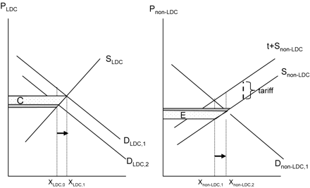
Figure 2. Impact of Liberalization by a Preference-Granting Country
Notes:
Figure 2. Impact of Liberalization by a Preference-Granting Country
Unless provided in the caption above, the following copyright applies to the content of this slide: © The Author 2006. Published by Oxford University Press on behalf of the International Bank for Reconstruction and Development / THE WORLD BANK. All rights reserved. For permissions, please e-mail: journals.permissions@oxfordjournals.org.

