Slide 1
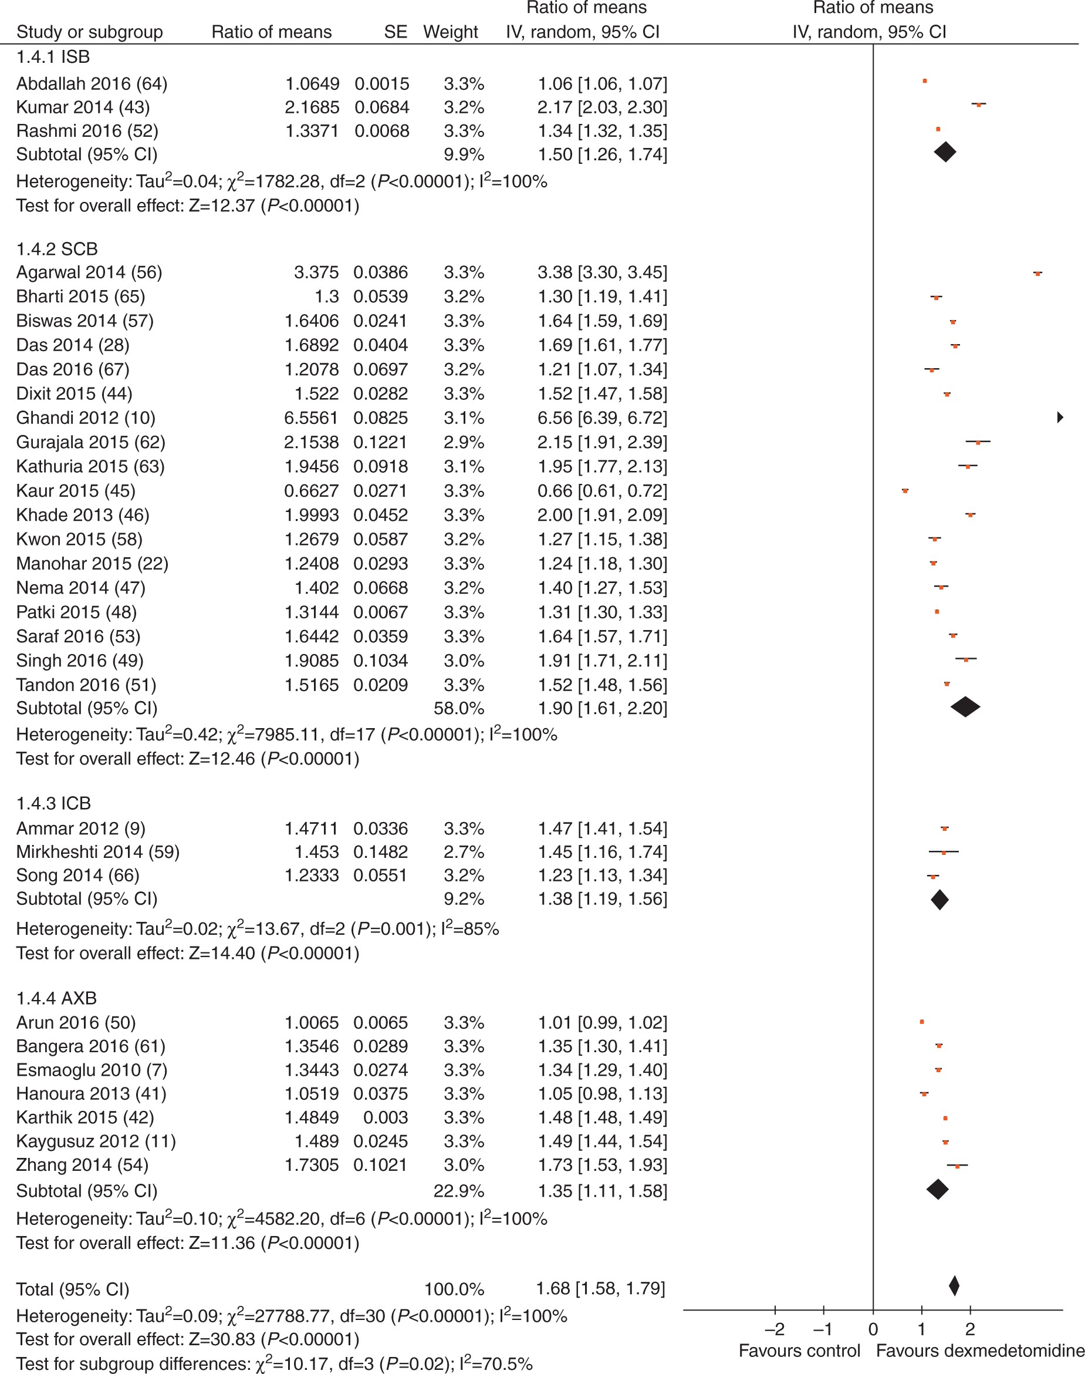
Fig 3 Forest plot depicting motor block duration. The individual trials’ ratio of means, standard error, and the ...
Notes:
Fig 3 Forest plot depicting motor block duration. The individual trials’ ratio of means, standard error, and the pooled estimates of the ratio of means are shown. The 95% confidence intervals are shown as lines for individual studies and as diamonds for pooled estimates. Abbreviations: AXB, axillary block; CI, confidence interval; ICB, infraclavicular block; ISB, interscalene block; SCB, supraclavicular block; SE, standard error.
Unless provided in the caption above, the following copyright applies to the content of this slide: © The Author 2017. Published by Oxford University Press on behalf of the British Journal of Anaesthesia. All rights reserved. For Permissions, please email: journals.permissions@oup.com

Slide 2
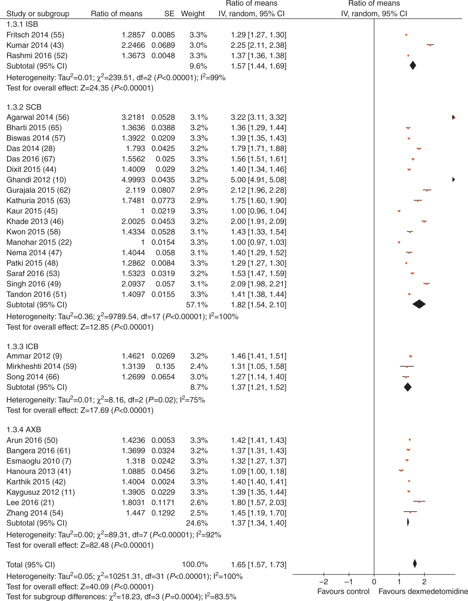
Fig 2 Forest plot depicting sensory block duration. The individual trials’ ratio of means, standard error, and the ...
Notes:
Fig 2 Forest plot depicting sensory block duration. The individual trials’ ratio of means, standard error, and the pooled estimates of the ratio of means are shown. The 95% confidence intervals are shown as lines for individual studies and as diamonds for pooled estimates. Abbreviations: AXB, axillary block; CI, confidence interval; ICB, infraclavicular block; ISB, interscalene block; SCB, supraclavicular block; SE, standard error.
Unless provided in the caption above, the following copyright applies to the content of this slide: © The Author 2017. Published by Oxford University Press on behalf of the British Journal of Anaesthesia. All rights reserved. For Permissions, please email: journals.permissions@oup.com

Slide 3
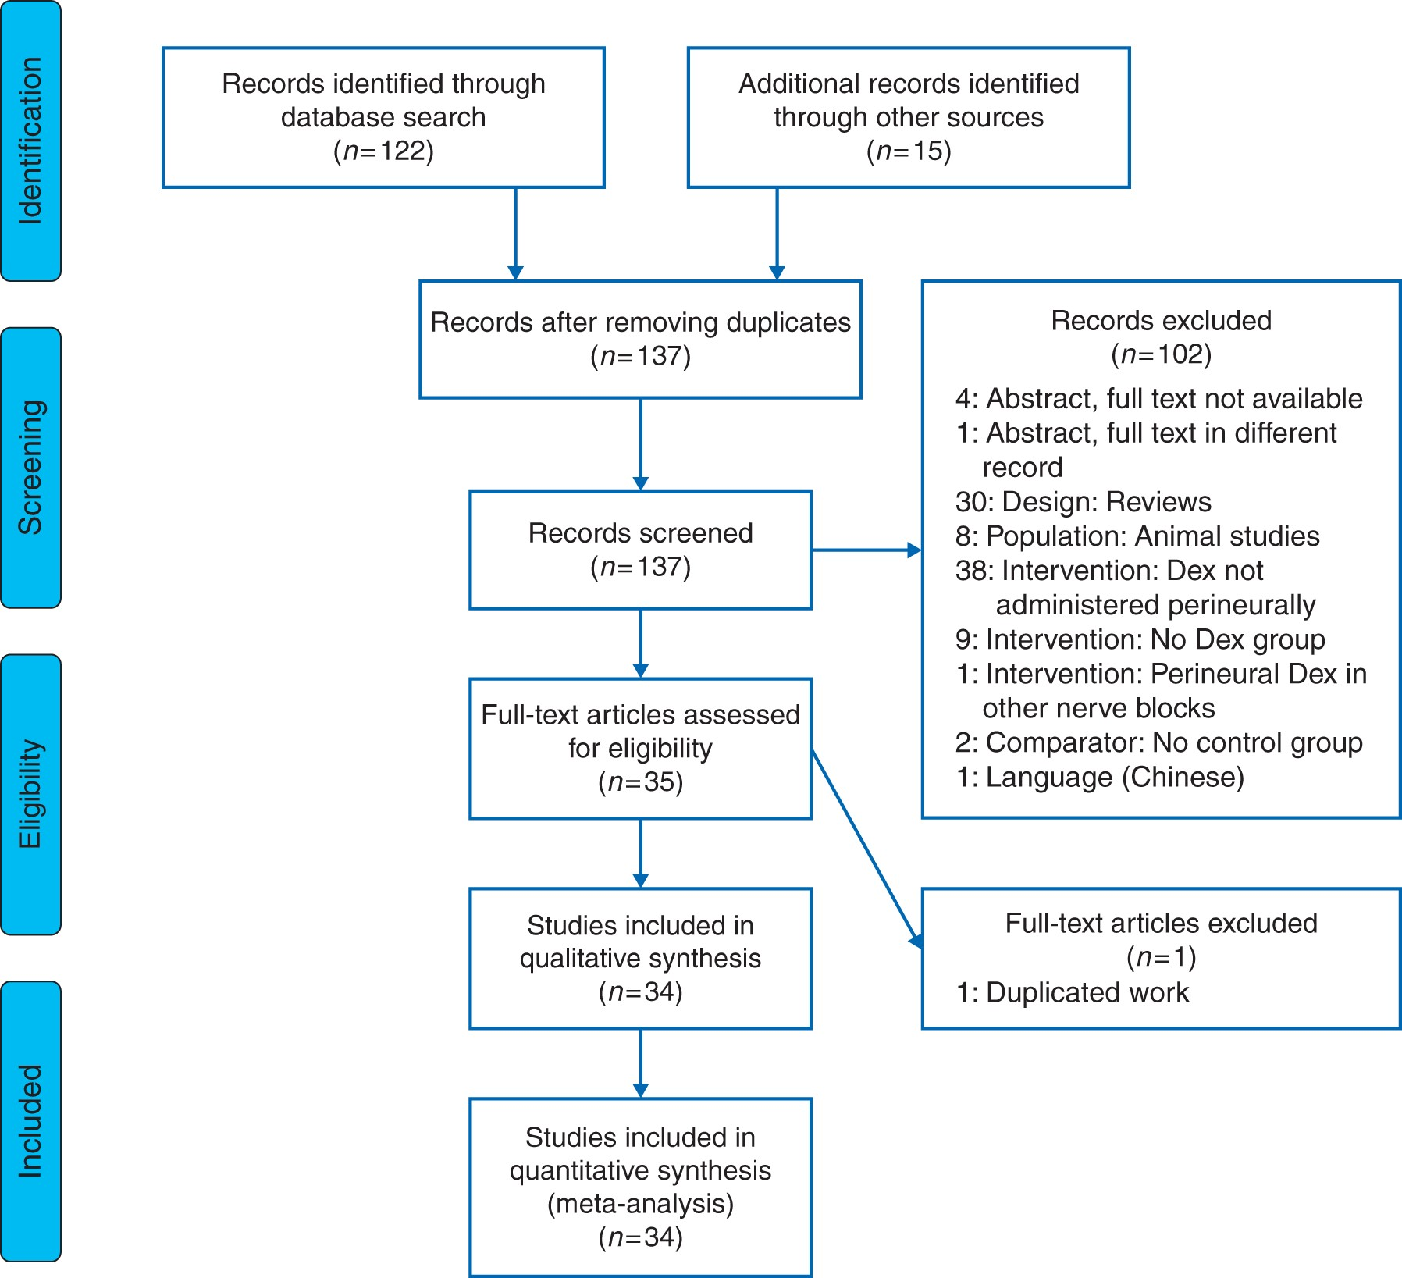
Fig 1 Preferred reporting items for systematic reviews and meta-analyses (PRISMA)¹² flow diagram ...
Notes:
Fig 1 Preferred reporting items for systematic reviews and meta-analyses (PRISMA)12 flow diagram summarizing retrieved, included, and excluded randomized trials.
Unless provided in the caption above, the following copyright applies to the content of this slide: © The Author 2017. Published by Oxford University Press on behalf of the British Journal of Anaesthesia. All rights reserved. For Permissions, please email: journals.permissions@oup.com

