Slide 1
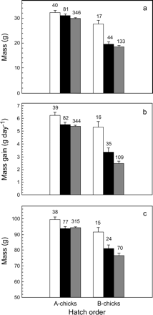
Figure 1 Growth performance of first-hatched (A-chicks) and second-hatched (B-chicks) roseate terns with one ...
Notes:
Figure 1 Growth performance of first-hatched (A-chicks) and second-hatched (B-chicks) roseate terns with one kleptoparasitic parent (white bars), two nonkleptoparasitic parents (black bars), and parents of unknown foraging behavior (gray bars). (a) Mass at day 3 is a measure of early growth, (b) linear growth rate is the average daily mass gain during the middle growth period, and (c) asymptotic mass provides an estimate of fledging mass. Given are means (±SD), with sample size (number of chicks) above bars.
Unless provided in the caption above, the following copyright applies to the content of this slide: Behavioral Ecology vol. 16 no. 2 © International Society for Behavioral Ecology 2004; all rights reserved.

Slide 2
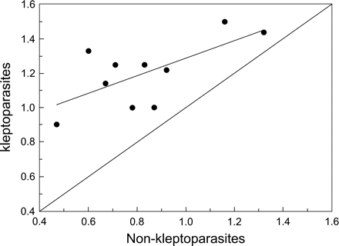
Figure 2 Productivity (mean number of chicks fledged per pair) comparisons between kleptoparasites and ...
Notes:
Figure 2 Productivity (mean number of chicks fledged per pair) comparisons between kleptoparasites and nonkleptoparasites at Falkner Island, 1990–1999. Each point represents a single year. Diagonal line represents equal reproductive success between groups.
Unless provided in the caption above, the following copyright applies to the content of this slide: Behavioral Ecology vol. 16 no. 2 © International Society for Behavioral Ecology 2004; all rights reserved.

