Slide 1
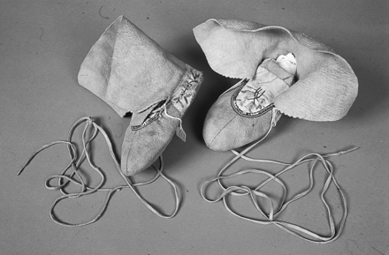
Fig 1. Eskimo/European moccasins (pair), leather, horse-hair, silk and buckskin, foot length 230 mm, Mackenzie ...
Notes:
Fig 1. Eskimo/European moccasins (pair), leather, horse-hair, silk and buckskin, foot length 230 mm, Mackenzie Basin, Canadian Arctic, c.1926–1928
Unless provided in the caption above, the following copyright applies to the content of this slide: © The Author [2005]. Published by Oxford University Press on behalf of The Design History Society. All rights reserved.

Slide 2
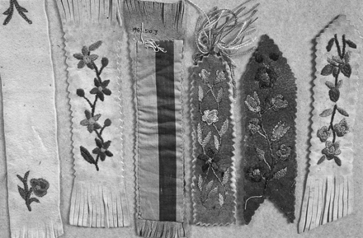
Fig 2. Bookmarkers, leather, buckskin, fabric and silk thread, Mackenzie Basin, Canadian Arctic, c.1926–1928
Notes:
Fig 2. Bookmarkers, leather, buckskin, fabric and silk thread, Mackenzie Basin, Canadian Arctic, c.1926–1928
Unless provided in the caption above, the following copyright applies to the content of this slide: © The Author [2005]. Published by Oxford University Press on behalf of The Design History Society. All rights reserved.

Slide 3
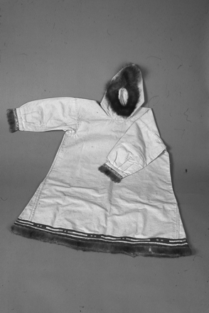
Fig 3. Eskimo/European parka, canvas, fabric and fur with decorated hem and cuffs, length 1128 mm, width 840 mm, ...
Notes:
Fig 3. Eskimo/European parka, canvas, fabric and fur with decorated hem and cuffs, length 1128 mm, width 840 mm, Mackenzie Basin, Canadian Arctic, c. 1926–1928
Unless provided in the caption above, the following copyright applies to the content of this slide: © The Author [2005]. Published by Oxford University Press on behalf of The Design History Society. All rights reserved.

Slide 4
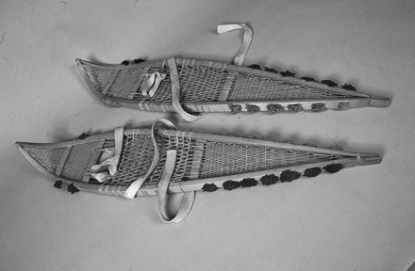
Fig 4. Eskimo/North American Inuit, snow shoes (pair, Cree type), wood, gut, fabric webbing and wool, length 860 mm, ...
Notes:
Fig 4. Eskimo/North American Inuit, snow shoes (pair, Cree type), wood, gut, fabric webbing and wool, length 860 mm, width 175 mm, Mackenzie Basin, Canadian Arctic, c.1926–1928
Unless provided in the caption above, the following copyright applies to the content of this slide: © The Author [2005]. Published by Oxford University Press on behalf of The Design History Society. All rights reserved.

Slide 5
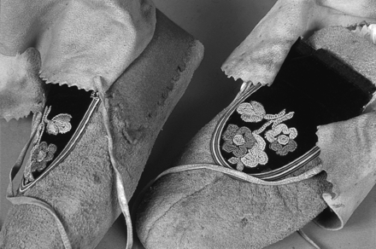
Fig 5. Eskimo/European moccasins (pair), leather, horse-hair, silk and buckskin, foot length 230 mm approx., ...
Notes:
Fig 5. Eskimo/European moccasins (pair), leather, horse-hair, silk and buckskin, foot length 230 mm approx., Mackenzie Basin, Canadian Arctic, c.1926–1928
Unless provided in the caption above, the following copyright applies to the content of this slide: © The Author [2005]. Published by Oxford University Press on behalf of The Design History Society. All rights reserved.

Slide 6
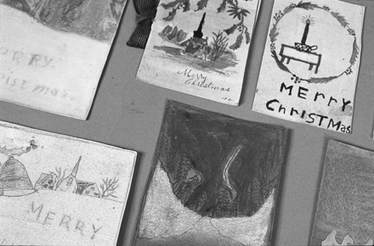
Fig 6. Christmas cards, hand drawn and painted by mixed-race orphans at an Anglican mission school, for their ...
Notes:
Fig 6. Christmas cards, hand drawn and painted by mixed-race orphans at an Anglican mission school, for their teacher Ethel Garton, Mackenzie Basin, Canadian Arctic, c.1926–1928
Unless provided in the caption above, the following copyright applies to the content of this slide: © The Author [2005]. Published by Oxford University Press on behalf of The Design History Society. All rights reserved.

Slide 7
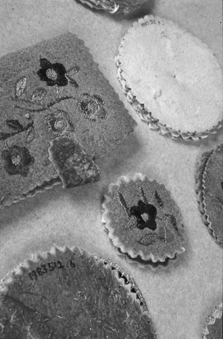
Fig 7. Needle-cases, leather, fabric and silk thread, Mackenzie Basin, Canadian Arctic, c.1926–1928
Notes:
Fig 7. Needle-cases, leather, fabric and silk thread, Mackenzie Basin, Canadian Arctic, c.1926–1928
Unless provided in the caption above, the following copyright applies to the content of this slide: © The Author [2005]. Published by Oxford University Press on behalf of The Design History Society. All rights reserved.

Slide 8
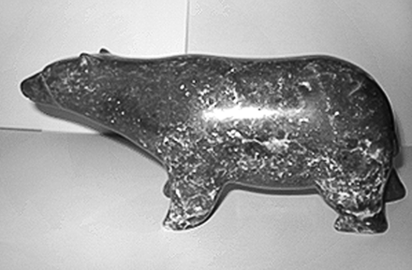
Fig 8. Aoudla Pee (b. 1920), ‘Bear’, 200 mm high approx., serpentine stone, from Cape Dorset, Canada, private ...
Notes:
Fig 8. Aoudla Pee (b. 1920), ‘Bear’, 200 mm high approx., serpentine stone, from Cape Dorset, Canada, private collection. Photograph © John R. Tarrant. Stone carving continues to this day. This and Figure 9 are later examples of Inuit stone carving, here made in the relatively hard Serpentine stone, and are good examples of the legacy of outside agencies.
Unless provided in the caption above, the following copyright applies to the content of this slide: © The Author [2005]. Published by Oxford University Press on behalf of The Design History Society. All rights reserved.

Slide 9
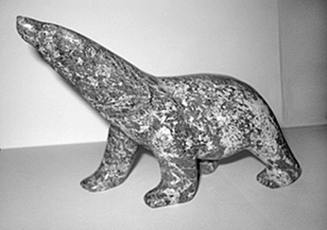
Fig 9. Josepee Parr (b. 1973), ‘Bear’, 200 mm high approx., serpentine stone, from Cape Dorset, Canada, private ...
Notes:
Fig 9. Josepee Parr (b. 1973), ‘Bear’, 200 mm high approx., serpentine stone, from Cape Dorset, Canada, private collection. Photograph © John R. Tarrant
Unless provided in the caption above, the following copyright applies to the content of this slide: © The Author [2005]. Published by Oxford University Press on behalf of The Design History Society. All rights reserved.

