Slide 1
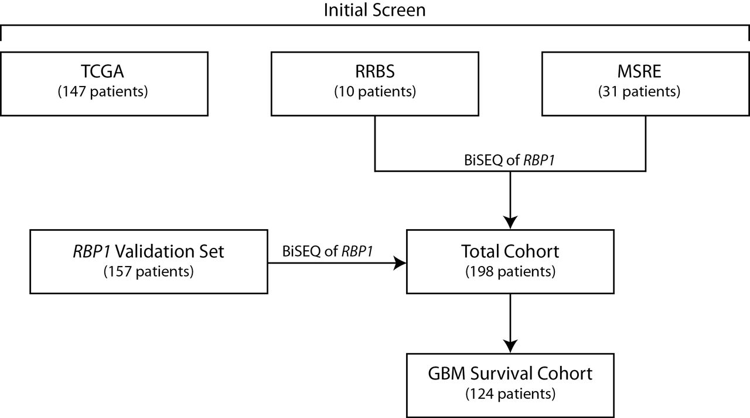
Figure 1. Flow diagram of patient cohorts included in the analysis. The different patient cohorts and number of ...
Notes:
Figure 1. Flow diagram of patient cohorts included in the analysis. The different patient cohorts and number of patients in each cohort are given. BiSEQ = bisulfite sequencing; GBM = glioblastoma multiforme; MSRE = methylation-sensitive restriction enzyme; RBP1 = retinol binding protein 1; RRBS = reduced representation bisulfite sequencing; TCGA = The Cancer Genome Atlas.
Unless provided in the caption above, the following copyright applies to the content of this slide: © The Author 2012. Published by Oxford University Press. All rights reserved. For Permissions, please e-mail: journals.permissions@oup.com.

Slide 2
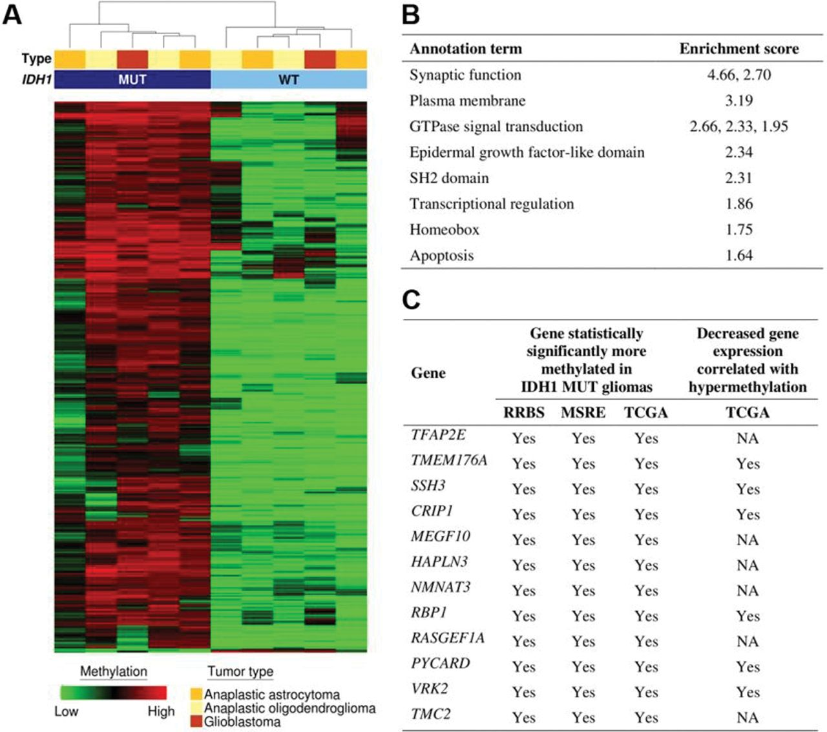
Figure 2. Characterization of genome-wide differential methylation. A) Hierarchical clustering of differentially ...
Notes:
Figure 2. Characterization of genome-wide differential methylation. A) Hierarchical clustering of differentially methylated CpG islands (P 1.30) associated with differentially methylated genes by DAVID annotation analysis is given. Terms with multiple enrichment scores denote multiple statistically significant clusters of genes with the specified annotation term. C) Candidate hypermethylated genes in IDH1 MUT tumors are shown. Statistically significantly methylated genes in a given dataset denote an adjusted Q value of less than 0.05 (calculated by Storey multiple comparison adjustment, unpaired t test). MSRE = methylation-sensitive restriction enzyme; NA = not available; RBP1 = retinol binding protein 1; TCGA = The Cancer Genome Atlas.
Unless provided in the caption above, the following copyright applies to the content of this slide: © The Author 2012. Published by Oxford University Press. All rights reserved. For Permissions, please e-mail: journals.permissions@oup.com.

Slide 3
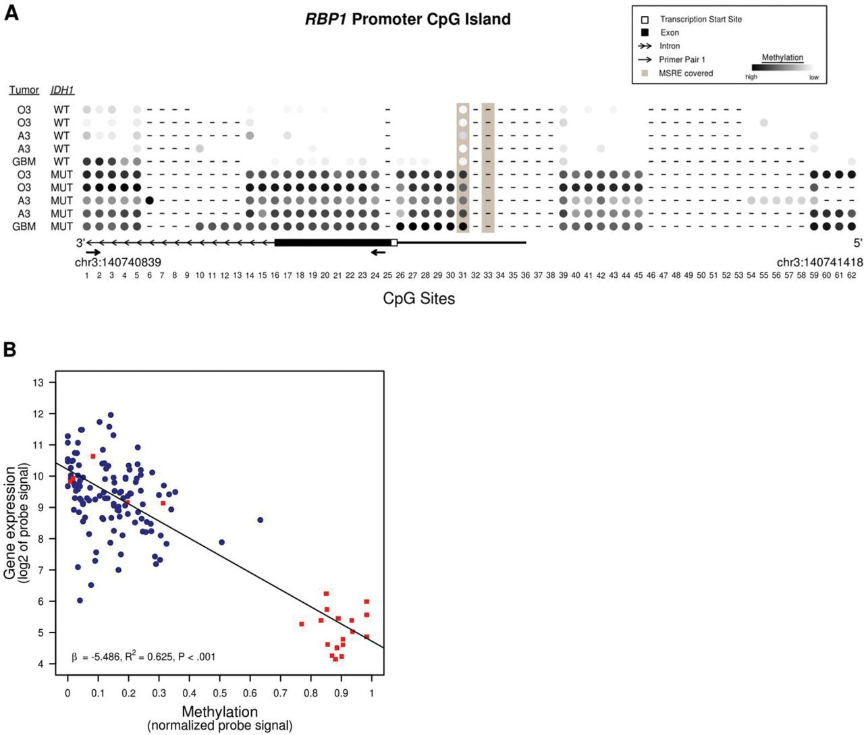
Figure 3. Retinol binding protein 1 (RBP1) methylation and gene expression. A) The CpG island methylation pattern for ...
Notes:
Figure 3. Retinol binding protein 1 (RBP1) methylation and gene expression. A) The CpG island methylation pattern for the RBP1 promoter is shown. Sixty-two CpG sites were included in the analysis. CpG methylation for isocitrate dehydrogenase 1 (IDH1) mutant (MUT) and wild-type (WT) glioma samples were determined by reduced representation bisulfite sequencing. Solid arrows flank the location sequenced by bisulfite sequencing with the sequencing primer pair 1. B) Data from The Cancer Genome Atlas were analyzed to determine a relationship between RBP1 promoter methylation and gene expression using the Pearson correlation coefficient (R2) and the slope of the regression line (β). The two-sided P value was based on the T statistic with 140 df. The blue circles represent IDH1 WT samples, and red squares represent IDH1 MUT samples. All tumors from the The Cancer Genome Atlas were glioblastoma multiforme (GBM, grade IV). MSRE = methylation-sensitive restriction enzyme; A3 = anaplastic astrocytoma (grade III); O3 = anaplastic oligodendroglioma (grade III).
Unless provided in the caption above, the following copyright applies to the content of this slide: © The Author 2012. Published by Oxford University Press. All rights reserved. For Permissions, please e-mail: journals.permissions@oup.com.

Slide 4
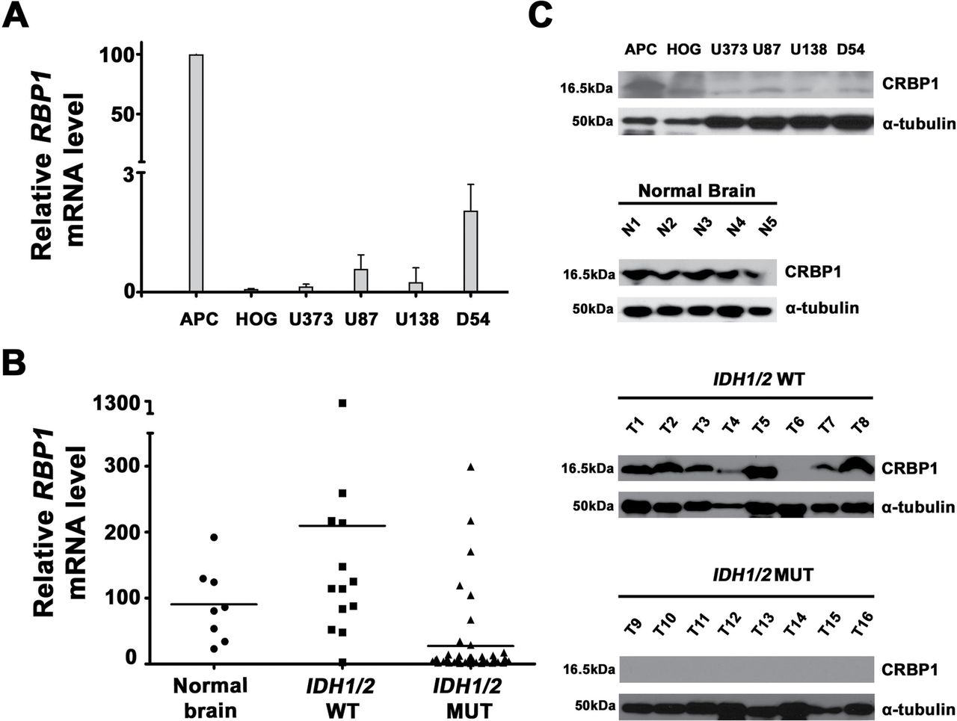
Figure 4. Retinol binding protein 1 (RBP1) gene expression in human cell lines and glioma tumor samples. A) RBP1 mRNA ...
Notes:
Figure 4. Retinol binding protein 1 (RBP1) gene expression in human cell lines and glioma tumor samples. A) RBP1 mRNA levels in the astrocyte progenitor cells (APC), human oligodendroglioma (HOG), U373, U138, and D54 cell lines were determined by quantitative real-time reverse transcriptase polymerase chain reaction using β-actin as an internal control and standardized to the mRNA level for APC cells, which was set as 100%. Data represent the mean and 95% confidence interval (whisker bars) from three independent experiments done in triplicate. B) RBP1 mRNA levels in 56 samples from the Total Cohort were measured by quantitative real-time reverse transcriptase polymerase chain reaction using β−actin as an internal control and standardized to the expression observed for normal brain cDNA (n = 7). Data represent the mean from three independent experiments done in duplicate. C) Representative western blots for cellular retinol binding protein 1 (CRBP1) protein expression in six cell lines, five normal brain samples, and sixteen tumor samples are shown. Isocitrate dehydrogenase 1 (IDH1)/IDH2 wild-type (WT) tumors (T1–T8) and IDH1/IDH2 mutant (MUT) tumors (T9–T16) were analyzed, and α-tubulin was used as a loading control. Please note that the goat anti-CRBP1 antibody used for the cell lines produced two nonspecific bands that are shown in the top panel of some samples. These nonspecific bands were not observed with the rabbit anti-CRBP1 antibody used in the normal brain and tumor tissues.
Unless provided in the caption above, the following copyright applies to the content of this slide: © The Author 2012. Published by Oxford University Press. All rights reserved. For Permissions, please e-mail: journals.permissions@oup.com.

Slide 5
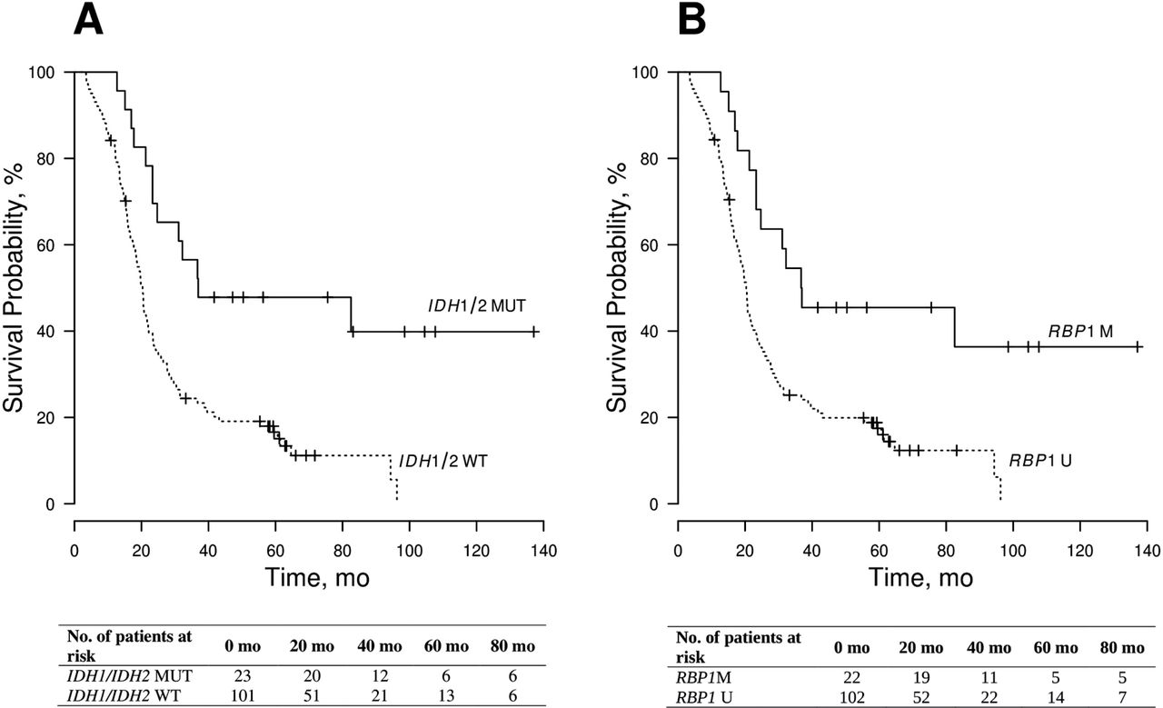
Figure 5. Kaplan–Meier analysis of overall survival (OS) in a cohort of 124 primary glioblastoma multiforme patients ...
Notes:
Figure 5. Kaplan–Meier analysis of overall survival (OS) in a cohort of 124 primary glioblastoma multiforme patients using Cox proportional hazards analysis. A) Survival among patients with isocitrate dehydrogenase 1 (IDH1)/IDH2MUT (solid line, n = 23) and IDH1/IDH2WT (dashed, n = 101) tumors shown. B) Survival among retinol binding protein 1 (RBP1)-methylated (solid line, n = 22) and RBP1-unmethylated (dashed line, n = 102) patients is shown. The number of patients at risk is given below each Kaplan–Meier curve. M = methylated; MUT = mutant; U = unmethylated; WT = wild-type.
Unless provided in the caption above, the following copyright applies to the content of this slide: © The Author 2012. Published by Oxford University Press. All rights reserved. For Permissions, please e-mail: journals.permissions@oup.com.

