Slide 1
Figure 1. Stimulus and procedure in the first experiment. A drifting luminance-defined square-wave grating was ...
Notes:
Figure 1. Stimulus and procedure in the first experiment. A drifting luminance-defined square-wave grating was presented within a stationary rectangular aperture during the adaptation periods. The direction of motion was leftward or rightward in separate conditions. Subjects always fixated at the bull's eye. During the test period, a flashed target was presented in a randomly determined position within the motion-adapted region (the dashed rectangle indicates the motion-adapted region and was not visible during the experiment). The stimuli are not drawn to scale.
Unless provided in the caption above, the following copyright applies to the content of this slide: © 2007 The AuthorsThis is an Open Access article distributed under the terms of the Creative Commons Attribution Non-Commercial License (http://creativecommons.org/licenses/by-nc/2.0/uk/) which permits unrestricted non-commercial use, distribution, and reproduction in any medium, provided the original work is properly cited.

Slide 2
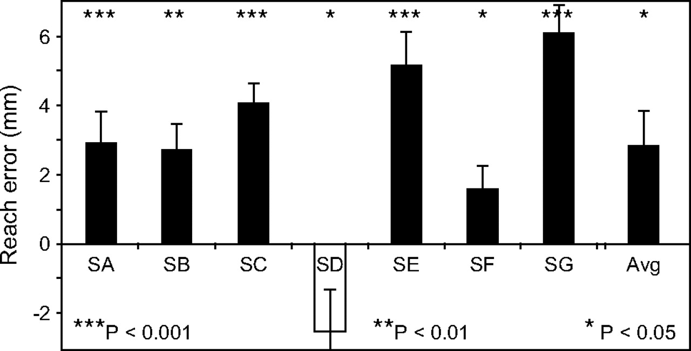
Figure 2. The manual following response of reaching movements to a stationary object after visual motion adaptation in ...
Notes:
Figure 2. The manual following response of reaching movements to a stationary object after visual motion adaptation in the sham and control TMS conditions. Positive values on the ordinate indicate a deviation in the end point of the reaching movement opposite the direction of motion adaptation. There was a significant average deviation (Z = 2.1, P < 0.05). Individually, 6 of the 7 subjects showed a significant positive error (consistent with the MAE, although no motion was perceived during the test period). Of the 6 subjects who showed a manual following response, the least significance was for subject SF (Wilcoxon signed ranks test, Z = 2.5, P < 0.05). These results indicate that prior exposure to motion influences goal-directed reaching. Error bars, 95% confidence intervals.
Unless provided in the caption above, the following copyright applies to the content of this slide: © 2007 The AuthorsThis is an Open Access article distributed under the terms of the Creative Commons Attribution Non-Commercial License (http://creativecommons.org/licenses/by-nc/2.0/uk/) which permits unrestricted non-commercial use, distribution, and reproduction in any medium, provided the original work is properly cited.

Slide 3
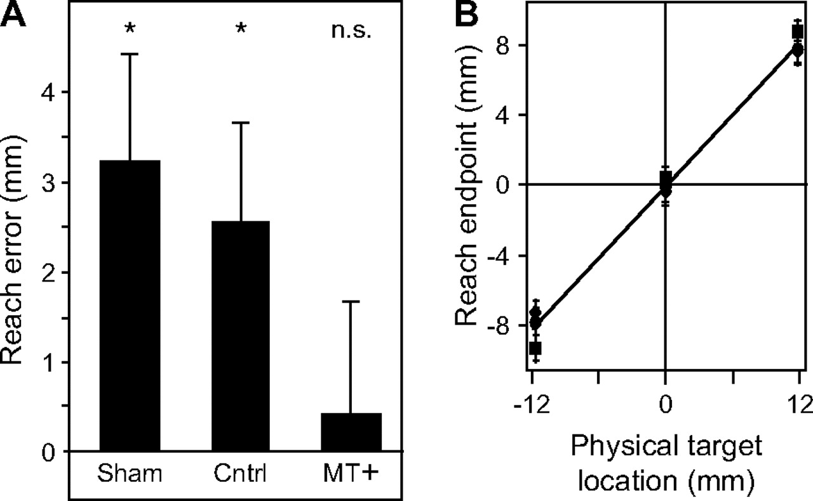
Figure 3. The effect of MT+ disruption on the manual following response. (A) In sham and control conditions, rTMS was ...
Notes:
Figure 3. The effect of MT+ disruption on the manual following response. (A) In sham and control conditions, rTMS was delivered away from, or to the vertex of, each subject's head. There remained a significant manual following response in both conditions (Z = 2.05 and 1.9, respectively, P 0.05). The results indicate that disruption of MT+ eliminates the manual following response and suggest that MT+ processes motion information for reaching movements to static objects. (B) Results for 3 representative subjects showing that reaching movements to the 3 targets were differentiable (subjects did not point to random locations). All 7 subjects showed a significant difference in end point reach position as a function of the physical target location (the least significant effect of physical target position was for subject SB, F2,357 = 644.9, P < 0.05). Error bars ± standard error of mean.
Unless provided in the caption above, the following copyright applies to the content of this slide: © 2007 The AuthorsThis is an Open Access article distributed under the terms of the Creative Commons Attribution Non-Commercial License (http://creativecommons.org/licenses/by-nc/2.0/uk/) which permits unrestricted non-commercial use, distribution, and reproduction in any medium, provided the original work is properly cited.

Slide 4
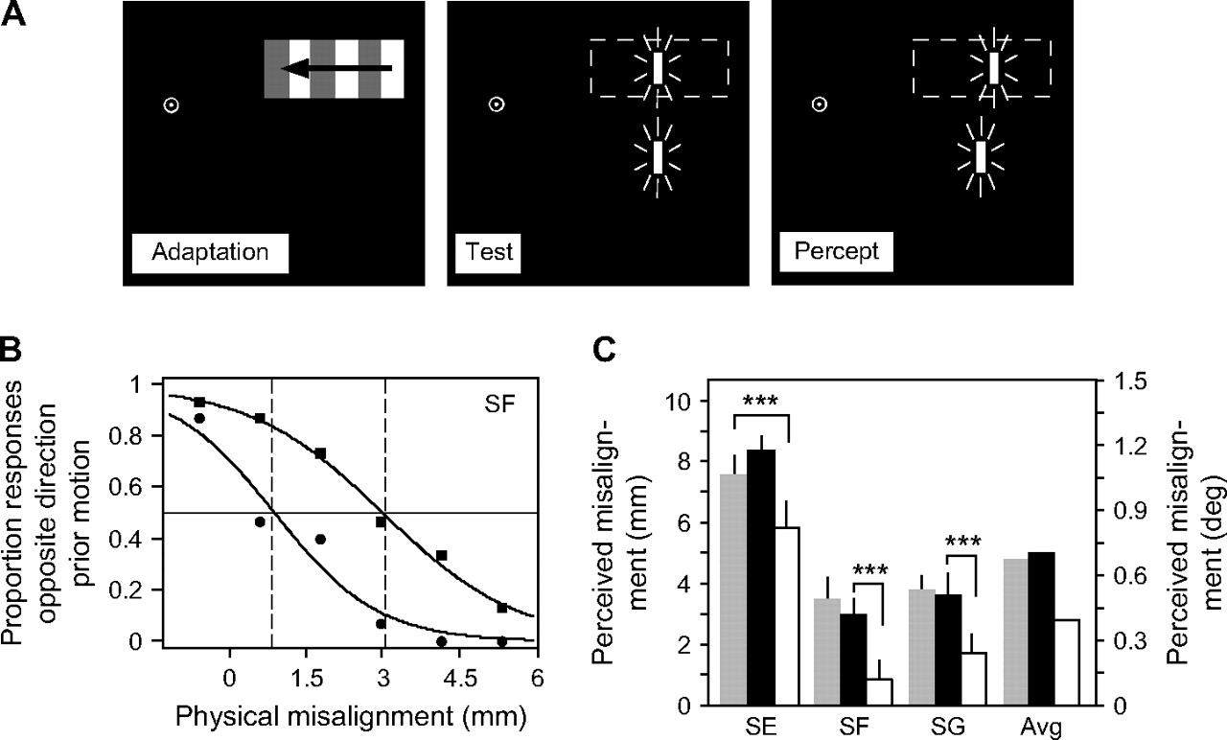
Figure 4. Stimuli and results of the second experiment. (A) The stimulus in the second experiment was identical to that ...
Notes:
Figure 4. Stimuli and results of the second experiment. (A) The stimulus in the second experiment was identical to that in the first experiment, with the exception that an additional reference target was flashed below the motion-adapted region. In the test period, subjects made a vernier alignment judgment. Following motion adaptation, subjects perceived physically aligned targets to appear misaligned, consistent with previous reports (Whitney and Cavanagh 2003). (B) Psychometric functions for subject SF revealing the perceived misalignment between the flashed test stimuli with sham TMS (squares) and with TMS of MT+ (circles). The ordinate shows the proportion of flashed targets in the motion-adapted region that appeared shifted opposite the direction of previously viewed motion. The abscissa shows the relative misalignment between the 2 flashed targets; positive values indicate that the target in the motion-adapted region was physically shifted in the direction of prior motion. The PSE on the psychometric function (PSE, indicated by 50% point on the psychometric function) is the physical misalignment between the flashes that created an apparent alignment between them (i.e., the point at which the illusion in A was nulled). For the psychometric functions in (B), the perceived misalignment in the sham condition was 3 mm and the perceived misalignment with stimulation of MT+ was 0.9 mm, a significant reduction (maximum likelihood ratio test, χ12 = 23.5, P < 0.001). (C) rTMS of MT+ significantly reduced the perceived misalignment between the flashed targets for all 3 subjects. The white bars indicate TMS of MT+; the black and gray bars indicate sham and control TMS, respectively. The least significant reduction occurred in the control versus MT+ stimulation conditions for subject SE (χ12 = 12.1, P < 0.01). Within each subject, all pairwise comparisons (MT+ vs. control or sham stimulation) were significant at the 0.01 level (X2 test, Bonferroni corrected for multiple comparisons), indicated by the asterisks. Error bars ± standard error of the logistic curve fit.
Unless provided in the caption above, the following copyright applies to the content of this slide: © 2007 The AuthorsThis is an Open Access article distributed under the terms of the Creative Commons Attribution Non-Commercial License (http://creativecommons.org/licenses/by-nc/2.0/uk/) which permits unrestricted non-commercial use, distribution, and reproduction in any medium, provided the original work is properly cited.

