Slide 1
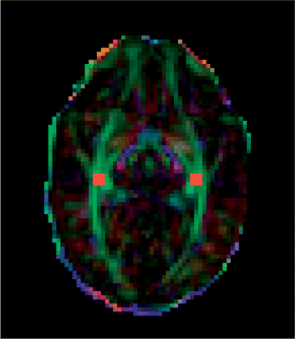
Fig. 1 Colour-coded FA map showing the position of the seed mask (in red) in the white matter adjacent to the ...
Notes:
Fig. 1 Colour-coded FA map showing the position of the seed mask (in red) in the white matter adjacent to the lateral geniculate nuclei. Green represents fibres orientated in the anterior–posterior direction, blue represents fibres in the superior–inferior direction and red represents fibres in the left–right direction.
Unless provided in the caption above, the following copyright applies to the content of this slide: © The Author (2008). Published by Oxford University Press on behalf of the Guarantors of Brain. All rights reserved. For Permissions, please email: journals.permissions@oxfordjournals.org

Slide 2
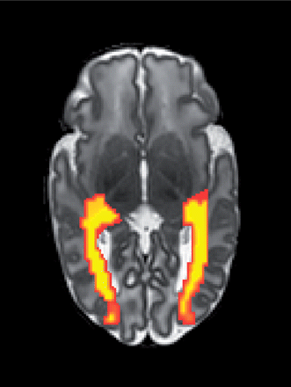
Fig. 2 Connectivity distributions in the optic radiations in an infant who was born at 26 weeks GA and imaged at 40 ...
Notes:
Fig. 2 Connectivity distributions in the optic radiations in an infant who was born at 26 weeks GA and imaged at 40 weeks PMA, overlaid on the infants native T2-weighted image.
Unless provided in the caption above, the following copyright applies to the content of this slide: © The Author (2008). Published by Oxford University Press on behalf of the Guarantors of Brain. All rights reserved. For Permissions, please email: journals.permissions@oxfordjournals.org

Slide 3
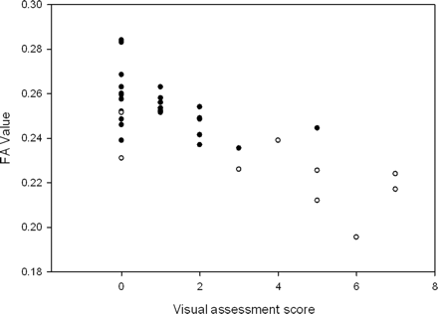
Fig. 3 Graph showing FA versus visual assessment score. Black circles indicate infants with no evidence of ...
Notes:
Fig. 3 Graph showing FA versus visual assessment score. Black circles indicate infants with no evidence of abnormality on MRI and white circles indicate infants with evidence of focal lesions.
Unless provided in the caption above, the following copyright applies to the content of this slide: © The Author (2008). Published by Oxford University Press on behalf of the Guarantors of Brain. All rights reserved. For Permissions, please email: journals.permissions@oxfordjournals.org

Slide 4
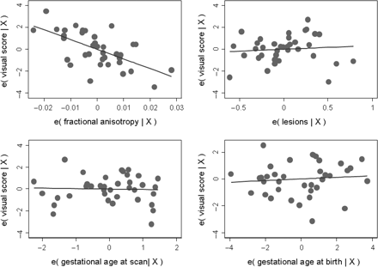
Fig. 4 Partial regression plots demonstrating the variance in (i) FA, (ii) MRI-detected brain lesions, (iii) ...
Notes:
Fig. 4 Partial regression plots demonstrating the variance in (i) FA, (ii) MRI-detected brain lesions, (iii) post-menstrual age at scan, (iv) gestational age at birth attributable to the model.
Unless provided in the caption above, the following copyright applies to the content of this slide: © The Author (2008). Published by Oxford University Press on behalf of the Guarantors of Brain. All rights reserved. For Permissions, please email: journals.permissions@oxfordjournals.org

Slide 5
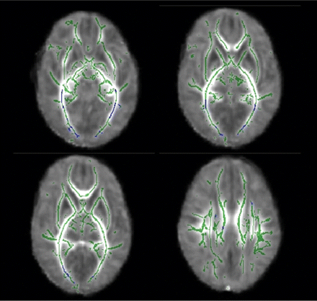
Fig. 5 Mean FA skeleton overlaid on the mean FA map. Regions of the mean FA skeleton in green represent areas where ...
Notes:
Fig. 5 Mean FA skeleton overlaid on the mean FA map. Regions of the mean FA skeleton in green represent areas where there were no significant correlation between visual scores and FA. Areas in blue are regions where visual assessment score was linearly correlated with FA.
Unless provided in the caption above, the following copyright applies to the content of this slide: © The Author (2008). Published by Oxford University Press on behalf of the Guarantors of Brain. All rights reserved. For Permissions, please email: journals.permissions@oxfordjournals.org

